Slide 1






Slide 2
rac·on·teur
noun /ˌrakˌänˈtər/ /-ən-/ raconteurs, plural
A person who tells anecdotes in a skillful and amusing way
Acceptance test framework for C#
Allows writing stories in plain text with VisualStudio The stories are executed as xUnit tests

Slide 3
Agenda
Definition
Advantages for testers
Advantages for developers
Hello Raconteur
Examples

Slide 4
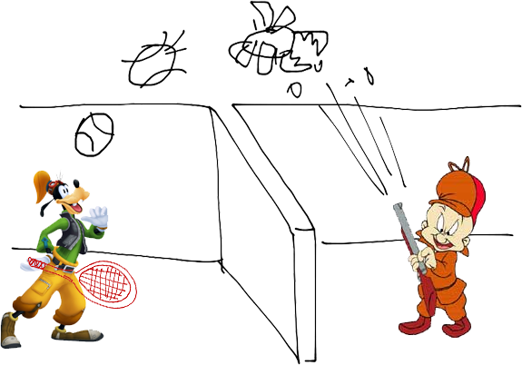
The Situation

Slide 5
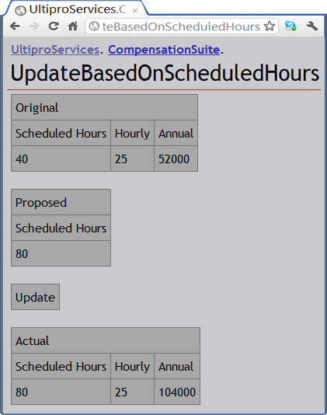
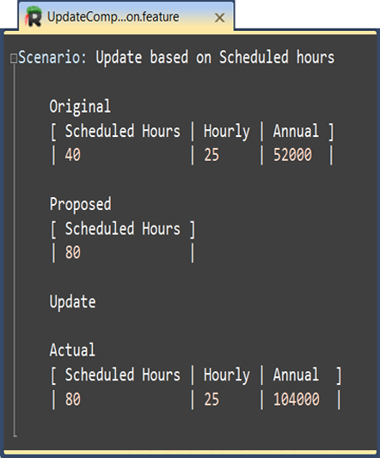
Fitnesse

Slide 6
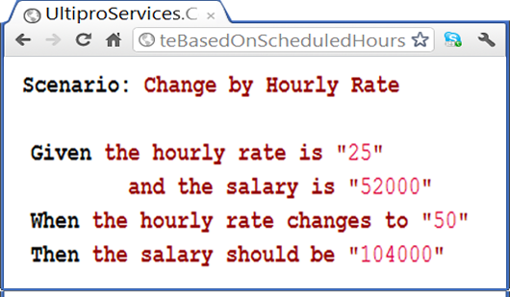
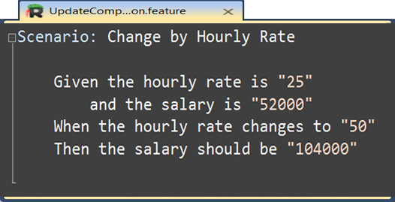
Cucumber

Slide 7
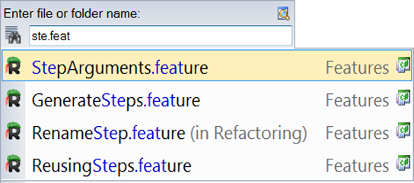
Search & Navigation

Slide 8
Intellisense
Raconteur screenshot (pending ctrl+space)

Slide 9
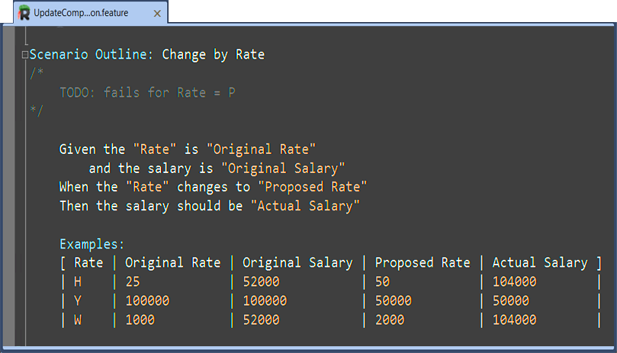
Syntax Highlight

Slide 10
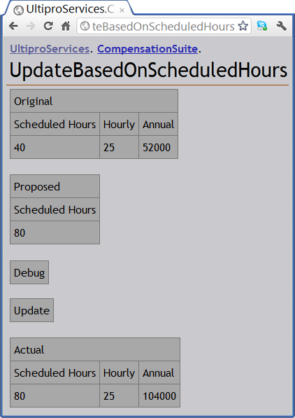
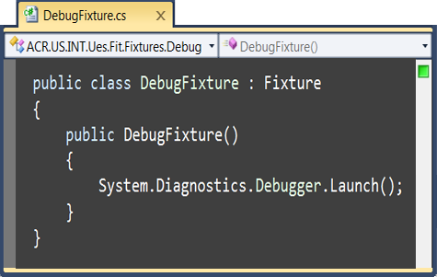
Debug

Slide 11
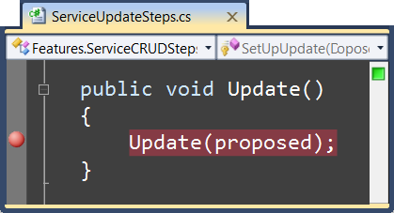
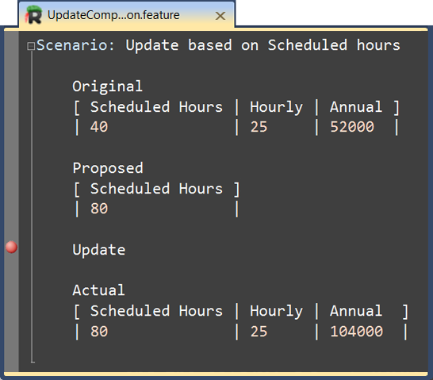
Debug

Slide 12
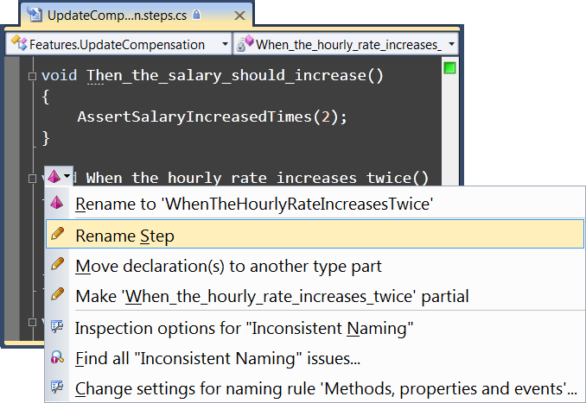
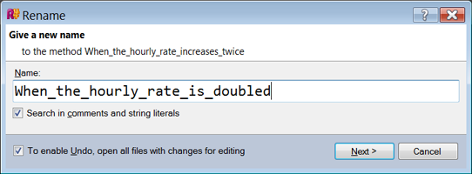
Refactoring

Slide 13
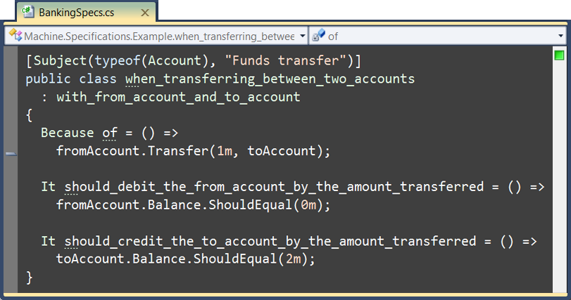
Free text

Slide 14
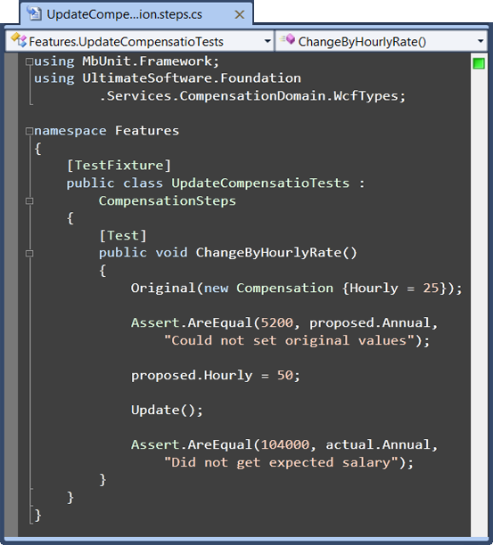
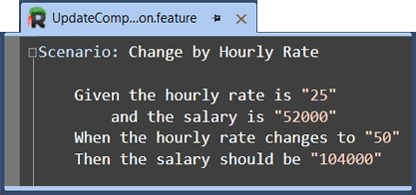
Separation of Concerns

Slide 15
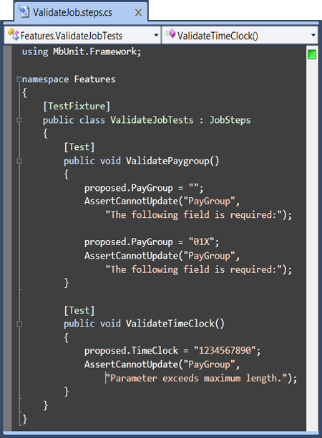
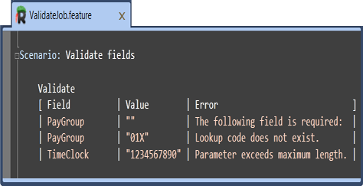
External DSL

Slide 16
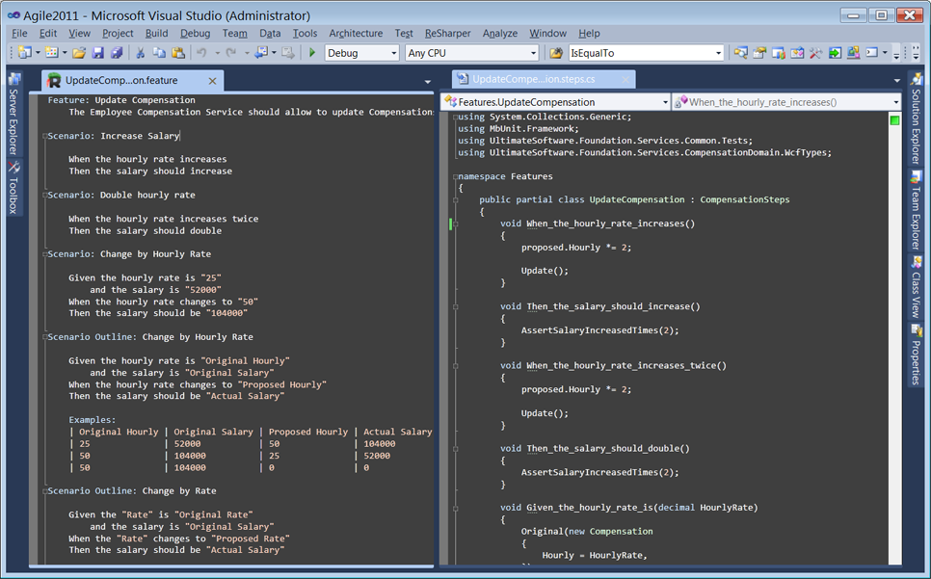
IDE

Slide 17
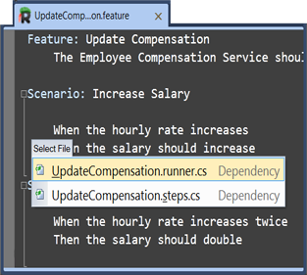
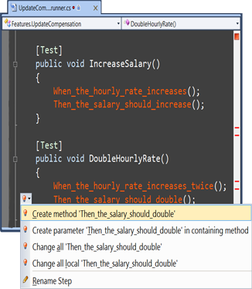
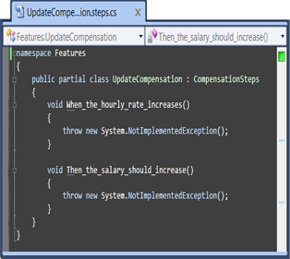
Flow

Slide 18
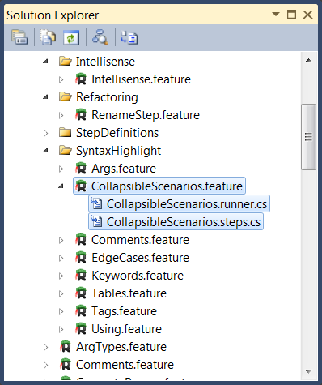
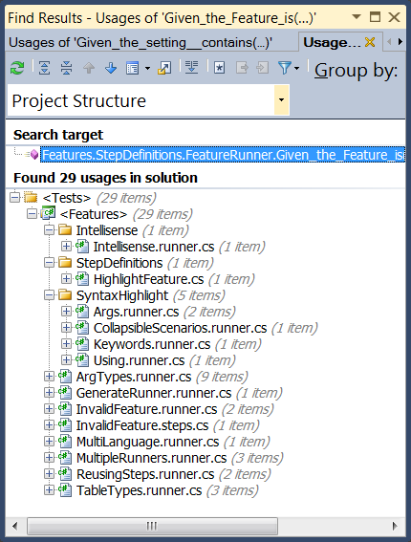
Organization

Slide 19
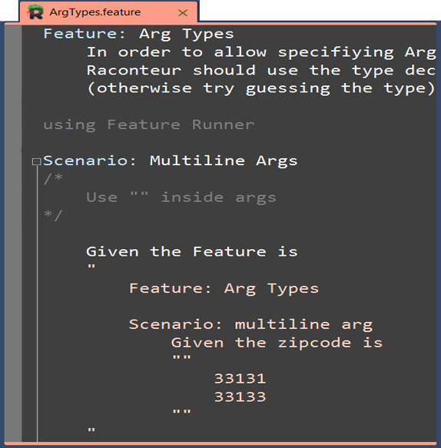
C#

Slide 20
UltiPro Web Services

Slide 21
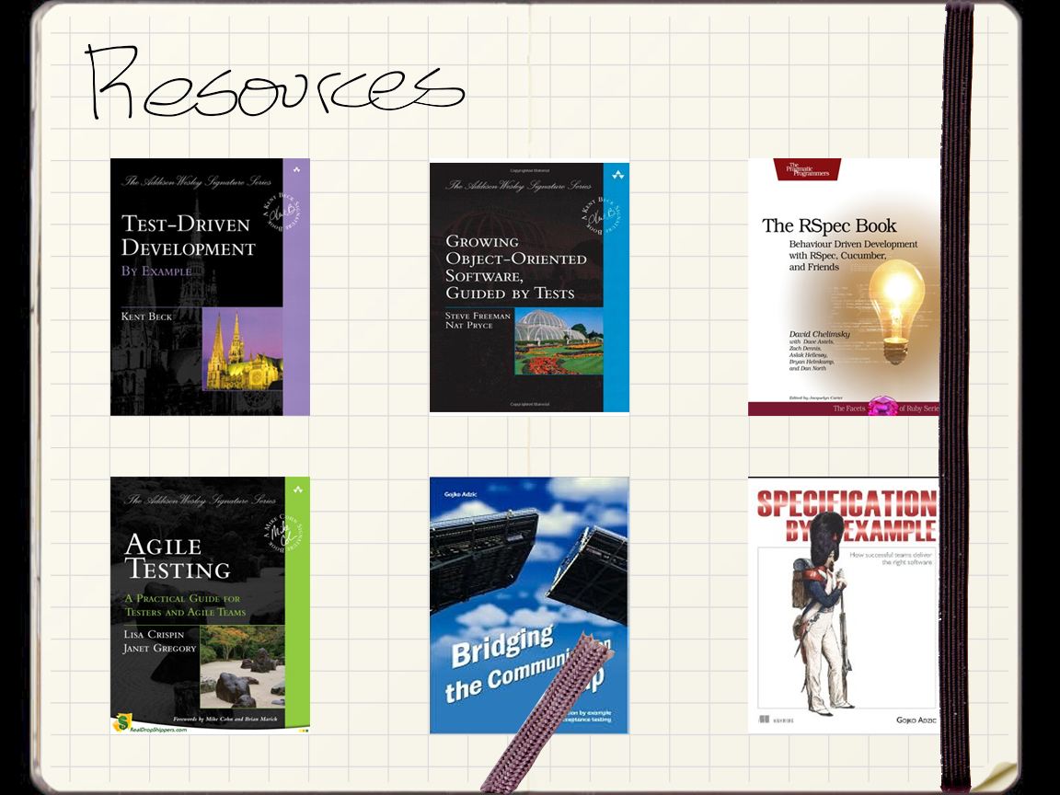
Resources

Slide 22
?

