Slide 1
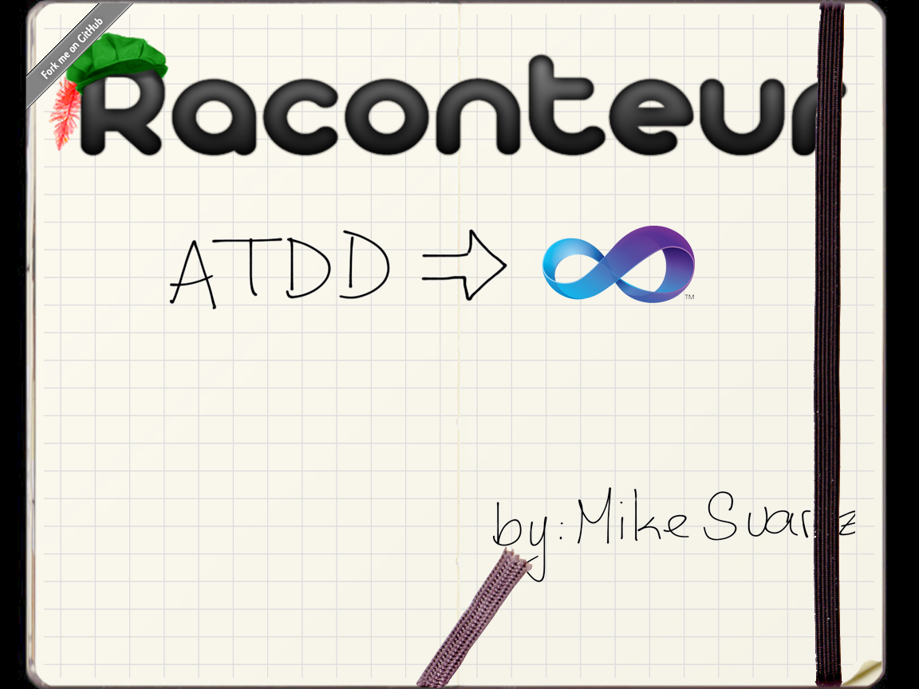



http://twitter.com/msuarz
http://msuarz.blogspot.com
http://github.com/msuarz

Slide 2
rac·on·teur
noun /ˌrakˌänˈtər/ /-ən-/ raconteurs, plural
A person who tells anecdotes in a skillful and amusing way
Acceptance test framework for C#
Allows writing stories in plain text with VisualStudio The stories are executed as xUnit tests

Slide 3
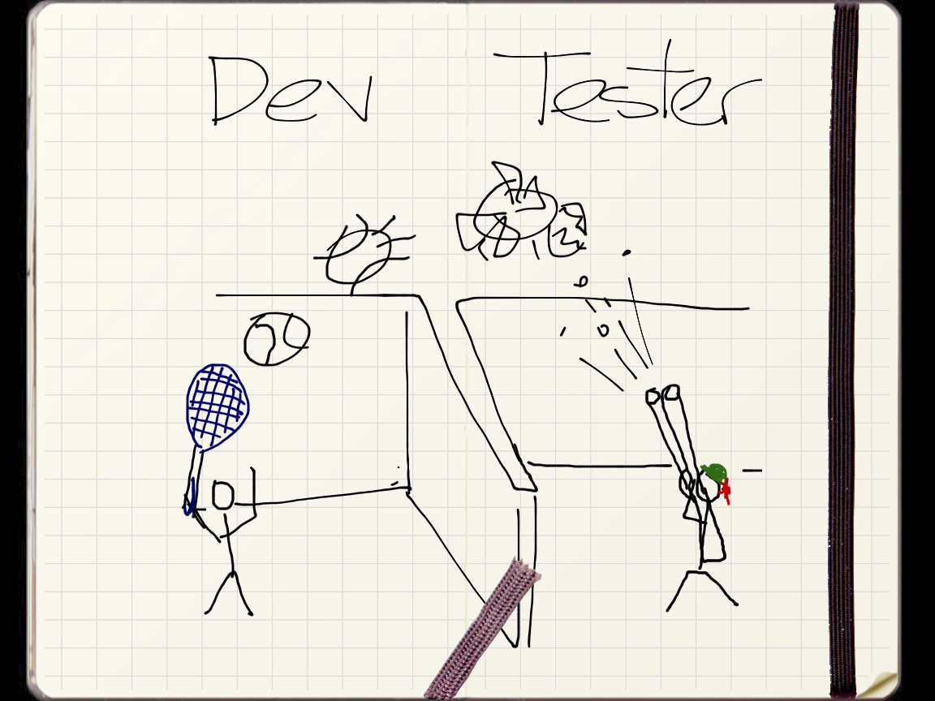

Slide 4
Tester
Keep syntax
Fitnesse Page/ Rac Feature
Cucumber / Rac

Slide 5
Tester
Search and navigation
R# ctrl+sft+n

Slide 6
Tester
Intellisense
Raconteur screenshot (pending ctrl+space)

Slide 7
Tester
Syntax highlight
Rac Change by Rate

Slide 8
Tester
Debugging
Fitnesse Debug Feature code + fixture in page
Rac present/future

Slide 9
Tester
Refactoring
Screenshot alt+enter + rename

Slide 10
Developer - xUnit
Free text
Mspec

Slide 11
Developer - xUnit
SoC
1 regular mbunit
Vs
F+R+S in Rac

Slide 12
Developer - xUnit
External DSL
2 test looking like each other
1 rac test

Slide 13
Developer - AT
IDE
Featu|Step

Slide 14
Developer - AT
Flow
F+R+S

Slide 15
Developer - AT
Organization
Sol Explorer | Alt+f7

Slide 16
Developer - AT
Keep language
Feature with using and comments, multiline args

Slide 17
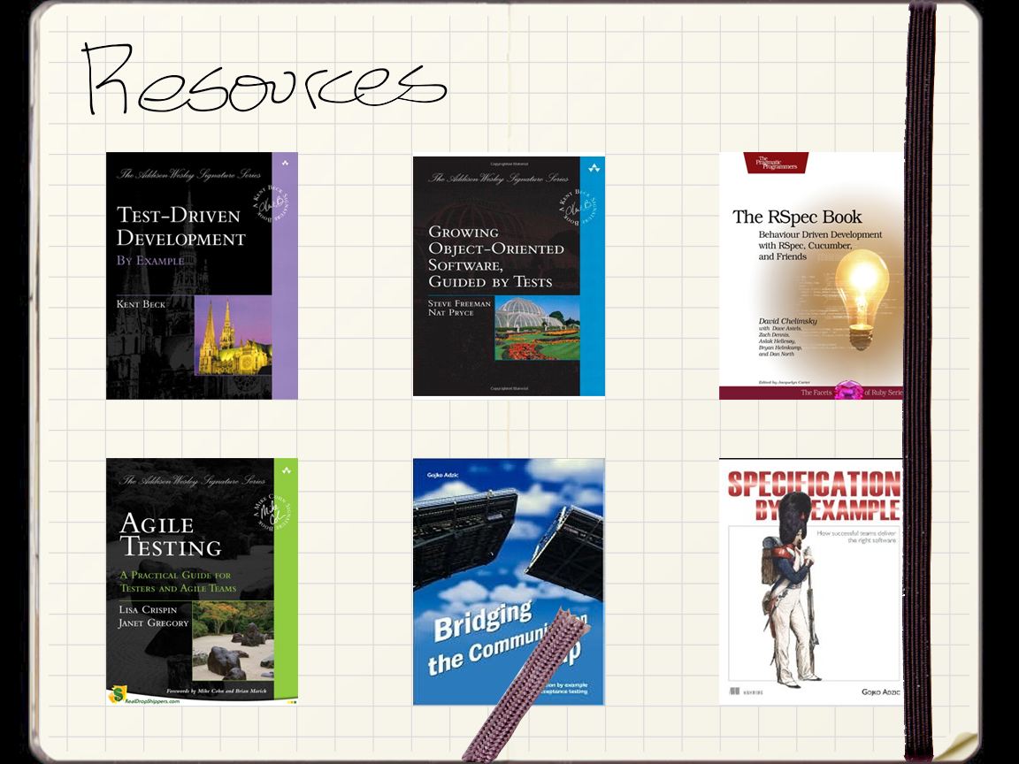

Slide 18


