Slide 1
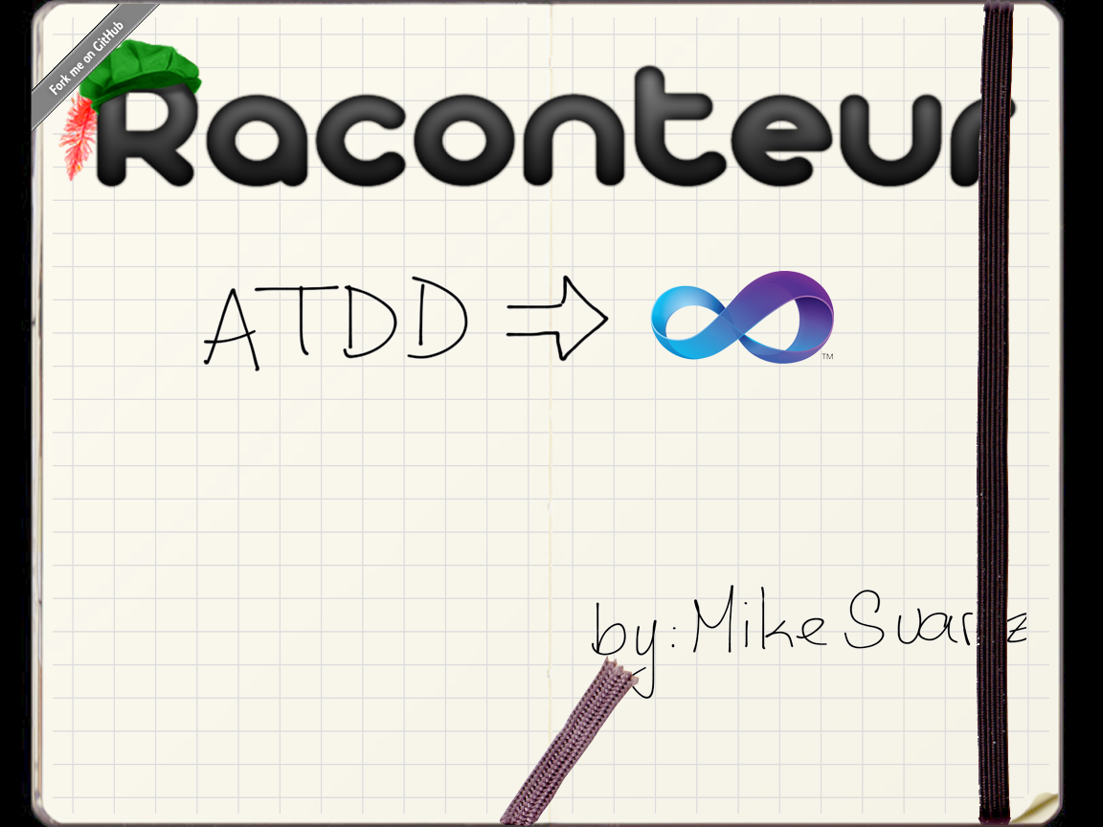



http://twitter.com/msuarz
http://msuarz.blogspot.com
http://github.com/msuarz

Slide 2
Define: Raconteur
Dictionary definition
Programming definition

Slide 3
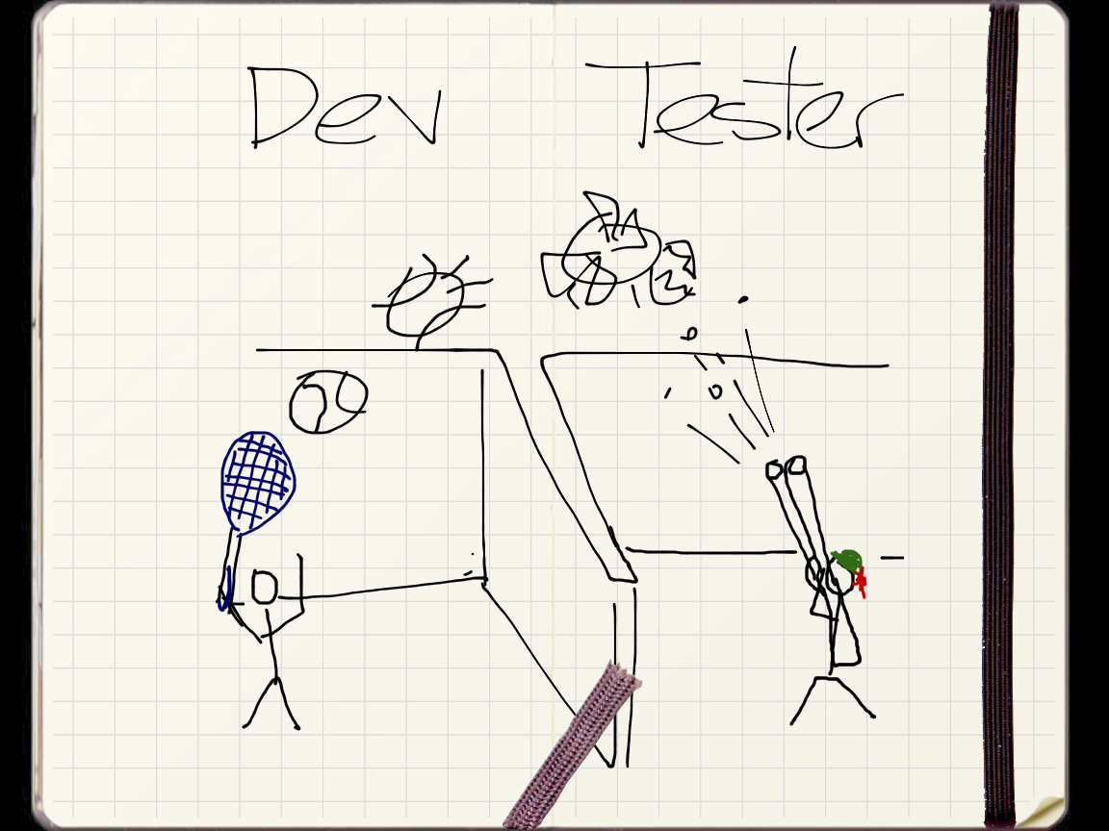

Slide 4
Tester
Keep syntax

Slide 5
Tester
Search and navigation

Slide 6
Tester
Intellisense

Slide 7
Tester
Syntax highlight

Slide 8
Tester
Debugging

Slide 9
Tester
Refactoring

Slide 10
Developer - xUnit
Free text

Slide 11
Developer - xUnit
SoC

Slide 12
Developer - xUnit
External DSL

Slide 13
Developer - xUnit
External DSL

Slide 14
Developer - AT
IDE

Slide 15
Developer - AT
Flow

Slide 16
Developer - AT
Organization

Slide 17
Developer - AT
Keep language

Slide 18
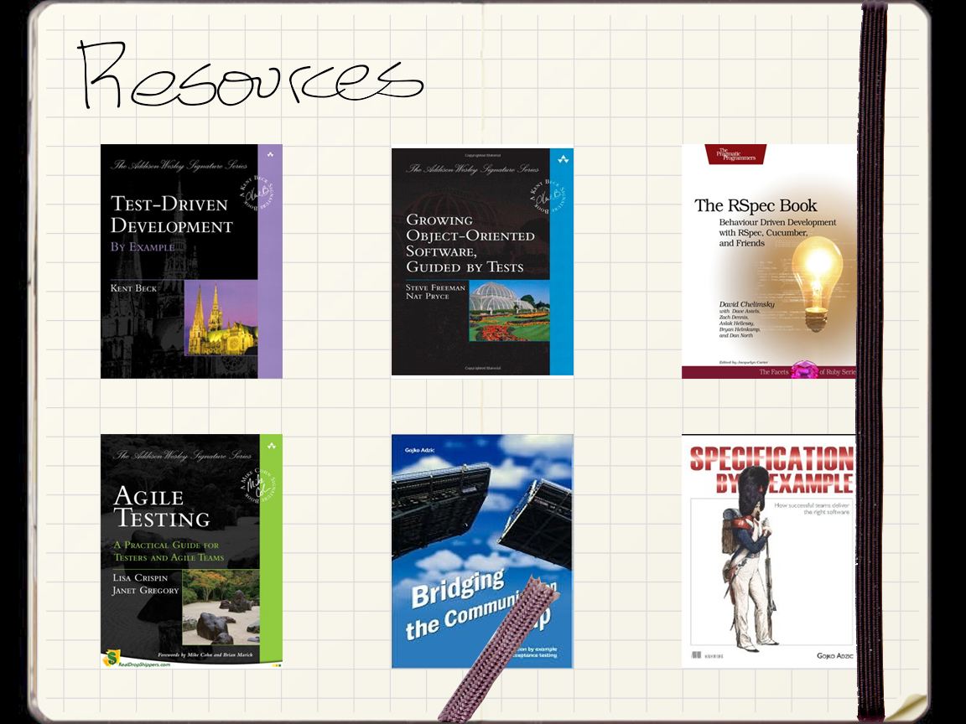

Slide 19


