Slide 1
IBM University Engagement Project Submission
“Exploring the Power of Agentic AI with IBM Granite and LangFlow”

Slide 2

Project Tile – Interview Trainer Agent
Domain of Project - Education
Student Name | Recent Passport Photo | Email ID | Mobile number [WhatsApp]
Manti Sucharitha |  | msucharitha2007@gmail.com | 9063285454

Slide 3
Problem Statement -
Problem Statement – Interview Trainer Agent
The Challenge
An Interview Trainer Agent, powered by RAG (Retrieval-Augmented Generation),
prepares users for job interviews by generating tailored question sets and preparation strategies based on their profile name, experience level, and job role.
It retrieves role-specific interview questions, industry expectations, behavioral scenarios, and HR guidelines from recruitment portals, professional networks, and company interview databases.
Users can input their resume or job title, and the agent provides targeted questions, model answers, and improvement tips.
It supports both technical and soft skill assessment, ensuring a comprehensive interview prep experience.
This AI-driven assistant builds user confidence, sharpens responses, and increases success rates in competitive hiring environments.
Technology – Use of IBM Cloud Lite services / IBM Granite is mandatory.

Slide 4
Proposed Solution -
Proposed Solution – AI-Powered Interview Trainer Agent
The proposed solution is an AI-powered Interview Trainer Agent built using LangFlow, IBM watsonx.ai, and IBM Granite Models to help users prepare for job interviews in a simple and personalized way.
The system uses a Retrieval-Augmented Generation (RAG) approach to retrieve interview questions, HR guidelines, technical concepts, and company interview information from trusted sources. This helps the AI provide accurate and relevant interview preparation.
The system includes four main AI agents:
Interview Knowledge Agent – Retrieves interview questions, company interview patterns, and industry expectations using RAG.
Question Generation Agent – Generates personalized technical, HR, and behavioral interview questions based on the user’s resume, skills, experience, and job role.

Slide 5
Answer Evaluation Agent – Reviews the user’s answers, provides scores, identifies mistakes, and suggests improvements with model answers.
Interview Coaching Agent – Gives interview tips, communication guidance, confidence-building suggestions, and personalized preparation plans.
The solution also provides a simple dashboard (built using Streamlit or React) where users can upload their resume, practice mock interviews, view their scores, track progress, and identify areas for improvement.
LangFlow manages the workflow between AI agents, IBM watsonx.ai handles AI model deployment and embeddings, and IBM Granite Models generate interview questions, evaluate answers, and provide personalized guidance.
Overall, this solution provides an intelligent Interview Trainer Assistant that helps users improve their interview skills, build confidence, and increase their chances of getting hired.

Slide 6
Technology Used
Langflow platform -For designing and orchestrating multi-agent workflows visually
IBM Grainte model - for eg – ibm-granite-3-2-8b – For natural language understanding, reasoning, and personalization
IBM Cloud – It provides the infrastructure to build, deploy, and scale the Nutrition Agent efficiently. IBM Cloud enables a reliable, secure, and scalable environment for deploying the Nutrition Agent.
RAG– RAG to fetch real data first, then generate intelligent answers, making the Nutrition Agent more trustworthy and effective.
IBM Watsonx.ai - For model deployment, embeddings, and AI governance
Vector Database (FAISS/Chroma) – For RAG-based nutritional data retrieval

Slide 7
Langflow component Used -
1) Chat Input – Interface where users enter their queries, preferences, or meal details (text/voice/image).
2) IBM watsonx AI Agent - Processes user input using Granite models to generate personalized nutrition insights and recommendations.
3) Name of IBM Granite model - Granite-4.0-8B-Instruct → Fast, efficient for real-time diet recommendations
4) Chat output -Displays AI-generated responses such as diet plans, nutritional analysis, and health suggestions.
5) IBM BOB – IBM Bob was used to generate, refine, and accelerate the development of the AI Nutrition Assistant by creating prompts, application logic, and code using IBM Granite models.

Slide 8
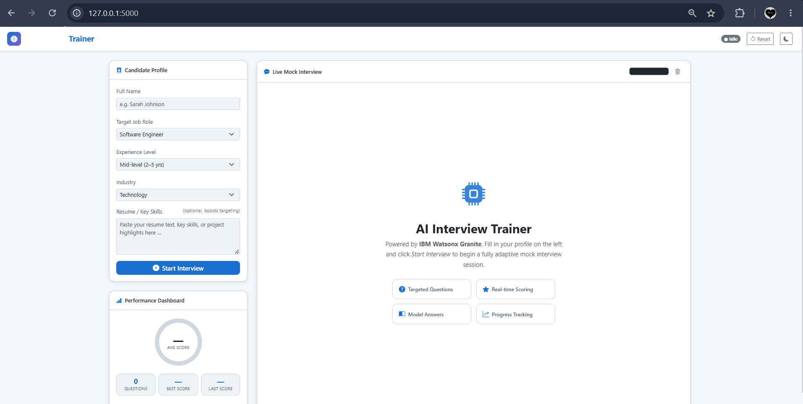

Slide 9
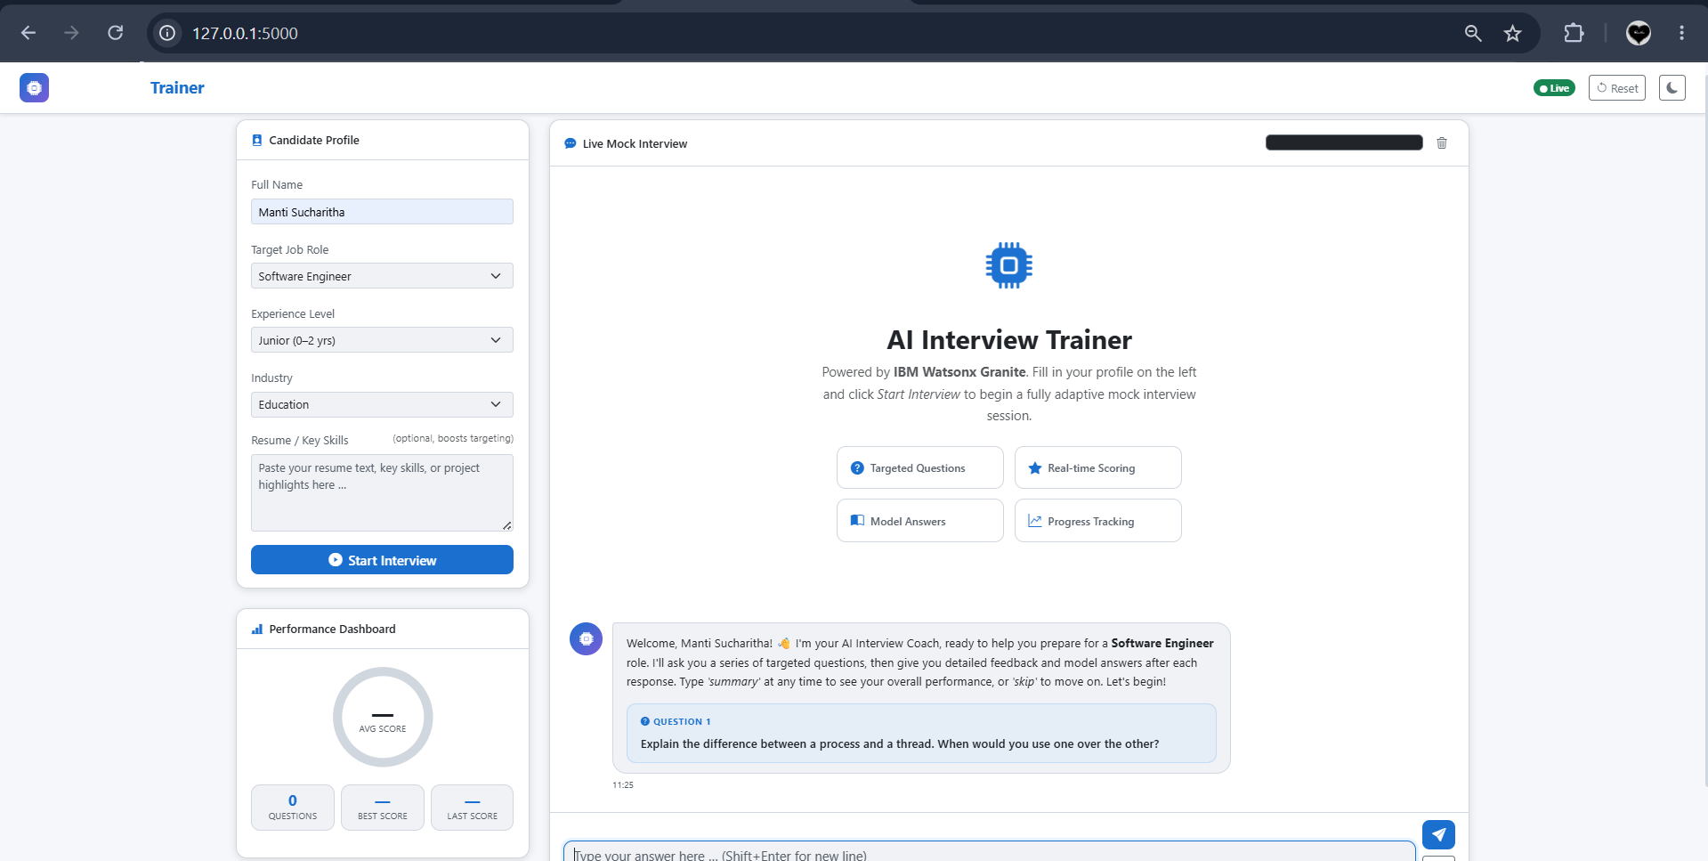

Slide 10
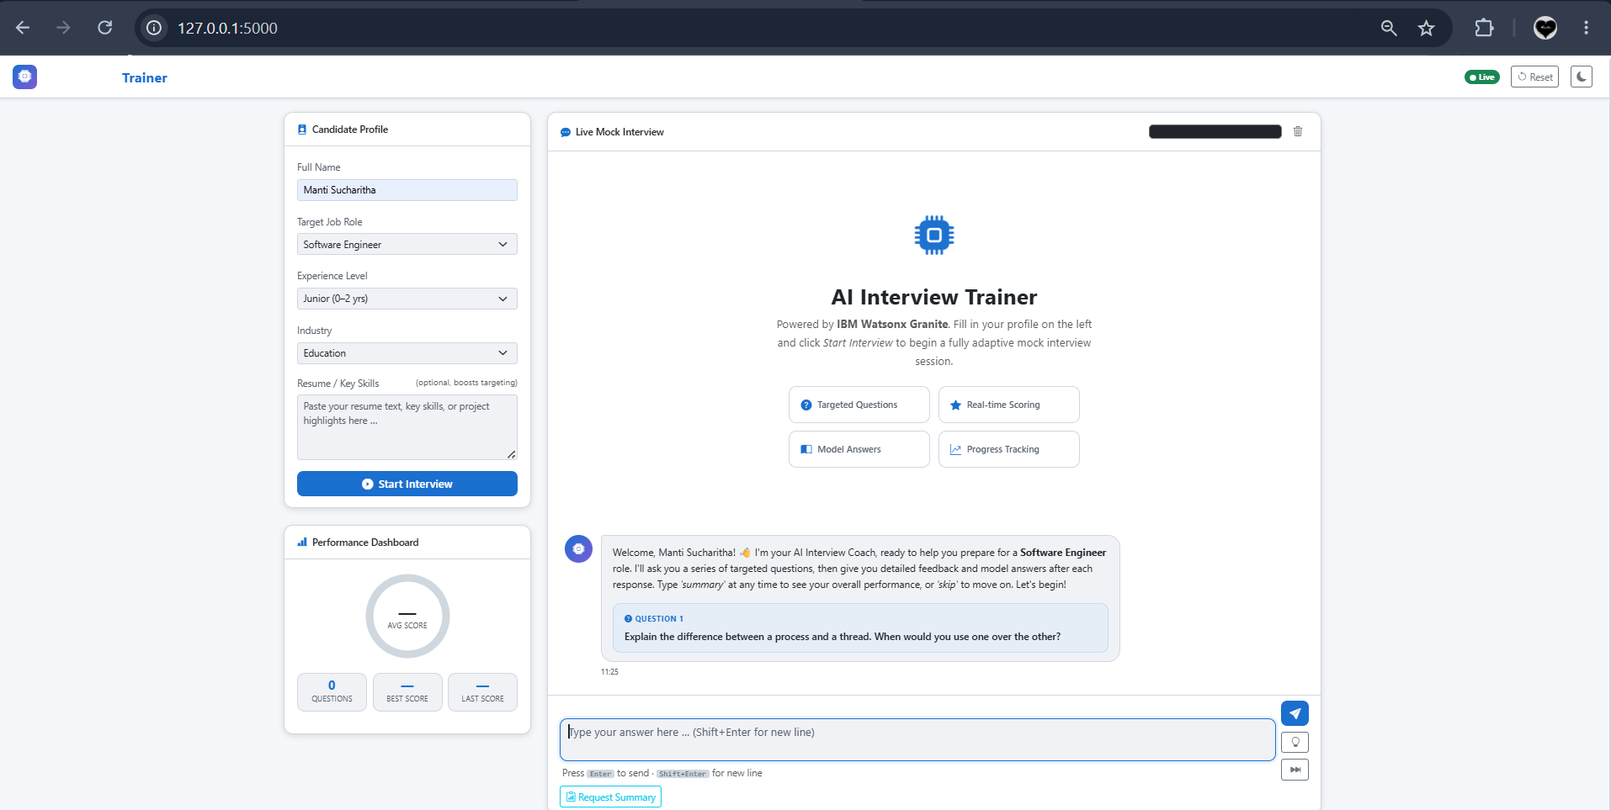

Slide 11
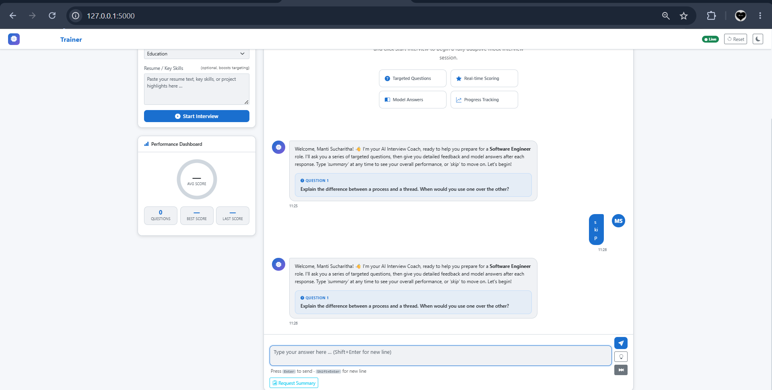

Slide 12
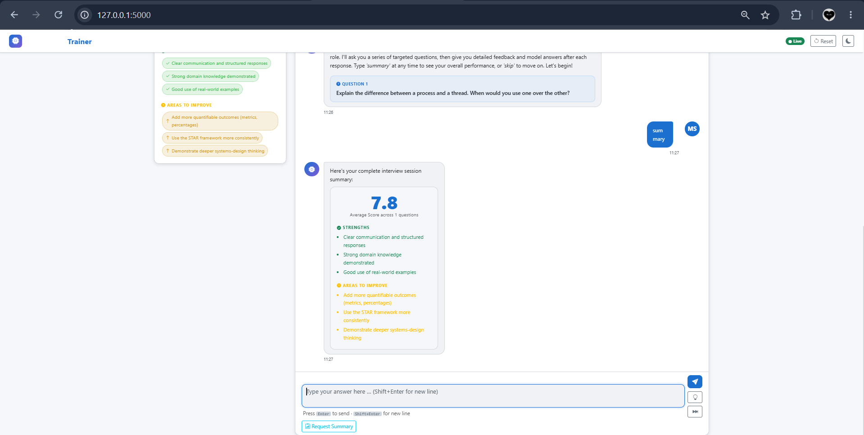

Slide 13
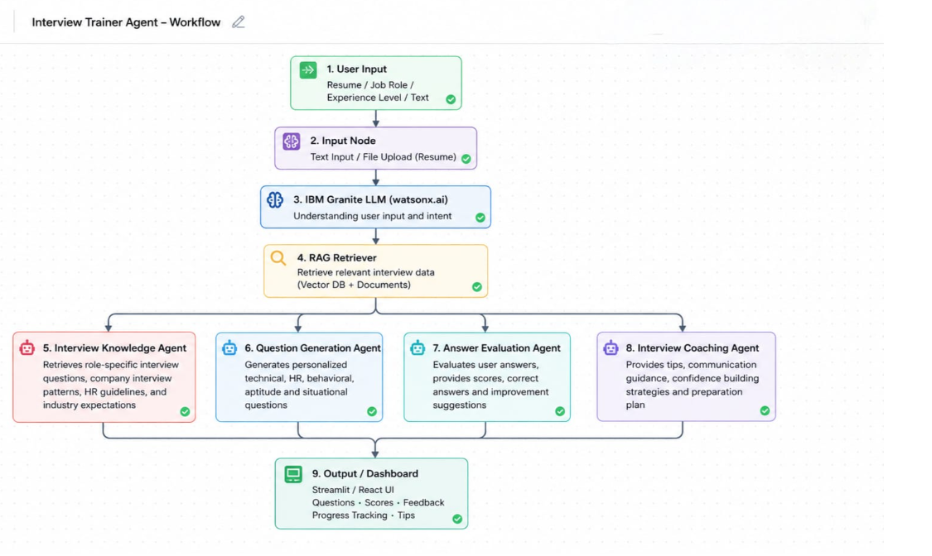
Langflow workflow -

Slide 14
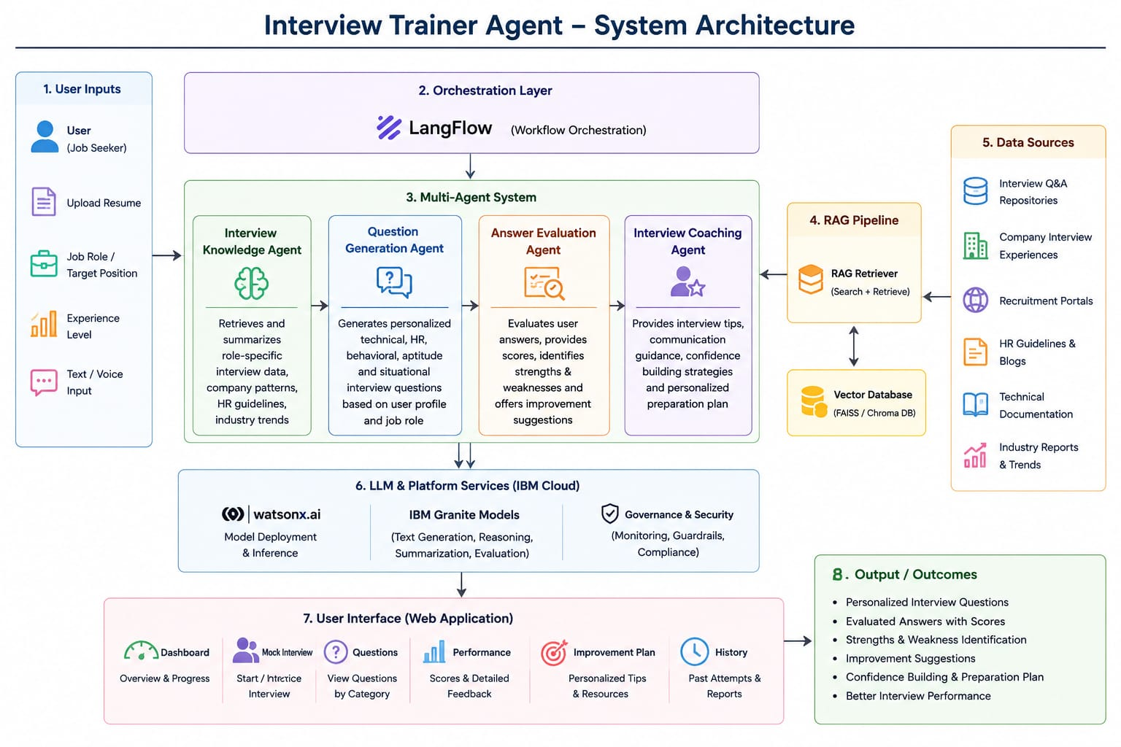
Architecture blueprint

Slide 15

Role of Agentic AI in the solution
Role of Agentic AI in Interview Trainer Agent
Agentic AI enables the Interview Trainer Agent to work as an intelligent, autonomous system rather than a simple chatbot. Using IBM watsonx.ai and IBM Granite Models, it coordinates multiple specialized AI agents to provide personalized interview preparation.
Agentic AI understands the user’s resume, skills, experience level, and target job role to generate personalized interview questions and preparation strategies. It also adapts in real time by improving recommendations based on the user’s performance during mock interviews.
Overall, Agentic AI makes the Interview Trainer Agent proactive, personalized, and goal-oriented, acting like a smart virtual interview coach that helps users improve their skills, build confidence, and increase their chances of success in job interviews.

Slide 16
Novelty and Uniqueness
Novelty and Uniqueness – Interview Trainer Agent
The proposed Interview Trainer Agent stands out by combining Agentic AI, RAG, and personalized interview coaching into a single intelligent system.
Multi-Agent Intelligence – Multiple AI agents work together to generate questions, evaluate answers, and provide interview guidance instead of functioning as a simple chatbot.
RAG-Based Accuracy – Retrieves interview questions, company hiring trends, and industry expectations from trusted sources to provide accurate and up-to-date preparation.
Personalized Interview Preparation – Generates customized interview questions and preparation plans based on the user’s resume, skills, experience, and target job role.
Real-Time Feedback – Evaluates user responses instantly and provides scores, model answers, and suggestions for improvement.
Comprehensive Interview Support – Covers technical, HR, behavioral, aptitude, and communication skills in one platform.
Mock Interview Experience – Simulates real interview scenarios to improve confidence and interview performance.
This makes the solution a smart, adaptive, and personalized virtual interview coach rather than just a question-and-answer chatbot.

Slide 17
Git Hub Link
Github URL – https://github.com/msucharitha2007-wq/Interview-Trainer
·
·
·

Slide 18
Future Scope
Future Scope – Interview Trainer Agent
AI-Powered Voice Mock Interviews –
The system can be enhanced with voice-based mock interviews, where users answer questions verbally. AI can evaluate communication skills, pronunciation, fluency, confidence, and speaking pace to provide detailed feedback.
2. Company-Specific & Multilingual Interview Support –
The agent can be expanded to provide interview preparation for specific companies by using company interview patterns and recent hiring trends. It can also support multiple languages, allowing users to practice interviews in their preferred language and making the platform more accessible to a wider audience.
·
·
·

Slide 19
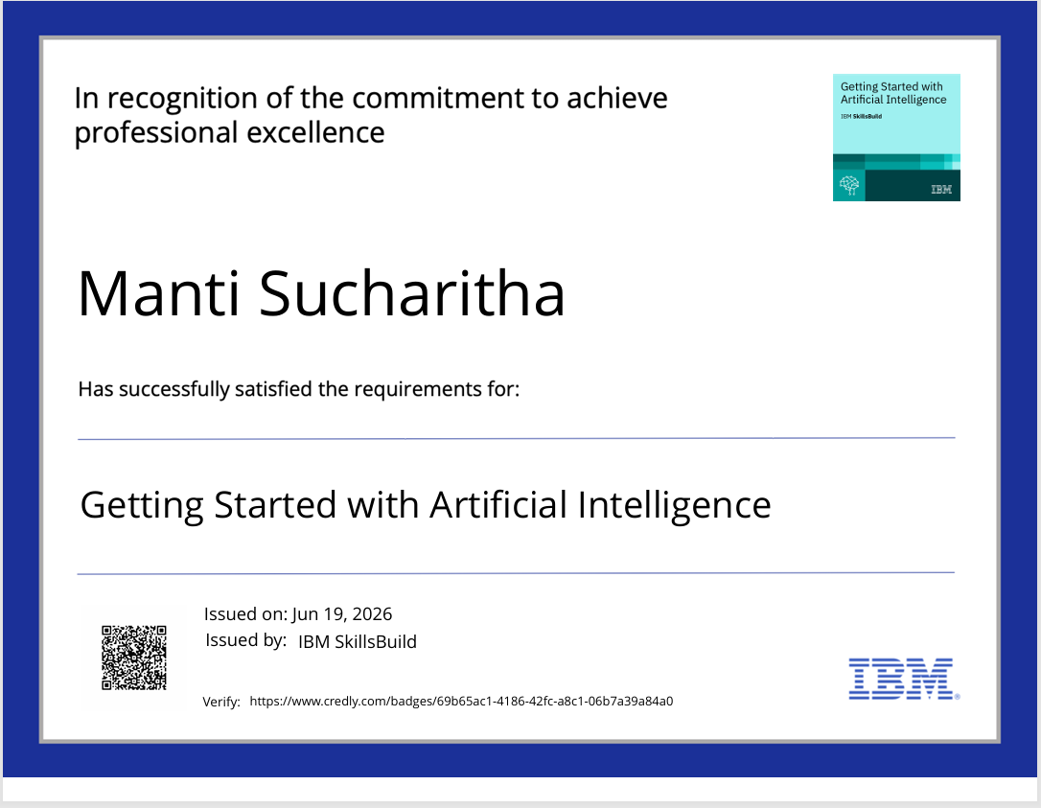
Certificates Earned:

Slide 20
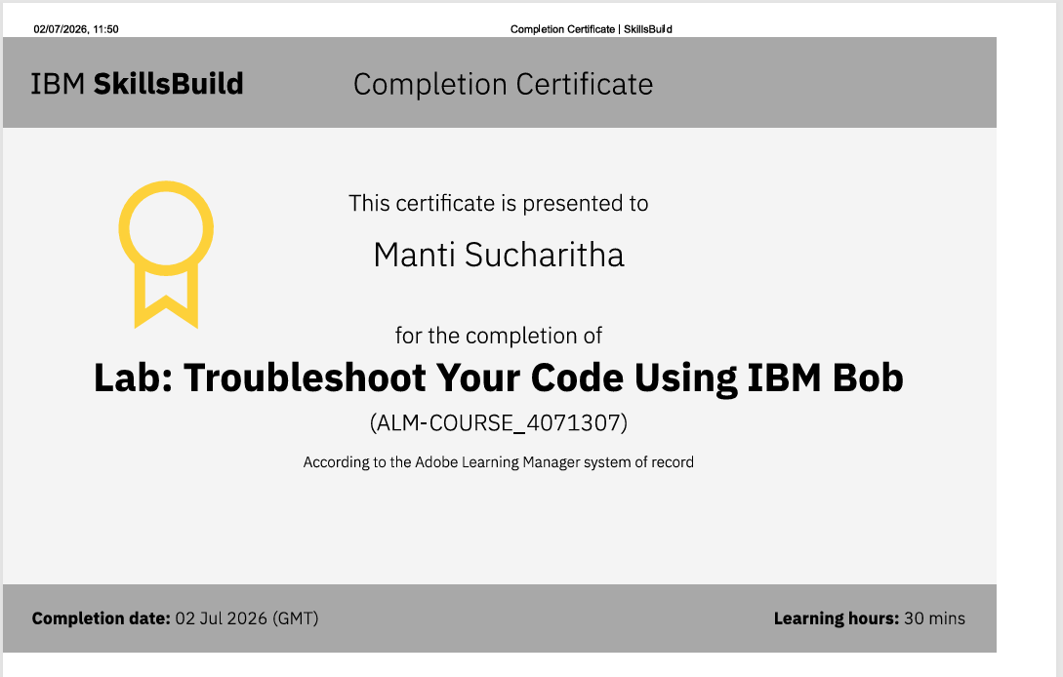
Certificates Earned:​

Slide 21


