Slide 1
Metro Interstate Traffic Volume Data Analysis
Presenter: Suchismita Moharana

Slide 2
Introduction
Time is important to everyone and hence in Today’s world, everyone wants to utilize their time wisely. We will discuss about how predicting road traffic volume will help us in saving time on road when we travel during busy hours.

Slide 3
Data Source
For our analysis, we have collected this data (which is publicly available) from http://archive.ics.uci.edu/ml/datasets/Metro+Interstate+Traffic+Volume
This analysis will help in better urban planning, maintenance planning, lowering congestion level and increasing driver safety by forecasting the traffic volume for a future timeframe.

Slide 4
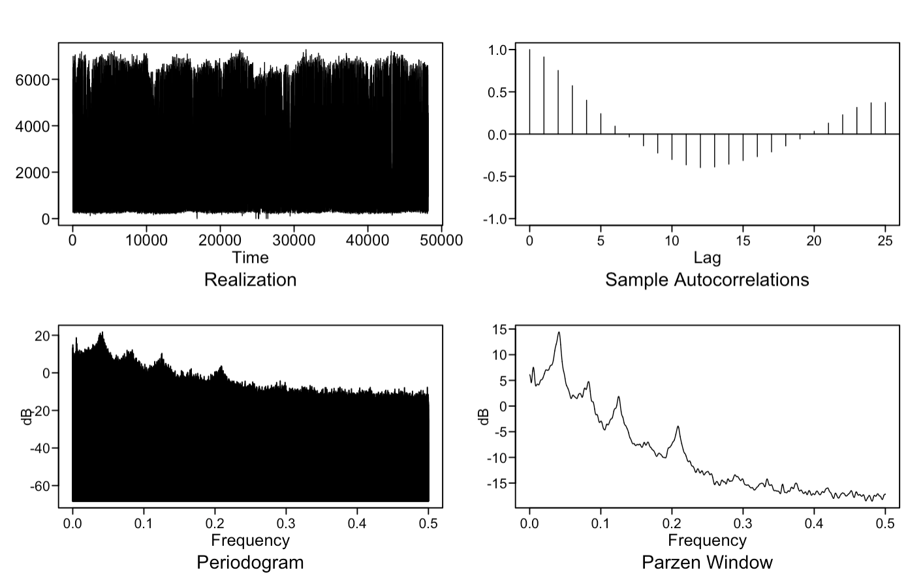
Stationary / Non-Stationary
By looking at the ACF (which shows dampening sinusoidal behavior) and by looking at the spectral density, we can say that there is some seasonality present in the data. Hence it is non-stationary. Also, from spectral density we can see that data has a cycle of 24. Also, it has cycle at 12.

Slide 5

ARMA (5,1) model for our data
We found ARMA(5,1) as best fit by AIC estimate function with a lowest AIC of 13.10500.
We can represent it as below.
(1 - 2.08 B + 1.43 B² - 0.26 B³ - 0.13 B⁴ + 0.09 B⁵) (X_{t} - 3259.8) = a_{t} - 0.78 a_{t-1} , $σa2$ = 491248.7

Slide 6
General Traffic Trend on Holidays /None
The trend in boxplot shows that traffic is not very high on holidays. Rather it is high when it is not a holiday.

Slide 7
Next Strategy on this data
As we saw from graphs, traffic is low on holidays and high when day not is marked as holiday. So, we are going to analyze more on this data to find out what is the trend around the holidays.
We will use multivariate time series analysis and lagged variable approach to analyze and predict traffic volume right before and after the holiday.

Slide 8
Thank You!
Presenter: Suchismita Moharana

