Slide 1


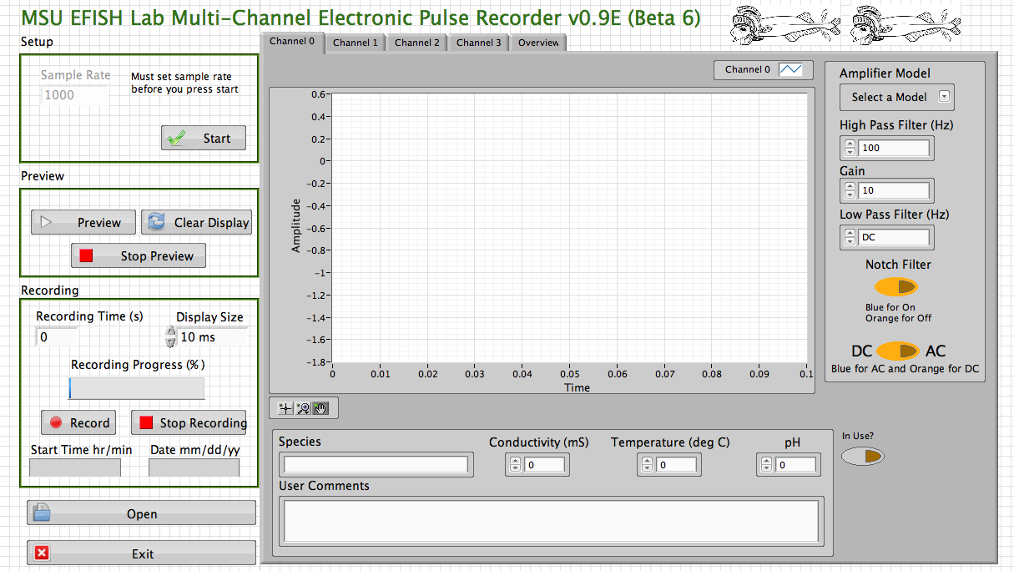
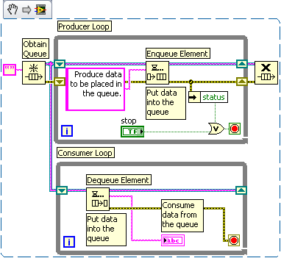


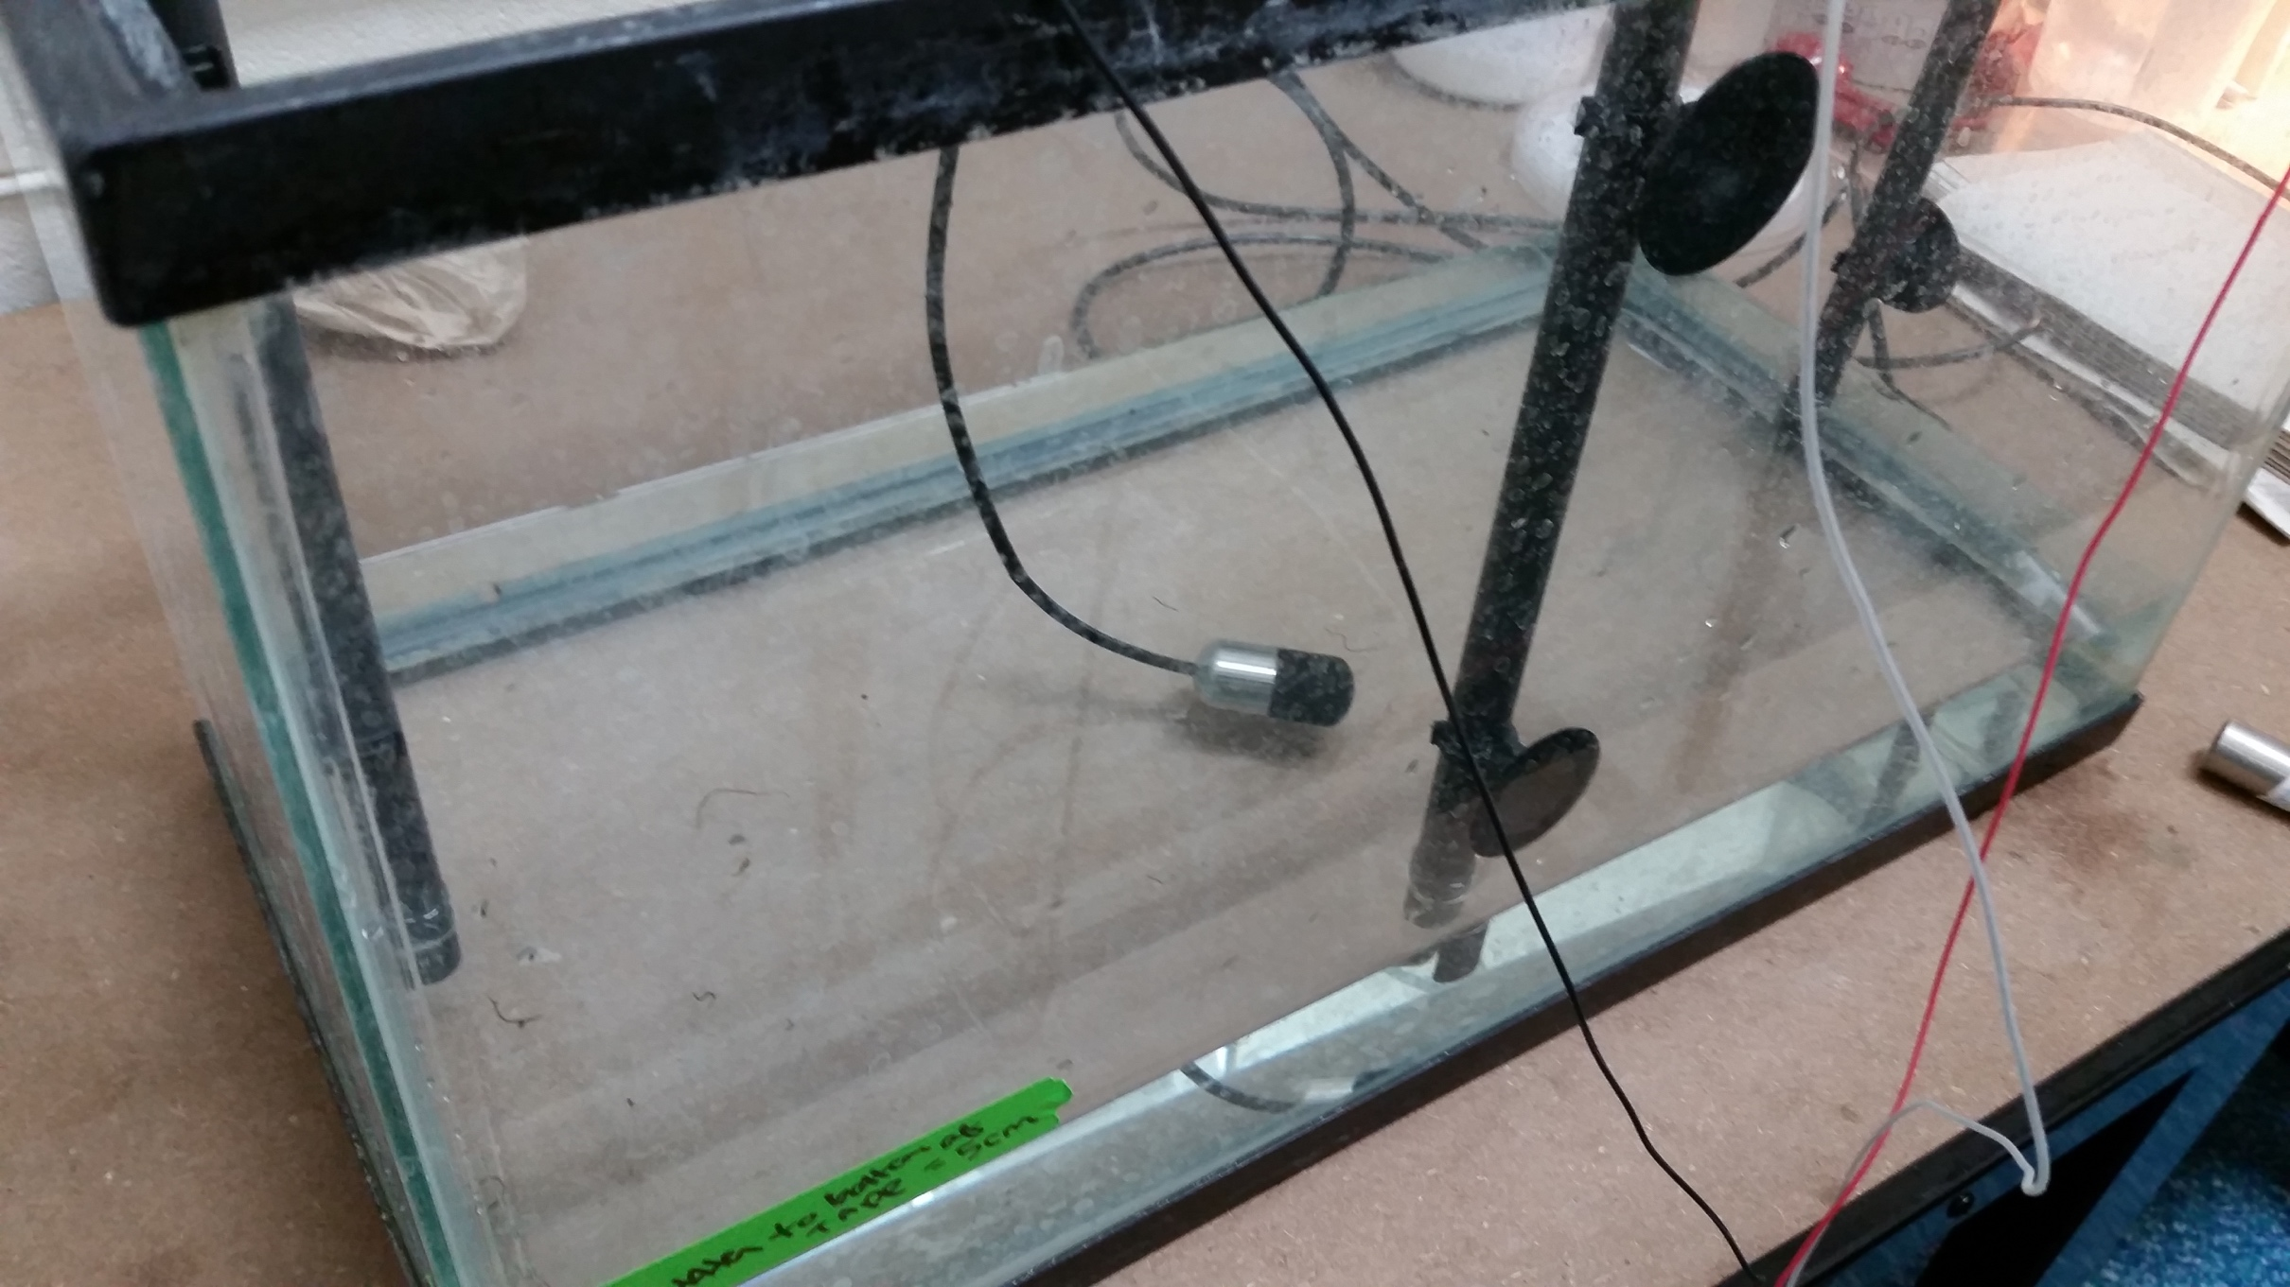
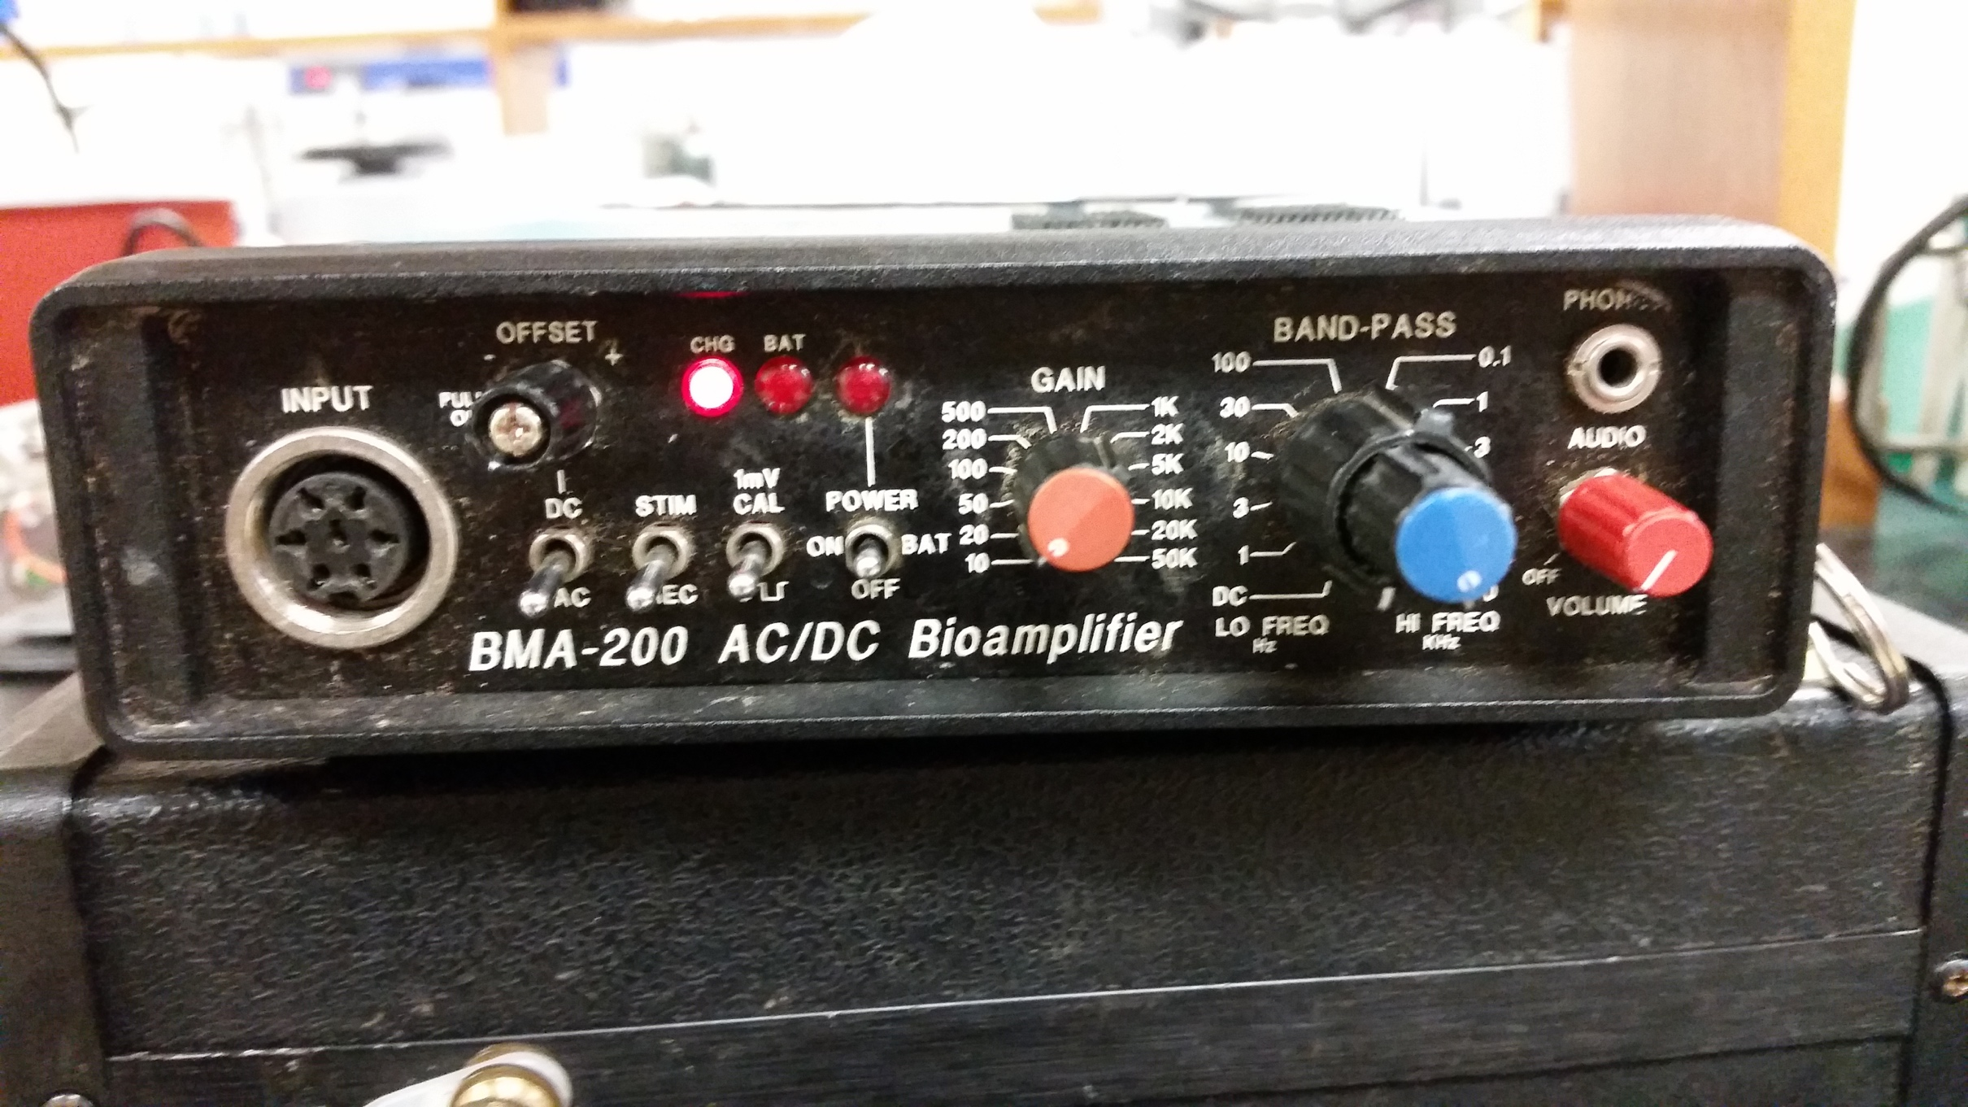
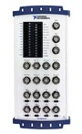
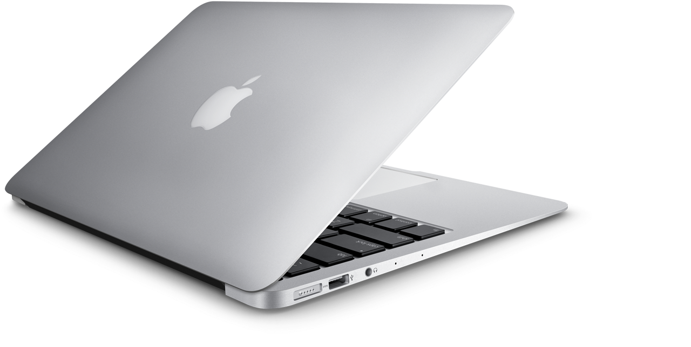

LabVIEW Based Software for Recording Electric Organ Discharges from Weakly Electric Fish
Adam Gleichman and Jason Gallant
Electric Fish Lab • Departement of Integrative Biology• Michigan State University
Abstract
Results
Mormyrid fish produce electric organ discharge (EOD) pulses in water with a specialized electric organ, which is used in communication and navigation. To better understand the behavior of these fishes, accurate recordings of their EOD behavior are critical. Using LabVIEW (National Instruments, Inc.), we developed a software program capable of recording and visualizing EOD behavior in real time. A requirement of such software is the ability to record electric discharges at high sampling rates (100khz-1MhZ ) over a wide range of durations (10ms - 1hr). Due to limited hardware capabilities (CPU, RAM), we used a combination of direct disk writing and dynamic down sampling of displayed data. The software features a real-time display of data for instrument calibration, as well as real-time display of data during recording. In addition, controls for A/D acquisition can be adjusted ‘on the fly’ and metadata regarding specimens can also be recorded. The software is written as a user-friendly GUI for use in the classroom and by researchers that are unfamiliar with computer programming, and will be freely available for download and install on Mac, Windows and Linux platforms.
Programs Created
Single Channel Recording
Used for recording from a single individual for discovering behavior from a single individual.
Multiple Channel Recording
Used for larger scale experiment where recording from multiple tanks needs to be done at once.
Objectives
The Gallant laboratory is interested in the evolution of electric signaling behavior. A critical piece of this research is recording the diverse electric discharges made by many lineages of electric fishes, which are typically the length of a nervous system action potential (1-10ms) and are typically very weak (<1 V peak to peak).
What do We Need From the Software
the ability to record voltage levels from amplifiers that were connected to the fish tank set ups (pictures in the Methods Section)
pair meta data from the user with a recording (ex: fish species, temperature, comments, etc..)
keep accurate timing
handle sampling rates of greater than or equal too 100,000 samples per second
display of data for the user to see if there is a problem with the hardware
compatibility with MAC OS, Windows, and Linux
work with National Instruments data acquisition boards
user friendliness
What we functions wanted to make
- Single Channel Recording
-Multiple Channel Recording
-Voltage Trigger
-Single Waveform Recording
Priorities
1. Single Channel Recording
2. Multiple Channel Recording
3. Scheduled Recording
-Voltage Trigger
-Single Waveform Recording
We chose LabVIEW for our programming language because of its ability for parallel task handling and for its compatibility with MAC OS, Windows, and Linux
The solution to the accurate timing was to set the speed of the internal sample clock that is inside the NI boards and ask for a set amount of data that would be in 0.1 of a second then count the amount of times the program read the data until it reaches the amount of time that the user wants
Data is recorded in .tdm / .tdms file format because of how well it pairs the metadata and data from the board and its efficiency
The DAQmx-base libraries for LabVIEW were able to read voltage from the BNC cables that connect the amplifiers to the DAQ board
Program Features
Architecture
Real Time Display
The DAQ (data acquisition) board displays data in real time, which will help users to diagnose hardware issues, such as electrode positioning and amplifier settings.
Recording for a Given Amount of Time
This allows for the user to easily scale up or down the amount of time depending on what they need for their experiments (e.g single EOD or multiple EODs).
Ability to Open .tdms Files
Files with the extension of .tdms are part text, part binary. An ordinary computer can not open these files without a special program or plugin for Windows Excel. A .tdms open function was added so anyone can open up previously made files without having to install more software.
Work with Meta Data from the User
All files recorded by the user will also record the settings the user inputs inside the tab function such as: species, comments, etc. This eliminates possible mismatching of meta data with recorded voltage data.
Records up to 4 Channels
Simultaneous recording allows for synchronous recording of multiple individuals, enabling higher throughput behavior experiments.
Rolling Display
A rolling display displays the most recent data in a specific amount time specified by the user. By not stacking data history, the data is easier to look at over long periods of time and the display will not slow down the recording.
Methods
Software: LabVIEW 2014 with DAQmx-base library (14.0)
Hardware: MacBook pro and air with an National Instruments DAQ (Data Acquisition) board USB-6211 and USB-6216
Recording methods follow Gallant et al. 2011
Sample Rate: 100 kHz
Time of Recording: between 15 to 35 minutes
AD Resolution: 16 bits (for all boards)
Boards:
NI USB-6211
16 Inputs, 250 kHz max, Multifunction I/O
NI USB 6216
16 Inputs, 400 kHz max, Multifunction I/O
Credit to LabVIEW Wiki
Courtesy of ni.com
Courtesy of ni.com
The basic model of the program architecture is a double producer consumer setup. Producer/Consumer structures are a way to execute two tasks simultaneously. One structure handles reading data and recording data while the other then looks for user events (e.g. a button is pressed) and processes how to react to those events. This architecture allows the program to multitask between reading data, writing data, and responding to user input. If you have more specific questions just ask me, I will have the code printed with me on hand.
Potential
Differences (Voltage)
Future Directions
Acknowledgments
Amplifies
Voltage
Increase the modularity and efficiency of the multiple channel recording software
Create a program to record automatically according to the time of the day
Find a way to replicate an oscilloscope triggering mechanism for recording single waveforms
Stronger error handling
Scale up the Multiple Channel software for 8 channels
Possible advancement to an open source programming language
Use the voltage reading to calculate position of fishes for studying behavior
We would like to thank Ryan Taylor, Nicole Thompson, Sophia Sdao, and Fernando Fernandez for their assistance and suggestions. Sponsored by NSF IOS. “Genomic Basis of Electric Signal Diversity” to JRG. Thanks to the National Instruments Help Desk, and Alan Gleichman for
all of the help!
References:
Gallant, J., et al. (2011) Patterns of geographic signal variation and its morphological correlates in a mormyrid electric fish provide insights into evolution of electrogenic signal diversity J Comp Physiol. A. 2011 Aug;197(8):799-817.
Converts Analog Voltage into
Digital Data
Courtesy of apple.com
Courtesy of ni.com

