Slide 1

BP Passport
TECHNICAL, MARKETING AND PITCH OVERVIEW
BP Passport
Digital blood-pressure care built for Pakistan
A bilingual PWA that helps people check, track and share blood-pressure information with consent.
Uzair Ahmad, Founder & CEO
Muhammad Suhaib, Co-Founder & Tech Lead
Karachi, Pakistan | October 2026

Slide 2
BP Passport
THE NEED
02
Pakistan needs continuity after the first BP check
The screening gap is large. The follow-up gap is larger.
11%
26.3%
32.5M
currently controlled
have never had BP measured
Pakistani adults live with hypertension
1 : 1,300
Product response
One in three adults
screen once, then track, guide and share
doctor-to-patient ratio
The product must work outside the clinic and remain useful between visits.
Notes:
Sources: BP_Passport_Investor_Deck.pptx and project README. Epidemiological figures come from the supplied project research and should be revalidated before external publication.

Slide 3
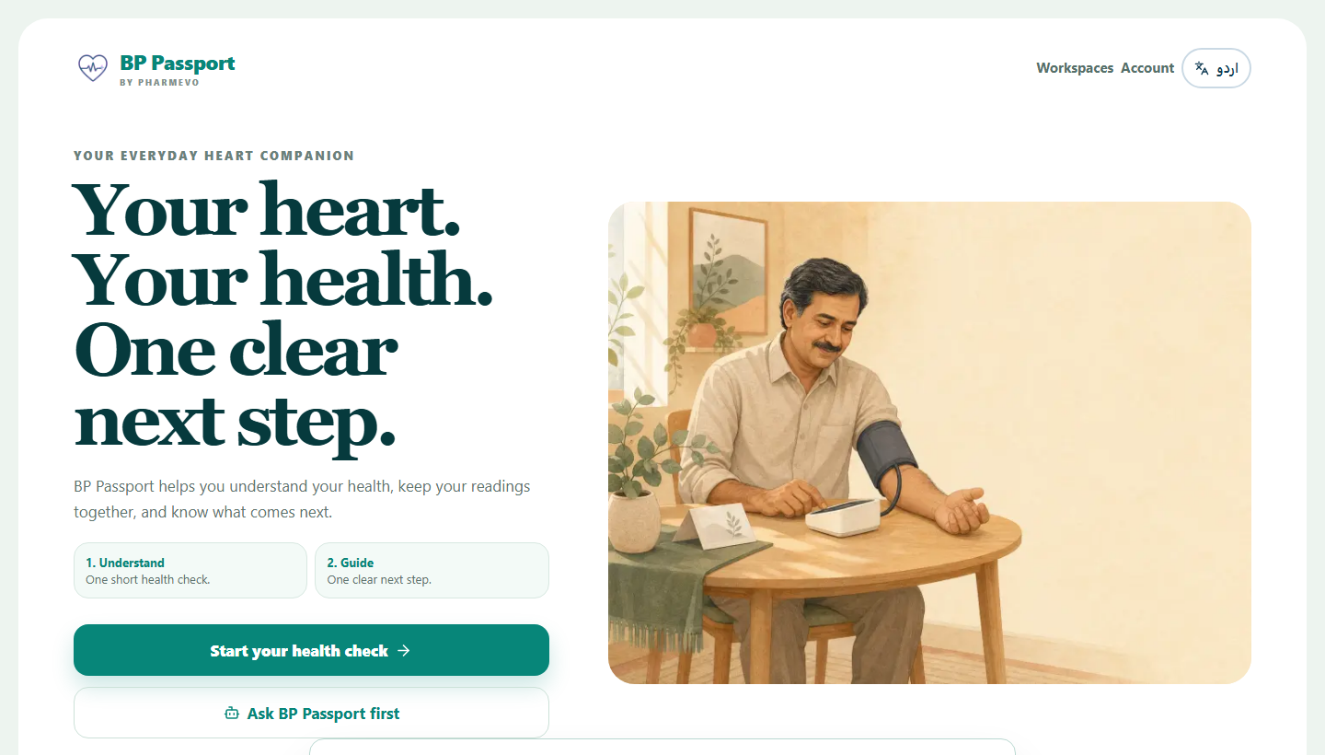
BP Passport
PRODUCT
03
One journey from a first check to ongoing care
Simple enough for a first-time user. Structured enough for a clinician.
01
Check
Start from a QR link or the web. No app-store install.
02
Understand
Answer the guided health check and see a clear next step.
03
Track
Save BP readings, medicines, reminders and progress.
04
Share
Grant a clinician expiring, read-only access and revoke it anytime.
ENGLISH + URDU
PWA
VOICE + TEXT
LOCAL-FIRST

Slide 4
BP Passport
PRODUCT
04
Three workspaces, one care record
Patient, clinician and programme roles stay separate and clear.
PATIENT
Health check, BP log, medicines, reminders, reports, caregiver controls, streaks and a bilingual voice or text assistant.
Daily care
CLINICIAN
A separate portal lists consented patients, opens structured trends and respects share expiry or instant revocation.
Read-only review
PROGRAMME
A protected admin console supports clinician review and programme oversight without exposing patient dashboards.
Pilot operations
Current implementation

Slide 5
BP Passport
SAFETY AND TRUST
05
Clinical safety runs before the AI layer
The assistant can improve wording. It never owns emergency detection or clinical thresholds.
RESPONSE PIPELINE
User input
Deterministic triage
Local or model reply
DRAP output guardrail
BP values, symptoms or a spoken question
Red-flag symptoms and crisis thresholds run first
The app works without a model key
Unsafe diagnosis or therapy language fails closed
PRIVACY CONTROLS
Explicit consent
Patient-controlled sharing
Session revocation
Database boundary
essential, research and reminders
expiring, read-only and revocable
global sign-out plus server blacklist
forced RLS and append-only audit events

Slide 6
BP Passport
TECHNOLOGY
06
One Next.js application serves every product surface
The architecture stays small enough for a two-person team and strong enough for a controlled pilot.
Client PWA
Next.js 16.3
Supabase
Optional services
Patient, clinician and admin routes
English and Urdu, RTL, service worker
React 19 and TypeScript
App Router pages plus 16 route handlers
Email Auth and PostgreSQL
12 migrations, RLS and audit log
Gemini, Groq or Anthropic
PostHog, Sentry and Resend
Local-first fallback
The health check and saved Passport work without cloud configuration. Consented records sync when Supabase is enabled.
Browser → API → PostgreSQL

Slide 7
BP Passport
TECHNOLOGY
07
The stack is conventional by design
Security and clinical behaviour receive the complexity budget.
APPLICATION STACK
Web
Next.js 16.3, React 19.1, strict TypeScript
QUALITY CONTROLS
122
Interface
Tailwind CSS v4 with a CSS-first design system
automated tests
Language
next-intl with English, Urdu and true RTL
Clinical thresholds, every lifestyle combination, database migrations, RLS, sharing, consent and session revocation.
Data
Supabase Auth and PostgreSQL with forced RLS
Validation
Zod at boundaries, Vitest and PGlite
Production checks
lint, typecheck, tests, build
Notes:
Sources: current repository package.json, README.md, app/api route inventory, db/migrations and successful project validation output.

Slide 8
BP Passport
MARKET
08
Patient access stays free. Organizations fund delivery
The commercial buyer and the care user are deliberately different.
PEOPLE
CLINICIANS
PROGRAMME PARTNERS
Check and track
Review trends
Reach populations
Free health check, Passport, assistant and sharing
Structured read-only records from patients who grant access
Campaign deployment, aggregate pilot reporting and operations
Initial wedge
26.3% of Pakistani adults have never had their blood pressure measured.

Slide 9
BP Passport
GO TO MARKET
09
A pilot loop links screening to clinician review
Each channel feeds the next instead of operating as a separate campaign.
1. QR screening
2. Patient follow-up
3. Clinician review
Pharmacies, campuses, workplaces and clinics
BP logging, coaching, reports and WhatsApp sharing
Structured trends create a reason to return
Programme proof
completion, referral and repeat-use data
Core channels
physical screening, clinical relationships, WhatsApp and direct web

Slide 10
BP Passport
BUSINESS MODEL
10
Free patient care, funded through B2B services
Commercial work must never change patient-facing clinical guidance.
FREE PATIENT CORE
PLANNING CASE
Health check, Passport, assistant, reports and clinician sharing
PKR 16.5M
COMMERCIAL SERVICES
Corporate wellness programmes, clinician SaaS and sponsored deployments
staged funding plan
FUTURE EXTENSIONS
PKR 5.5M
pilot
Lab integrations, FHIR interoperability and regional multi-tenant SaaS
PKR 11M
gated production
Figures are planning assumptions from the supplied investor materials.
Notes:
Source: BP_Passport_Investor_Deck.pptx. The funding values and revenue model are planning assumptions, not audited results.

Slide 11
BP Passport
PILOT
11
Three evidence gates before wider scale
The pilot should prove use, clinical relevance and operational repeatability.
01
02
03
Production readiness
Karachi pilot
Measured scale
Hosted backend, migrations, email auth, monitoring
Three controlled sites with trained operators
Expand only after published gates are met
TARGET GATES
>70%
health-check completion
>25%
referral click-through
40 / 50
clinicians rate portal useful
Targets from the current pilot plan
Notes:
Source: BP_Passport_Investor_Deck.pptx and BP_Passport_NIC_Pitch_Deck_v2.pptx. KPI gates are pilot targets, not achieved results.

Slide 12
BP Passport
TEAM AND NEXT STEP
12
Built by a clinical-product founder and a full-stack technical lead
Uzair Ahmad
Muhammad Suhaib
CURRENT ASK
Founder & CEO
Co-Founder & Tech Lead
Pilot sites
Clinical product direction, partnerships and commercial strategy
Application engineering, data security and deployment
Clinical validation
Corporate distribution
Staged funding
linkedin.com/in/uzairahmad02
linkedin.com/in/msuhaib-03-fsjavadev
Karachi, Sindh, Pakistan
BP Passport

