Slide 1

WhatsApp Chat Analyser
TEAM NUMBER
21
TEAM
M Suhas Rao – 18H61A05M2
M Shashidhar Reddy – 18H61A05M3
M Balakrishna – 18H61A05M5
GUIDE
Mr. Madar Bandu
Assistant Professor

Slide 2
Contents
Abstract(Problem statement)
Introduction
Motivation
Existing Approaches and Drawbacks
Methodology
Aims & Objectives
Tools & Technologies
Conclusion
Design
Uml Diagrams
Implementation

Slide 3
ABSTRACT
The most used and efficient method of communication in recent times is an application called WhatsApp. WhatsApp chats consist of various kinds of conversations held among groups of people. This chat consists of various topics. This information can provide lots of data for the latest technologies such as machine learning. This tool aims to provide in-depth analysis of this data which is provided by WhatsApp. Irrespective of whichever topic the conversation is based on, our developed code can be applied to obtain a better understanding of the data. WhatsApp-Analyzer is a statistical analysis tool for WhatsApp chats. Working on the chat files that can be exported from WhatsApp it generates various plots showing, for example, which other participant a user responds to the most. We propose to employ dataset manipulation techniques to have a better understanding of WhatsApp chat present in our phones.

Slide 4
Introduction
WhatsApp claims that nearly 55 billion messages are sent each day. The average user spends 195 minutes per week on WhatsApp, and is a member of plenty of groups. With this treasure house of data right under our very noses, it is imperative that we embark on a mission to gain insights on the messages which our phones are forced to bear witness to. WhatsApp Analysis tool is based on data analysis and processing. The first step in implementing a machine learning algorithm is to understand the right learning experience from which the model starts improving and provide lots of data for machine learning model. Data pre-processing plays a major role when it comes to machine learning. In order to make the model more efficient we need lots of data, so we turned our focus primarily on one of the large scale data producers owned by Facebook which is nothing but WhatsApp.

Slide 5
Motivation
In a study of the southern part of India was conducted on the age group of between 18 to 23 years to investigate the importance of WhatsApp among youth. Though this study, it was found that students spent 8 hours per day on using WhatsApp and remained online almost 16 hours a day. All the respondents agreed that they are using WhatsApp for communicating with their friends. They also exchange images, audio and video files with their friends using WhatsApp. It was also proved that the only application that the youth uses when they are spending time on their smartphone is WhatsApp. Methods used in this survey is to analyse the intensity of WhatsApp usage and its popular services and to identify the degree of positive or negative impacts of using WhatsApp.

Slide 6
Existing Approaches and Drawbacks
EXISTING APPROACH
In existing approach the data analyzed has only features of displaying the users, the chats and this models were created keeping in mind the old features of the WhatsApp application which didn’t had the feature of emojis, status sharing and most importantly export of the data. In previous versions of WhatsApp there was no export chat option so it was difficult to extract data for analysis so there isn’t a full fledged application developed which does an in-depth chat analysis
DRAWBACKS
There is a lot of development in the current system. In the older version there was no feature to display status, there was no feature to share documents and there was no feature to share location. In the current version, all of these features are available. In older version we couldn't share images through docs format. In this system user is able to access WhatsApp in windows through WhatsApp web application, which can be connected through QR code. There is another feature called export chat where user can send or share or get the chat detail for data analysis through email, Facebook or some messenger application.

Slide 7
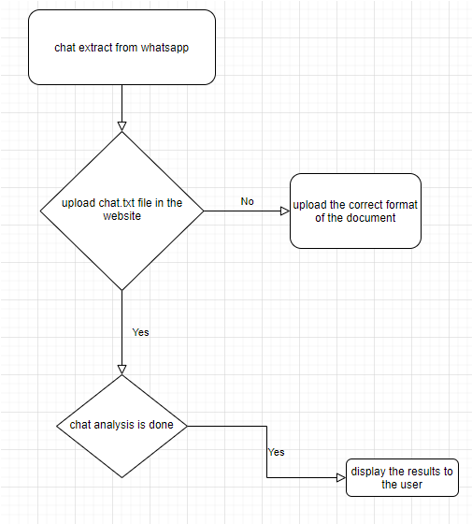
Methodology
Working model of the website

Slide 8
Methodology Explanation
The method of WhatsApp Chat analysis is divided into different stages, the process includes gathering relevant data, importing to the jupyter notebook and analyzing it to obtain the results.
Collecting data is the first step of the process flow which includes defining project, setting up the machine environment suitable for the development requirements and later understanding the data using different python libraries and machine learning techniques. Data Cleaning need to done on the data collected so that the analysis be very accurate for perfect results.
For chat data Go to WhatsApp -> Open any chat -> Click Top Right -> Click on more -> Select Export Chart -> Select without media -> Send via mail . The output of the chat will be in .txt format, save the document in local machine
For the data analysis Upload the .txt file to the webapp and click on the analysis then analysis will be done on the chat and the chat results will be displayed with info like – user, time, date, chat, emojis used, heatmap of the chat, active time of the chat and basic sentiment analysis of the chat and other information about the chat.

Slide 9
Aims and Objectives
In this decade the upcoming technologies are mainly dependent on data. This data can only be obtained if there is some research applied on the context of the requirements of the tool. Since a lot of machine learning enthusiasts develop models which helps solve multiple problems, the requirements of appropriate data are very large scale. This project aims to provide a better understanding towards various types of chats. This analysis proves to be better input to machine learning models which essentially explore the chat data. These models require proper learning instances which provides better accuracy for these models. Our project ensures to provide an in-depth exploratory data analysis on various types of WhatsApp chats. The main aim is to simplify the process of getting conclusions and extraction of the knowledge from the chat data to take crucial decisions at a faster rate.

Slide 10
Conclusion
It can be said that the capabilities of the WhatsApp application and the power of the python programming language in implementing whatever network data analysis intended, cannot be overemphasized. WhatsApp group chat and visually represent the top 10 and top 20 users in the chat groups. A pseudocode of the plot was given and at the end, visual representation of the plot was implemented. The system was done with python, and the python libraries that were implemented includes, NumPy, Pandas, Matplotlib and Seaborn. At the end of the work expected results were obtained and the analysis was able to show the level of participation of the various individuals on the given WhatsApp group. On serious note this system has the ability to analyse any WhatsApp group data input into it.

Slide 11
REFERENCES
[1] Available from: http://www. statista.com/statistics/260819/number-of-monthly-active-WhatsApp-users. Number of monthly active WhatsApp users worldwide from April 2013 to February 2016(in millions).
[2] Ahmed, I., Fiaz, T., “Mobile phone to youngsters: Necessity or addiction”, African Journal of Business Management Vol.5 (32), pp. 12512-12519, Aijaz, K. (2011).
[3] Aharony, N., T., G., The Importance of the WhatsApp Family Group: An Exploratory Analysis. “Aslib Journal of Information Management, Vol. 68, Issue 2, pp.1-37” (2016).
[4] Access Data Corporation. FTK Imager, 2013. Available at http://www.accessdata.com/support/product-downloads.
[5] D.Radha, R. Jayaparvathy, D. Yamini, “Analysis on Social Media Addiction using Data Mining Technique”, International Journal of Computer Applications (0975 – 8887) Volume 139 – No.7, pp. 23-26, April 2016.
[6] Jessica Ho, Ping Ji, Weifang Chen, Raymond Hsieh, “Identifying google talk”, IEEE International Conference on Intelligence and Security Informatics, ISI ‘09, pp. 285-290, 2009.
[7] Mike Dickson, “An examination into AOL instant messenger 5.5 contact identification.”, Digital Investigation, ScienceDirect, vol.3, issue 4, pp. 227-237, 2006.
[8] Mike Dickson, “An examination into yahoo messenger 7.0 contact identification”, Digital Investigation, ScienceDirect, vol. 3, issue 3, pp. 159-165, 2006.

Slide 12
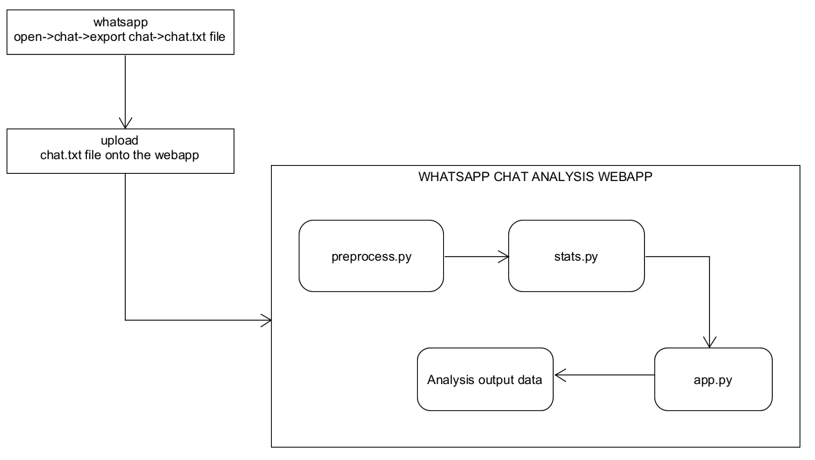
PROJECT ARCHITECTURE

Slide 13
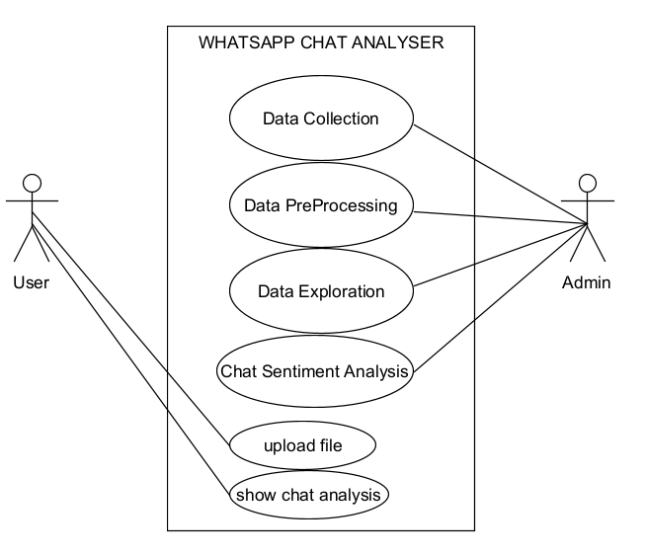
USE CASE DIAGRAM

Slide 14
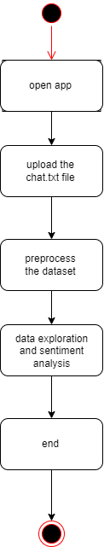
STATE DIAGRAM

Slide 15
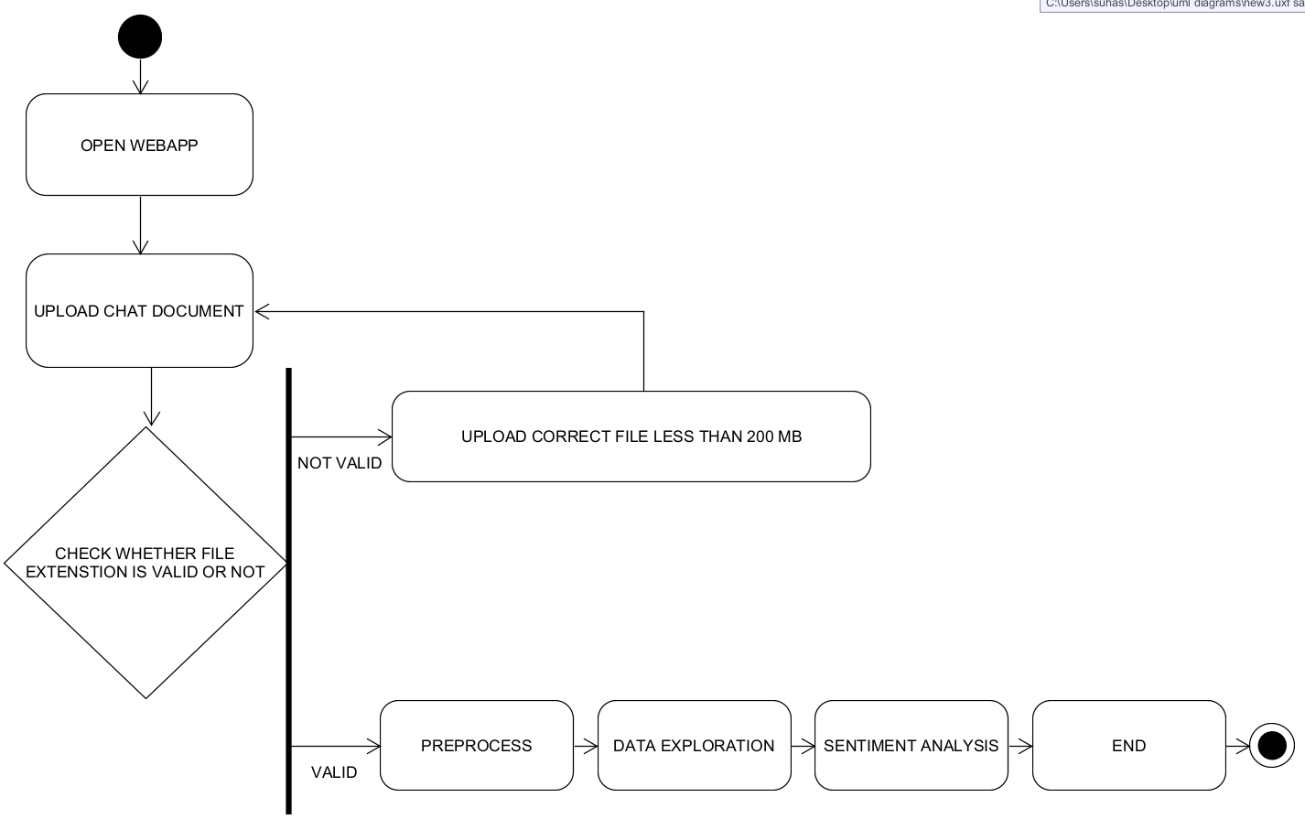
ACTIVITY DIAGRAM

Slide 16
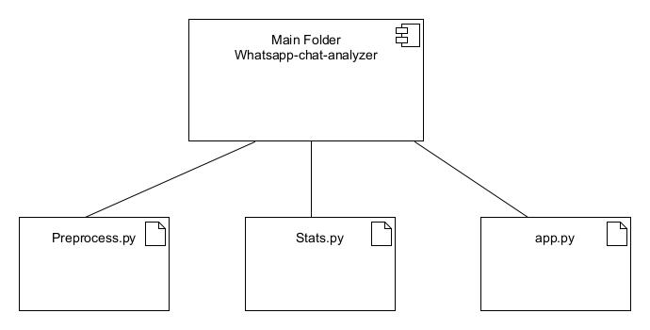
COMPONENT DIAGRAM

Slide 17
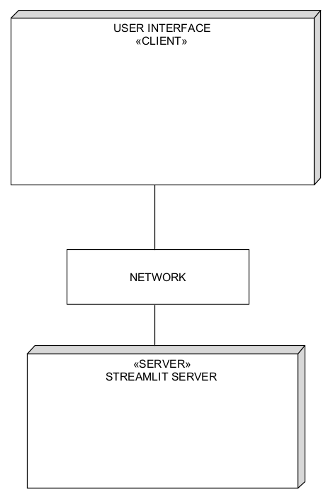
DEPLOYMENT DIAGRAM

Slide 18
MODULE DESCRIPTION
Natural language Toolkit
Natural Language Processing is a process in which we make the computer understand our Human Language, then further we can perform any text analysis.
The Natural Language Toolkit (NLTK) is an open source Python library for Natural Language Processing.

Slide 19
Module Description
VADER Sentiment Analysis :
VADER (Valence Aware Dictionary and Sentiment Reasoner) is a lexicon and rule-based sentiment analysis algorithm that is specifically attuned to sentiments expressed in social media texts.
It uses a combination of sentiment lexicon which is list of lexical features which are generally labelled according to their semantic orientation as either positive or negative

Slide 20
TECHNOLOGIES USED
PROGRAMMING LANGUAGE – PYTHON
Code editor – jupyter notebook, PyCharm community edition
LIBRARIES – NumPy, Pandas, Regex, URLExtract, Wordcloud, Collections, Emoji
Natural language Toolkit – Vader(Valence Aware Dictionary And Sentiment Reasoner.
Web Framework – Streamlit(open source python web framework)

Slide 21
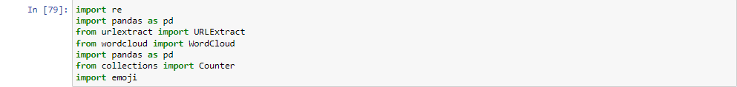
SAMPLE CODE
Importing the necessary libraries for date collection , preprocessing and data exploration

Slide 22
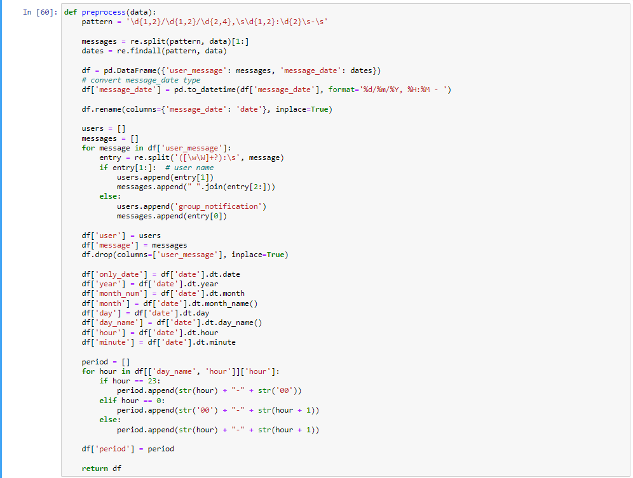
Preprocessing the data using tokenization method

Slide 23
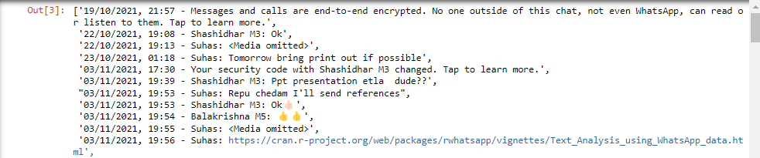
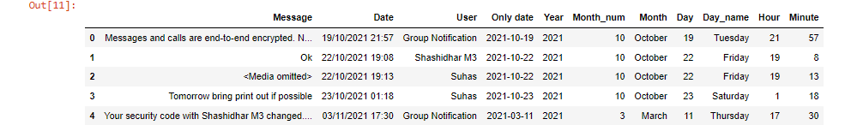
Chat.txt file before pre-processing – tokenization process using regex
Chat.txt file after pre-processing

Slide 24
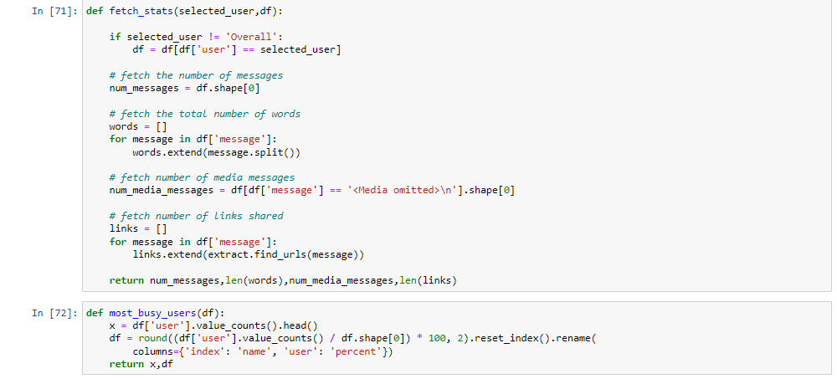
stats.py – Data Exploration

Slide 25
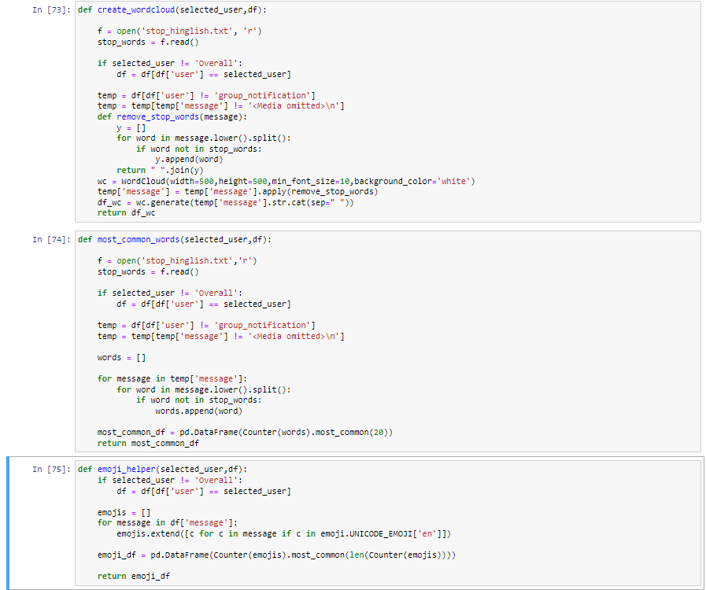

Slide 26
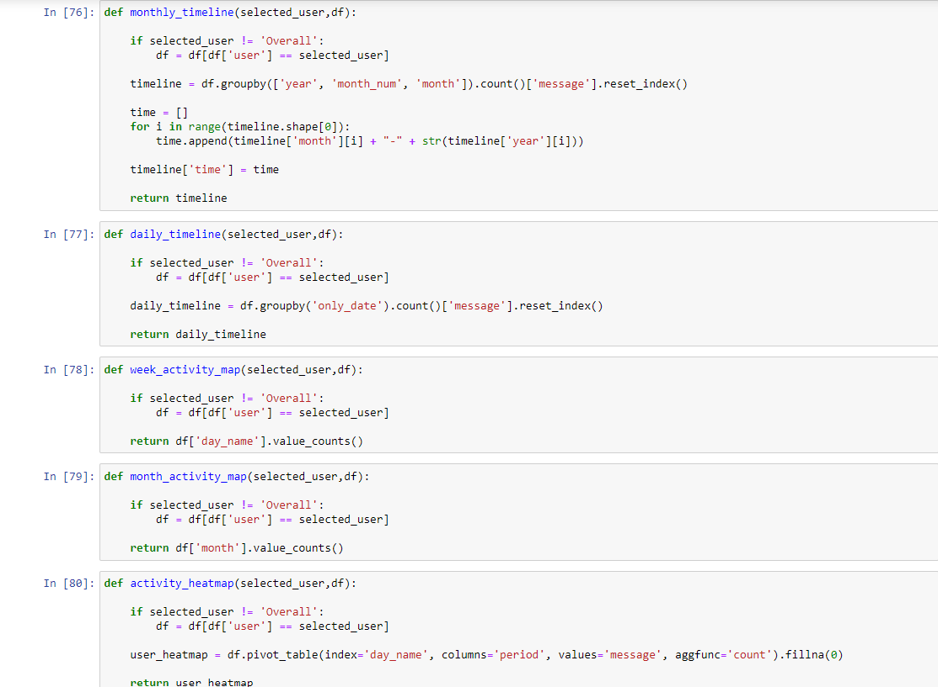

Slide 27
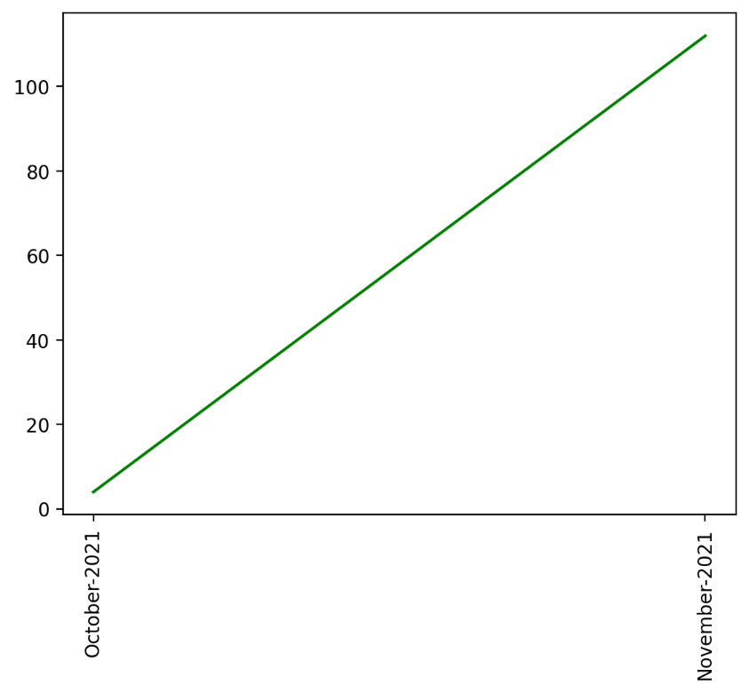
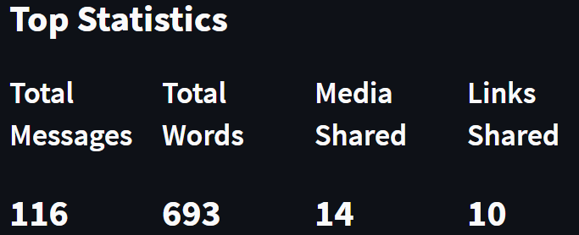
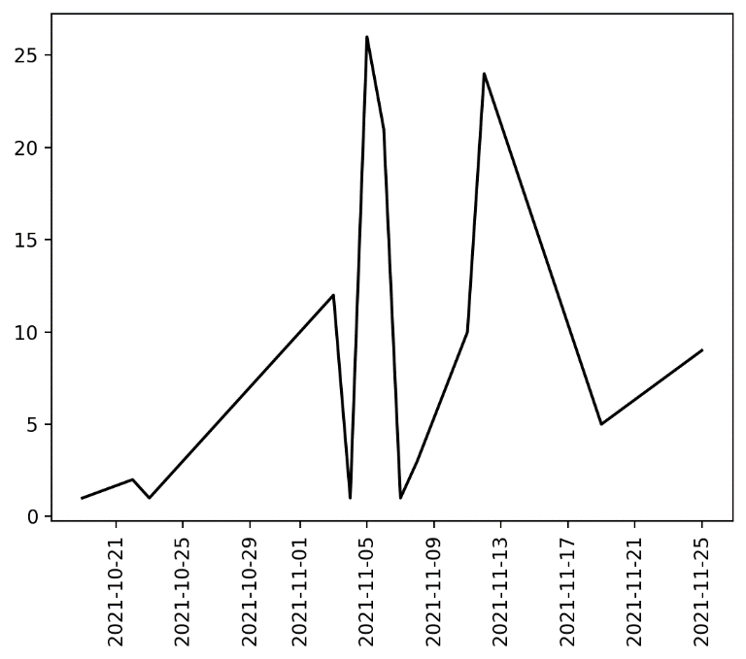
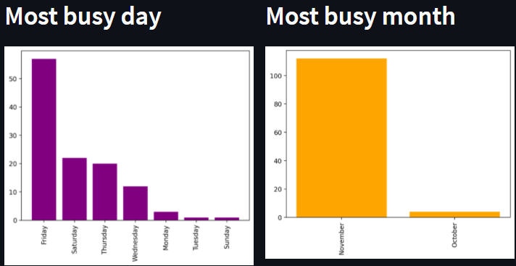

Slide 28
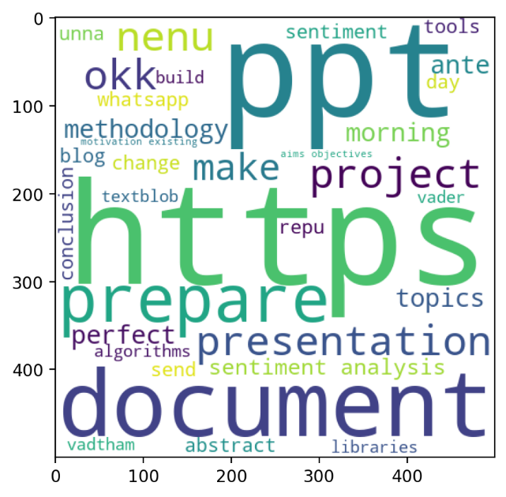
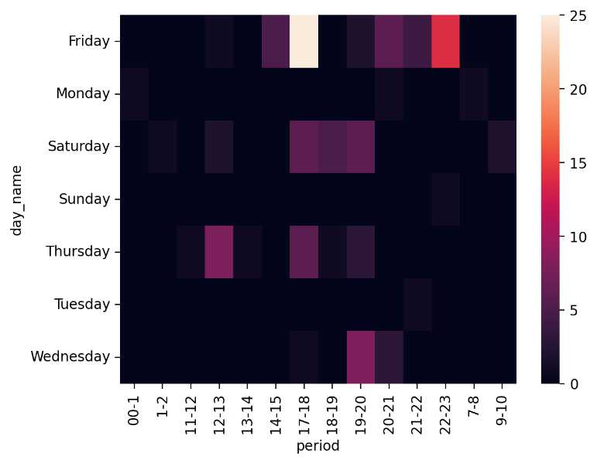
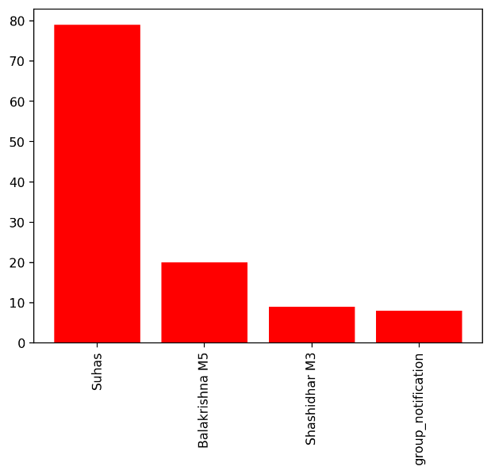
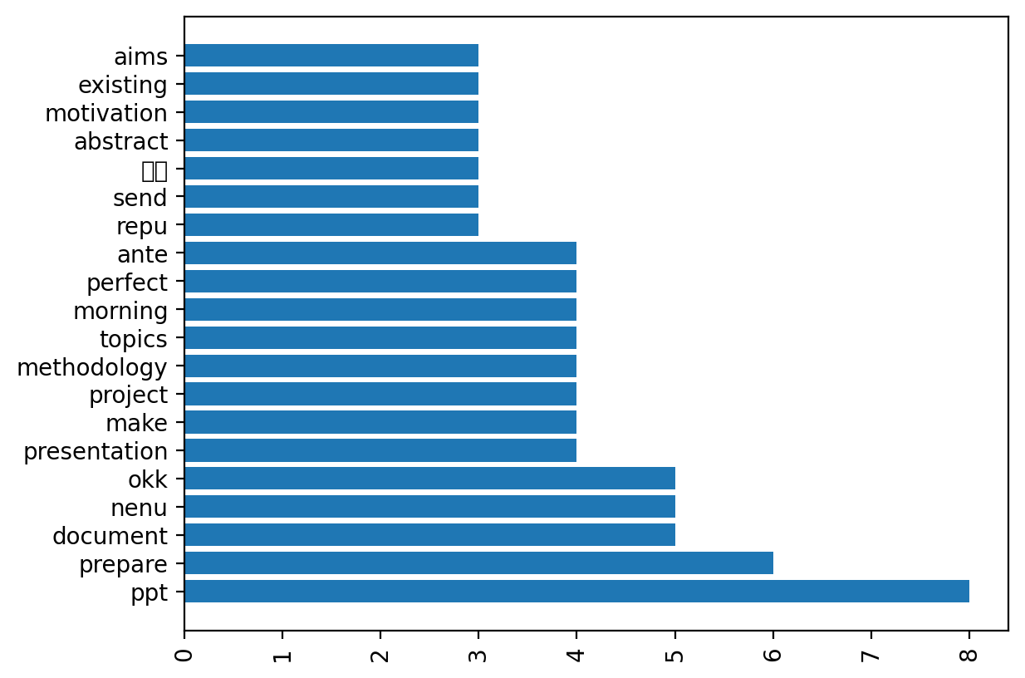
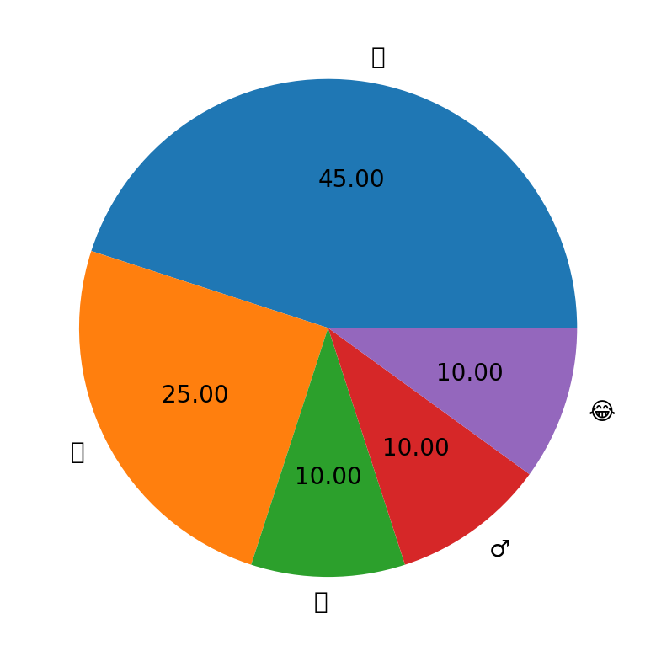

Slide 29
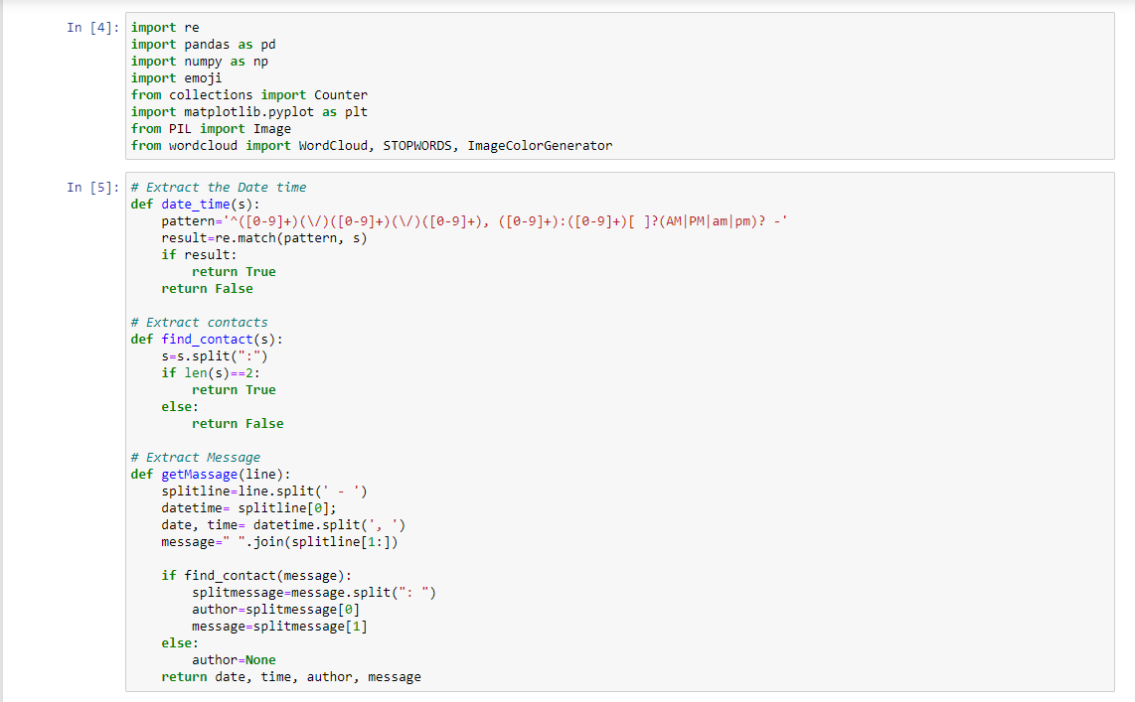
SENTIMENT ANALYSIS OF WHATSAPP CHAT
Importing libraries , extract date, time, contacts and message

Slide 30
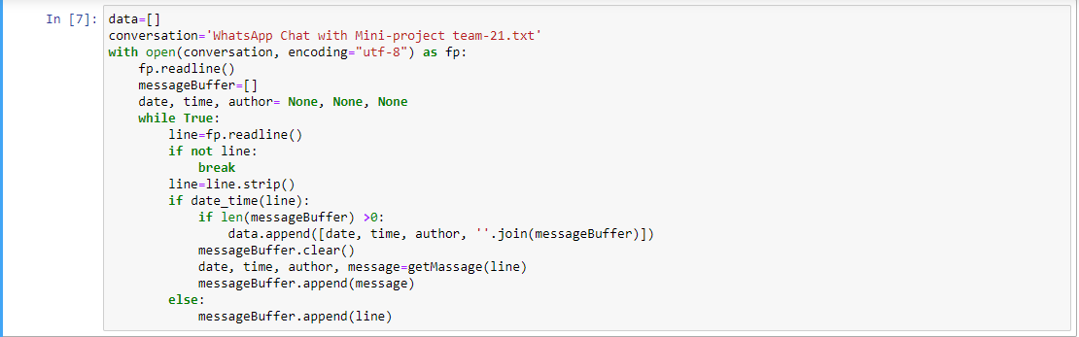
READING FILE

Slide 31
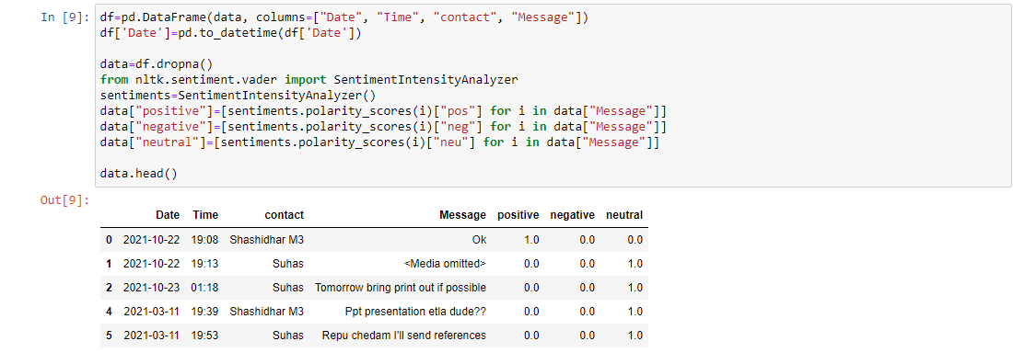
SENTIMENT ANALYSIS USING
VADER-NATURAL
LANGUAGE PROCESSING ALGORITHM

Slide 32
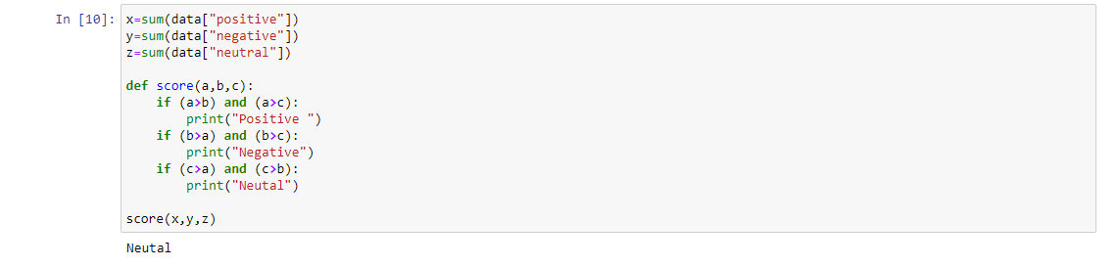
OVERALL SENTIMENT ANALYSIS
OF THE CHAT

Slide 33
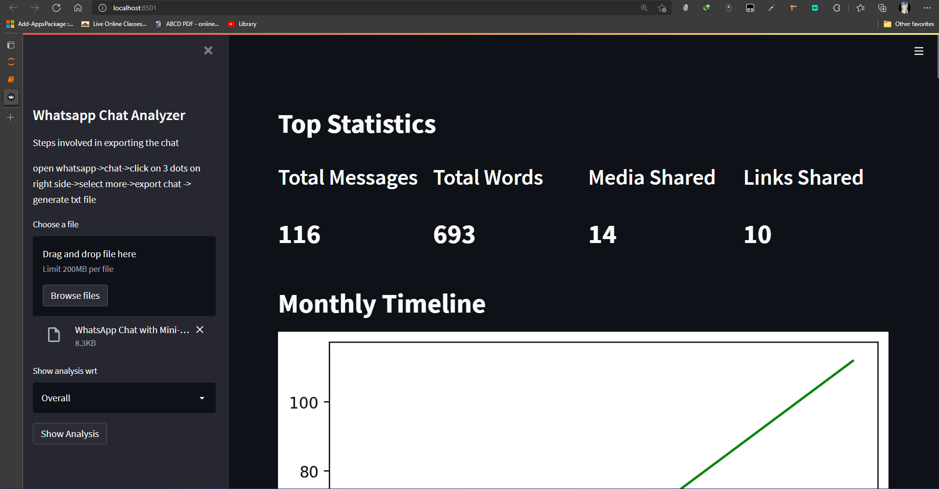
WEBAPP DESIGN

