Slide 1
speech_tools for ROS
John Parker
Intelligent Robotics III
Spring 2015

Slide 2
speech_tools
A set of ROS nodes that accomplish the following:
  1) speech_recognition.py – uses pocketsphinx speech recognizer with the cmu07a.dict dictionary and a probabilistic language model en-us.lm, which is the best general language model for that dictionary
  2) speech_recognition_nb.py – calls pocketsphinx using jeeves.dict and jeeves.lm, custom files that the user generates to match only the words found in the Naive Bayes and Keyword Extraction training data.
  3) speech_synthesis.py – uses the Festival speech synthesis system to 'speak' all messages sent to the ROS topic to which it subscribes
  4) speech_integrated.py – combines the Naive Bayes text classification method, and the A.L.I.C.E chatbot system to make a robust speech system that can use flexible AIML scripts for conversation and can also respond to commands with high accuracy using the Naive Bayes classification system.

Slide 3
speech_tools
Software Requrements:
The speech_recognition.py and speech_recognition_nb.py nodes require that you have installed on your machine pocketsphinx from CMU. You can install either from a debian repository, or from source, but the pocketsphinx binary must be in your bash execution path for these ROS nodes to work correctly (the binary will be placed in your bash execution path automatically if you install from debian repo or follow all source install instructions from CMU)
The speech_synthesis.py node requires that you have installed the Festival speech recognition system. This can be obtained from the Ubuntu debain repositories.

Slide 4
speech_tools
System Startup:
If you want to use the entire system, start all four ROS nodes in no particular order.
If you only want to use the speech recognition modules, then startup speech_recognition.py if you want to use the standard 60,000+ word dictionary from CMU, or startup speech_recognition_nb.py if you would like to use your own custom language dictionary and language model (read further slides for instructions). Before you start the node(s), make sure that the audio system settings on your machine are configured to receive input from your microphone channel. After you have started the node, you can listen on the ROS topic that the node publishes to in order to read the output of the pocketsphinx speech recognizer.
If you only want to use the speech synthesizer, then startup speech_synthesis.py. If you publish messages on the ROS topic that this node subscirbes to, the text string in those messages will be synthesized into speech over your machine's audio system by the Festival speech synthesis program.

Slide 5
speech_integrated.py – How it Works
Combines the A.L.I.C.E. and Naive Bayes speech methods
If an A.L.I.C.E. string was matched, print the A.L.I.C.E response
Else print the Naive Bayes classification, which always gives a match
NOTE: to make sure the system works, make sure there is no 'catch all' phrase using wildcards in any of the A.L.I.C.E. scripts, as this will prevent the Naive Bayes classification system from functioning

Slide 6
Making changes to the A.L.I.C.E. scripts
To change the A.L.I.C.E. scripts:
  All AIML scripts to be used with A.L.I.C.E. are found in the folder ./jeevespersonality/
  You can edit the scripts, or if you add a new one, be sure to add it to ./jeevespersonality-startup.xml
  All changes are effective as soon as the speech_integrated.py ROS node is restarted
  For information on the AIML standard, reference:
    AIML tutorial: http://www.pandorabots.com/pandora/pics/wallaceaimltutorial.html
    AIML reference manual: http://www.alicebot.org/documentation/aiml-reference.html

Slide 7
Making changes to the Naive Bayes training data
All training data is found in ./nb_keywords_training_data/
The structure is as follows:
  ./nb_keywords_training_data/categories/
  contains a set of directories whose names are the text classes to be recognized by the Naive Bayes classifier system. Each directory contains a single text document that contains all the training data for that class.
To make changes, simply add or remove sentences from the text document in a particular class.
To add a new class, simply make a new directory whose name is the class, and create a text document in the directory that includes the sentences that comprise the training data for that class.

Slide 8
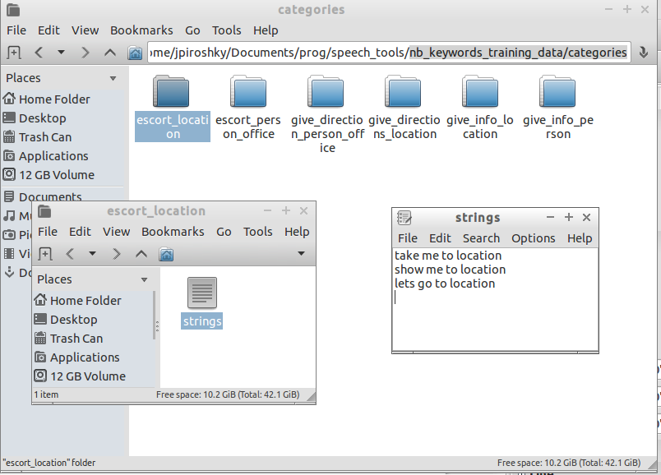
Making changes to the Naive Bayes training data

Slide 9
Making changes to the Keywords training data
All training data is found in ./nb_keywords_training_data/
The structure is as follows:
  ./nb_keywords_training_data/keywords/
  contains a set of directories whose names are the keyword classes to be recognized by the Keyword extraction system. Each directory contains a single text document that contains all the training data for that class.
To make changes, simply add or remove keywords from the text document in a particular class.
To add a new class, simply make a new directory whose name is the class, and create a text document in the directory that includes the keywords that comprise the training data for that class.

Slide 10
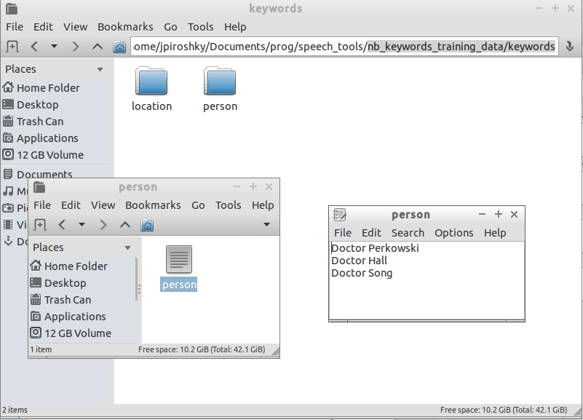
Making changes to the Keywords training data

Slide 11
Updating the jeeves.dic and jeeves.lm file
After making changes to the Naive Bayes and Keyword training data, the speech recognition dictionary and language model need to be updated to reflect the changes
Run the script ./nb_keyword_training_data/grab_training_data.py
to generate a file called for_lmtool.txt containing all the sentences and keywords found in the training data.
Go to http://speech.cs.cmu.edu/tools/lmtool-new.html and use the online form to choose the file for_lmtool.txt, and then click 'COMPILE KNOWLEDGE BASE'
Download and save the .dic and .lm files as jeeves.dic and jeeves.lm in the /speech_tools/ folder

Slide 12
Naive Bayes Text Classification and CMU Sphinx Dictionaries and Language Models
John Parker
Portland State University
Winter 2015

Slide 13
Naive Bayes Text Classification
What we will learn today:
  A machine learning technique that will take a text, and classify it according to categories that we specify.
  In essence, text classification is just a way of giving weighted scores based on prior evidence (training data), and we use Bayes Theorem instead of other ML techniques.
  For every input text, our algorithm will output a score for each category, indicating how likely it is that the text belongs to that category. The best score is our best guess.
  We will use Bayes Theorem with certain assumptions to make our score calculations very simple (naïve).

Slide 14
Assumptions
Our first assumption is that every text is just a 'Bag of Words'
  This means in our Bag of Words model, only the frequency (how often) a word occurs in a text is important
  Not important: word order, how near or far apart different words are from each other
Our second assumption is Conditional Independence
  This means that we treat the appearance of each word in our text like a statistically independent event
  i.e. our score is NOT based on words x,y,z appearing together in our text, only that x appears, y appears, z..

Slide 15
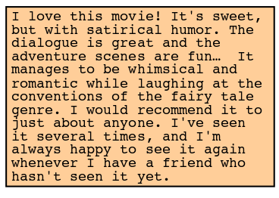
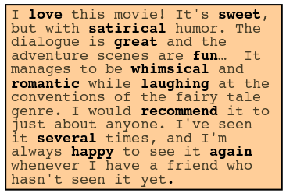

'Bag of Words' Representation

Slide 16
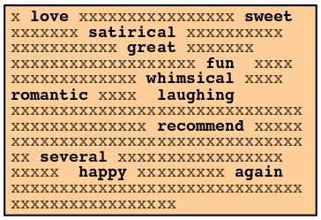
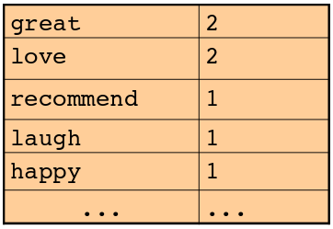
'Bag of Words' Representation

Slide 17
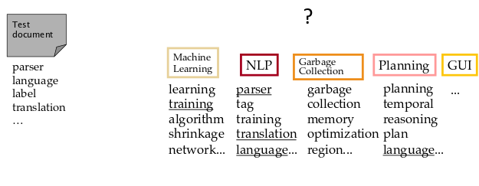
'Bag of Words' Representation
Which Category

Slide 18
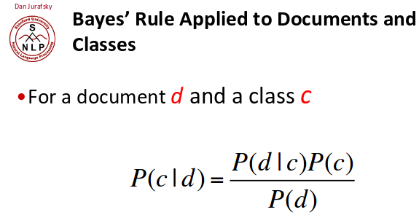
Classification is a Score based on Weights

Slide 19
Classification is a Score based on Weights
Score
Weights

Slide 20
Classification is a Score based on Weights
probability that
word set d is found
in a given class c(i)
base probability of class
c(i) relative to the other
classes
base probability of words
in set d
regardless of class
Score
Weights

Slide 21
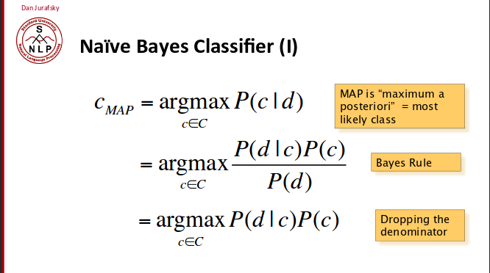

Slide 22
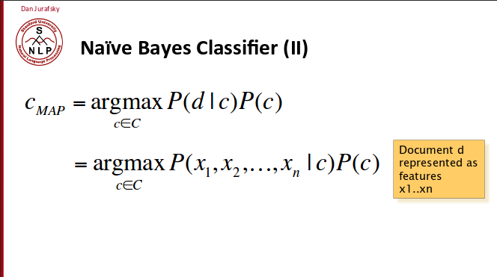

Slide 23
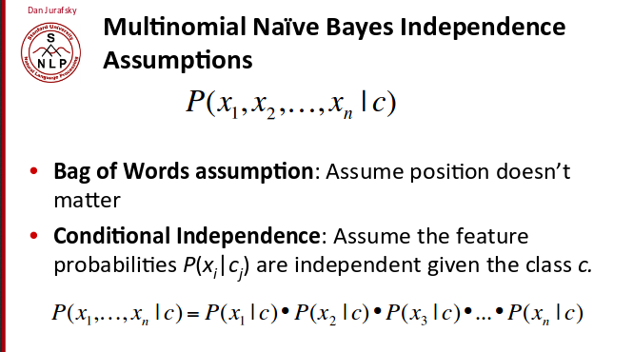
Probability of word x_{n} given class c
i.e. probability we draw word x_{n} out
of our bag of words for class c!

Slide 24
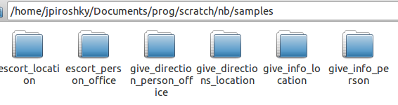






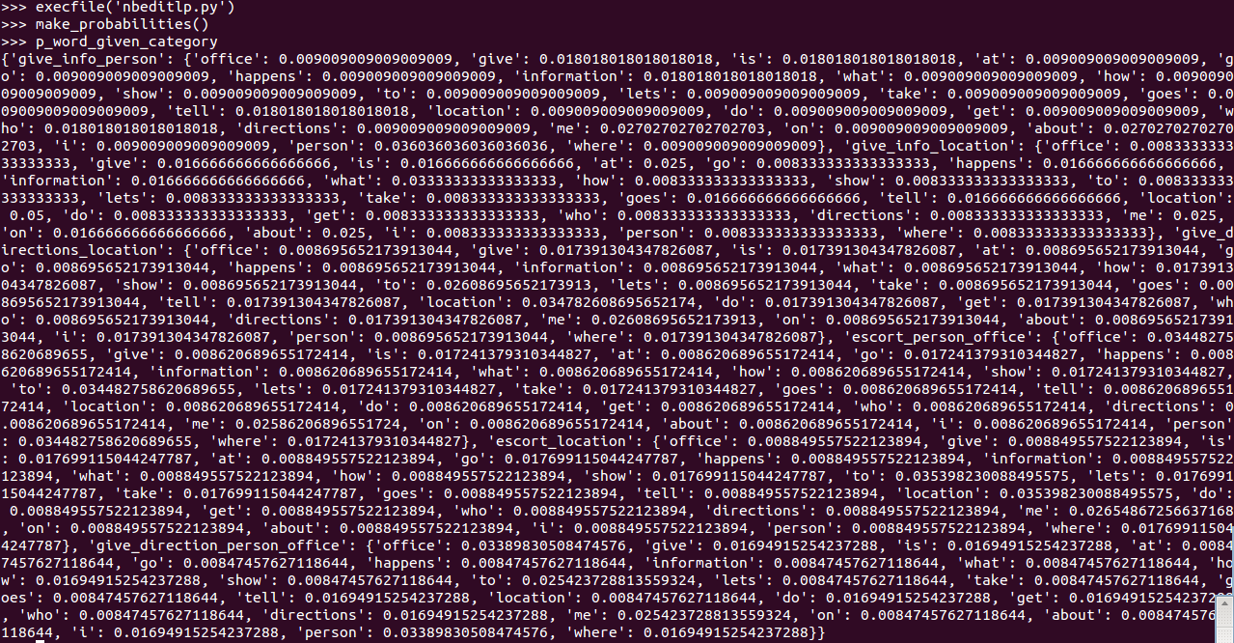

Slide 25
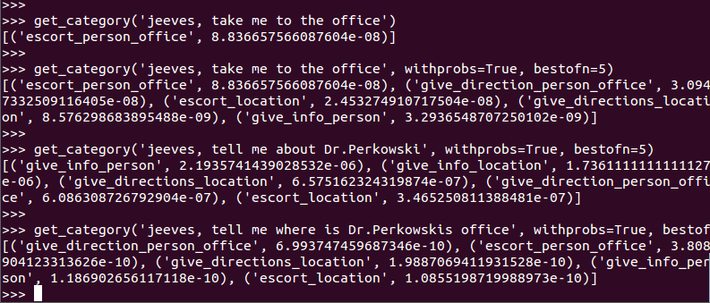

Slide 26
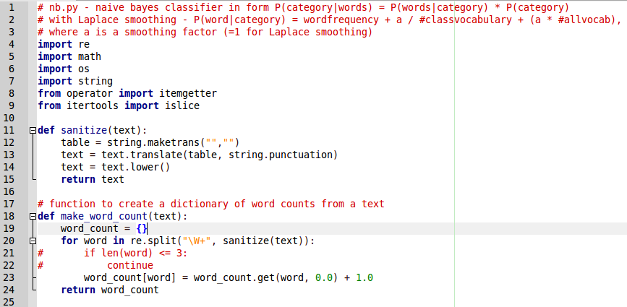
NB.py

Slide 27
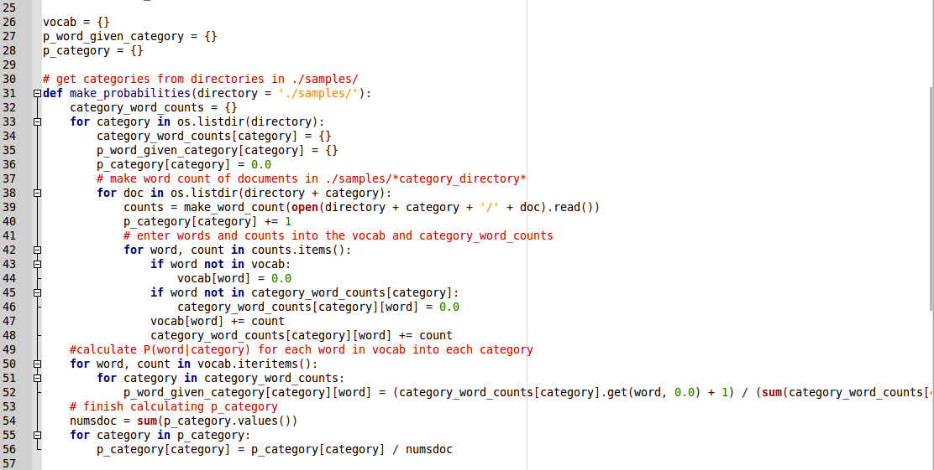
NB.py

Slide 28
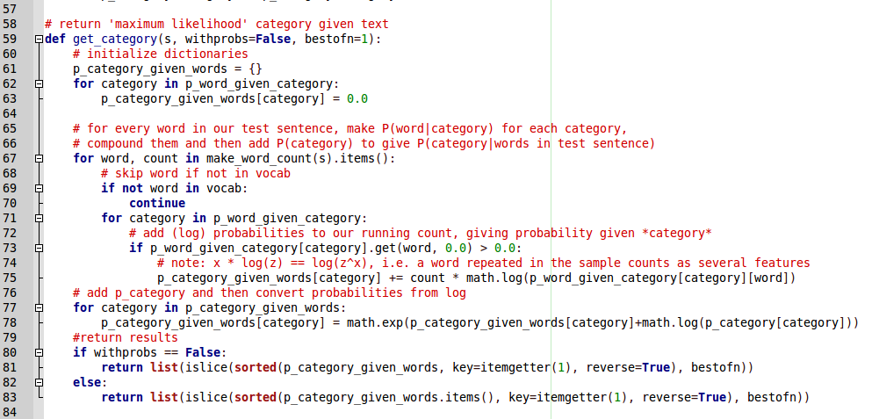
NB.py

Slide 29
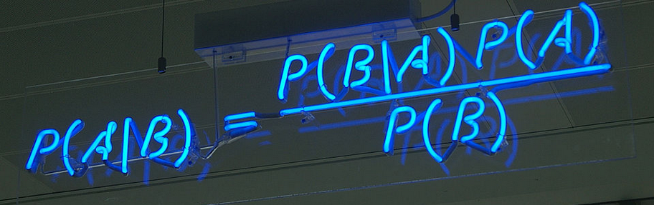
What is Bayes Theorem and Conditional Probability
Bayes Theorem:
Conditional Probability:
  P(A|B): read “probability of A given B”, i.e. what is the probability of A given we have condition B
  Example: someone is much more likely to cough if they have a cold, so the conditional probability P(cough|cold) is much higher than just P(cough)

Slide 30
Illustration of Bayes' Theorem
What is the probability that a student will be absent next week, given they are supposed to present next week?
  Let P(A) = probability student will be absent (.1)
  Let P(B) = probability student will be presenting (.2)
  So P(A|B) is probability of absent|'supposed to present'
  And since it is known (by experience) that a student is almost always supposed to present on the day they are absent, we can say P(B|A) is about (.9) ← probability of 'supposed to present'|absent

Slide 31
Illustration of Bayes' Theorem
presenting|absent
(.9)
absent
(.1)
(.45)
absent|presenting !
(.2)
presenting
What does this mean?
  Not surprising: If you present twice as often as you are absent, then missing every other presentation day is reasonable, right?
  Dr. Perkowski really is right, because missing almost every other day to present means a 90% chance that he will ask you to present given that you are going to be absent next week! ^_^

Slide 32
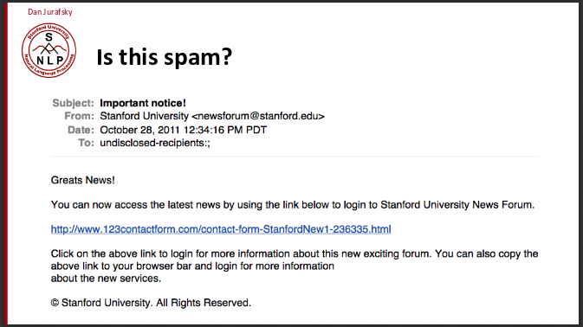
Why Text Classification?

Slide 33
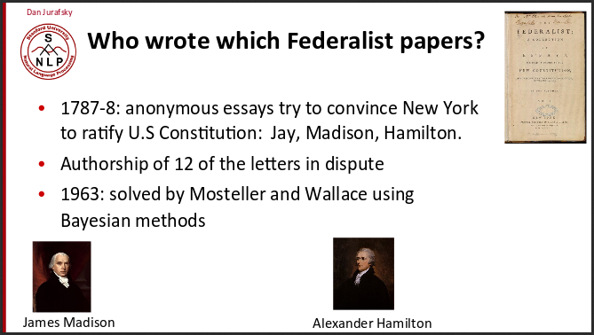
Why Text Classification?

Slide 34
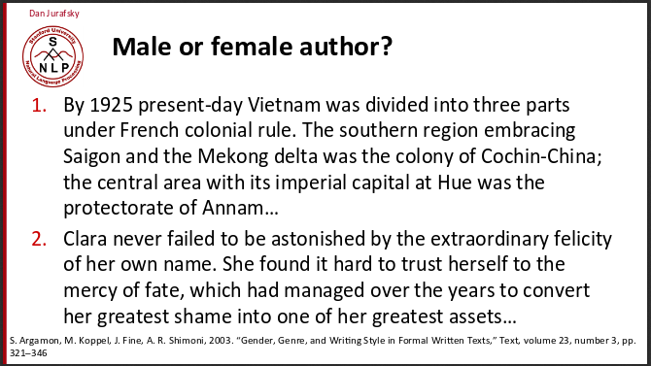
Why Text Classification?

Slide 35
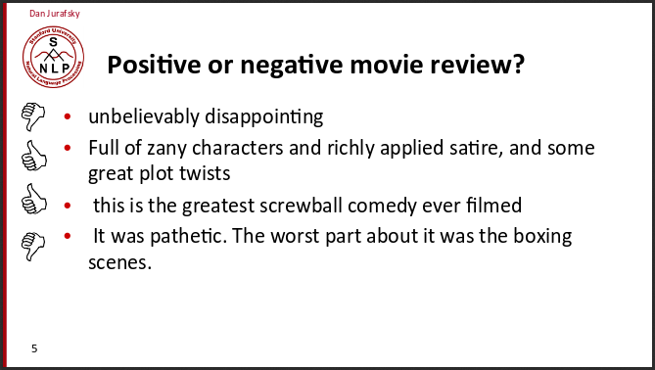
Why Text Classification?

Slide 36
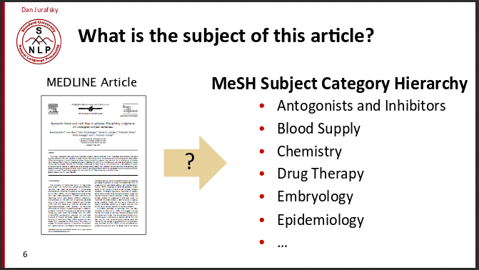
Why Text Classification?

Slide 37
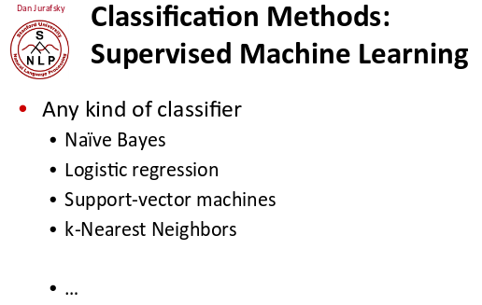
Why Text Classification?
Could use any kind of classifier:

Slide 38
CMU Sphinx
What to know about Sphinx:
  Probabilistic speech recognizer
  Uses 3 basic concepts
    Features – extracts 'phones' from audio sample as features making up 'subwords' → 'subword' features (syllables) form words → words are features in a grammar
    Model – a combination of a function and a learned values for the function, and the function returns the most probable next feature given the current feature
    Hidden Markov Model Assumption – assumes that speech behaves like a sequence of states where several next states are possible, and their probabilities (scores) depend on the current state

Slide 39
CMU Sphinx
Sphinx uses models at 3 different levels:
  Acoustic Model – models the likelihood of the next senone (phone)
  Phonetic Dictionary – maps words to phones; usually contains a few different 'pronunciations' for each word
  Language Model – models the likely next words given the current word state: **necessary to restrict search space – better restriction, better accuracy**

Slide 40
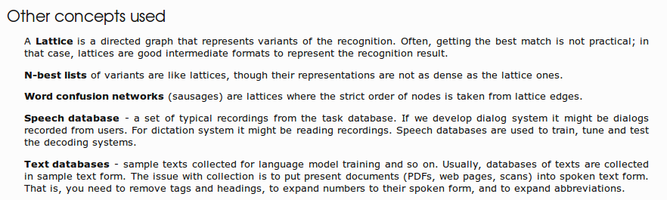
CMU Sphinx
Uses a lattice (nodes + links) to model match possibilities

Slide 41
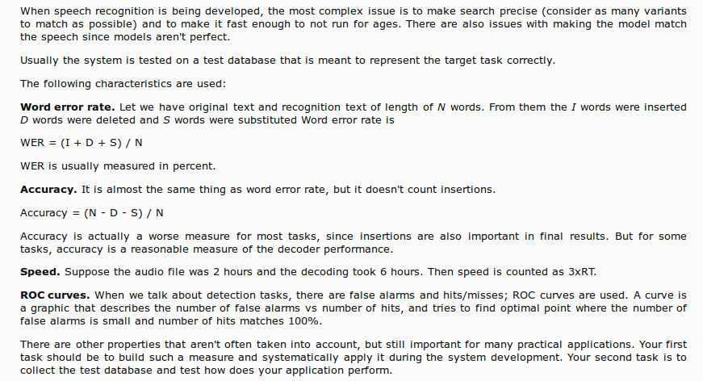
CMU Sphinx
How to evaluate speech recognition:

Slide 42
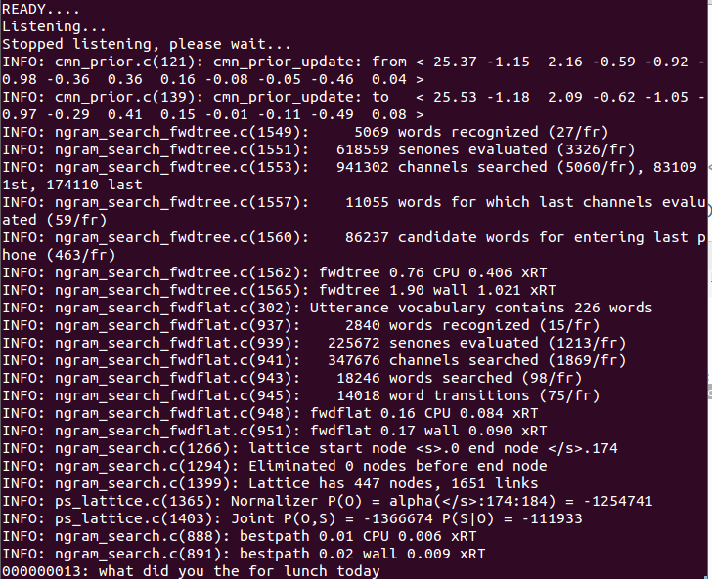
CMU Sphinx

Slide 43
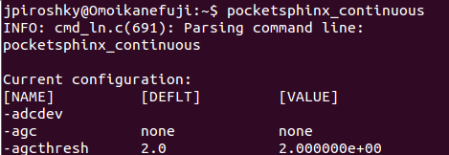
Running pocketsphinx
Run from command line

Slide 44
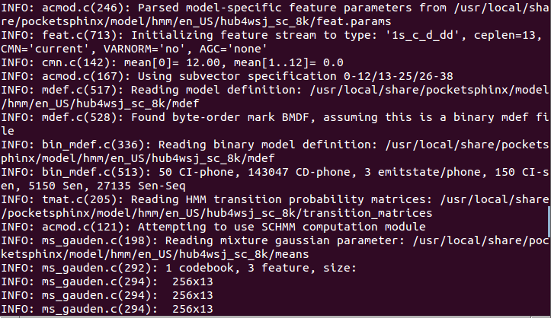
Running pocketsphinx
Default acoustic model: hub4wsj_sc_8k

Slide 45
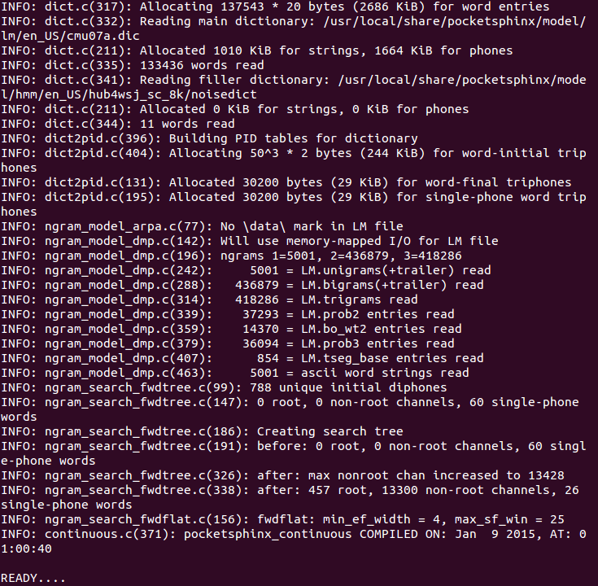
Running pocketsphinx
Default dictionary: cmu07a.dic <-133,000+ ent.

Slide 46
Running pocketsphinx
Default language model: NONE!

Slide 47
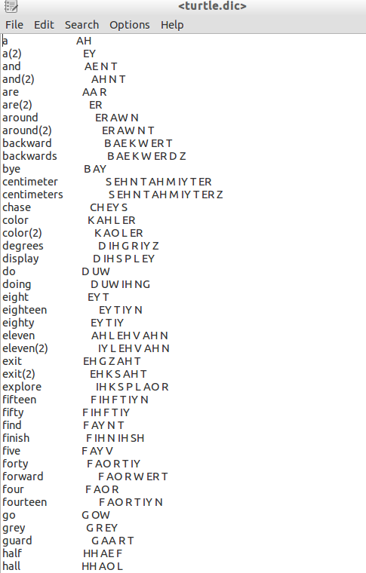
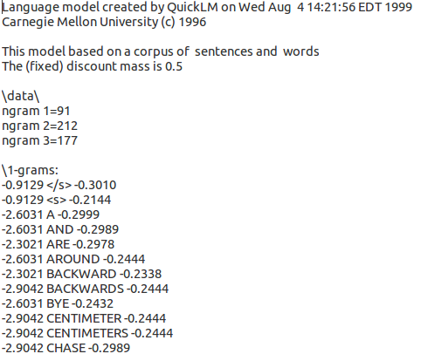
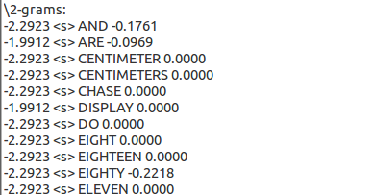
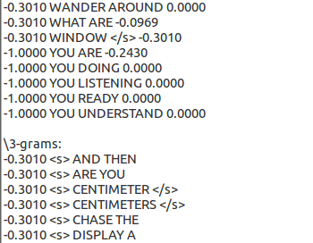
Dictionary + Language Model example: turtle.dic + turtle.lm
...
...
...
...

Slide 48
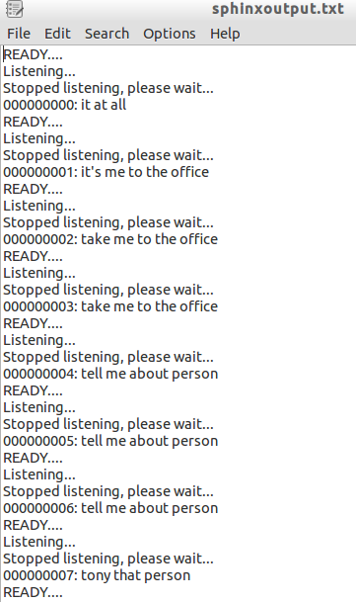
Jeevesphrase with cmu07a.dic and no language model

Slide 49
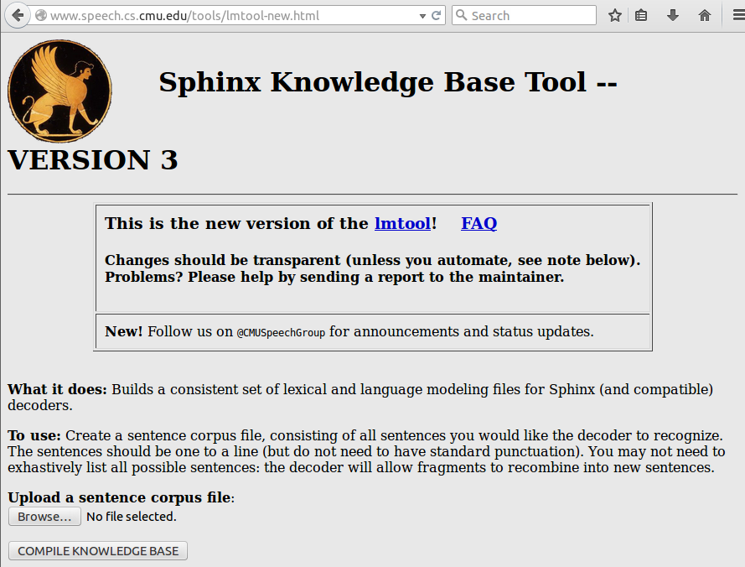
Creating a Dictionary + Language Model

Slide 50
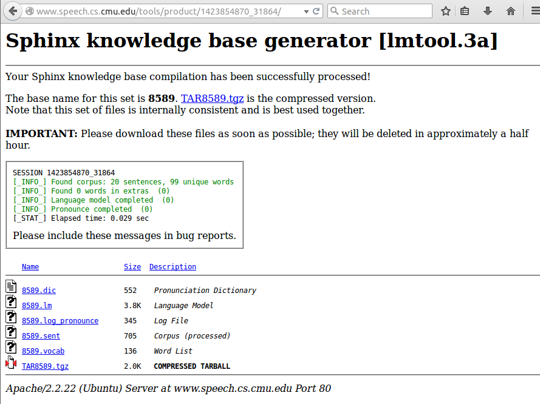
Creating a Dictionary + Language Model

Slide 51
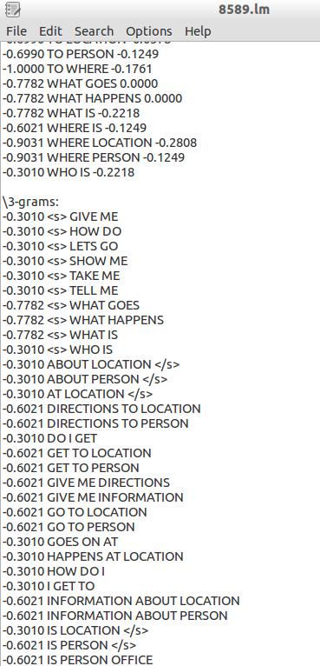
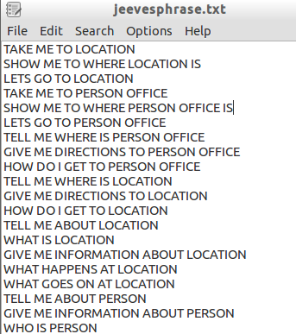
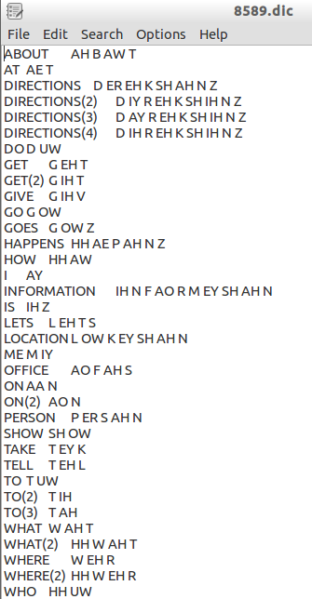
Creating a Dictionary + Language Model

Slide 52
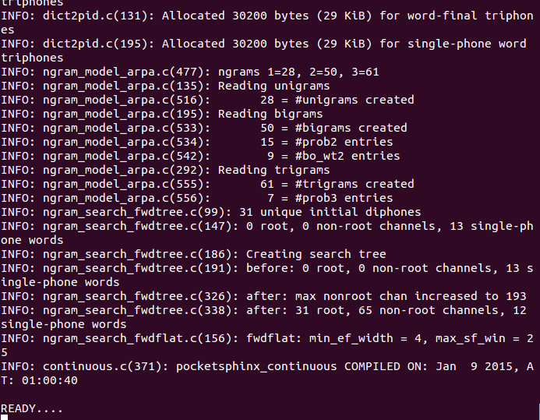
jeevesprhase with custom dictionary + language model

Slide 53
jeevesprhase with custom dictionary + language model

Slide 54
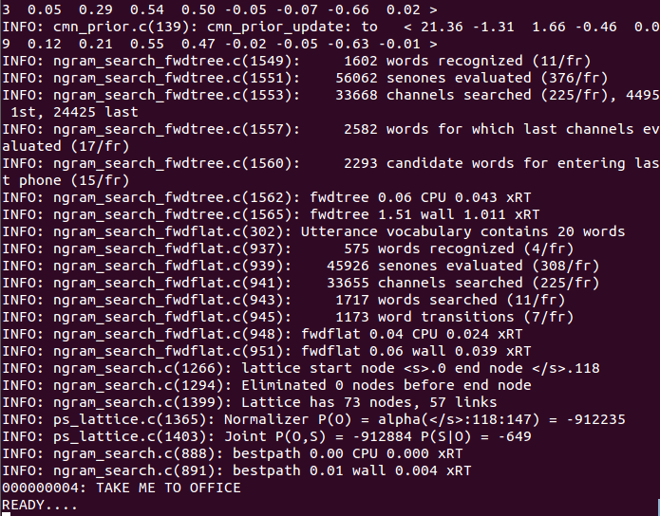
Jeevesprhase with custom dictionary + language model

