Slide 1
JavaProject Memory Match Game
Moungsung Im
Amos Omobude

Slide 2
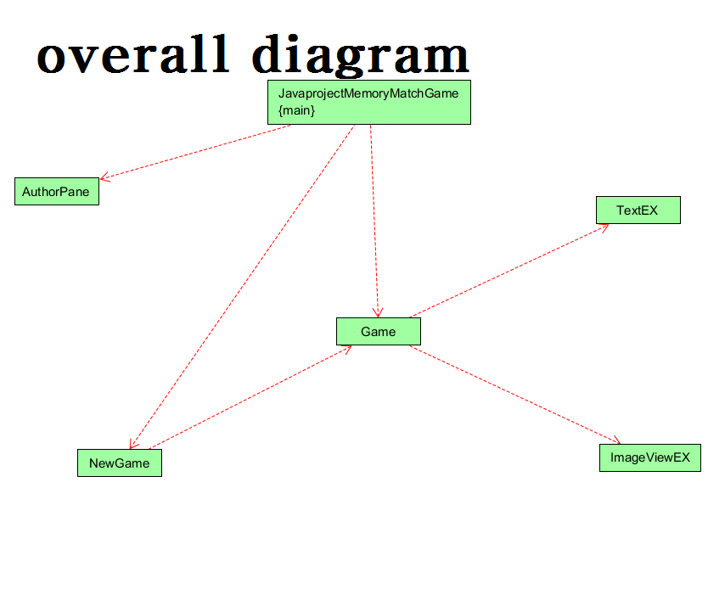
Overall UML Diagrams

Slide 3
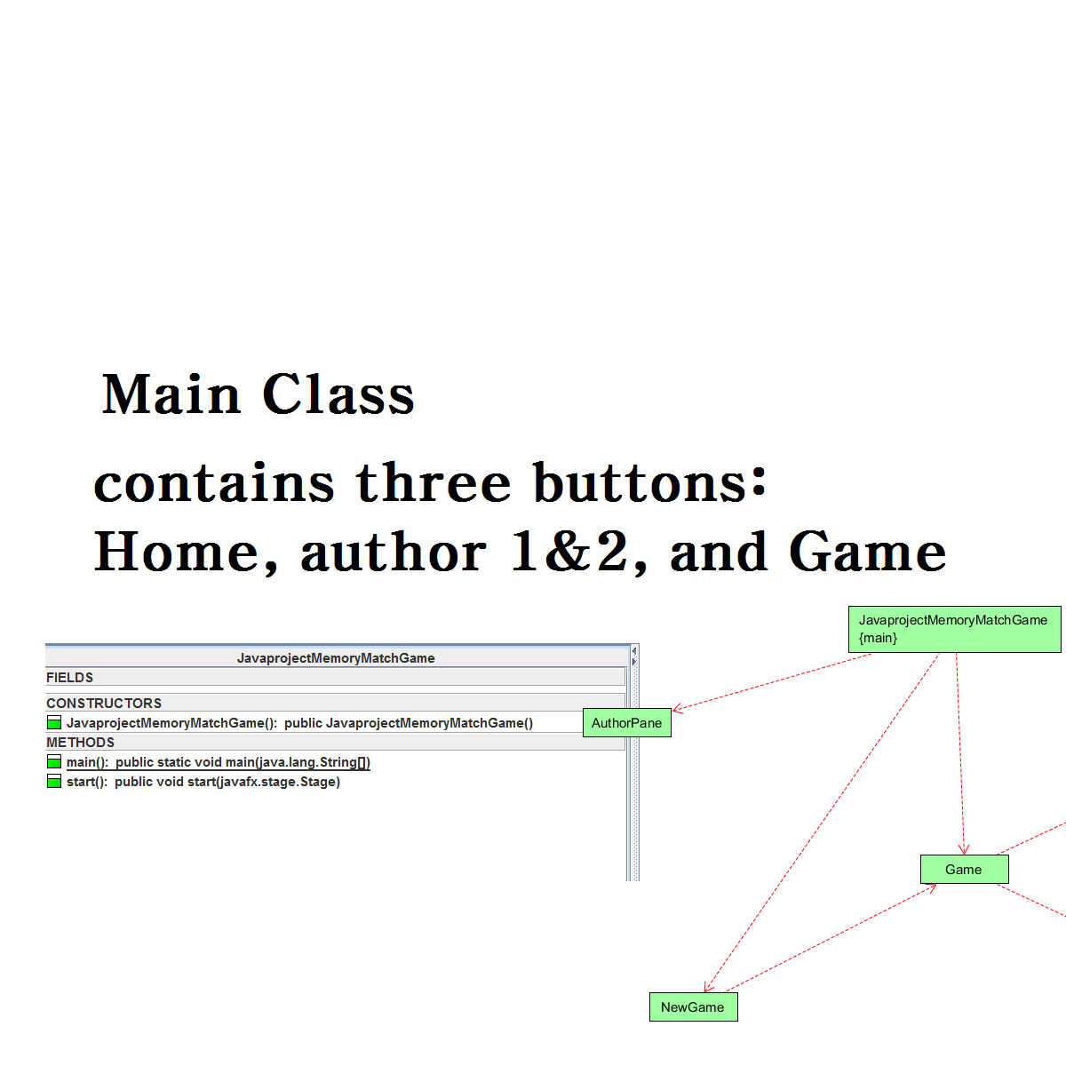
Information about class
Main Class

Slide 4
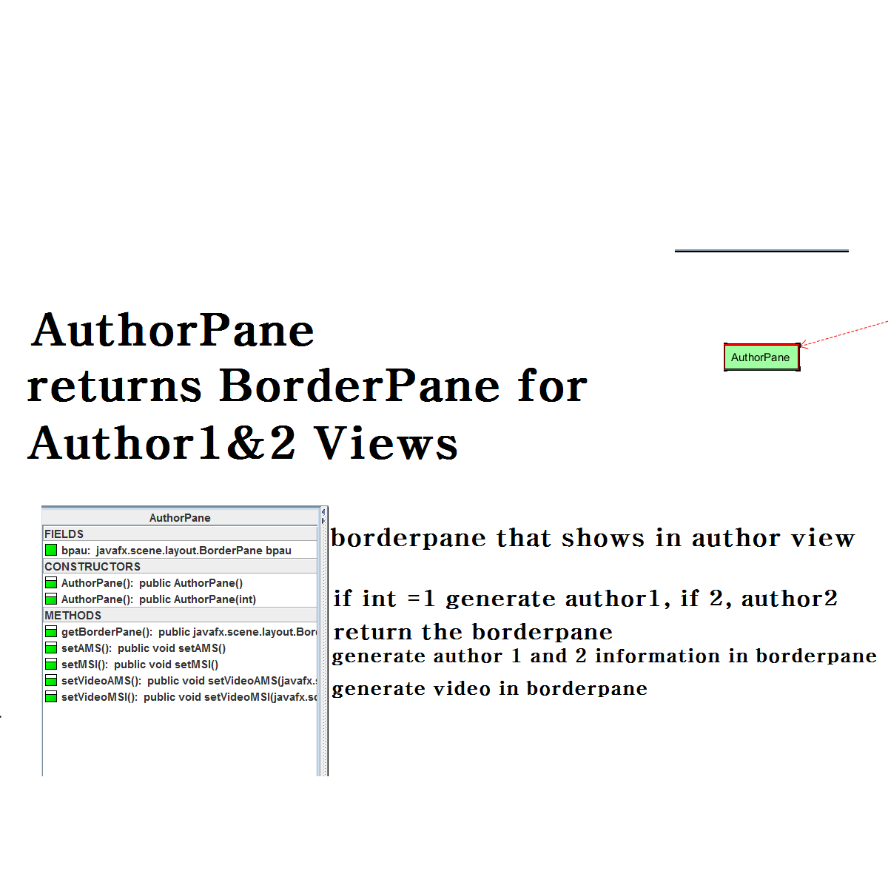
Information about class
AuthorPane

Slide 5
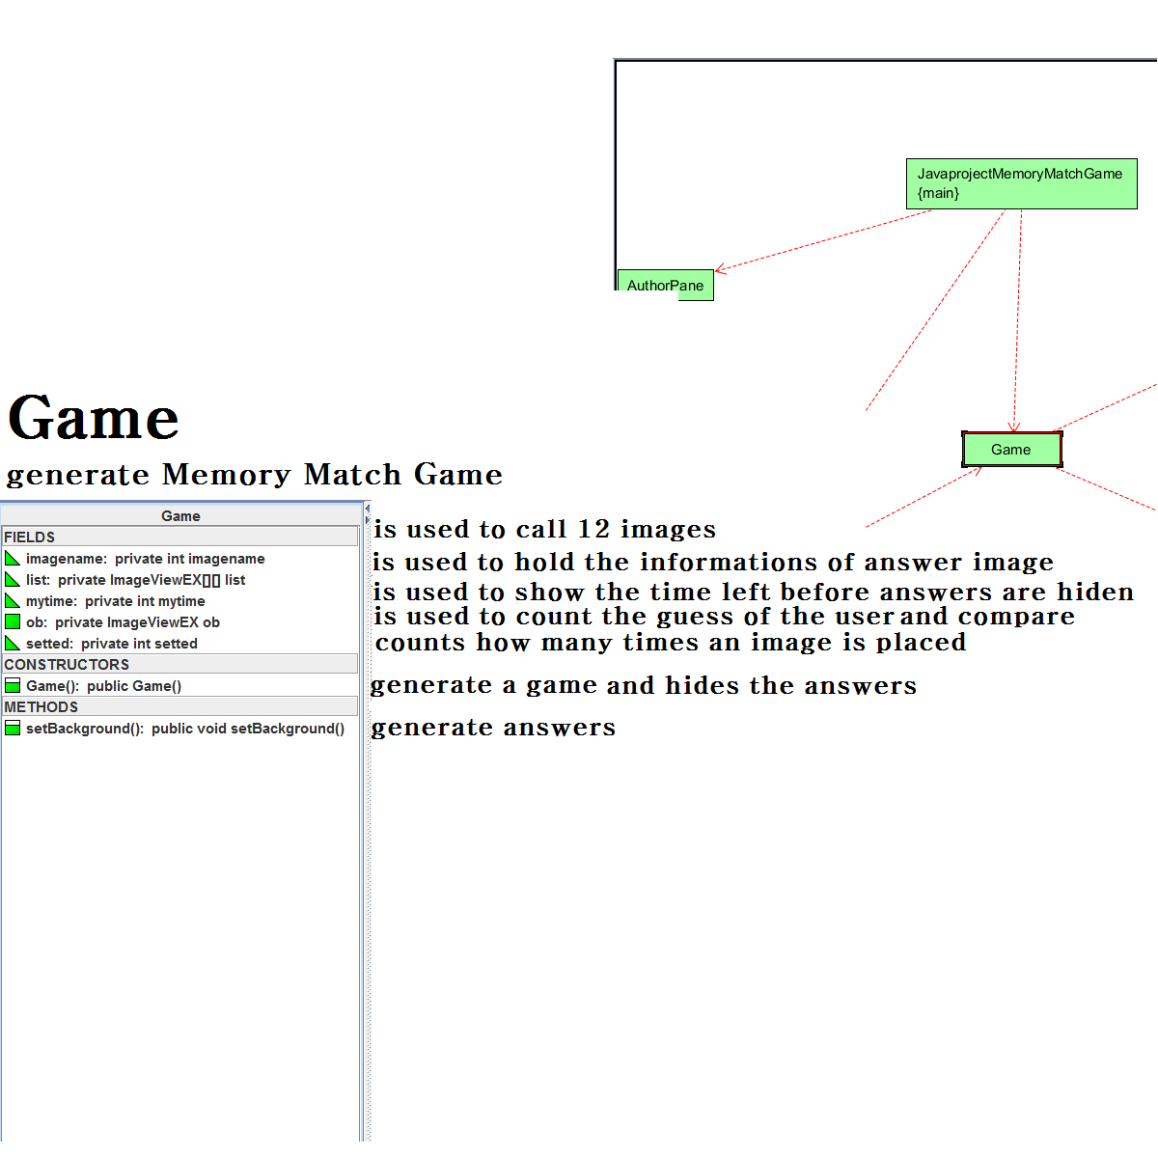
Information about class
Game

Slide 6
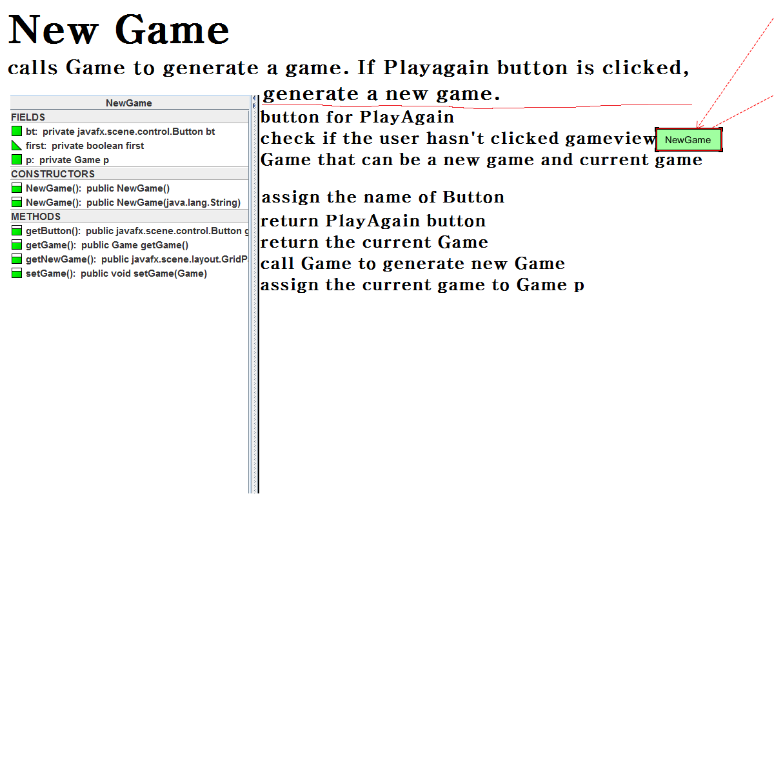
Information about class
NewGame

Slide 7
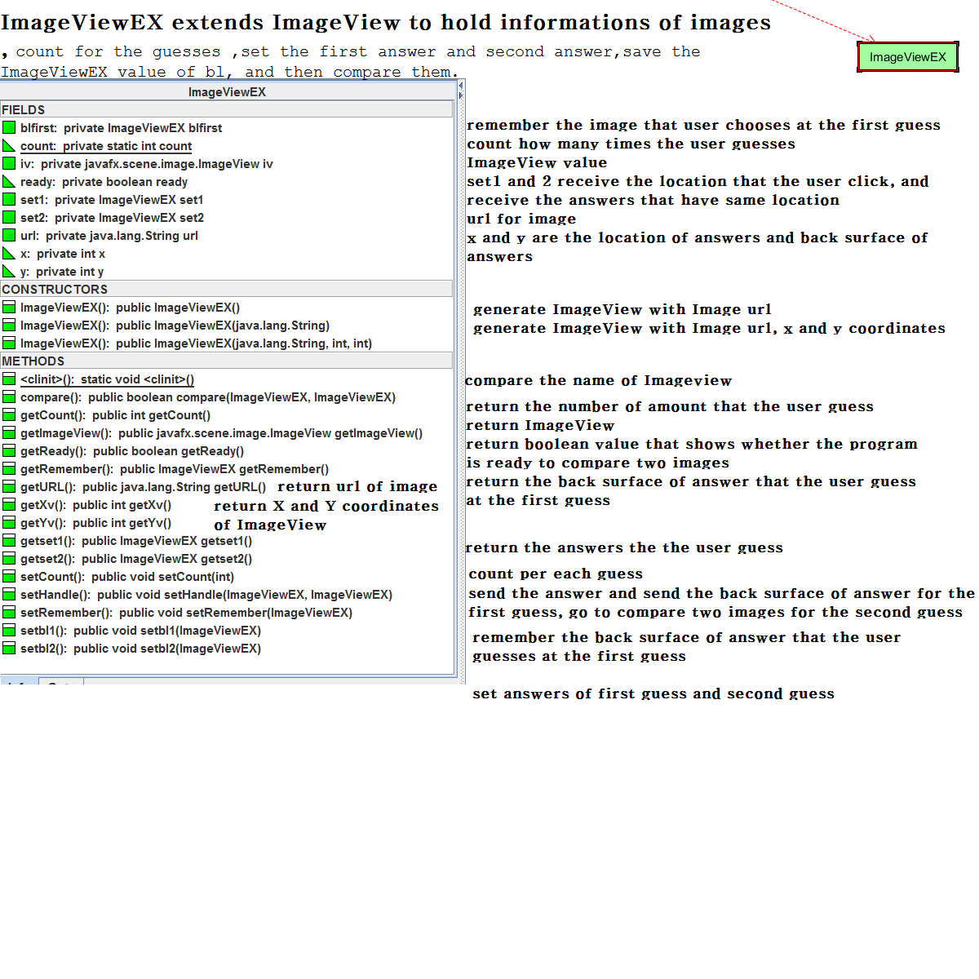
Information about class
ImageViewEX

Slide 8
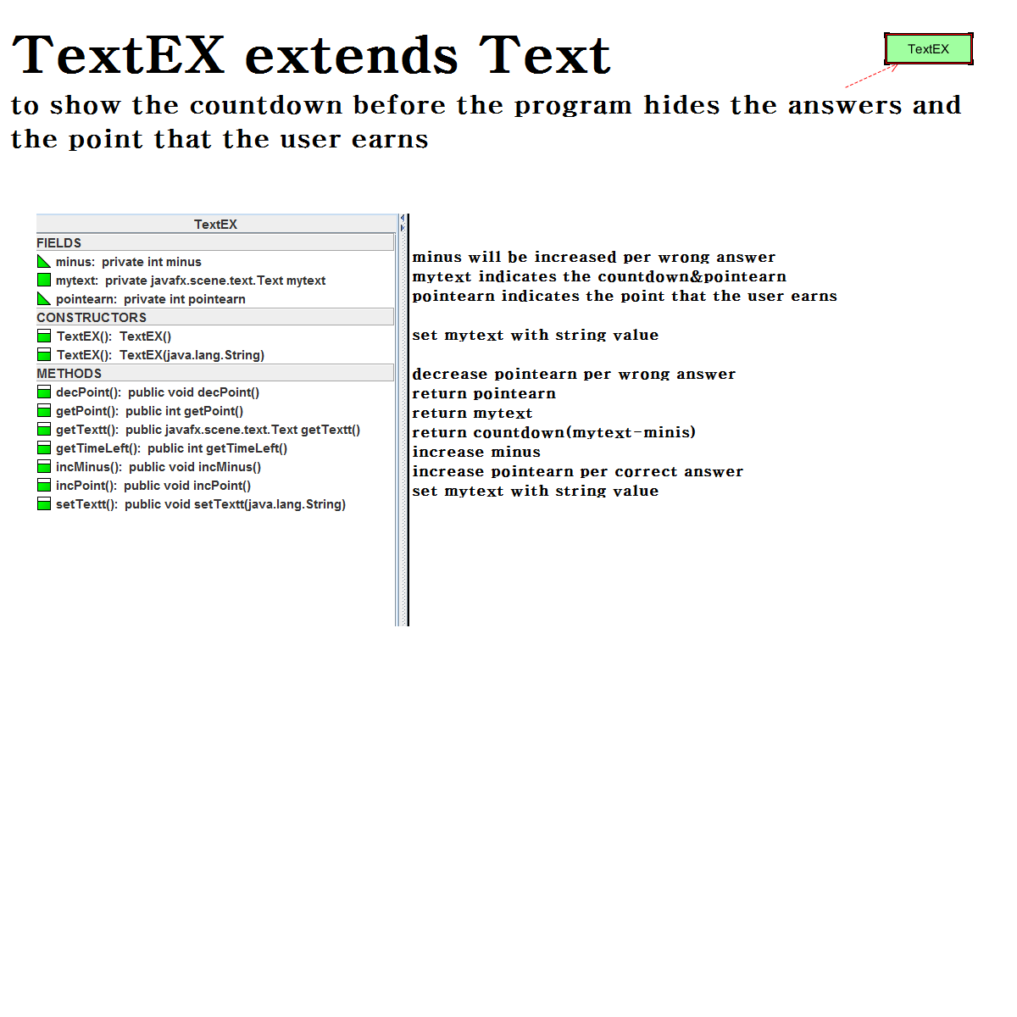
Information about class
TextEX

Slide 9
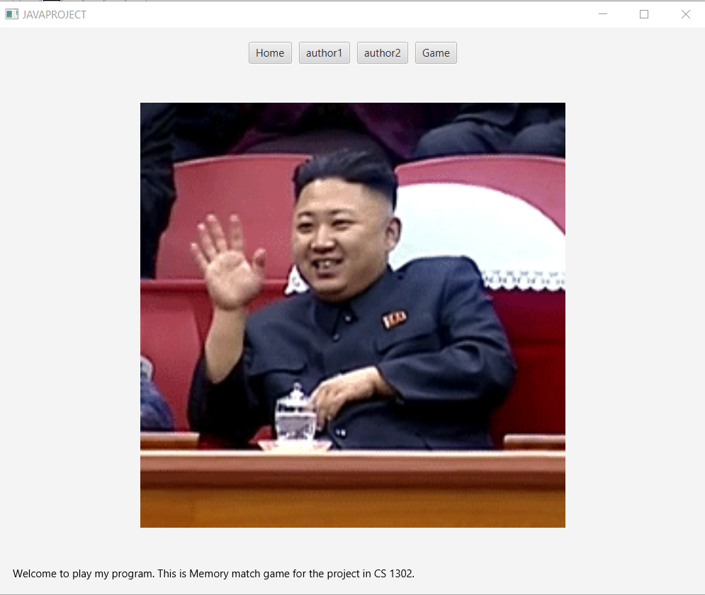
Preview HomeView

Slide 10
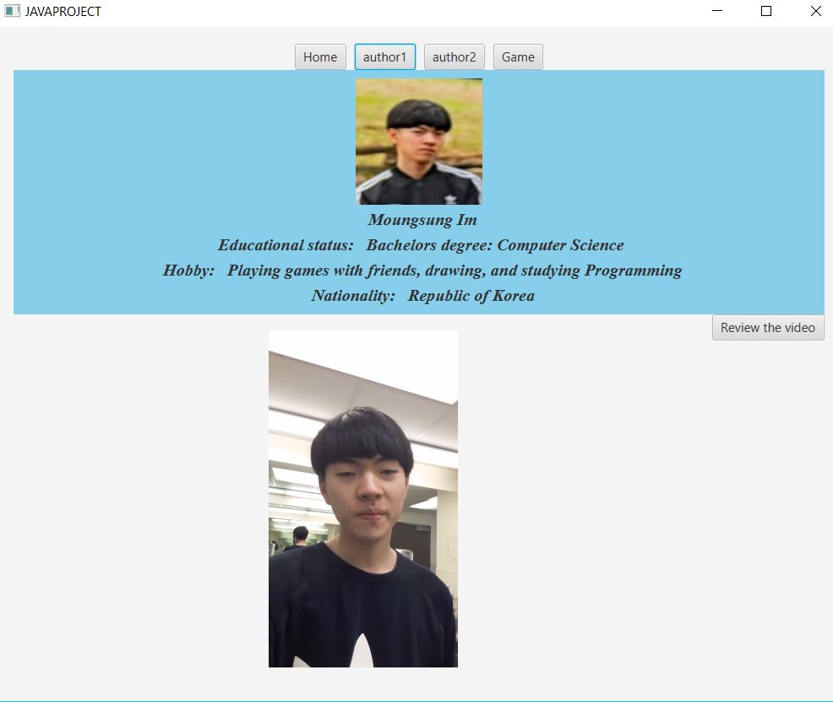

Preview Author 1 & 2 View

Slide 11
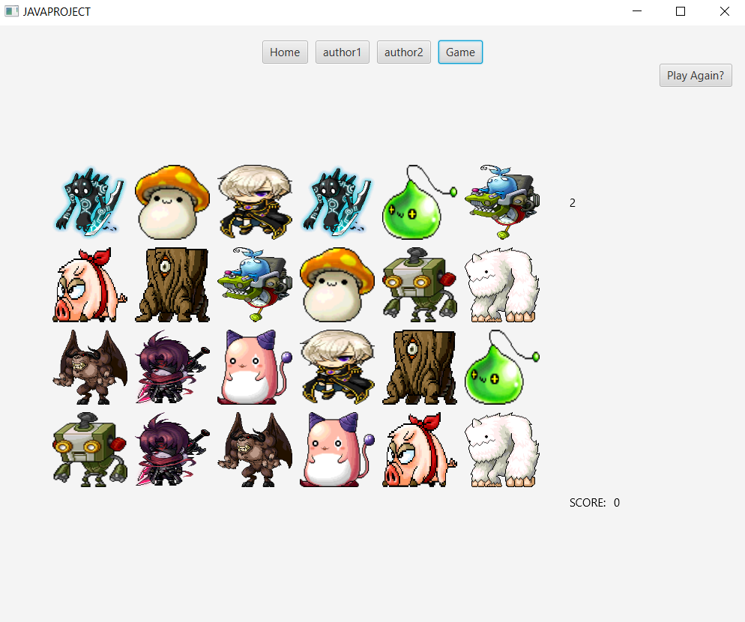
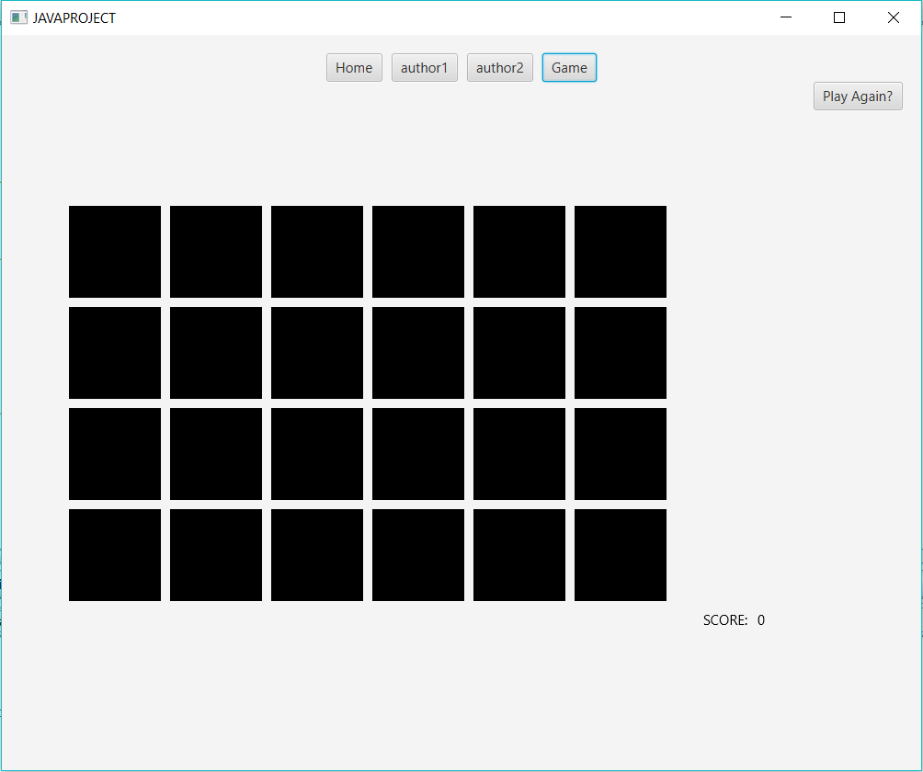
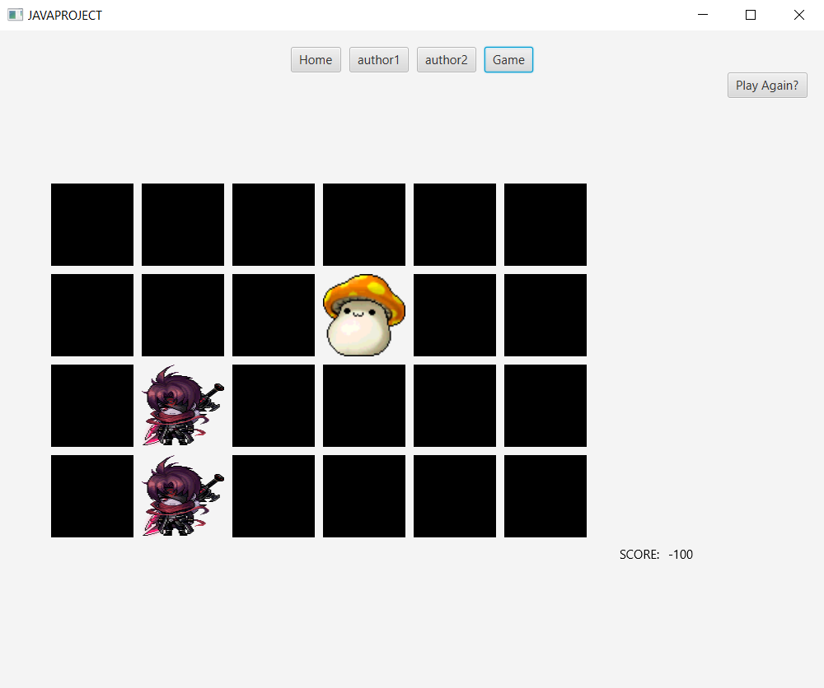
Preview Game View

