Slide 1
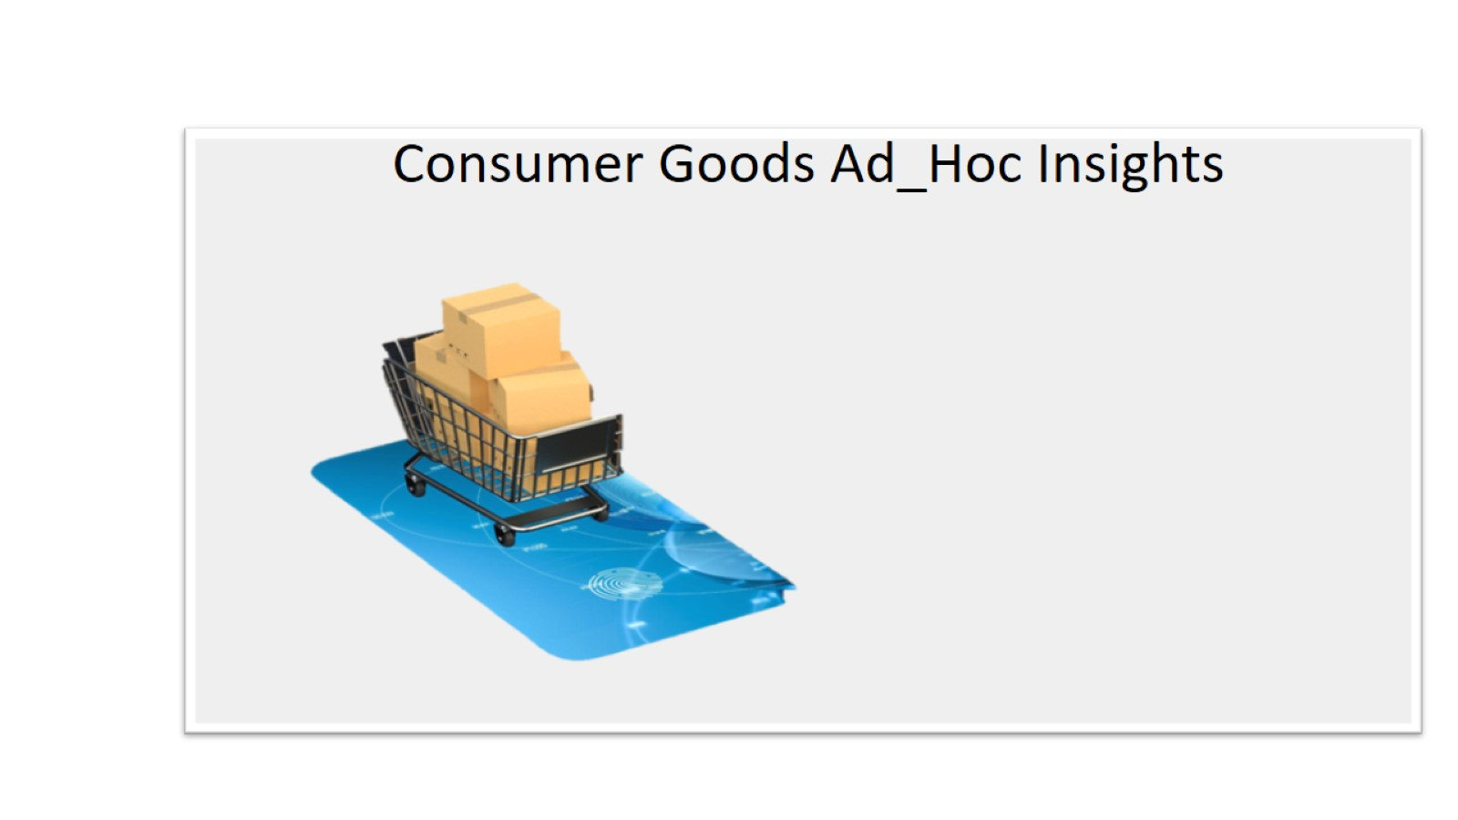

Slide 2
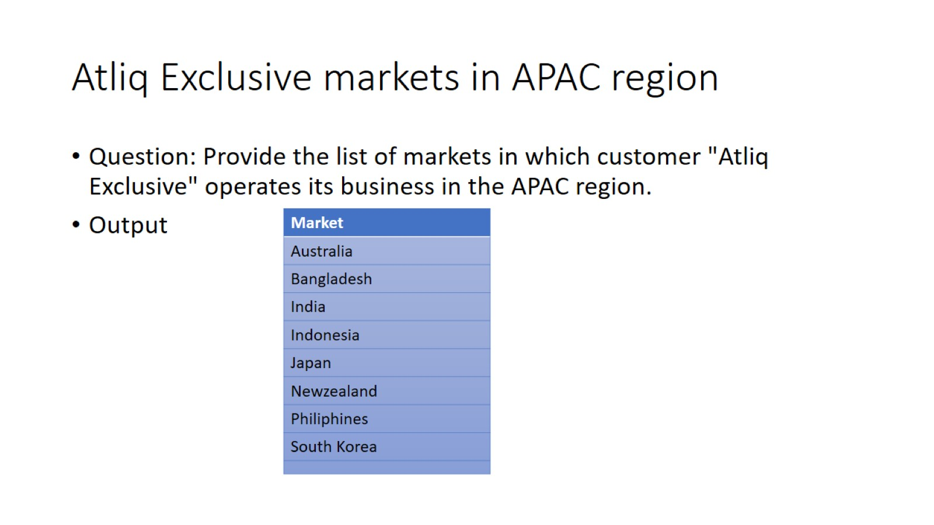
Atliq Exclusive markets in APAC region

Slide 3
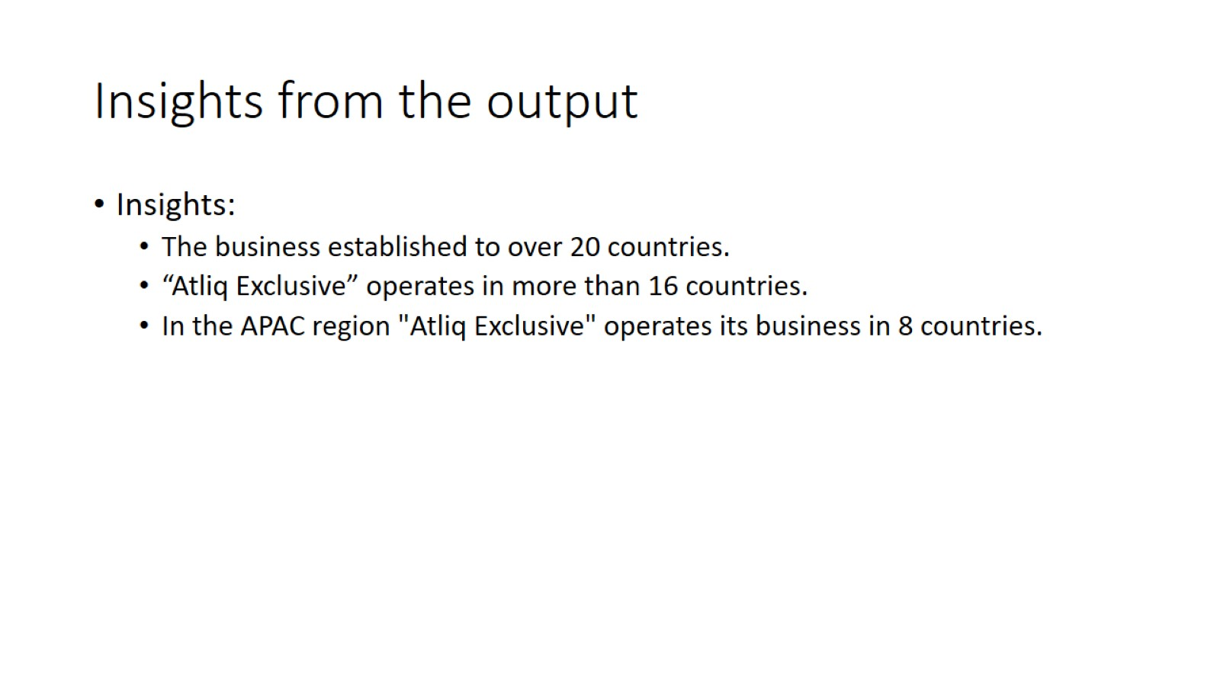
Insights from the output

Slide 4
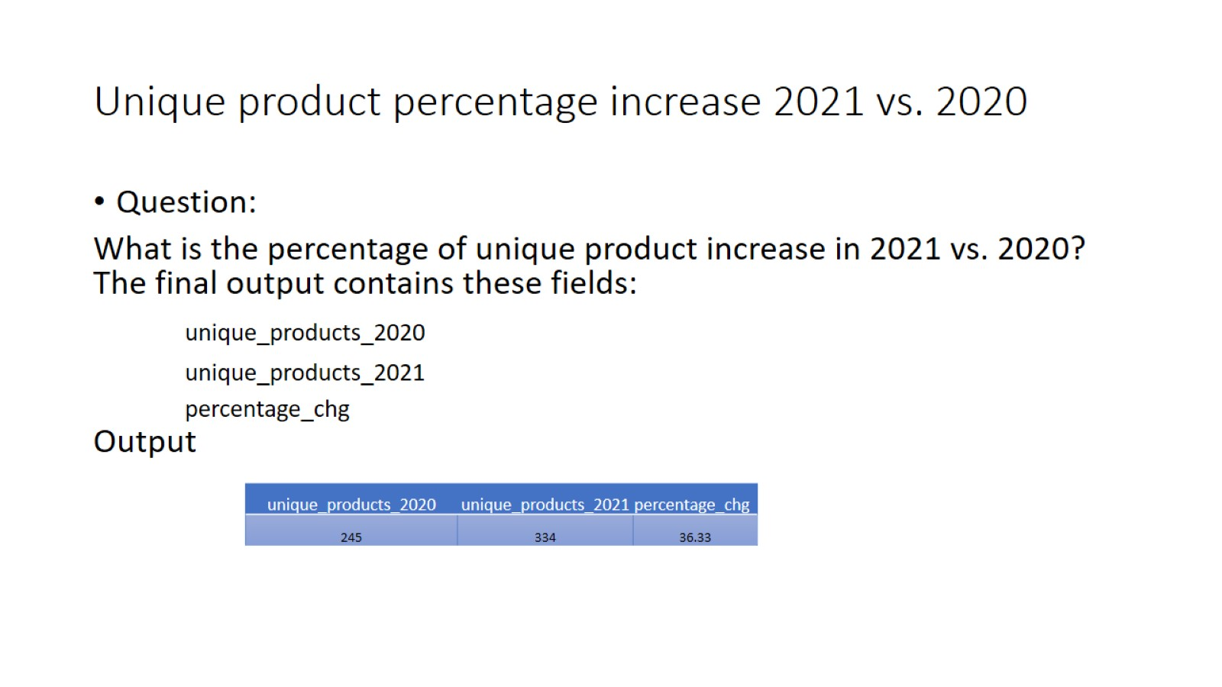
Unique product percentage increase 2021 vs. 2020

Slide 5
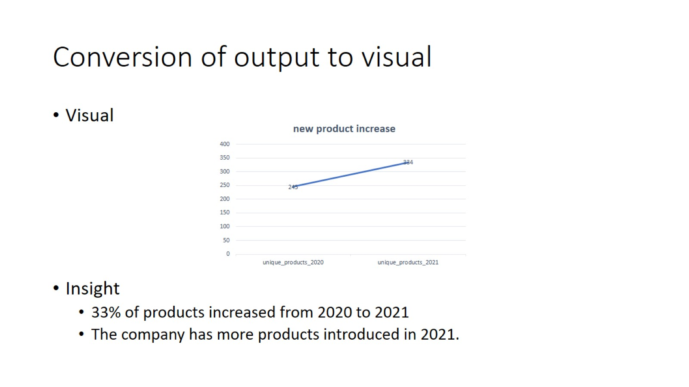
Conversion of output to visual

Slide 6
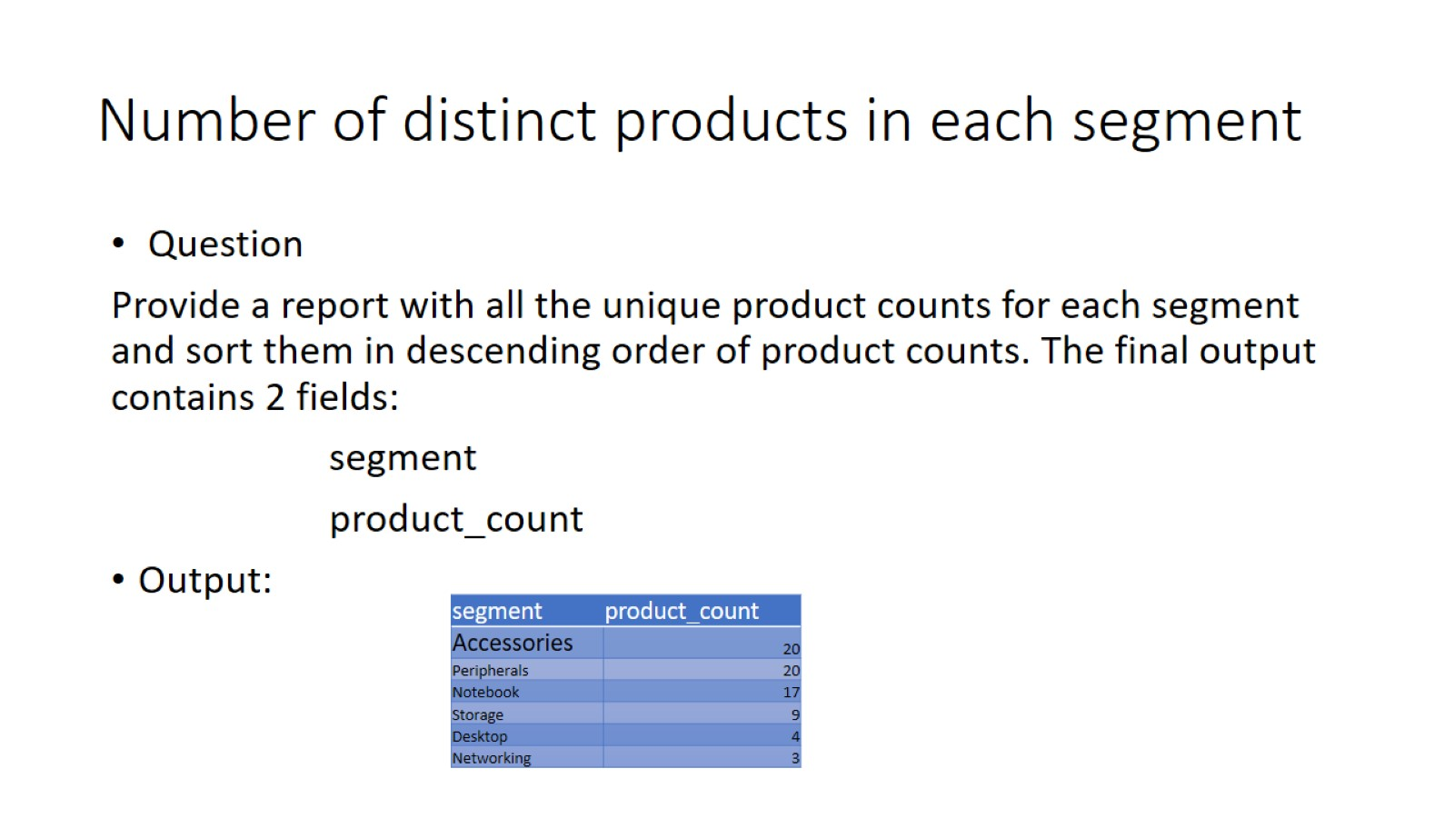
Number of distinct products in each segment

Slide 7
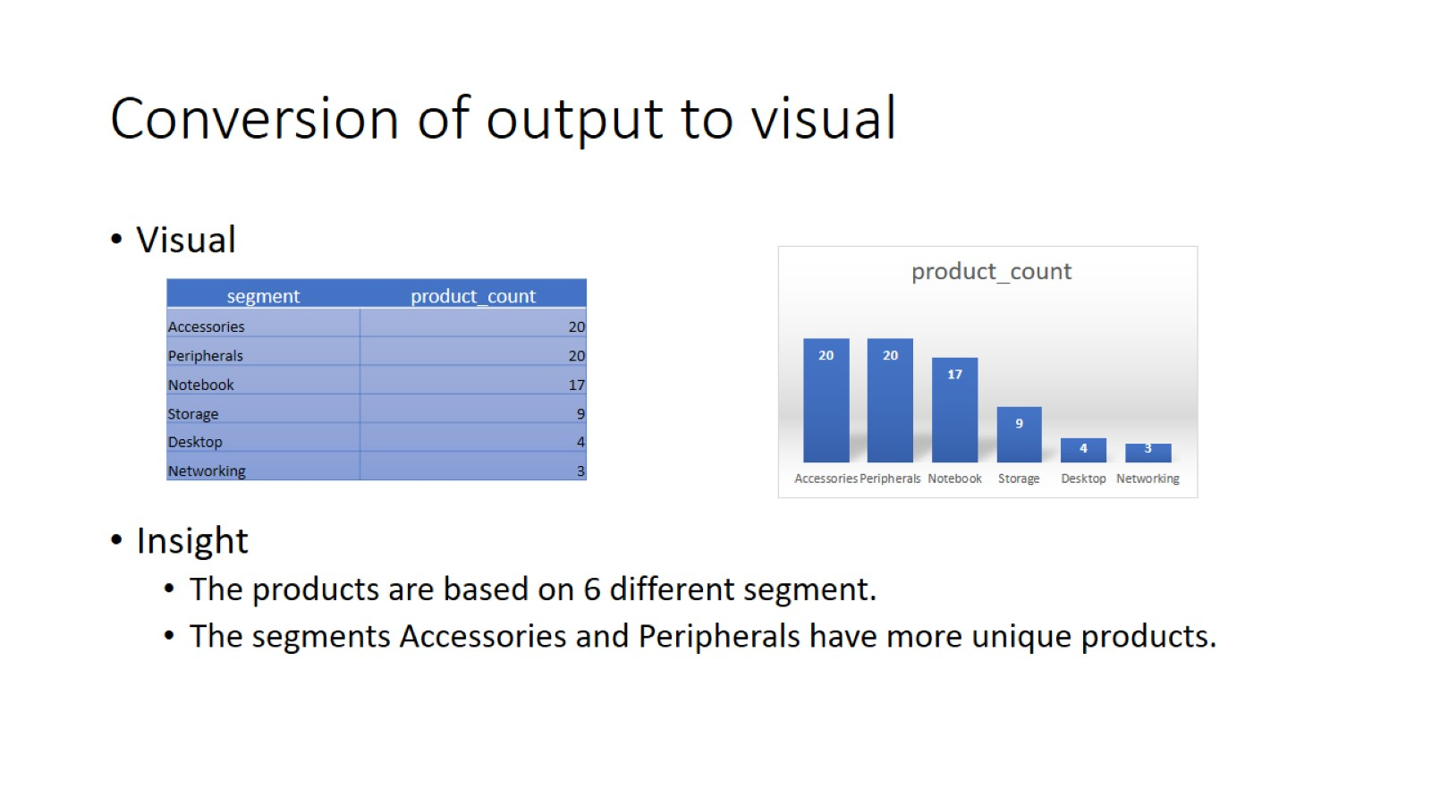
Conversion of output to visual

Slide 8
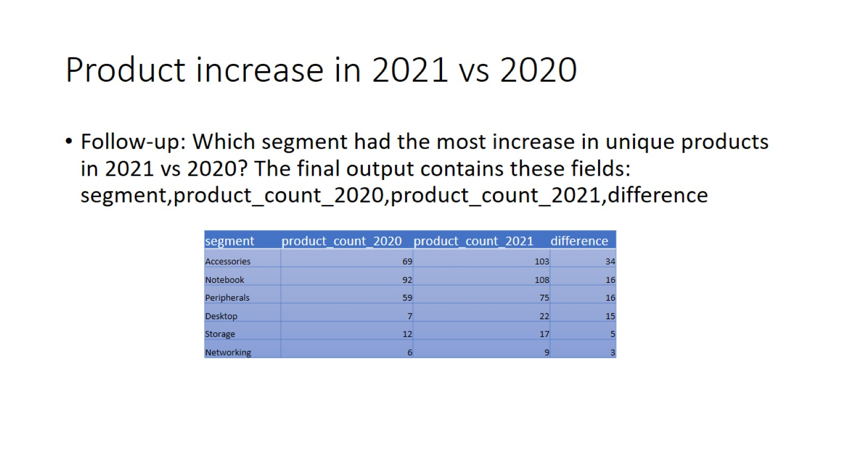
Product increase in 2021 vs 2020

Slide 9
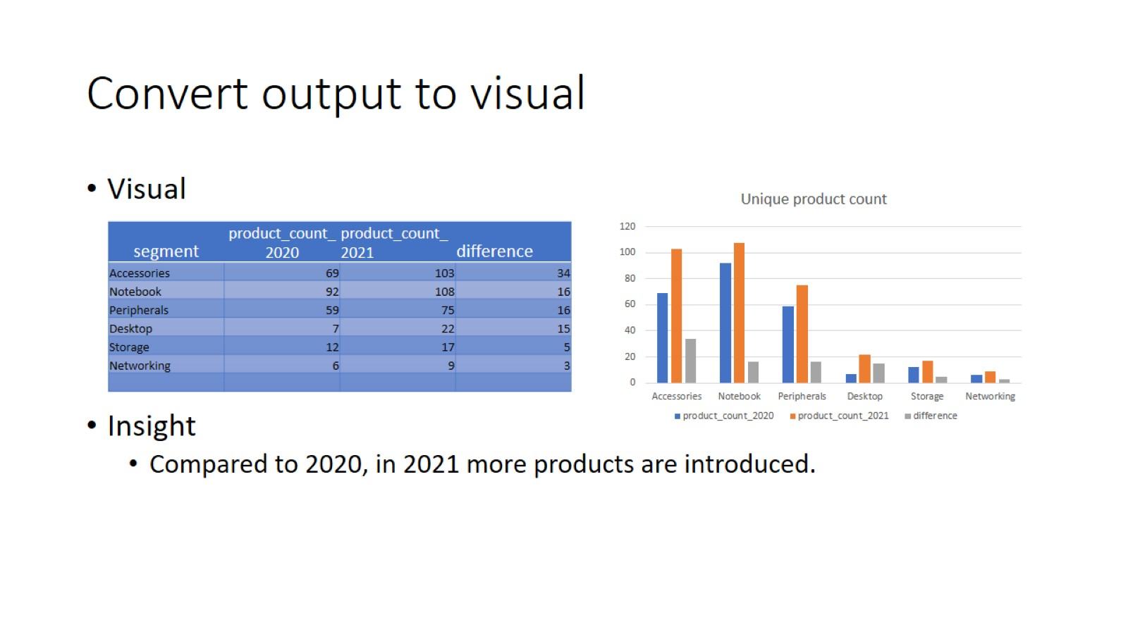
Convert output to visual

Slide 10
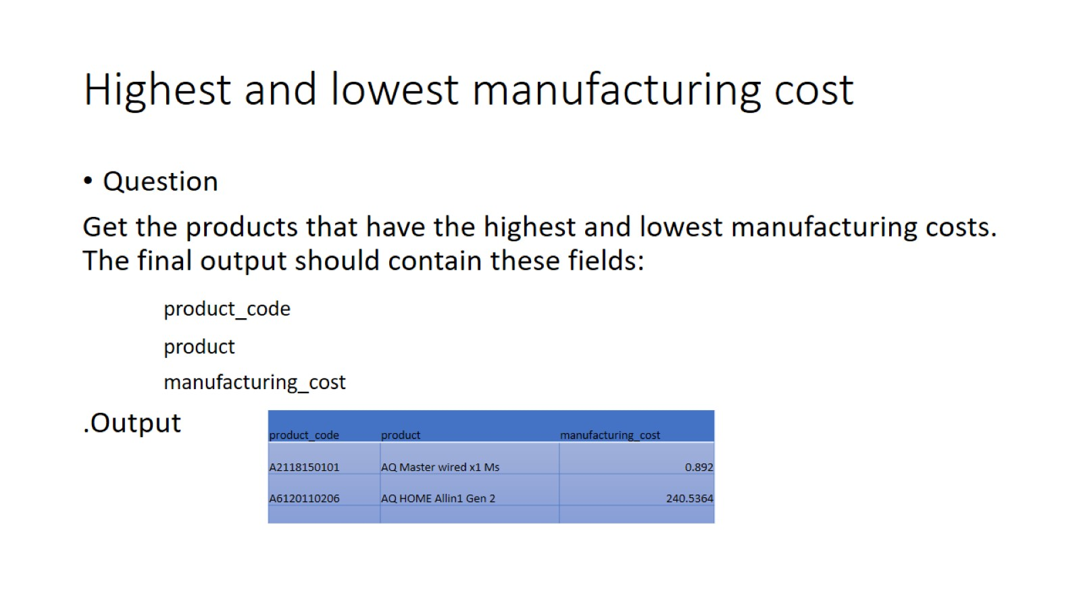
Highest and lowest manufacturing cost

Slide 11
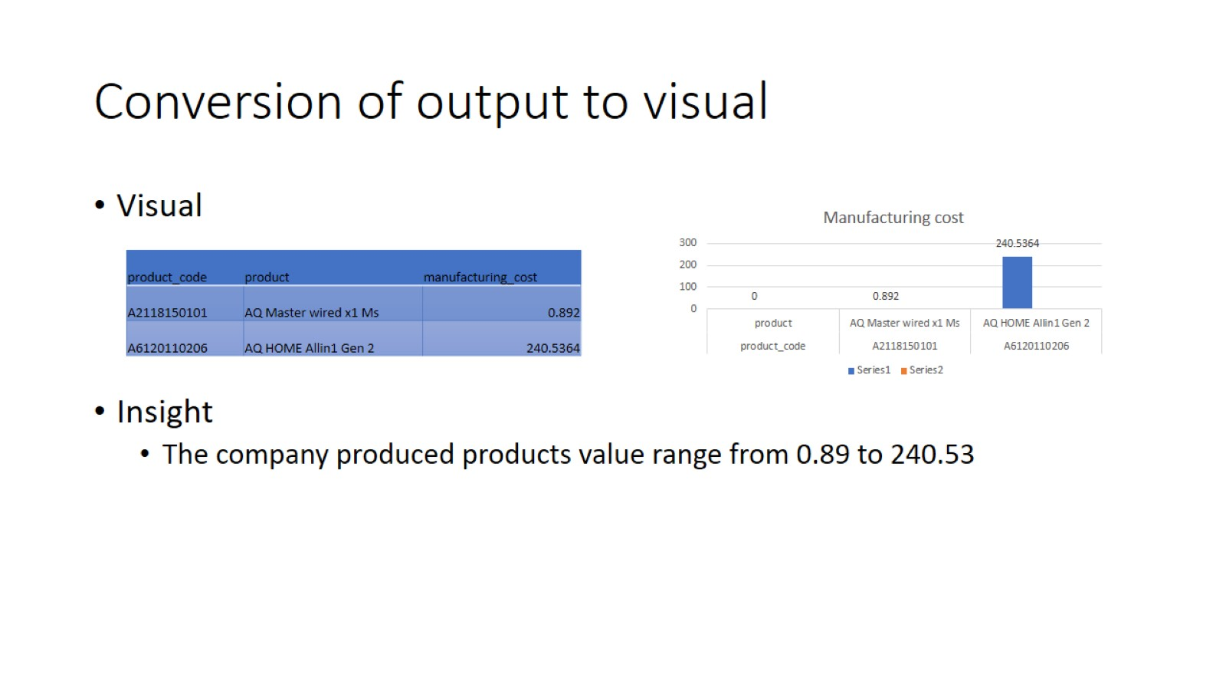
Conversion of output to visual

Slide 12
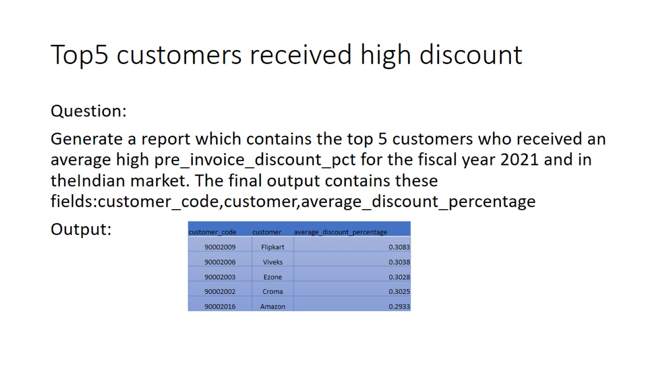
Top5 customers received high discount

Slide 13
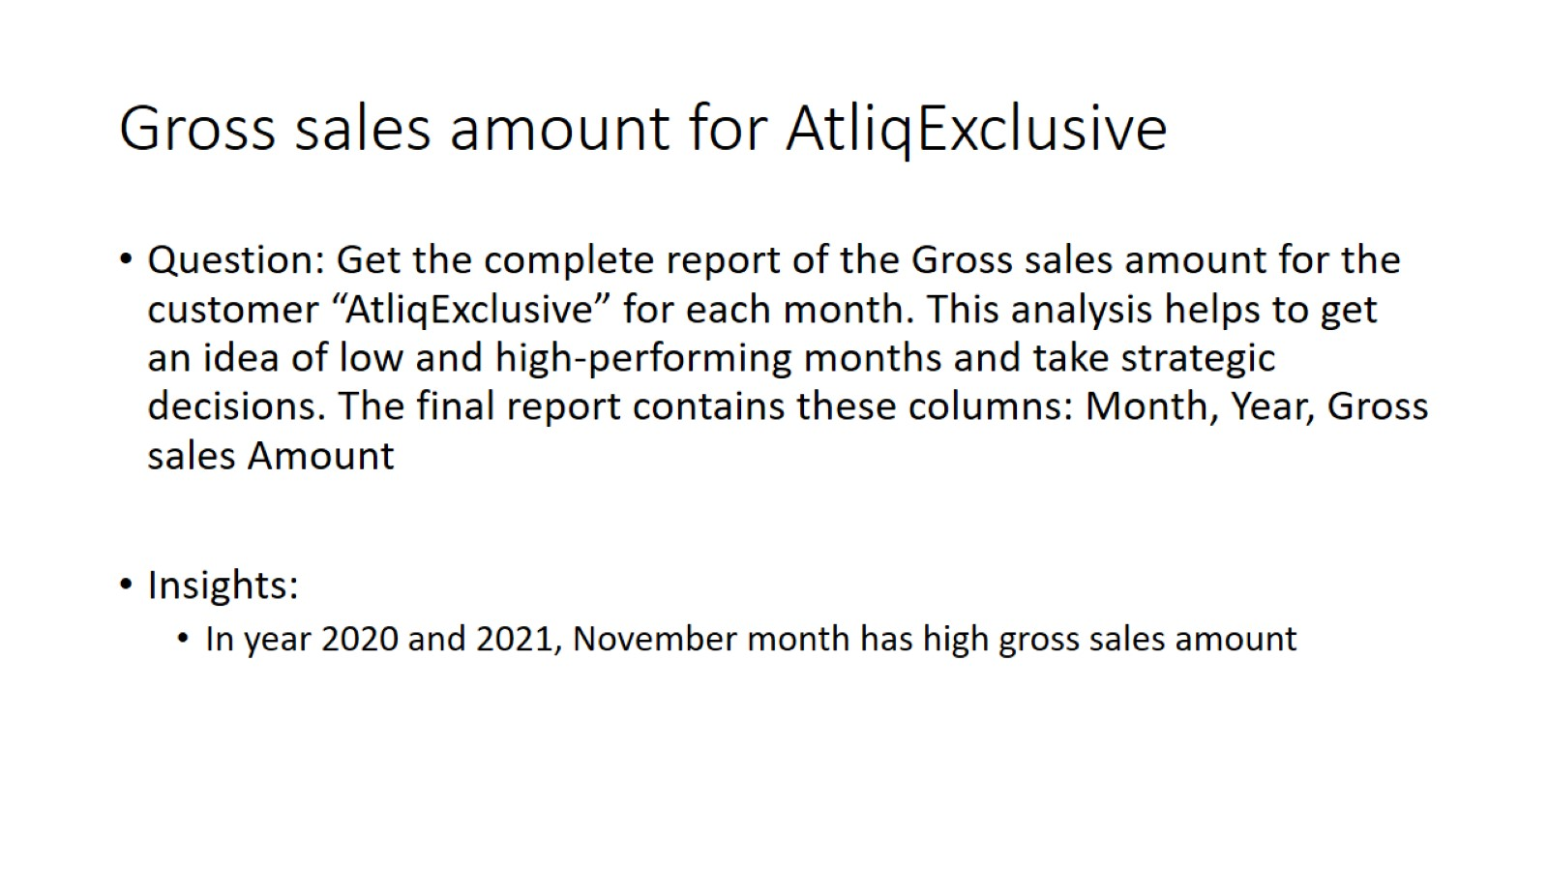
Gross sales amount for AtliqExclusive

Slide 14
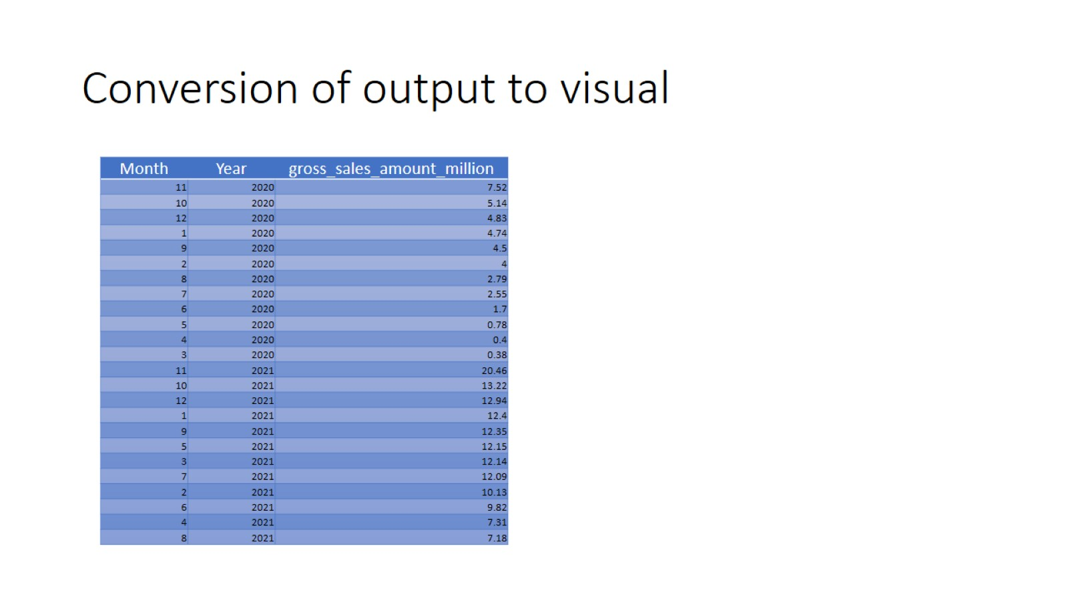
Conversion of output to visual

Slide 15
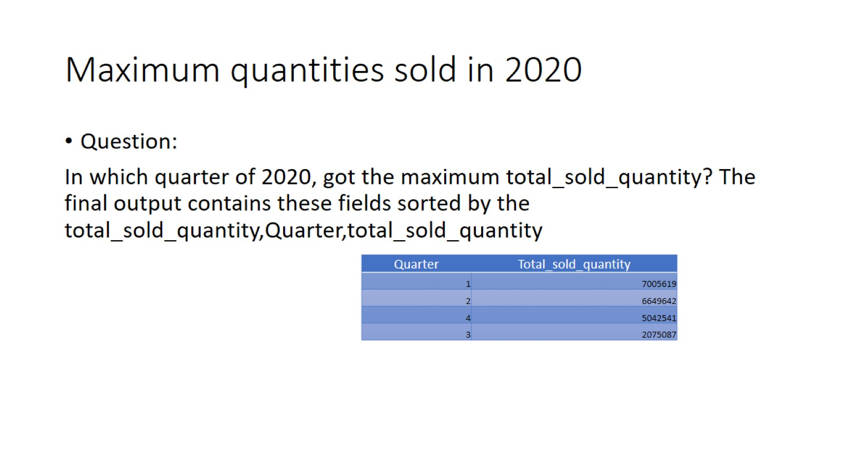
Maximum quantities sold in 2020

Slide 16
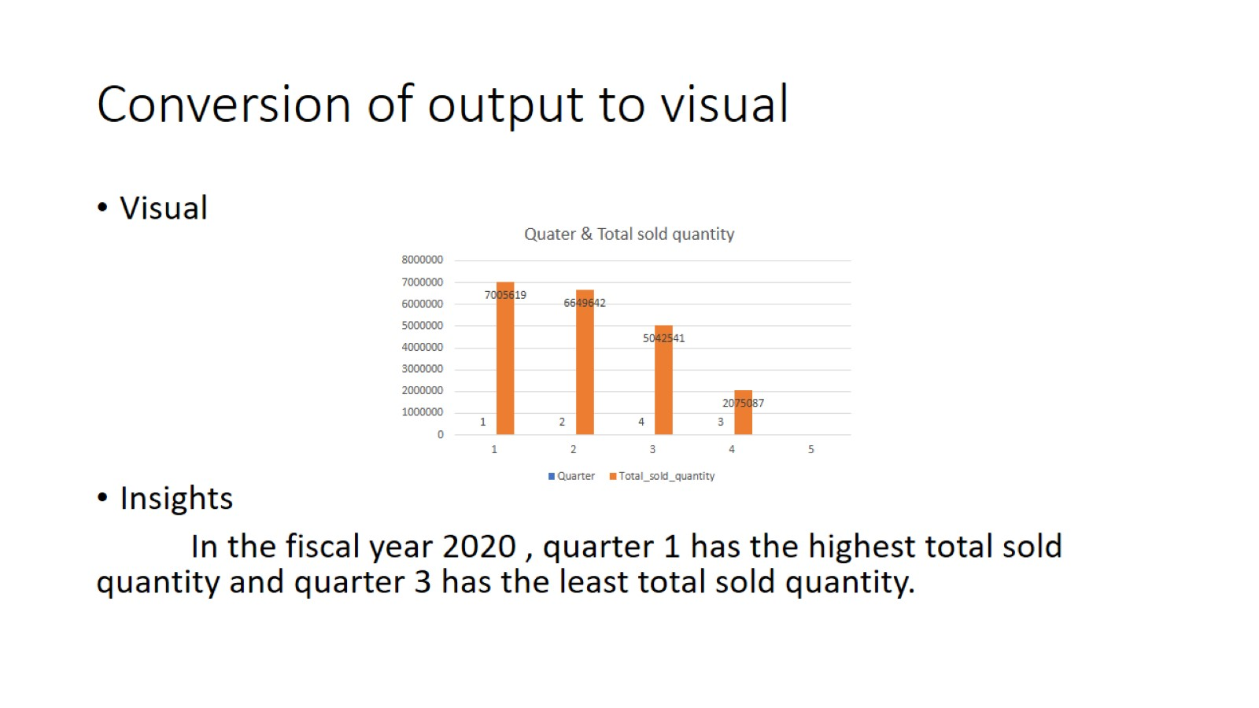
Conversion of output to visual

Slide 17
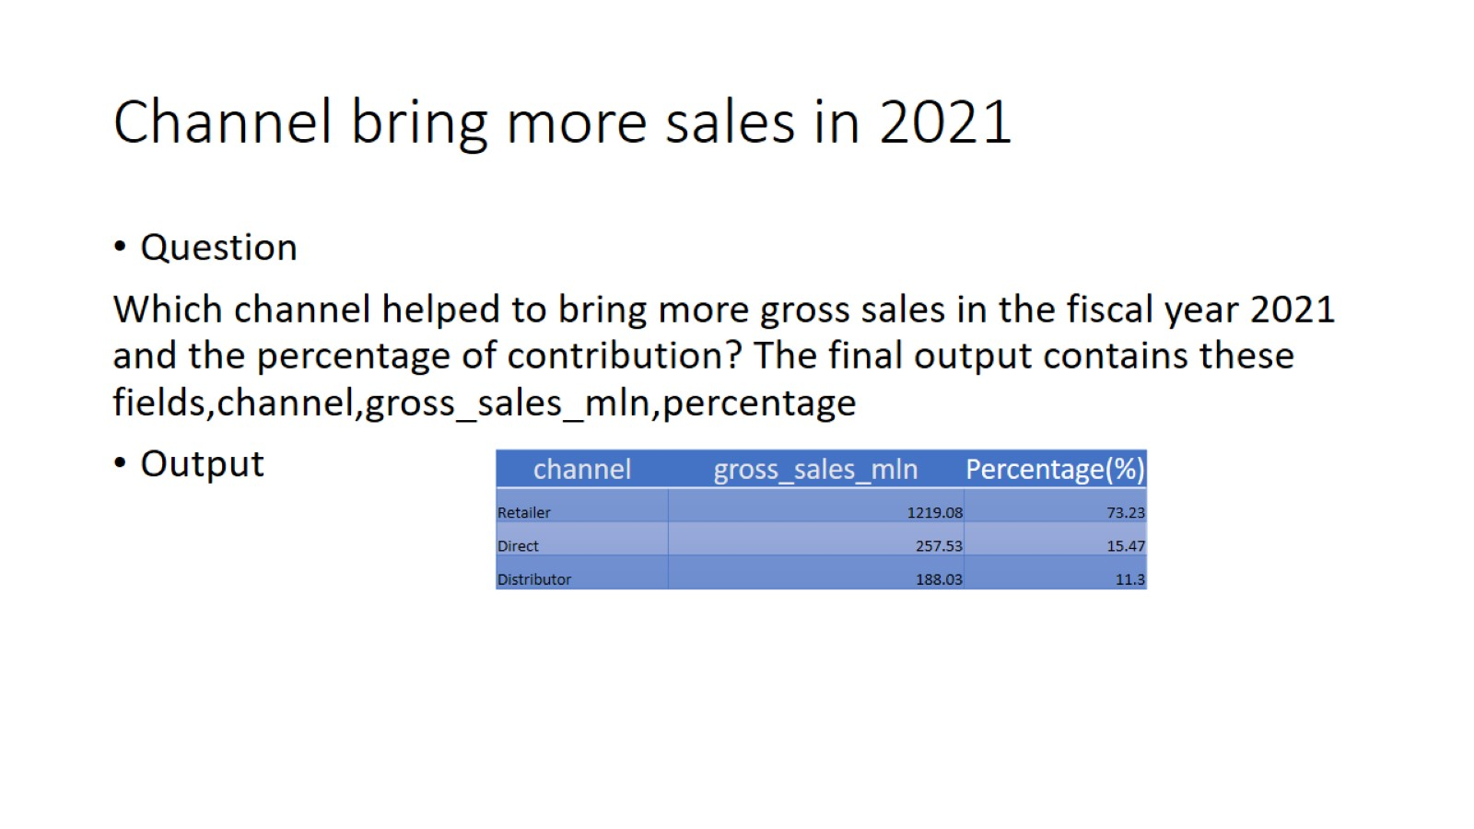
Channel bring more sales in 2021

Slide 18
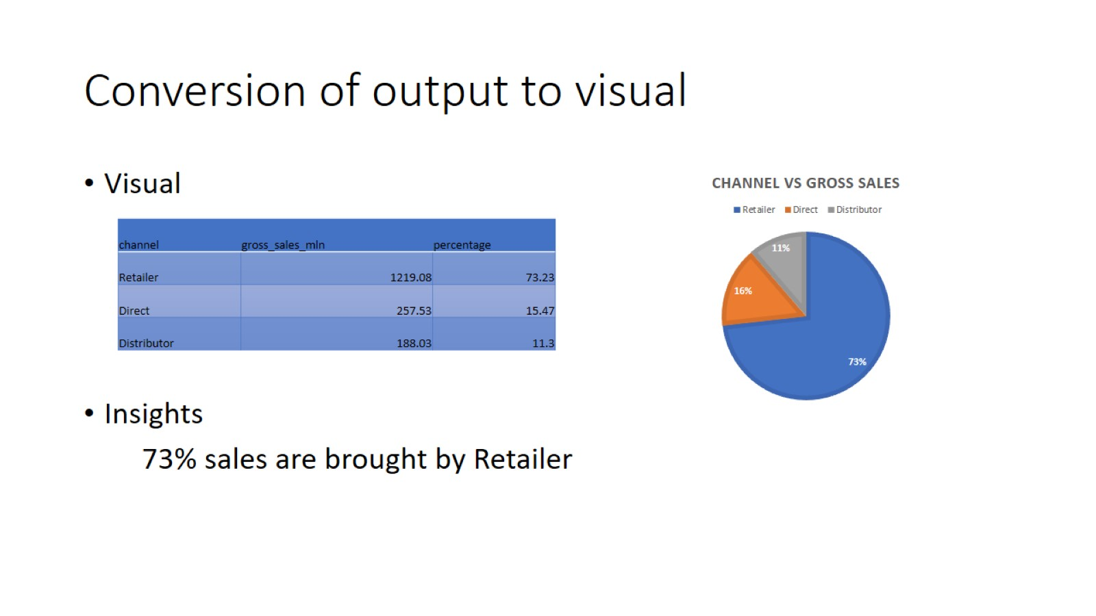
Conversion of output to visual

Slide 19
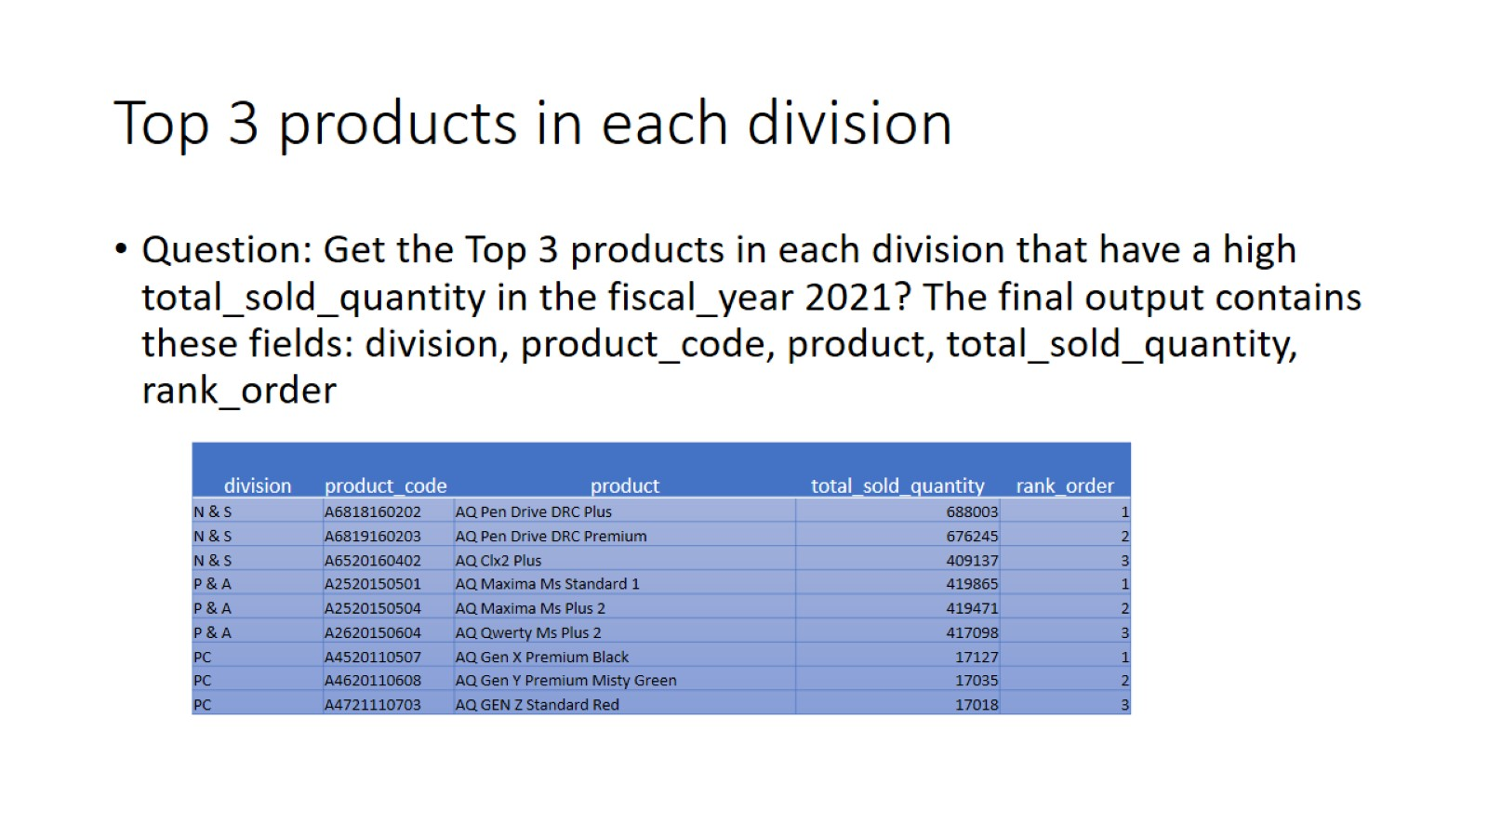
Top 3 products in each division

Slide 20
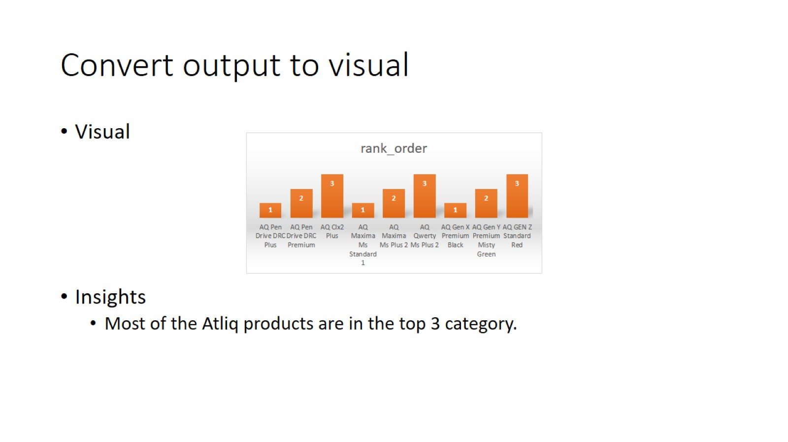
Convert output to visual

