Slide 1

Good Cabs Revenue Analysis
Presented by
Sunitha Madhavadhas

Slide 2
Table of Content
Company Overview
Goals
Adhoc Business Request
Primary Analysis
Dashboard
Recommendations

Slide 3
Good Cabs Company Overview
A two-year-old cab service company operating in 10 tier-2 cities across India.
6 Business cities Chandigargh, Coimbatore, Indore, Lucknow, Surat, Vadora.
4 Tourist cities Jaipur, Kochi, Mysore, Visakhapatnam.
Committed to supporting local drivers
Ambitious performance targets for 2024
Notes:
20/12/2024

Slide 4
Goal
Provide Insights to Chief of Operations in Transportation Domain
Design a dashboard with actionable insights to enhance the cab service experience for customers and optimize performance for the business.
Provide sql queries for the adhoc requests.

Slide 5

Adhoc Business Request
Notes:
20/12/2024

Slide 6
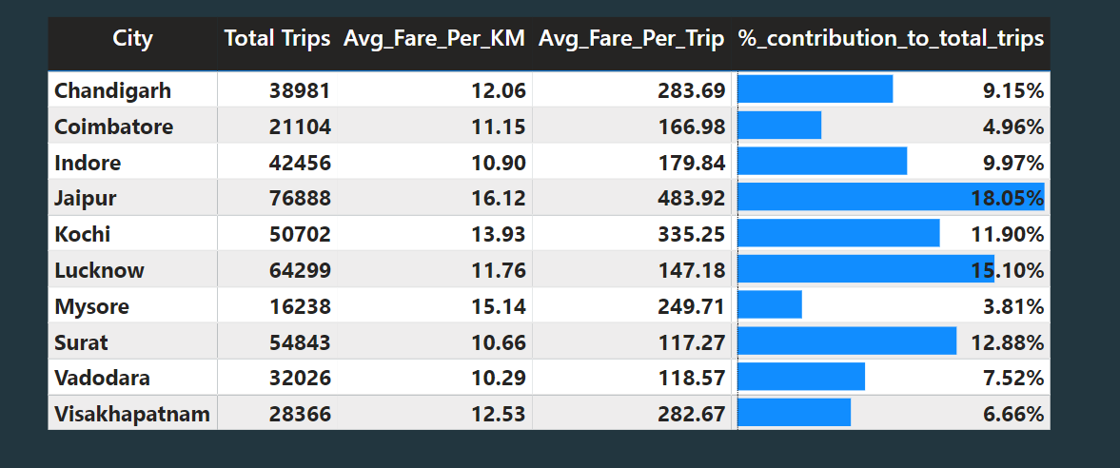
1 City-level Fare and Trip Summary Report
Notes:
20/12/2024

Slide 7
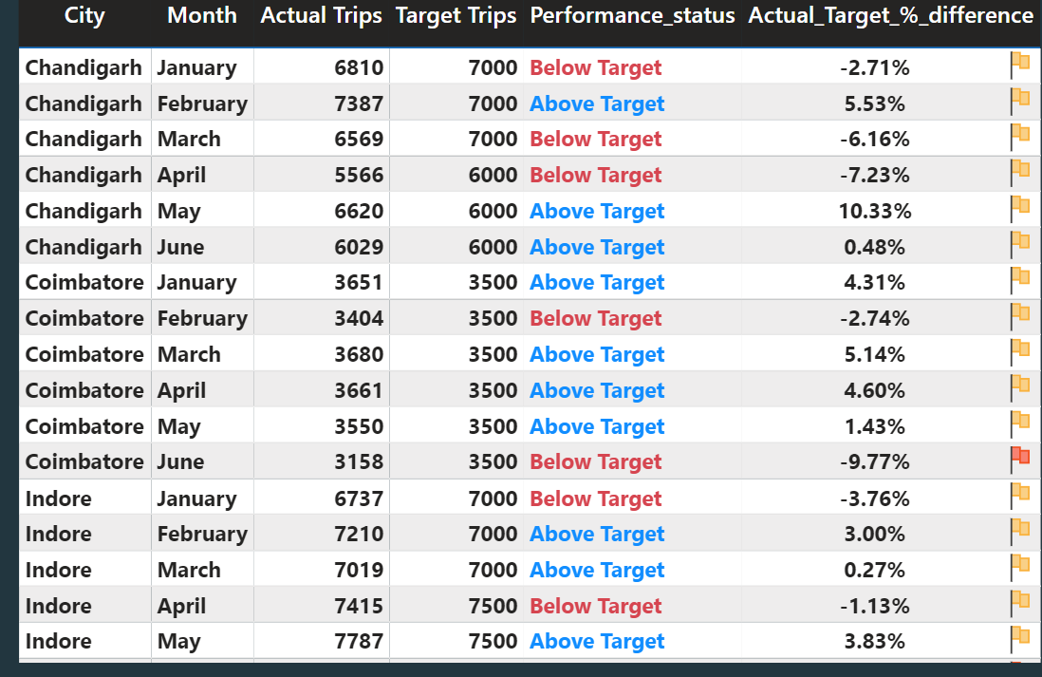
2.Monthly City-Level Trips Target Performance Report
Notes:
20/12/2024

Slide 8
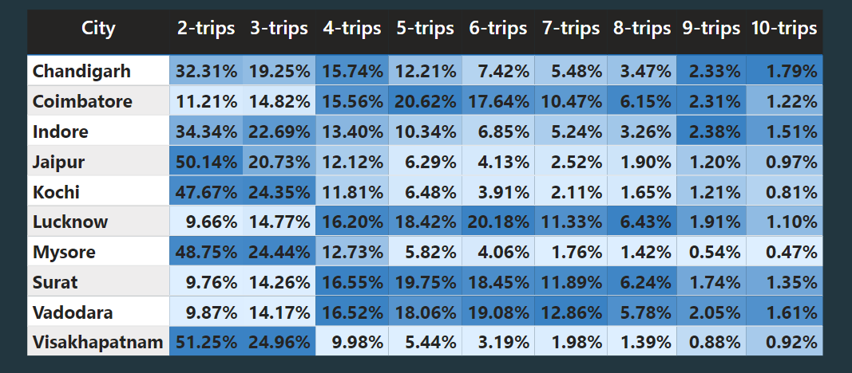
3.City-Level Repeat Passenger Trip Frequency Report
Notes:
20/12/2024

Slide 9
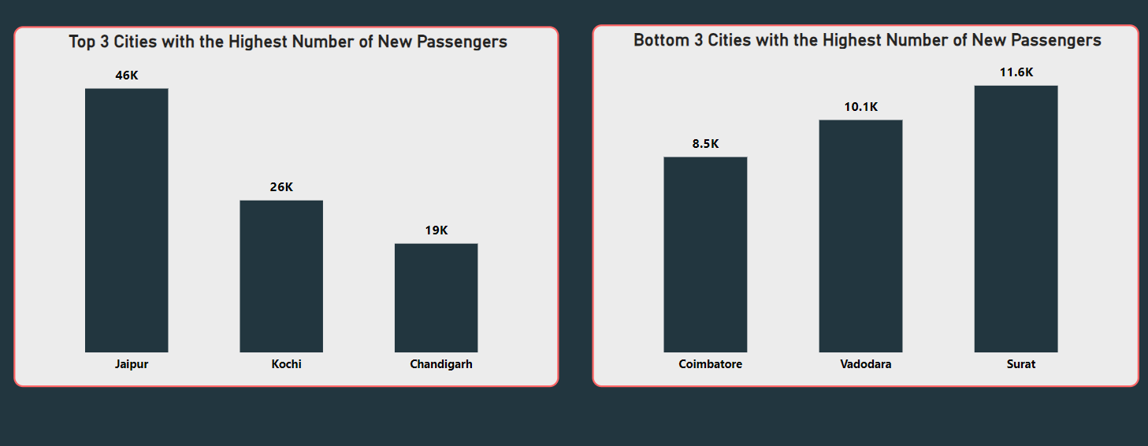
4.Identify Cities with Highest and Lowest New Passengers
Notes:
20/12/2024

Slide 10
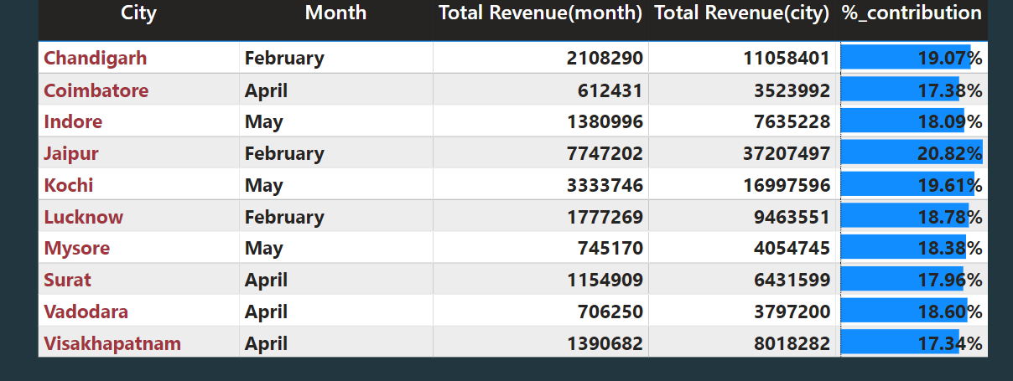
5.Identify Month with Highest Revenue for Each City
Notes:
20/12/2024

Slide 11
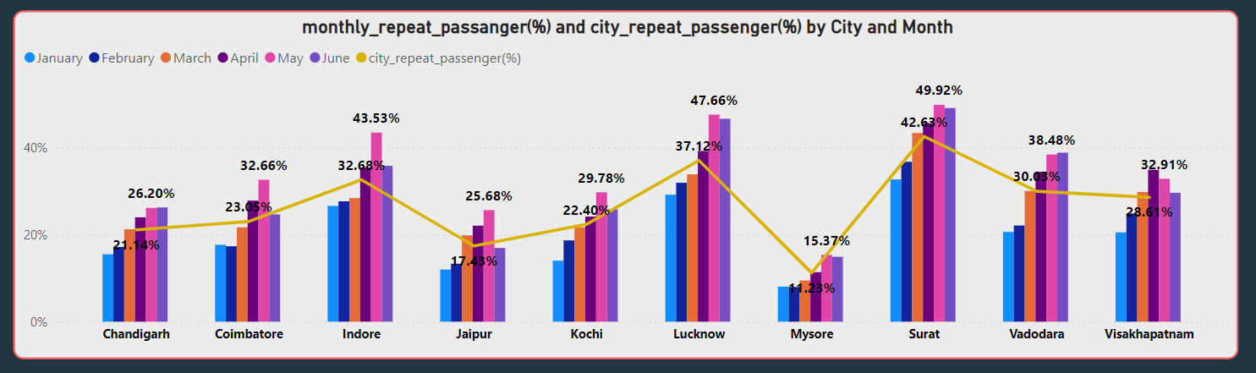
6. Repeat Passenger Rate Analysis
Notes:
20/12/2024

Slide 12
Primary Analysis
Notes:
20/12/2024

Slide 13
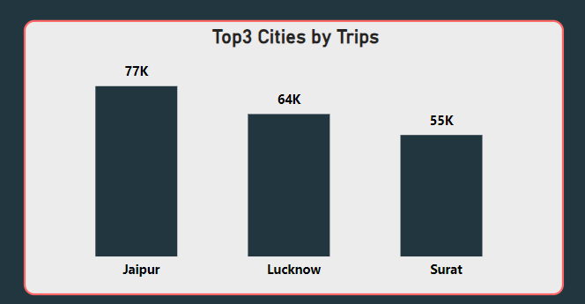
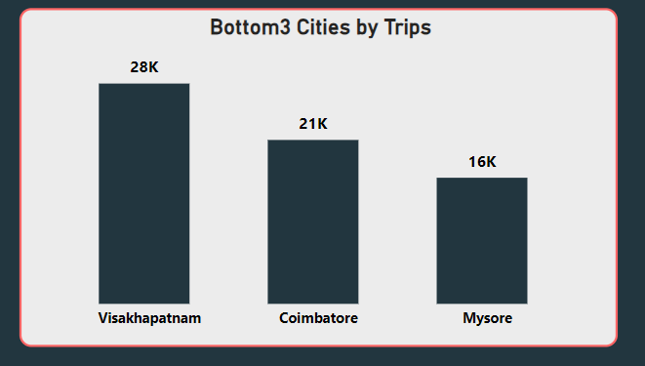
1.Top and Bottom performing Cities
Insight:
Jaipur(77k), Lucknow(64k) and Surat(55k) are the top3 cities
Mysore(16k), Coimbatore(21k), and Visakhapatnam(28k) are among the bottom3 least contributing cities out of the ten under consideration.

Slide 14
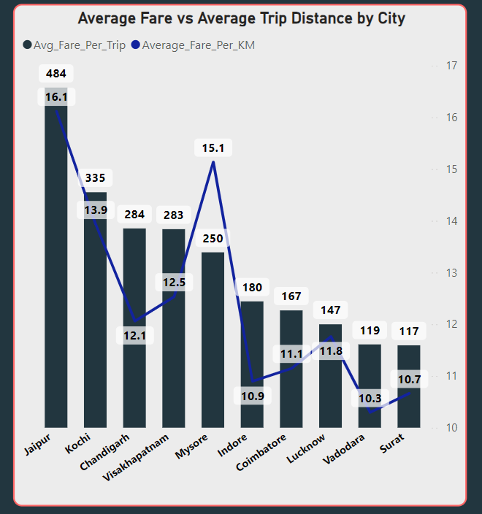
2. Average Fare per Trip by City
Insight:
Jaipur has the highest average fare per trip (Rs.484 per trip).
Surat has the lowest average fare per trip(Rs117 per trip).
Jaipur has highest average fare per km and Mysore has the second average fare per km.
Notes:
20/12/2024

Slide 15
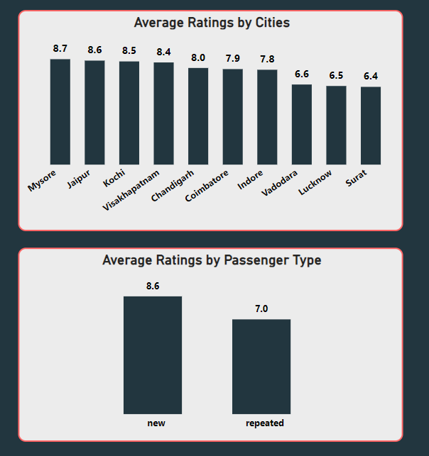
3. Average Ratings by City and Passenger Type
Insight :
Mysore, Jaipur, Kochi have the highest passenger rating and Vadodara, Lucknow, Surat have the lowest rating.
New Passengers gave high ratings compared to repeated passengers.
while Vadodara has the lowest rating.

Slide 16
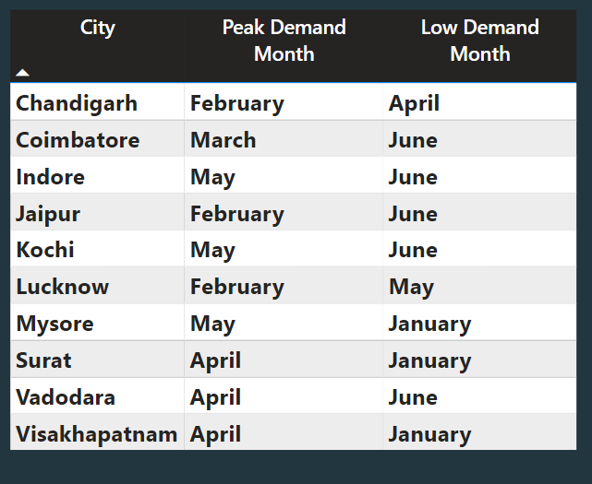
4. Peak and Low Demand Months by City
Insight :
February ,April, May were the peak demand months because April, May are the summer holiday months.
June was the low demand month followed by January.
This analysis will help Good cabs understand seasonal patterns and adjust resources accordingly.

Slide 17
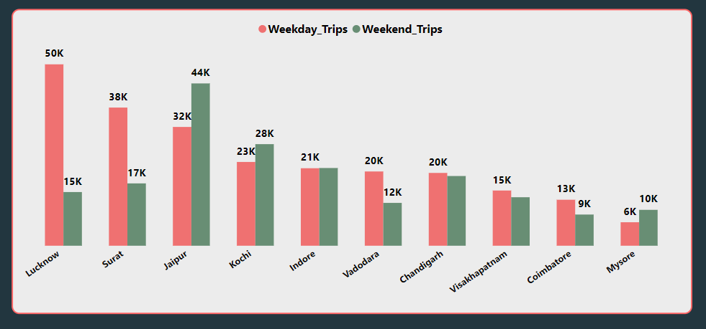
5. Weekend vs Weekday Trip Demand by City
Insight :
Weekday trip demand cities
  Lucknow
  Surat
  Vadora
  Chandigargh
  Visakhapatnam
  Coimbatore
Weekend trip demand cities
  Jaipur
  Kochi
  Indore
  Mysore

Slide 18
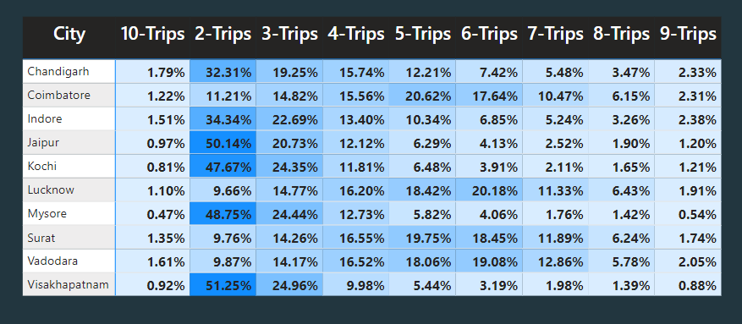
6. Repeat Passenger Frequency and City Contribution Analysis
Insight :
Cities contributing to higher trip frequencies are Jaipur, Kochi, and Lucknow, with Jaipur showing particularly high frequencies due to its tourism-driven demand.
Tourism-focused cities show spikes in repeat trip frequencies while business-focused cities exhibit consistent repeat trips due to professional or local commuting patterns.

Slide 19
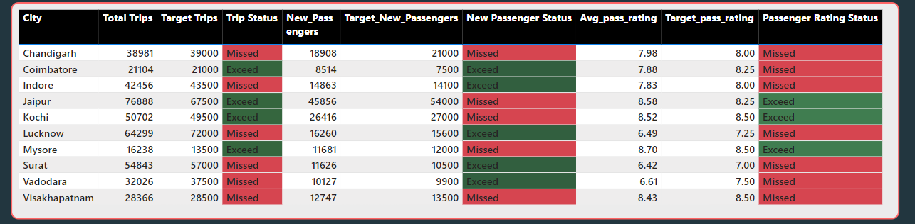
7.Monthly target Achievement Analysis
Insight :
Total trips – Coimbatore, Jaipur, Kochi and Mysore exceed their target trips.
New passengers - For business cities except Chandigarh everyone Achieved their target. None of the tourist cities were able to achieve their target.
Avg Passenger Rating – For tourist places except Visakhapatnam all cities were able to achieve their target. None of the business cities were able to achieve their target.

Slide 20
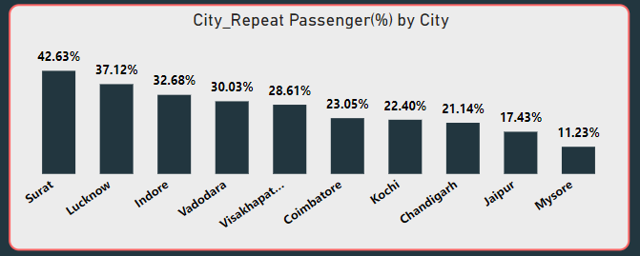
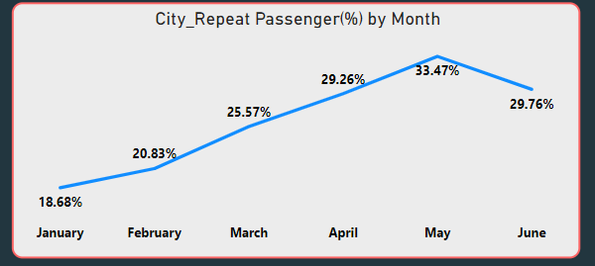
8.Highest and Lowest Repeat Passenger Rate(RRR %) by city and month
Insight :
Cities:
  Surat followed by Lucknow were top 2 cities with highest RPR%.
  Bottom 2 cities: Mysore and Jaipur were the bottom 2 cities with lowest RPR%.
Month:
  May has highest RPR% (33.47%). April and June has almost equal RPR%.
  January has the lowest RPR%
  January has the lowest RPR% (18.68%).

Slide 21
Dashboard
Notes:
20/12/2024

Slide 22
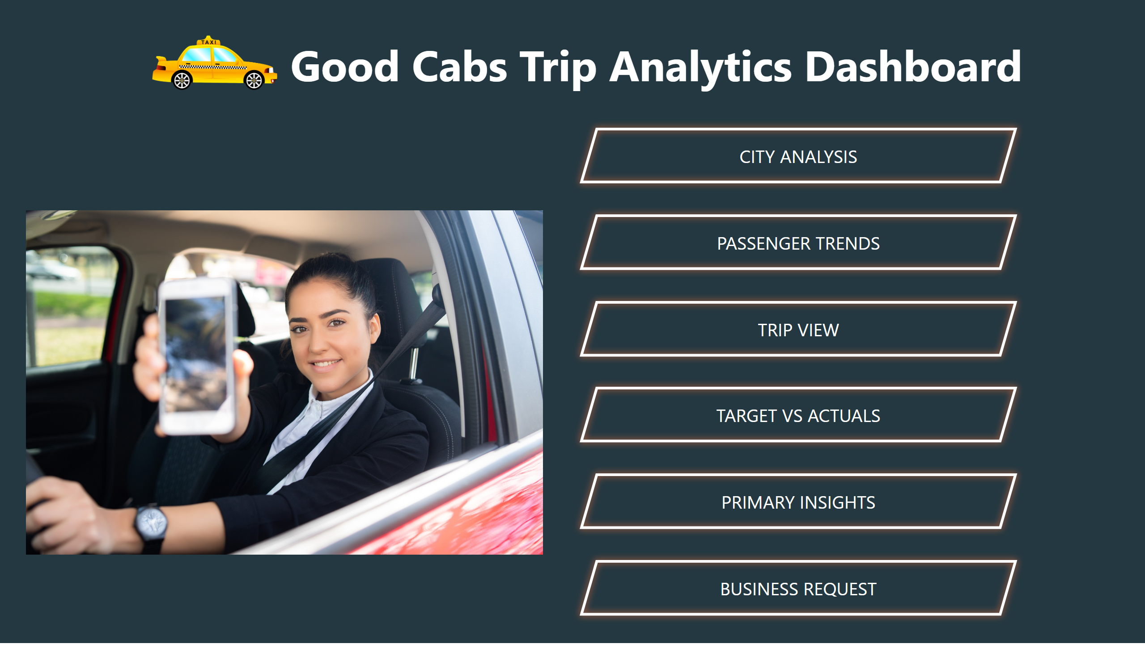
Home
Notes:
image
No alt text provided
textbox
No alt text provided
image
No alt text provided
actionButton
No alt text provided
actionButton
No alt text provided
actionButton
No alt text provided
actionButton
No alt text provided
actionButton
No alt text provided
actionButton
No alt text provided

Slide 23
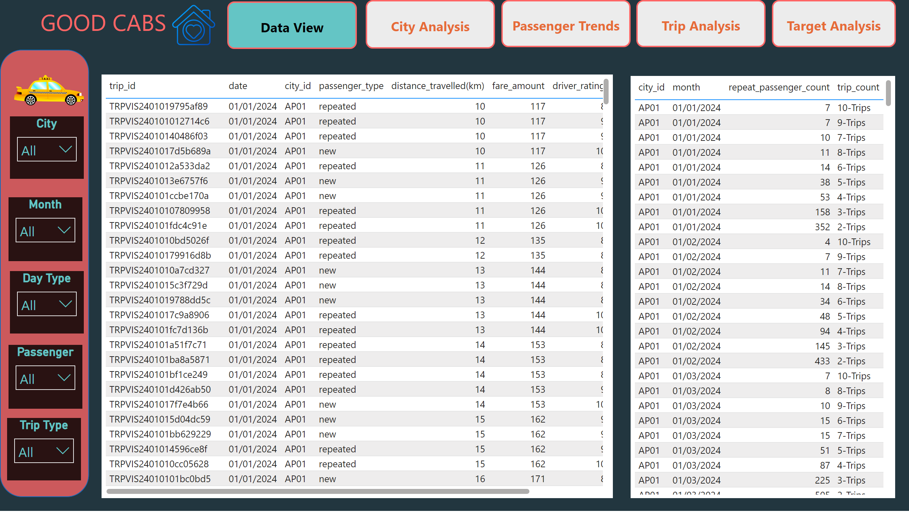
Data View
Notes:
shape
No alt text provided
City
No alt text provided
Month
No alt text provided
Day Type
No alt text provided
Passenger
No alt text provided
Trip Type
No alt text provided
image
No alt text provided
actionButton
No alt text provided
actionButton
No alt text provided
actionButton
No alt text provided
actionButton
No alt text provided
textbox
No alt text provided
tableEx
No alt text provided
tableEx
No alt text provided
actionButton
No alt text provided
image
No alt text provided

Slide 24
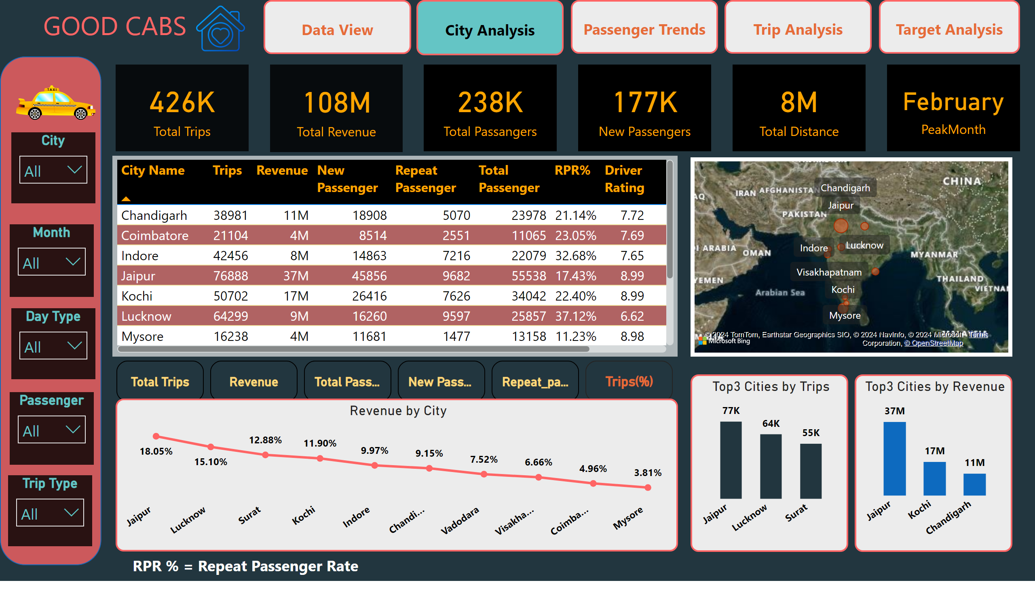
City View
Notes:
card
No alt text provided
card
No alt text provided
card
No alt text provided
card
No alt text provided
card
No alt text provided
shape
No alt text provided
City
No alt text provided
Month
No alt text provided
Day Type
No alt text provided
Passenger
No alt text provided
Trip Type
No alt text provided
image
No alt text provided
card
No alt text provided
actionButton
No alt text provided
actionButton
No alt text provided
actionButton
No alt text provided
actionButton
No alt text provided
textbox
No alt text provided
textbox
No alt text provided
map
No alt text provided
Top3 Cities by Revenue
No alt text provided
Top3 Cities by Trips
No alt text provided
Revenue by City
No alt text provided
advancedSlicerVisual
No alt text provided
tableEx
No alt text provided
actionButton
No alt text provided
image
No alt text provided

Slide 25
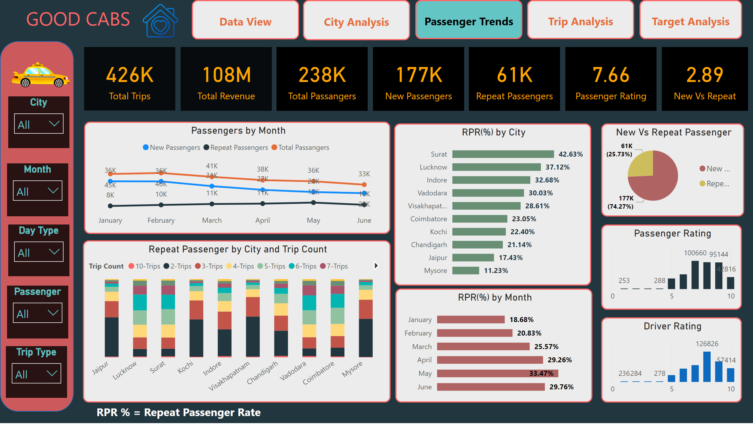
Passenger Trends
Notes:
card
No alt text provided
card
No alt text provided
card
No alt text provided
card
No alt text provided
card
No alt text provided
Passengers by Month
No alt text provided
hundredPercentStackedColumnChart
No alt text provided
Passenger Rating
No alt text provided
RPR(%) by City
No alt text provided
New Vs Repeat Passenger
No alt text provided
RPR(%) by Month
No alt text provided
Driver Rating
No alt text provided
shape
No alt text provided
City
No alt text provided
Month
No alt text provided
Day Type
No alt text provided
Passenger
No alt text provided
Trip Type
No alt text provided
image
No alt text provided
card
No alt text provided
actionButton
No alt text provided
actionButton
No alt text provided
actionButton
No alt text provided
actionButton
No alt text provided
textbox
No alt text provided
textbox
No alt text provided
card
No alt text provided
actionButton
No alt text provided
image
No alt text provided

Slide 26
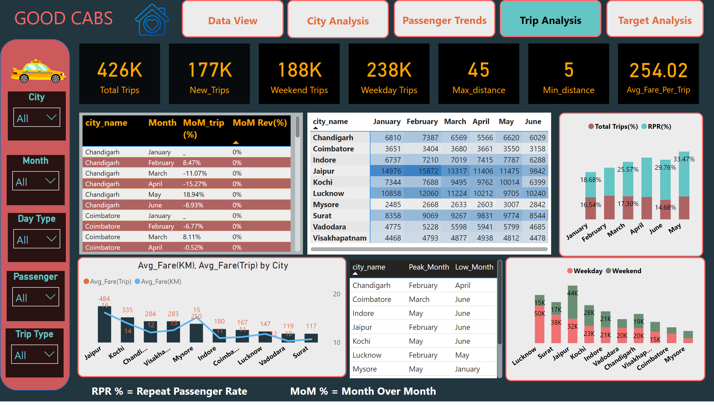
Trip View
Notes:
card
No alt text provided
card
No alt text provided
card
No alt text provided
card
No alt text provided
card
No alt text provided
shape
No alt text provided
City
No alt text provided
Month
No alt text provided
Day Type
No alt text provided
Passenger
No alt text provided
Trip Type
No alt text provided
image
No alt text provided
card
No alt text provided
actionButton
No alt text provided
actionButton
No alt text provided
actionButton
No alt text provided
actionButton
No alt text provided
textbox
No alt text provided
textbox
No alt text provided
pivotTable
No alt text provided
Weekday and Weekend Trips
No alt text provided
tableEx
No alt text provided
tableEx
No alt text provided
Avg_Fare(KM), Avg_Fare(Trip) by City
No alt text provided
Total Trips(%), RPR(%) By Month
No alt text provided
textbox
No alt text provided
card
No alt text provided
actionButton
No alt text provided
image
No alt text provided

Slide 27
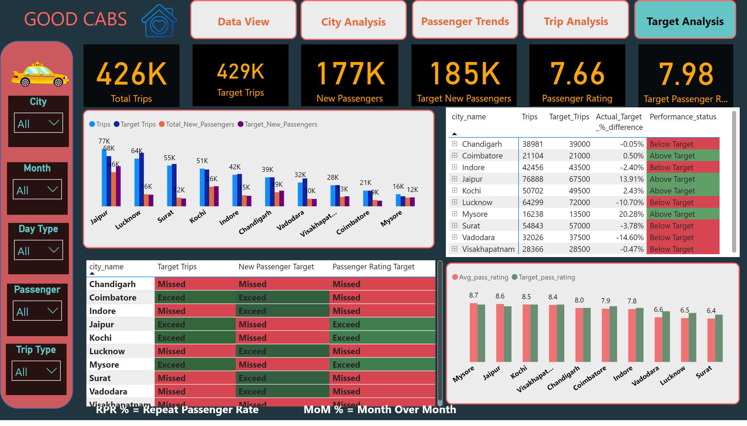
Target Vs Actuals
Notes:
card
No alt text provided
card
No alt text provided
card
No alt text provided
card
No alt text provided
card
No alt text provided
shape
No alt text provided
City
No alt text provided
Month
No alt text provided
Day Type
No alt text provided
Passenger
No alt text provided
Trip Type
No alt text provided
image
No alt text provided
card
No alt text provided
actionButton
No alt text provided
actionButton
No alt text provided
actionButton
No alt text provided
actionButton
No alt text provided
textbox
No alt text provided
textbox
No alt text provided
textbox
No alt text provided
clusteredColumnChart
No alt text provided
pivotTable
No alt text provided
clusteredColumnChart
No alt text provided
Target Analysis
No alt text provided
actionButton
No alt text provided
image
No alt text provided

Slide 28
Factors Influencing Repeat Passenger Rates
1.Service Quality
  -Driver Behavior and Professionalism
  -Vehicle Condition
  -Safety and Security
  -Punctuality
2. Pricing and Payment Flexibility
  -Competitive Pricing-Affordable and transparent pricing
  -Payment Options-Offering diverse payment methods (cash, card, digital wallets)
3. Convenience and Accessibility
  -Ease of Booking-A user-friendly app or booking system, quick confirmations, and live tracking
  -Availability of Cabs-Readily available rides, even during peak hours or in remote areas
  -Multiple Ride Option-Offering different categories (e.g., budget, premium, shared rides)
4. Customer Engagement and Loyalty Programs
  -Loyalty Rewards-Discounts, cashback, or reward points incentivize customers.
  -Personalization-Tailored offers or ride suggestions based on passenger history create a sense of familiarity.
  -Feedback Mechanisms- Actively seeking and implementing feedback.
  -Brand Reputation
5. External Factors
  -Competition
  -Economic Conditions
  -Social Trends

Slide 29
Recommendations
Loyalty Programs:
  -Introduce rewards for frequent users to encourage repeat trips.
City-Specific Offers:
  -Adjust pricing strategies in high-fare cities to encourage regular usage.
Improve Service Quality
  -Address customer complaints and improve driver behaviour
Dynamic pricing strategy
  -Optimize fair based on demand, city and competitor
Expand EV fleet
  -Introduce eco-friendly initiatives like electric cabs and solar charging
  stations.
6. Leverage Seasonal Trends
  -Promotions around peak months and weekend
  -Scale resources during peak-demand months and cities.

Slide 30
Thank You

