Slide 1
Play Ball
Mary Kiefer
https://github.com/msunkist99

Slide 2
Description
Major league baseball data is available to the public via downloadable delimited text files..
● The MLB data for the 1982 and 2015 seasons is loaded to the Play Ball MySQL application database. The data includes over 4500 games and 2,400 players and 129,000 records linking the games/players.
● The Play Ball front-end UI allows queries to be generated via drop down lists with the results displayed as players within a game or games for a player.

Slide 3
Features
Text file data loaded using Spring Batch application to MySQL database.
Spring Boot Web, Thymeleaf, and Spring Boot Data JPA are used for the front-end UI.
User registration and authentication
MySQL stored procedures for fast response on retrieving game and player data

Slide 4
Planning - User Stories
Analyzing data and database tables
Approach to load the game and player data to the database using many-to-many approach
Allowing the user to drill down in the UI to a specific game or player
Organizing the presentation of the game and player data in the UI
User registration and authentication

Slide 5
Planning - Database
Analyze the data which lead to the design of the database tables
Many-to-many relationship between games and players
Keys to ensure integrity of the data
Stored procedure to handle sophisticated queries and quick query response

Slide 6
Technology Stack
Java
Spring and Spring Batch
Thymeleaf
MySQL
GitHub

Slide 7
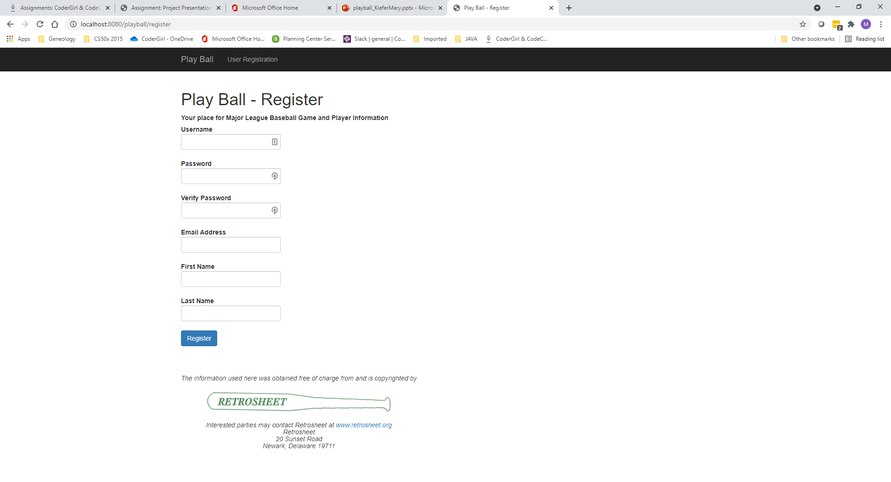
Demo

Slide 8
User Registration

Slide 9
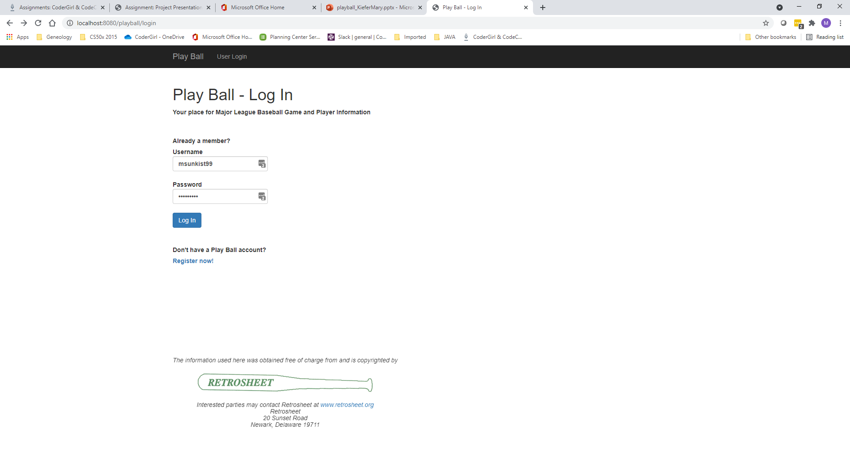
User Logon

Slide 10
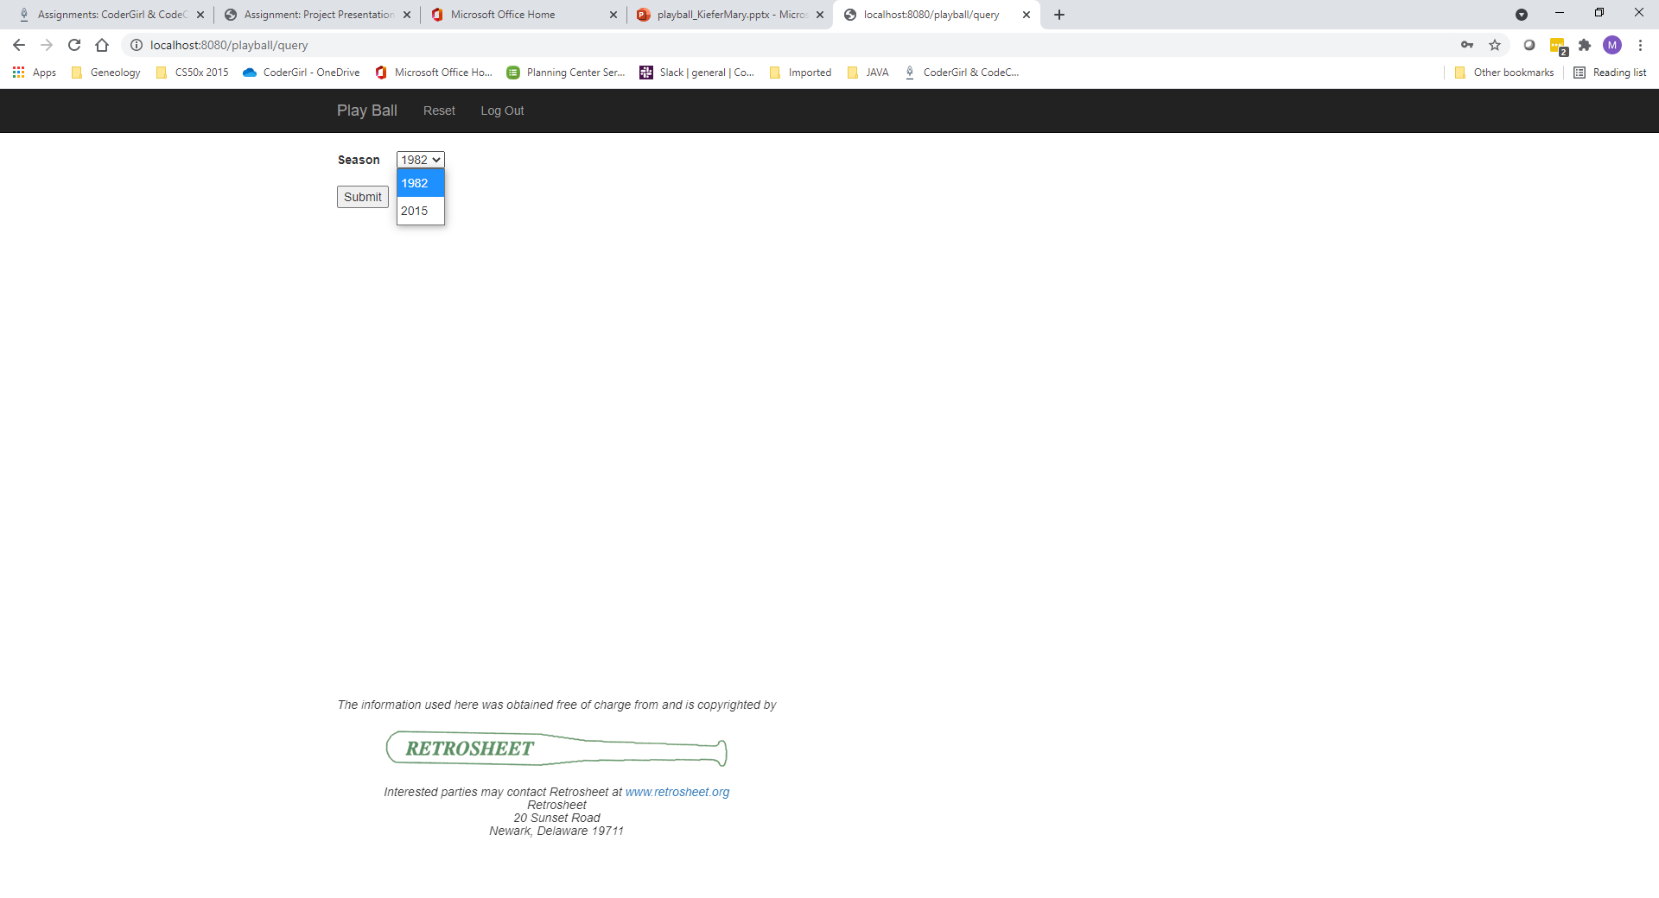
Select Season

Slide 11
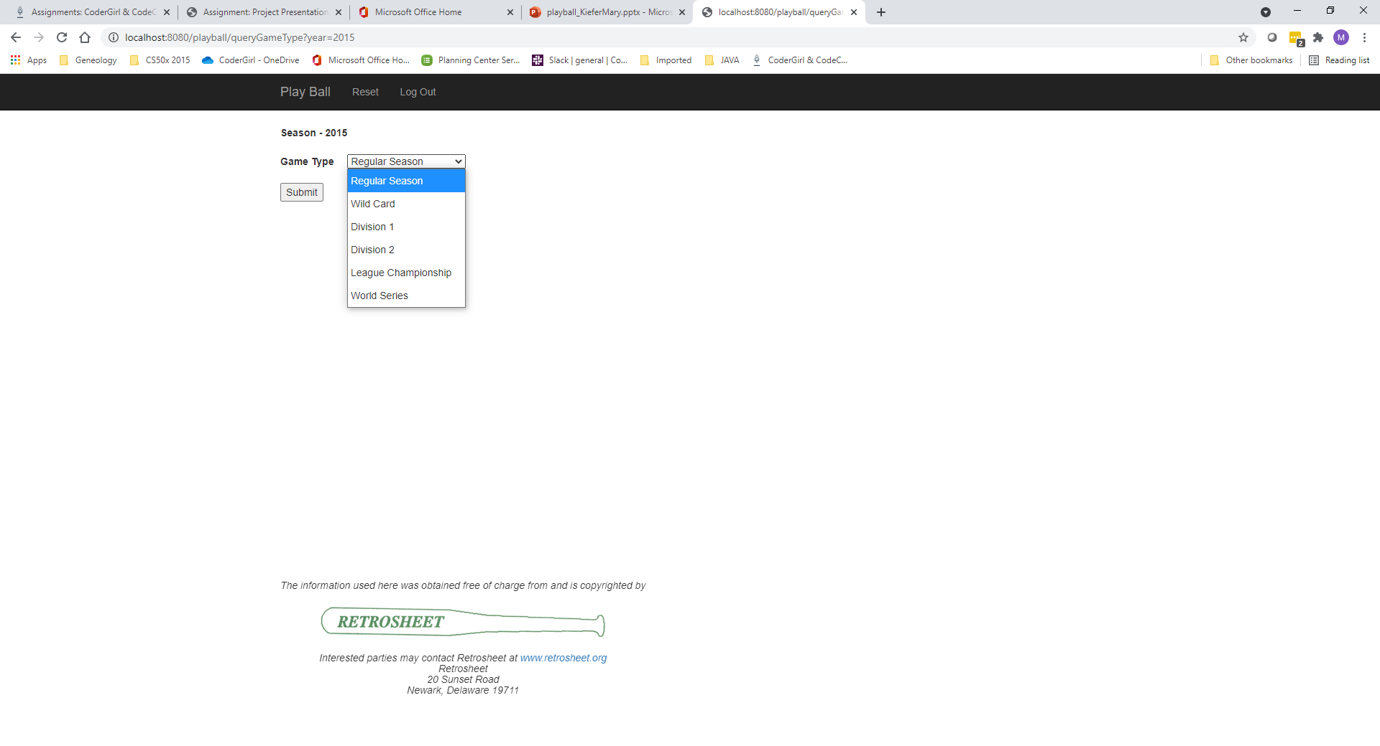
Select Game Type

Slide 12
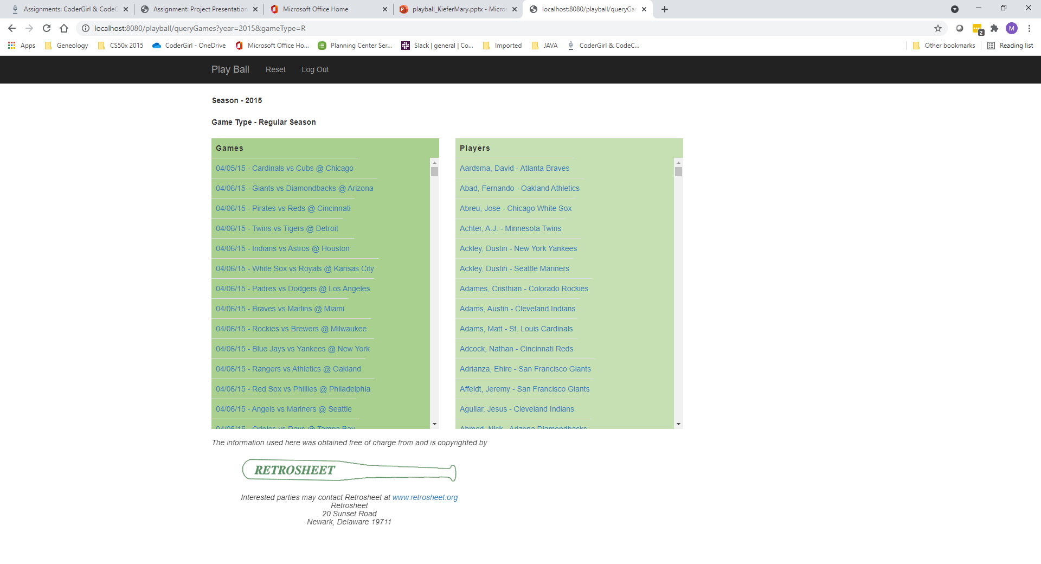
Select Game or Player

Slide 13
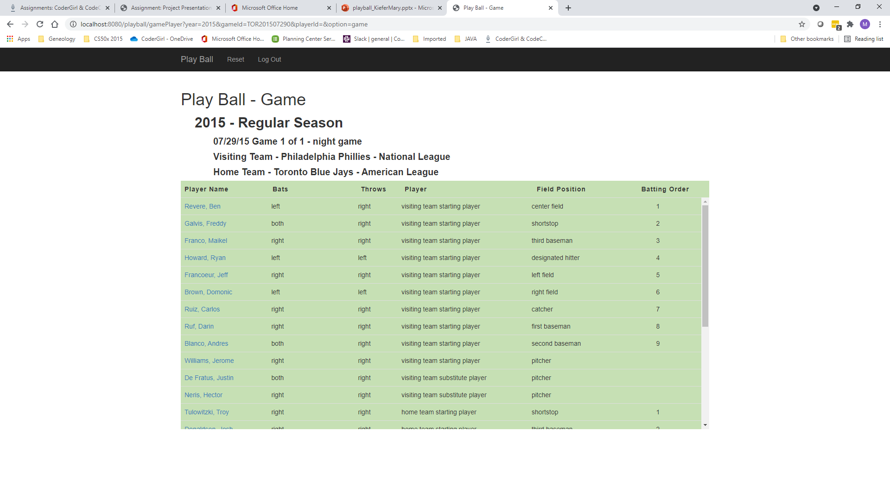
Game Details

Slide 14
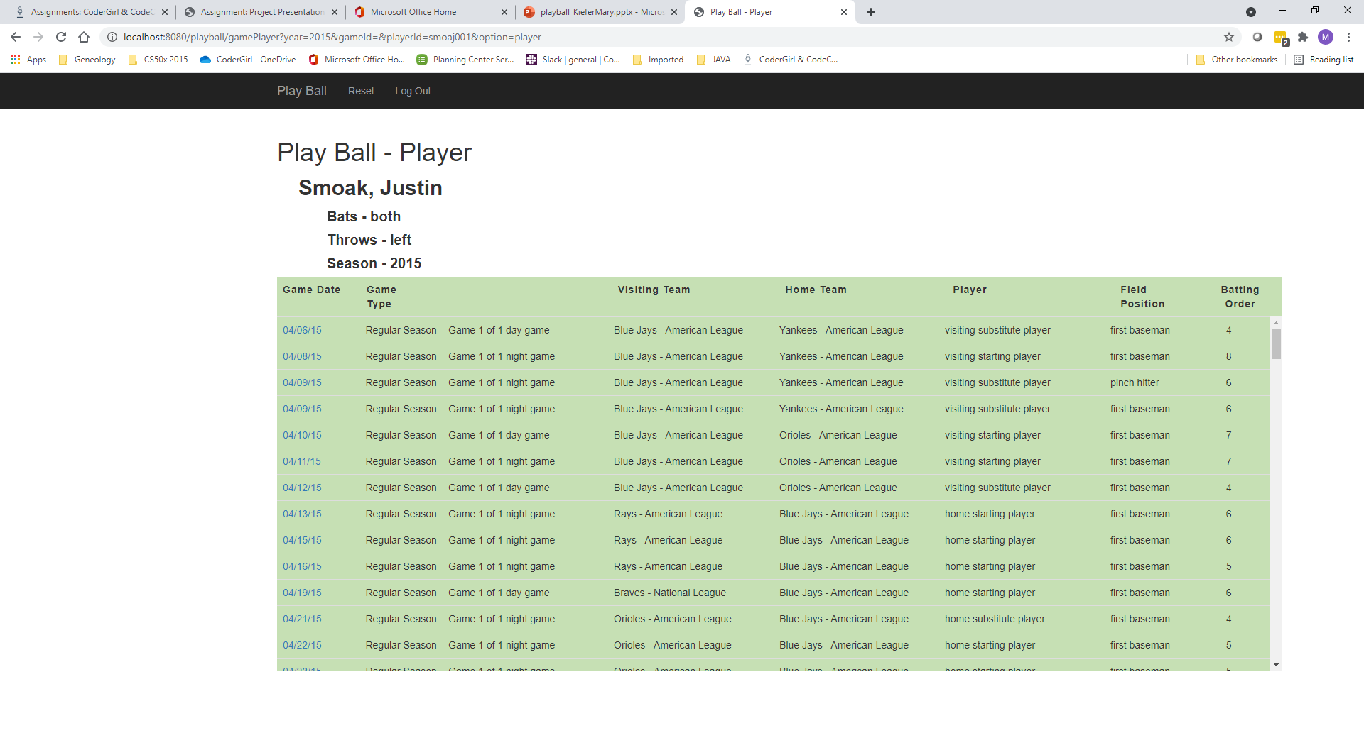
Player Details

Slide 15
What I Learned
I learned how to use Spring Batch by first completing a couple of online tutorials and then applying what I learned to my project to load text delimited files to my MySQL database
I learned more about Spring, Thymeleaf, Gradle, and MVC
I learned new techniques for presenting data such as columns, scrolling columns, and fixed headers.
I learned more about user registration and authentication

Slide 16
What’s Next
I would like to add additional sorting of game and player data in the presentation UI
I would like to add additional search functionality for games/players
I would like to add more detailed data for the games and players, for example
Game score and winner
Player game activity
Notes:
Be specific! If you mention another feature describe why that features is necessary, or what problem it solves. If you mention changing the UI mention specific technologies, or libraries you will use to do that. If you mention a technology, or feature you don’t know yet tell them how you plan on learning it.

