Slide 1


I/O Dependent Idempotence Bugs in Intermittent Systems
Milijana Surbatovich,
Limin Jia, and Brandon Lucia

Slide 2


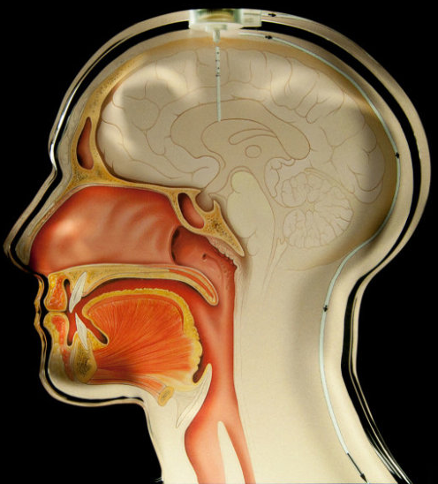
Energy-harvesting devices (EHDs) enable computing in inaccessible environments
Batteries:
expensive or impossible to access and replace
maintenance can be intrusive
Notes:
Emerging class of batteryless device that enable computing…, in harsh or remote environments

Slide 3
Intermittence in energy harvesting devices
Harvester
Hardware platform
Energy Buffer
Powers on as energy is available
Notes:
EHDS are platforms with …. Instead of battery, they have buffer and harvester, which is a capacitor, and gather energy from their environment as it is available. On poweroff, all volatile state is cleared, including stack, PC, and reg, and nv memory persists, use signifier other than color

Slide 4
Intermittence in energy harvesting devices
Volatile state clears, persistent state remains
Harvester
Hardware platform
Powers off at arbitrary program location
Energy Buffer
Notes:
Non-volatile memory!!!!

Slide 5
Background: intermittent execution causes bugs
Save volatile state periodically
B
A
A
Write-after-read: no dataflow
x := y
Re-execution causes dataflow
y := 5
B
B
B
Need to back up original value
Power fail
Re-execution must be idempotent
x := y
C
y := 5
B
Current systems provide forward progress and fix WAR bugs – is this enough?
Notes:
be explicit about WAR, it really is a simple problem, the compiler/system does etc. , not ‘we’

Slide 6
What about input operations?
B
x := input()
y := x
A different value on re-execution?
B
x := input()
y := x
Notes:
be explicit about WAR, it really is a simple problem, the compiler/system does etc. , not ‘we’

Slide 7
Current systems miss bugs caused by input
Repeating input operations causes unaddressed bugs
Want to port existing code-bases
Prior systems only address progress and WAR bugs

Slide 8
Outline
How intermittence causes bugs without system support
Repeated I/O operations can cause idempotence bugs
IBIS, a tool for detecting bugs caused by I/O operations
Evaluation and conclusion
Notes:
Can’t make progress though programs larger than one energy buffer without support. I’ll explain two common variants: checkpoints and tasks

Slide 9


Repeated I/O reads cause idempotence bugs
Control dependence on I/O causes inconsistent updates!
input := get_temp()
if (input < limit):
steady := 1
else:
blink := 1
assert(blink^steady)
get_temp() -> cold
input < limit
steady := 1
steady
1
0
blink
0
Execution Time
get_temp() -> hot
input > limit
blink := 1
assert == false
steady
1
1
blink
0
Notes:
On re-execution, the value that the program gets is different

Slide 10
Simple fix can break program timeliness
get_temp() -> cold
input < limit
steady := 1
input := get_temp()
if (input < limit):
steady := 1
else:
blink := 1
assert(blink^steady)
Execution Time
(input == cold)
input < limit
steady := 1
J. Hester, K. Storer, and J. Sorber. Timely Execution on Intermittently Powered Batteryless Sensors. (SenSys '17)
Notes:
Timeliness: first introduced by mayfly. Data needs to be fresh, else it should get regathered. To give a concrete example… Without special support, gathering and processing need to be in the same task

Slide 11
Detecting I/O bugs is particularly important for EHDs
Sensor driven
Input causes bugs
No simple fix
get_temp() -> cold
get_temp() -> cold
get_temp() -> hot
We characterize input-dependent bugs for the first time
Notes:
Frequently processing inputs. If we want to port existing libraries and code bases of drivers and system code, it needs to play nice with I/O. Existing system don’t address and in most cases are susceptible to I/O bugs

Slide 12
Outline
How intermittence causes bugs without system support
Repeated I/O operations can cause idempotence bugs
IBIS, a tool for detecting bugs caused by I/O operations
IBIS-Static – less precise, full coverage, no runtime cost
IBIS-Dynamic – no false positives, may have less coverage, runtime cost
Evaluation and conclusion
Notes:
Can’t make progress though programs larger than one energy buffer without support. I’ll explain two common variants: checkpoints and tasks

Slide 13
IBIS-S: static taint analysis and pattern matching
Uses standard taint analysis
Reports bug patterns to the programmer
Bug Pattern Matching
Taint Analysis
Report
Notes:
High level version first -> then detailed version, mention simple analysis

Slide 14
Taint analysis: tracks dataflow off inputs
LLVM analysis pass, programmer annotates tainted source
Algorithm
input := get_temp()
if (input < limit):
steady := 1
else:
blink := 1
alert(blink)
Mark uses of annotated functions as tainted, add to worklist
Repeat until list is empty
Get item from list, propagate taint to any uses
If a branch is tainted, propagate taint to any dependent stores
Notes:
Make it bigger, simplify?

Slide 15
Taint analysis: interprocedural flows
input := get_temp()
if (input < limit):
steady := 1
else:
blink := 1
alert(blink)
Function arguments
func sample:
io_src = getTemp()
process(io_src)
func process(temp):
sink = temp
Also: global variables,
return statements,
pass-by-ref parameters
alert(val):
if (val):
events++
Notes:
Sub topic: title slide, just show the one we need

Slide 16
Bug pattern matching
A tainted branch with paths that write to different variables
Bug Pattern
Safe Pattern
if input < limit
if input < limit
s0:
s1:
s0:
s1:
blink = 1
steady = 1
blink = 1
steady =0
blink = 0
steady = 1
blink
blink
steady
blink
steady
blink
steady
Pass outputs bug report of the tainted branch and differing variables to the programmer

Slide 17
Outline
How intermittence causes bugs without system support
Repeated I/O operations can cause idempotence bugs
IBIS, a tool for detecting bugs caused by I/O operations
IBIS-Static – less precise, full coverage, no runtime cost
IBIS-Dynamic – no false positives, may have less coverage, runtime cost
Evaluation and conclusion
Notes:
Can’t make progress though programs larger than one energy buffer without support. I’ll explain two common variants: checkpoints and tasks

Slide 18
IBIS-D: dynamic taint and freshness propagation
Taint: input dependent?
Fresh: written on the current execution?
Implementation
An execution must not read a stale, tainted value
Shadow memory to record metadata
taint
fresh
x
1
0
Compiler pass to instrument calls to runtime library
y := input
y
1
0
0
1
z := y
z
0
0
w := x
1
1
w
0
0
Runtime warning
Notes:
Make it bigger, simplify?

Slide 19
Outline
How intermittence causes bugs without system support
Repeated I/O operations can cause idempotence bugs
IBIS, a tool for detecting bugs caused by I/O operations
IBIS-Static – less precise, full coverage, low overhead
IBIS-Dynamic – no false positives, may have less coverage, runtime cost
Evaluation and conclusion
Notes:
Can’t make progress though programs larger than one energy buffer without support. I’ll explain two common variants: checkpoints and tasks

Slide 20
Goal of evaluation
Does IBIS-S provide usable reports to the programmer?
Does IBIS-D have reasonable overheads?
Reported Bugs
False Positives
IBIS-D

Slide 21
Evaluation methodology for IBIS-S
Embedded system drivers
Manual categorization
Software validation
IBIS-S
Existing intermittent apps
Notes:
No set benchmark suites. Existing embedded systems since our main use case is porting existing code/manual state management

Slide 22
IBIS-S finds bugs with few false positives
Blank bar means no reports generated
Sensor drivers more likely to have bugs
Not I/O driven – no bugs
Notes:
All true positives are observed, stacked bar plot, just mar

Slide 23
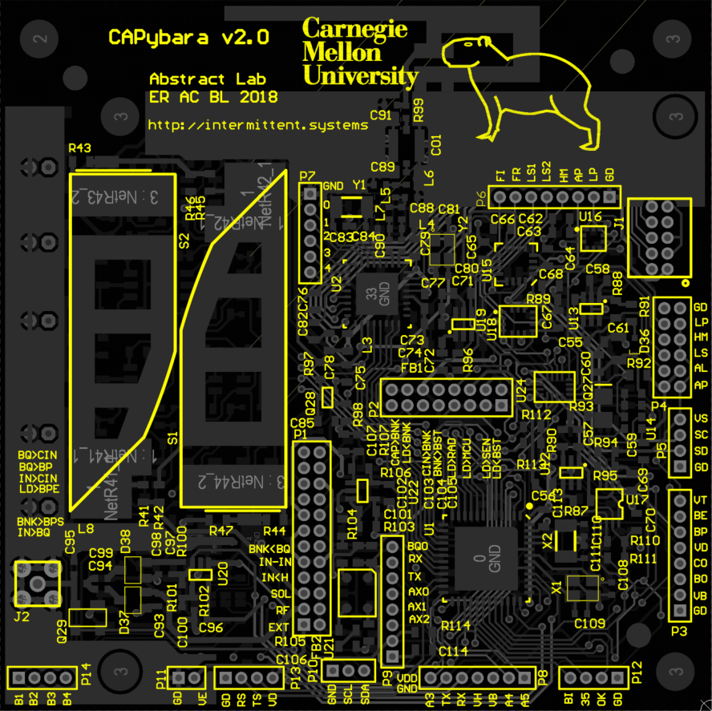
Evaluation methodology for IBIS-D
Embedded system drivers
Extract Bugs
IBIS-D
Compare runtimes
Existing intermittent apps
IBIS-D
Compare runtimes
Notes:
Existing embedded systems since our main use case is porting existing code/manual state management

Slide 24
IBIS-D performance
Constant shadow memory overhead
25x mean slowdown against unaltered
(in-line with valgrind)
Normalized to continuous unaltered
Notes:
Memory overhead is constant

Slide 25
Comparison and limitations of IBIS-S and IBIS-D
IBIS-S
IBIS-D
Opaque path conditions, may-write set
Sound
(Reported bugs are true bugs)
Complete
(Finds all bugs)
??
Exploring all paths?
Alias imprecision
Notes:
Remind no other tools, explain this fits with the driver usage, complementing benefits if guide down paths

Slide 26
Interesting challenges uncovered
Symbolic execution?
Safe instrumentation
Restart point
Path
Path’
Power failure

Slide 27
Read more in the paper
Discussion of how IBIS-S integrates with differing execution models
Implementation details
More evaluation for both systems
Case studies of a selection of bugs

Slide 28
Summary and take-aways
We characterize I/O idempotence bugs, not addressed by prior systems, and find they exist in real code
IBIS-S provides information to programmers about hard-to-reason about I/O dependences
IBIS-D detects concrete bug instances when running on real energy-harvesting hardware
I/O Dependent Idempotence Bugs in Intermittent Systems
Milijana Surbatovich, Limin Jia, Brandon Lucia

