Slide 1
Sweet Memories
Developed by
Suresh Mogudala
.Net Developer

Slide 2
Why Sweet Memories
Upload Personnel Images, all Image categories can be stored here.
Images can be shared across the Network.
Giving Permissions for authorized Users only.
Great View ,Easy to Down load, and Easy to Upload.
And many more

Slide 3
Modules list
Roles
Users
Registration
Upload Images

Slide 4
Roles
Admin
Admin can View logged in users, number of files uploaded etc as of now Admin cant perform any operation.
Users
User can Register and Upload Number of Images from his PC.

Slide 5
Coming to Design
List of tables Used
Roles
Users
Mapping
Files

Slide 6
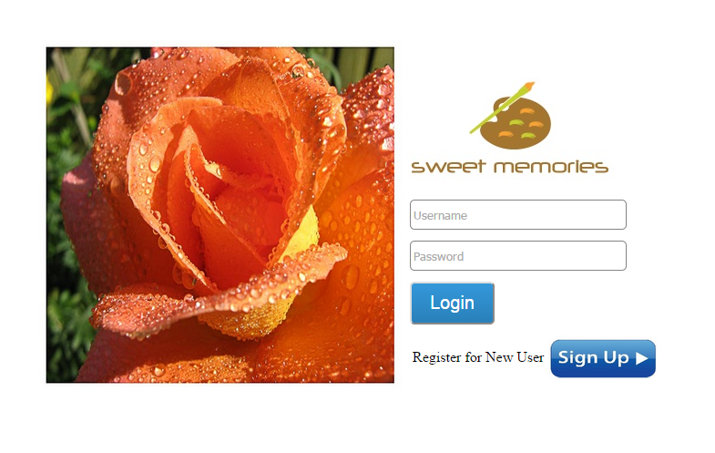
Screen Shots-Login Page
Notes:
User can Log in here, If the User is New the

Slide 7
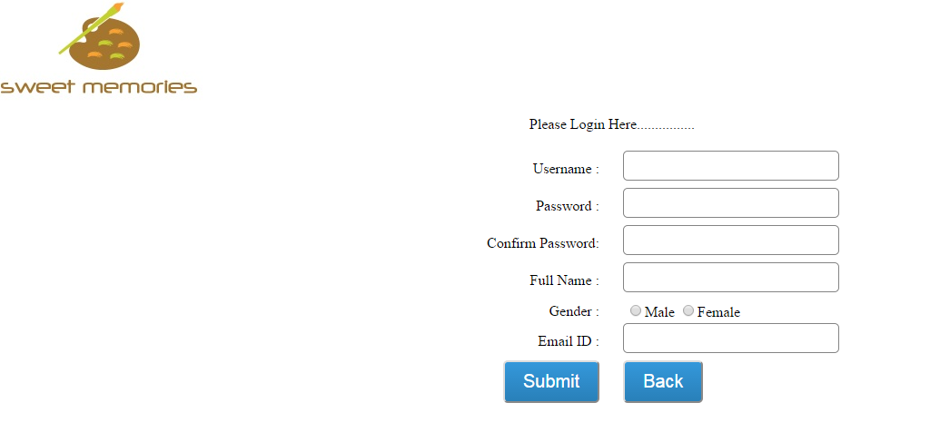
Users Registration Page

Slide 8
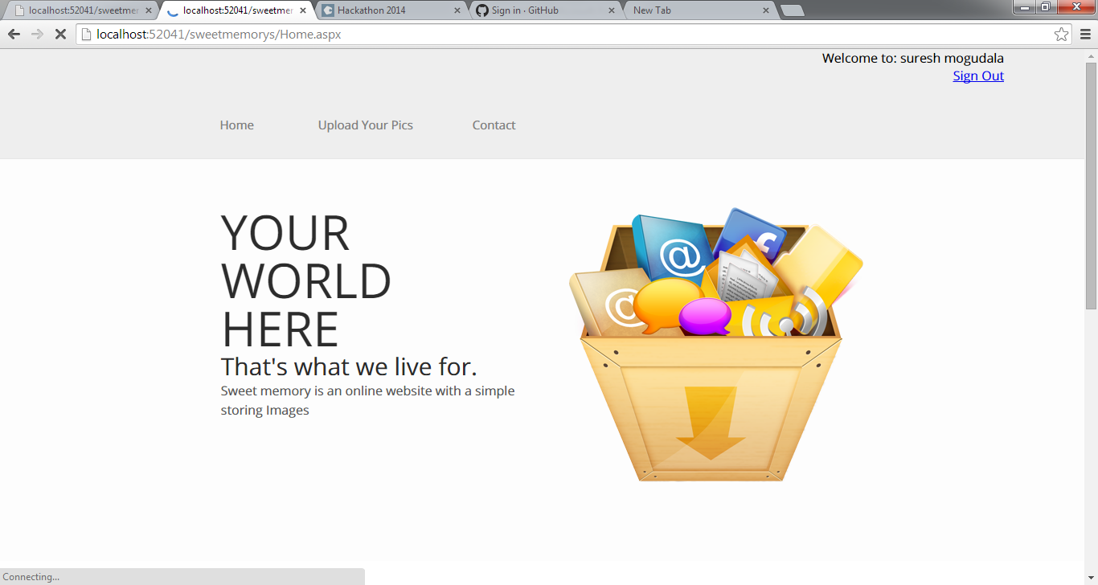
Home

Slide 9
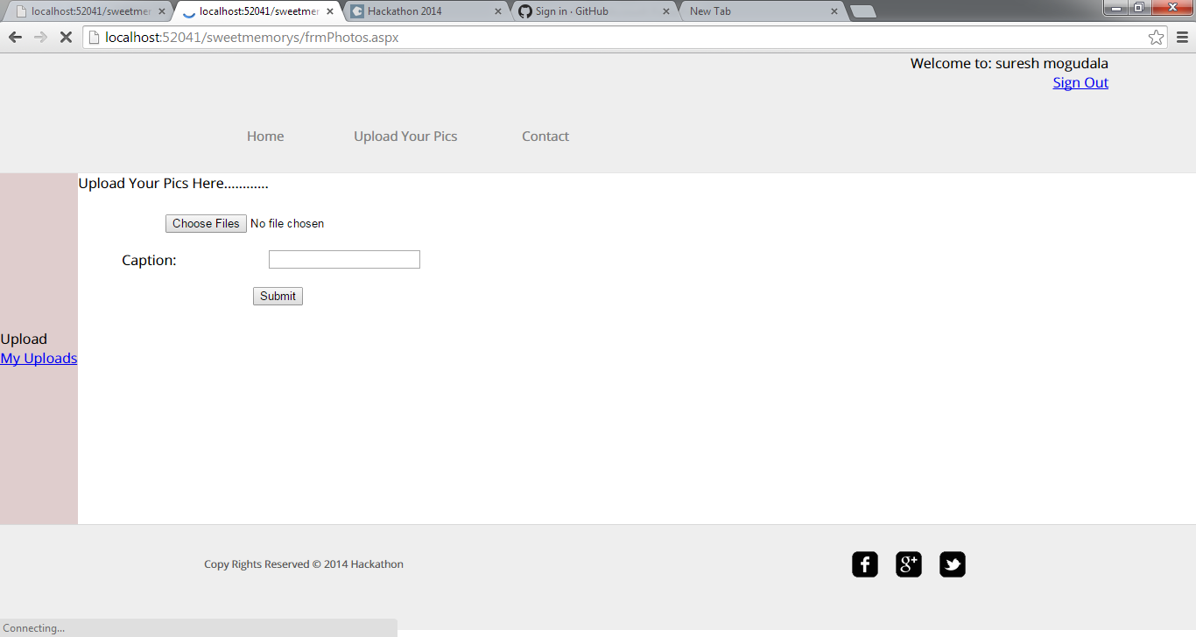
Uploading Images

Slide 10
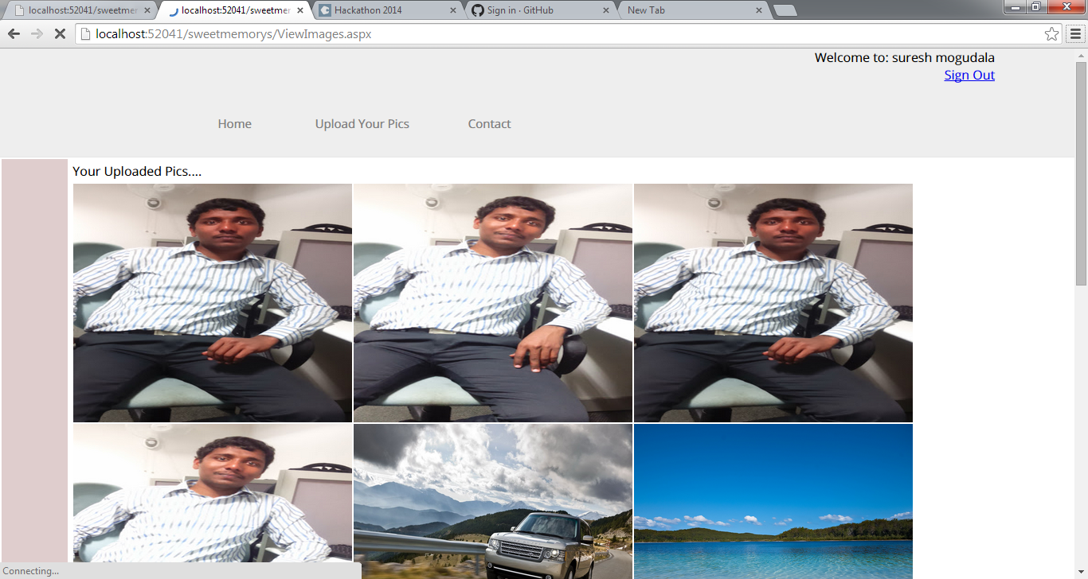
Uploaded Images

