Slide 1

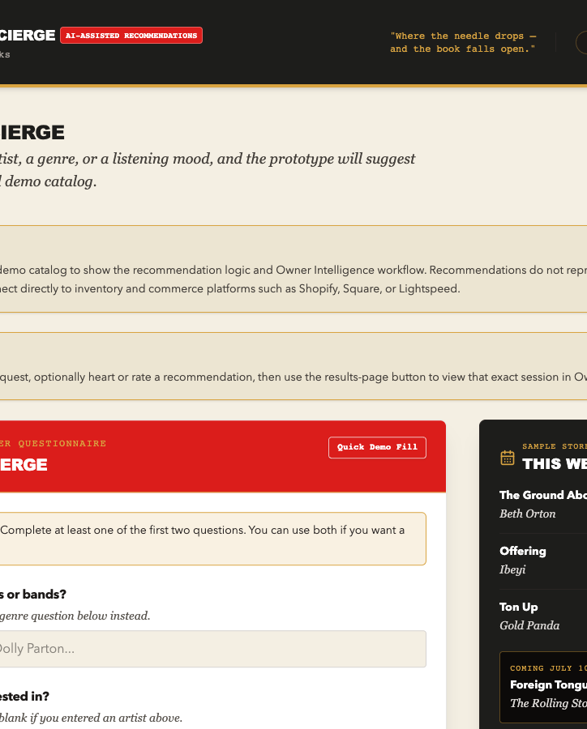
FINAL CAPSTONE PITCH
The Vinyl Concierge
AI-assisted record recommendations that become owner-ready interest signals.
Michelle Lentz
MS-AIB Applied Project
Summer 2026
The Vinyl Concierge
01
Notes:
Hi, my name is Michelle Lentz, and I am pitching The Vinyl Concierge.
It is an AI-powered recommendation and owner-intelligence platform for independent record stores. The pitch is simple: customers get warmer, more useful music discovery, and store owners get earlier visibility into what customers are asking for before that demand is obvious in sales.
The product is not just a themed recommendation engine. The business value is the loop: customer discovery becomes privacy-protected owner insight.

Slide 2
Independent stores need discovery signals they can trust.
The customer problem and the owner problem are connected.
Customers
Owners
Opportunity
Know a mood, artist, or setting, but may not know which record should come home.
Need to stock, restock, and feature titles before sales data makes demand obvious.
Turn discovery activity into early, anonymized signals that still require human judgment.
The Vinyl Concierge
02
Notes:
Independent record stores work in a category where taste, trust, and timing matter.
Customers often know a mood, an artist, or a listening context, but they may not know what record to buy next.
Owners have the other side of the same problem: they need to decide what to stock or feature before demand is clear. So the product asks whether customer discovery can also create useful owner signals.

Slide 3
The product turns recommendations into owner intelligence.
The defensible idea is the feedback loop, not a standalone recommender.
STEP 1
STEP 2
STEP 3
STEP 4
Customer request
>
Five-record stack
>
Interest response
>
Owner review
Artist, genre, mood, or listening setting
Match labels and shelf notes from a limited demo catalog
Saved interest, thumbs up, or thumbs down
Album, artist, and genre signals for cautious sourcing
A single recommendation request is not a sale. It is one signal that becomes useful when it is repeated, validated, and reviewed.
The Vinyl Concierge
03
Notes:
The current prototype has two connected experiences.
On the customer side, someone enters preferences, gets five records, and can respond with saved interest or ratings.
On the owner side, those actions become cautious sourcing signals. The dashboard reviews patterns, but it does not pretend one request is the same as a sale. A recommendation engine alone is easy to copy. A store-specific loop is the more defensible business opportunity.

Slide 4
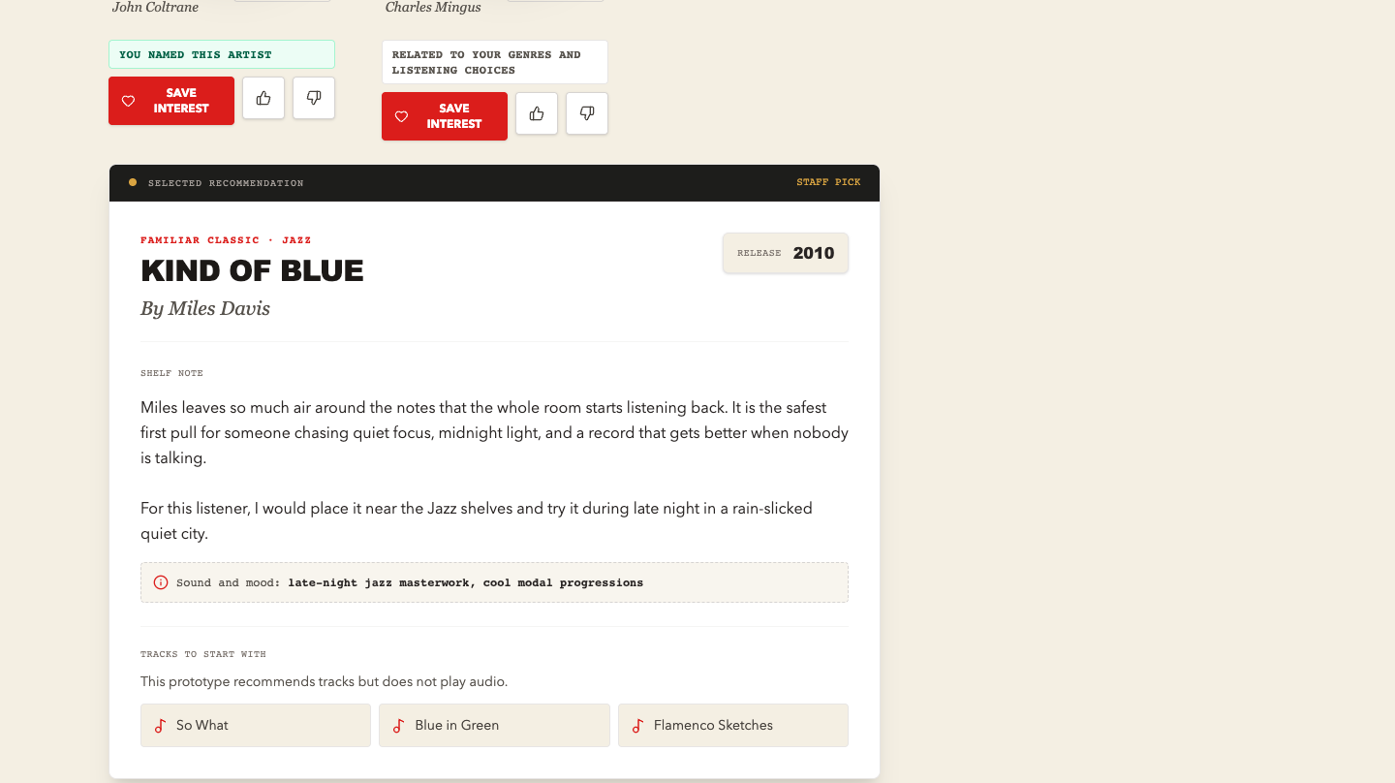
The live demo follows one customer into owner review.
This is the Zoom screen-share bridge.
Demo path
1. Start as a customer
2. Use Quick Demo Fill
3. Generate five recommendations
4. Mark interest or feedback if signed in
5. Open the same session in Owner Intelligence
SWITCH TO BROWSER
The Vinyl Concierge
04
Notes:
I am going to switch to the prototype now and walk through the professor path.
First I will start as a customer. I will use Quick Demo Fill so the flow is easy to see within the time limit, then generate a five-record recommendation stack.
Notice that the prototype clearly labels its limits. Then I will move into Owner Intelligence from the same session. The point is not that the app can run a record store today. The point is that the product thesis is implemented and visible.

Slide 5
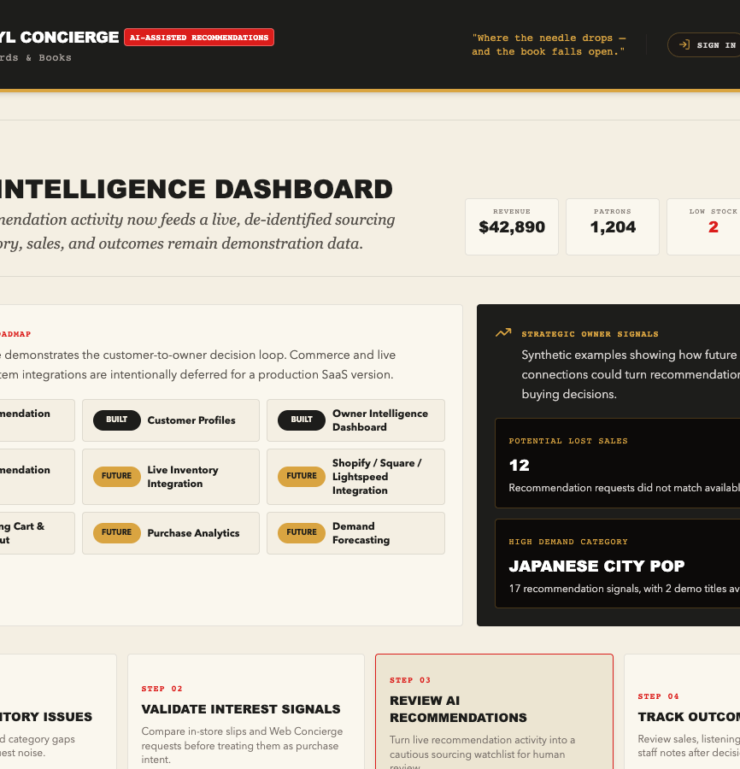
The prototype proves the loop is coherent.
The system now moves beyond a static interface.
What works today
Customer request to recommendations
Signed-in private session persistence
Owner-readable anonymized interest signals
Same-session sourcing review
Clear labels for demo data and low sample size
The product is strongest when AI supports the handoff between customer discovery and owner judgment.
The Vinyl Concierge
05
Notes:
The prototype proves that the core workflow is coherent.
It can take a customer request, generate recommendations, preserve private session context for signed-in users, create owner-readable interest signals, and show those signals in an owner review workflow.
The best version of this app is not trying to make AI sound magical. It is trying to make the handoff between customer discovery and owner judgment more useful.

Slide 6
Feedback changed the product because trust depends on honesty.
Tester feedback and AI review pushed the prototype toward clearer claims.
People asked for clarity
UI claims were tightened
Risk review shaped the backend
Bigger type, simpler prompts, clearer input requirements, and less niche record-store language.
Cart-like and playback-like cues were removed. Saved interest became a heart-based prototype signal.
Firestore rules, signal validation, role protection, and cautious owner language became part of the final story.
The final prototype is more credible because it says what is built, what is synthetic, and what remains future work.
The Vinyl Concierge
06
Notes:
The most important learning from feedback was that trust depends on honesty.
External testers liked the identity and concept, but they surfaced readability issues, unclear input requirements, terminology problems, and interface elements that accidentally implied working cart or audio features.
The final version uses larger type, clearer prompts, match-confidence labels, simpler language, heart-based saved interest, and visible prototype notices. AI-assisted review also helped identify risks in role access, signal validation, and owner-dashboard overconfidence.

Slide 7
The main risk is overclaiming what the signals mean.
Responsible deployment requires transparency, validation, and human review.
Risk areas
Controls
Interest signals are not purchases
A limited catalog can bias results
Broad tags can weaken matching
Owner dashboards can create automation bias
Prototype notices and match labels
Private sessions and anonymized signals
Firestore validation and role protection
Human review before inventory decisions
WATCH IN PRODUCTION
Complaint rate, weak matches, unusual demand spikes, stale inventory syncs, permission errors, and staff overrides.
The Vinyl Concierge
07
Notes:
The biggest risk is overclaiming.
Recommendation activity is useful, but it is not the same as purchase intent. A limited catalog can create availability bias. Broad genre tags can produce weak matches. Owner dashboards can create automation bias if the app makes signals look stronger than they are.
The prototype addresses those risks through transparency and governance: prototype notices, match labels, private sessions, anonymized owner signals, Firestore validation, role protection, and human review before inventory decisions.

Slide 8

Next foundations
DEPLOYMENT JUDGMENT
Live inventory
POS or ecommerce data
Purchase validation
Monitoring thresholds
Store-specific rollout support
Not ready for a commercial
pilot yet.
The ask: move into an integration-ready pre-pilot.
The recommendation engine is not the whole product. The stronger business is the feedback loop between discovery, privacy-protected signals, owner review, and inventory planning.
08
Notes:
My deployment judgment is cautious but positive, which is exactly how I would frame the ask to an internal stakeholder or early investor.
The Vinyl Concierge should not be deployed commercially in its current prototype form. Even a small pilot would need live inventory, POS or ecommerce connections, purchase validation, stronger monitoring, and store-specific rollout support.
My ask would be permission to move into an integration-ready pre-pilot: connect one store's real catalog and transaction systems, test whether saved-interest behavior predicts buying behavior, and measure whether owners find the dashboard useful without replacing their judgment.
The core takeaway is this: the recommendation engine is not the whole product. The stronger business is the feedback loop between customer discovery, privacy-protected interest signals, owner review, and inventory planning. Thank you.

