Slide 1

DoE-Based Remaining Useful Life Prediction
5G/6G Telecom Tower Antenna Digital Twin
Modeling, Simulation & Digital Twin
Prof. Dr. Adele Nasti
Srivardhan Varma Mudunuri · Matric. 100001259
Final Exam · 10–15 minutes
Srivardhan Varma Mudunuri · Matric. 100001259

Slide 2

1 · Problem
Predictive maintenance for 5G/6G telecom towers
Tower failures cause outages and revenue loss
Climber inspections are costly, slow, and risky
Drone 2D→3D scan gives geometry — but geometry alone is NOT a digital twin
Goal: predict Remaining Useful Life (RUL) from wind + temperature
SRH University · Prof. Dr. Adele Nasti
2

Slide 3
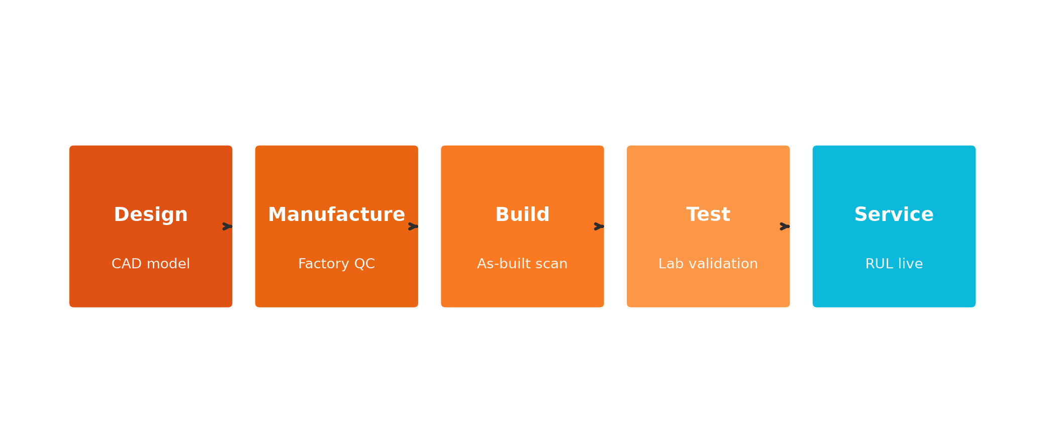
2 · Digital Twin Definition
Digital representation throughout its lifecycle
NOT a static CAD copy
Stages: Design → Manufacture → Build → Test → Service
Twin does NOT replace experimental testing
SRH University · Prof. Dr. Adele Nasti
3

Slide 4
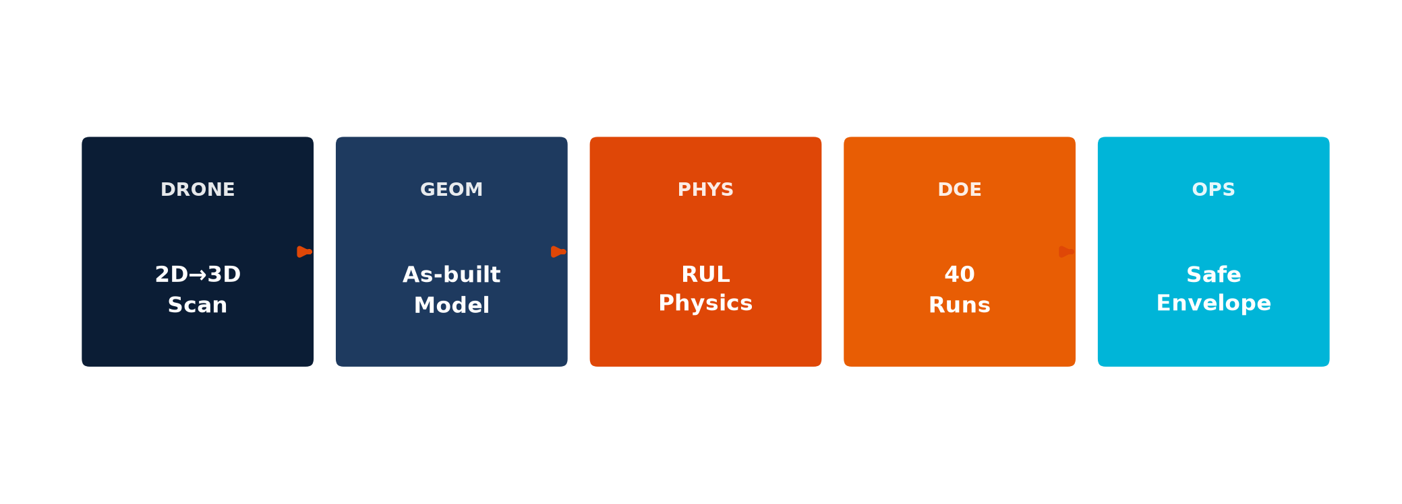
3 · End-to-End Approach
Drone geometry + physics RUL + Design of Experiments
Pipeline extends real industrial drone inspection into predictive maintenance
SRH University · Prof. Dr. Adele Nasti
4

Slide 5
4 · Physics-Based RUL Model
Wind fatigue × thermal aging
RUL (days) = 175,200 / (f_wind × f_temp × 24)
f_wind(v) = (v / 5)^1.6 f_temp(T) = 2^((T − 20) / 15)
Verification sanity checks:
• 5 m/s, 20 °C → ~20 years
• 15 m/s, 35 °C → ~1.7 years
• 35 m/s, 65 °C → ~41 days
SRH University · Prof. Dr. Adele Nasti
5

Slide 6
5 · Design of Experiments
Full factorial — same workflow as HEEDS Example 5 (Coil Spring)
Factor A: Wind speed — 4 levels [5, 15, 25, 35] m/s
Factor B: Temperature — 10 levels [20…65] °C
Design: 4 × 10 = 40 simulation runs
HEEDS workflow: Process → Parameters → Tagging → Study → Run → POST
SRH University · Prof. Dr. Adele Nasti
6

Slide 7
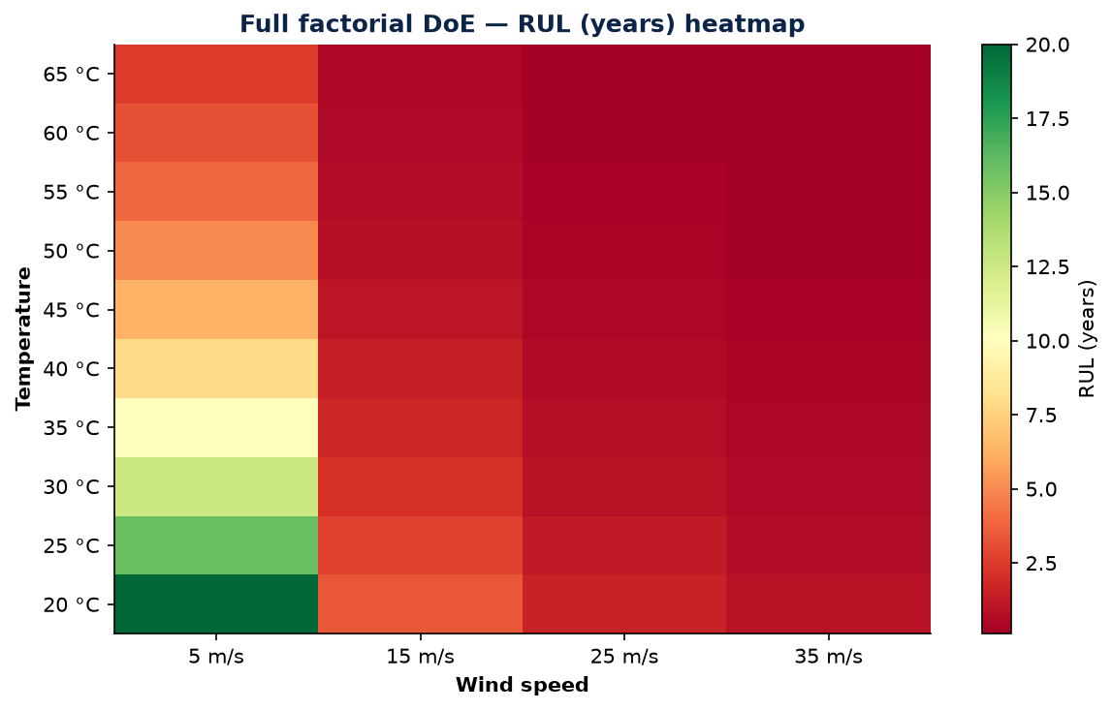
6 · DoE Results — Design Space
40-run factorial heatmap
RUL (years) across wind × temperature
SRH University · Prof. Dr. Adele Nasti
7

Slide 8
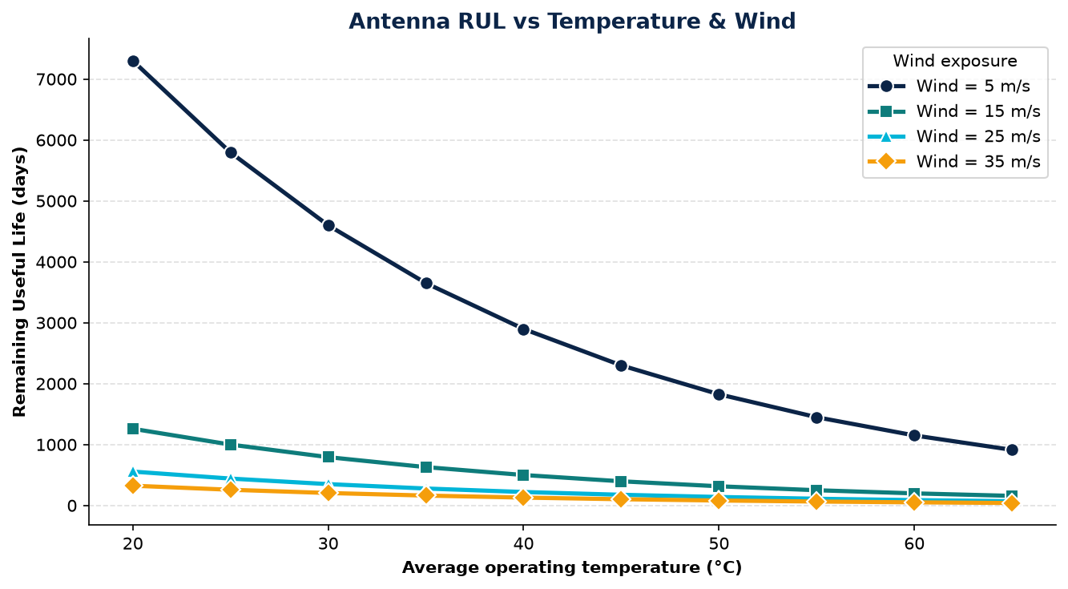
7 · RUL vs Temperature
Separate curve for each wind level
Higher wind collapses remaining life — dominant degradation driver
SRH University · Prof. Dr. Adele Nasti
8

Slide 9
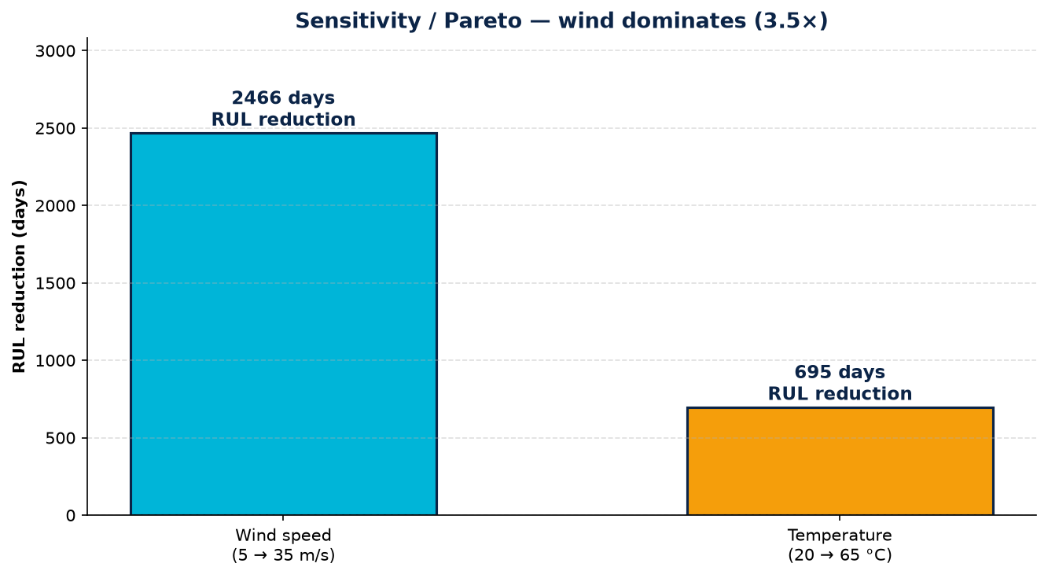
8 · Sensitivity Analysis
Pareto ranking of factors
Wind impact ≈ 3.5× temperature
SRH University · Prof. Dr. Adele Nasti
9

Slide 10
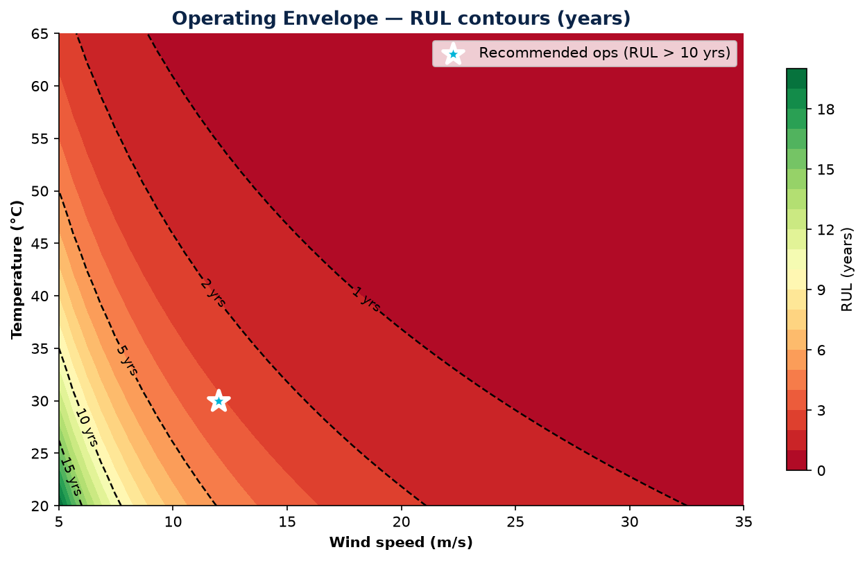
9 · Operating Envelope
Safe operating recommendation
Safe ops: wind ≤ 12 m/s and temp ≤ 30 °C → RUL > 10 years
SRH University · Prof. Dr. Adele Nasti
10

Slide 11
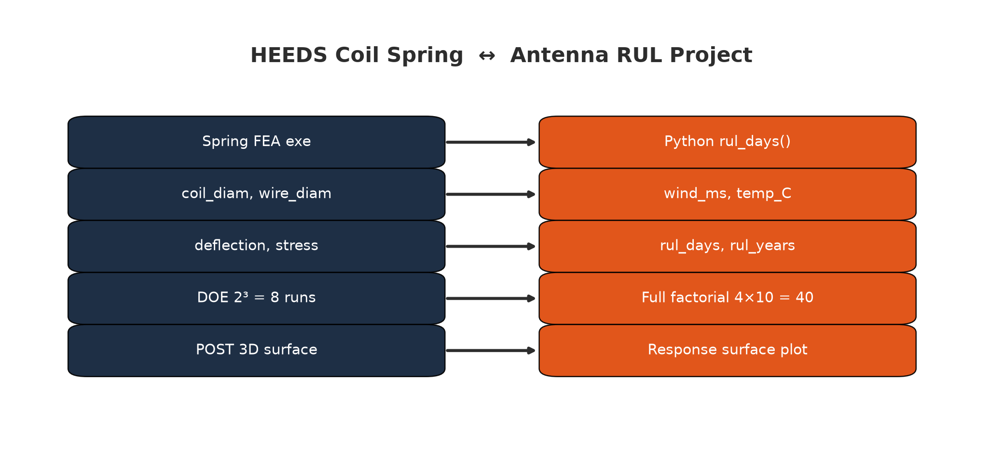
10 · HEEDS Mapping
Coil Spring DoE ≡ Antenna factorial study
SRH University · Prof. Dr. Adele Nasti
11

Slide 12
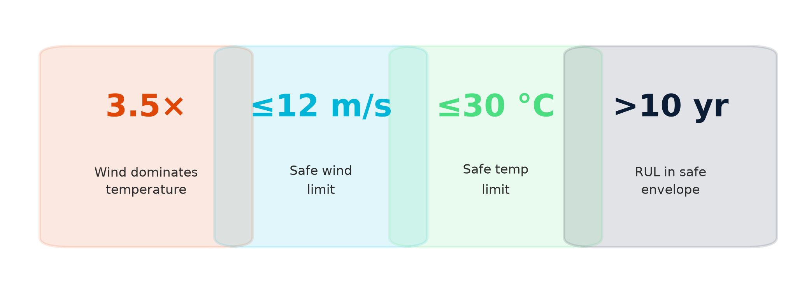
11 · Key Results
Predictive maintenance value · TRL 4–5
SRH University · Prof. Dr. Adele Nasti
12

Slide 13
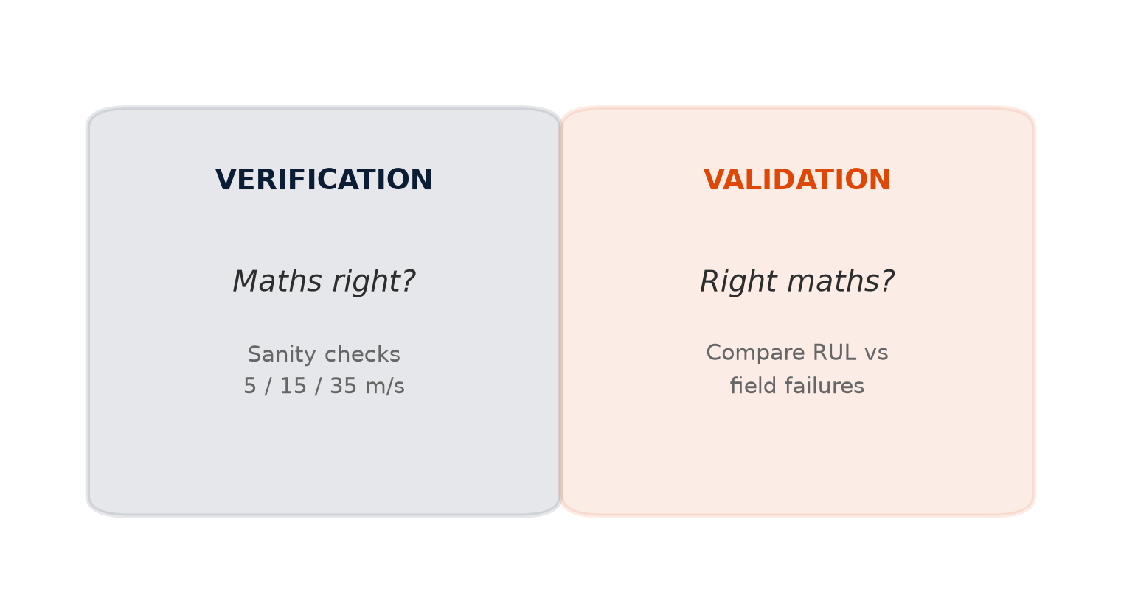
12 · Verification & Validation
Verification — maths right?
Sanity checks at anchor points
Validation — right maths?
Compare RUL vs field failures
Calibration ≠ validation
SRH University · Prof. Dr. Adele Nasti
13

Slide 14
13 · Live Demo & Value
Reproducible Python pipeline
Run: python project/run_project.py
Notebook: DigitalTwin_Antenna_RUL.ipynb
Value: fewer outages, safer crews, data-driven maintenance
Creative: telecom-specific RUL physics + DoE envelope
SRH University · Prof. Dr. Adele Nasti
14

Slide 15
14 · References
1. AIAA (2020). Digital Twin: Definition & Value
2. Grieves & Vickers (2017). Digital Twin: Mitigating Unpredictable Behavior
3. Tao et al. (2019). Digital Twin in Industry. IEEE TII
4. Montgomery (2017). Design and Analysis of Experiments
5. Liu et al. (2021). UAV photogrammetry for telecom towers
6. Kapteyn et al. (2021). Predictive digital twins. Nature Comp Sci
7. Siemens (2024). HEEDS Multi-Disciplinary Design Exploration
SRH University · Prof. Dr. Adele Nasti
15

Slide 16
Thank you
Questions welcome

