Slide 1
DoE-Based Remaining Useful Life Prediction
5G/6G Telecom Tower Antenna Digital Twin
Modeling, Simulation & Digital Twin
Prof. Dr. Adele Nasti
Srivardhan Varma Mudunuri · Matric. 100001259
Final Exam Presentation · 10–15 minutes

Slide 2
1. Problem Definition
Investor pitch: reduce outages, defer site visits, plan maintenance proactively
• Telecom operators lose revenue when 5G/6G antenna towers fail unexpectedly
• Traditional maintenance: periodic climber inspections — costly, risky, reactive
• Industrial context: drone 2D→3D photogrammetry pipeline (USA client, ≈€220K)
• Gap: geometry alone is NOT a digital twin — we need predictive as-used prognostics
• Objective: predict Remaining Useful Life (RUL) under wind + temperature

Slide 3
2. Digital Twin — Course Definition
• "Digital representation of a physical product throughout its lifecycle"
• NOT a static CAD copy — spans Design → Manufacture → Build → Test → Service
• Our twin stages (AIAA):
– As-designed: nominal antenna specifications
– As-built: drone photogrammetry geometry + QC
– As-used: physics-based RUL model fed by environmental sensors
• Twin does NOT replace experimental testing — it de-risks decisions

Slide 4
3. Approach & Software Workflow
1. Physics-based degradation model (wind fatigue + thermal aging)
2. Full-factorial Design of Experiments — 4×10 = 40 runs
3. Sensitivity analysis + Pareto ranking of factors
4. Response surface + operating envelope recommendation
5. Python implementation (replicates HEEDS MDO workflow)
Software: Python (NumPy, Pandas, Matplotlib) + HEEDS methodology
Validation path: compare RUL trends with field inspection data (future work)

Slide 5
4. RUL Physics Model — WHY these equations?
RUL (days) = 175,200 / (f_wind × f_temp × 24)
f_wind(v) = (v/5)^1.6 — drag-fatigue scaling (structural reliability)
f_temp(T) = 2^((T−20)/15) — Arrhenius thermal aging (electronics)
WHY physics-based: interpretable, extrapolatable within bounds, calibratable
Verification: sanity checks — (5m/s,20°C)≈20yr; (35m/s,65°C)≈41 days

Slide 6
5. Design of Experiments (DoE)
Factor A: Wind speed — 4 levels [5, 15, 25, 35] m/s
Factor B: Temperature — 10 levels [20…65] °C in 5°C steps
Design: Full factorial → 40 simulation runs
WHY full factorial: cheap analytical model; captures interaction for surface
Same workflow as HEEDS Example 4 (Coil Spring DoE)
Process → Parameters → Tagging → Study (DOE) → Run → POST

Slide 7
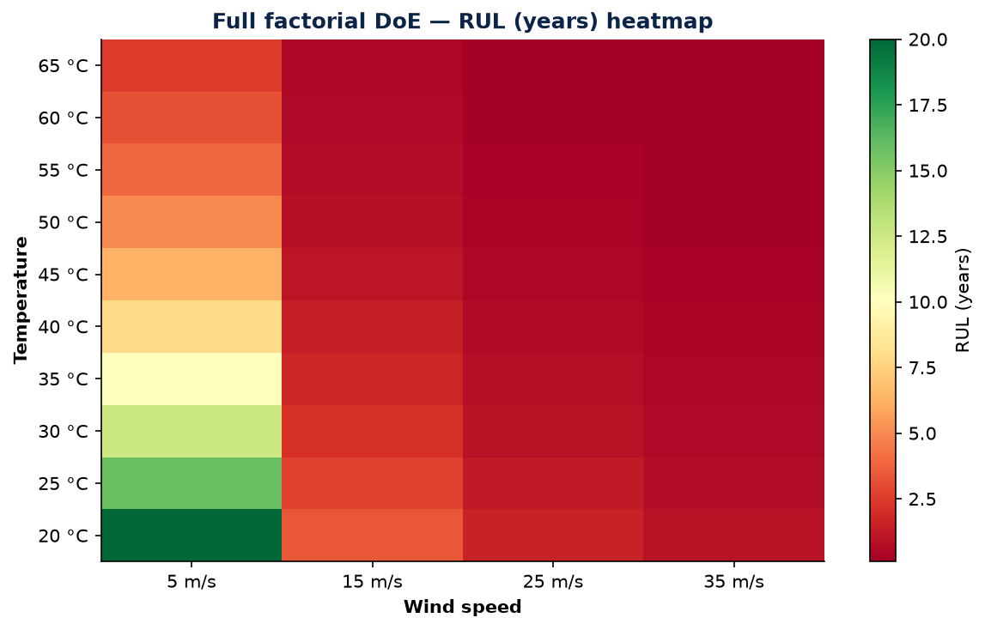
6. DoE Results — Design Space Heatmap
40-run factorial: RUL (years) across wind × temperature

Slide 8
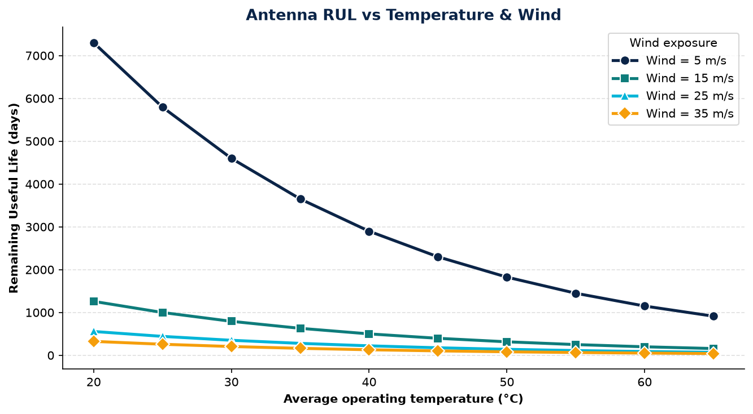
7. RUL vs Temperature (by Wind Level)
Higher wind collapses RUL curves — dominant degradation driver

Slide 9
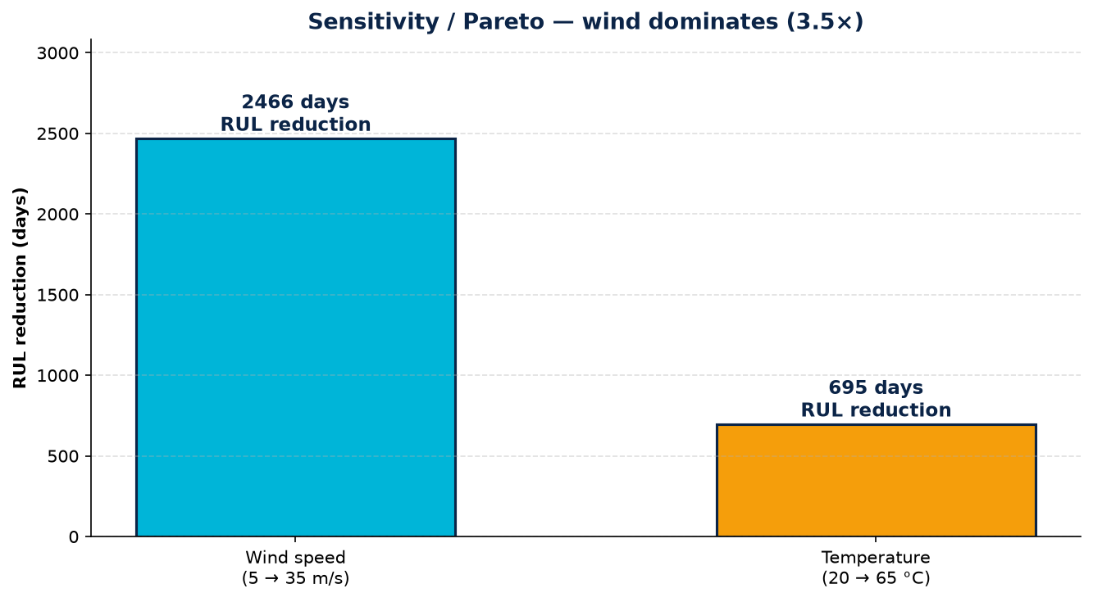
8. Sensitivity & Pareto — Key Finding
Wind speed impact ≈ 3.5× temperature — counterintuitive for RF engineers

Slide 10
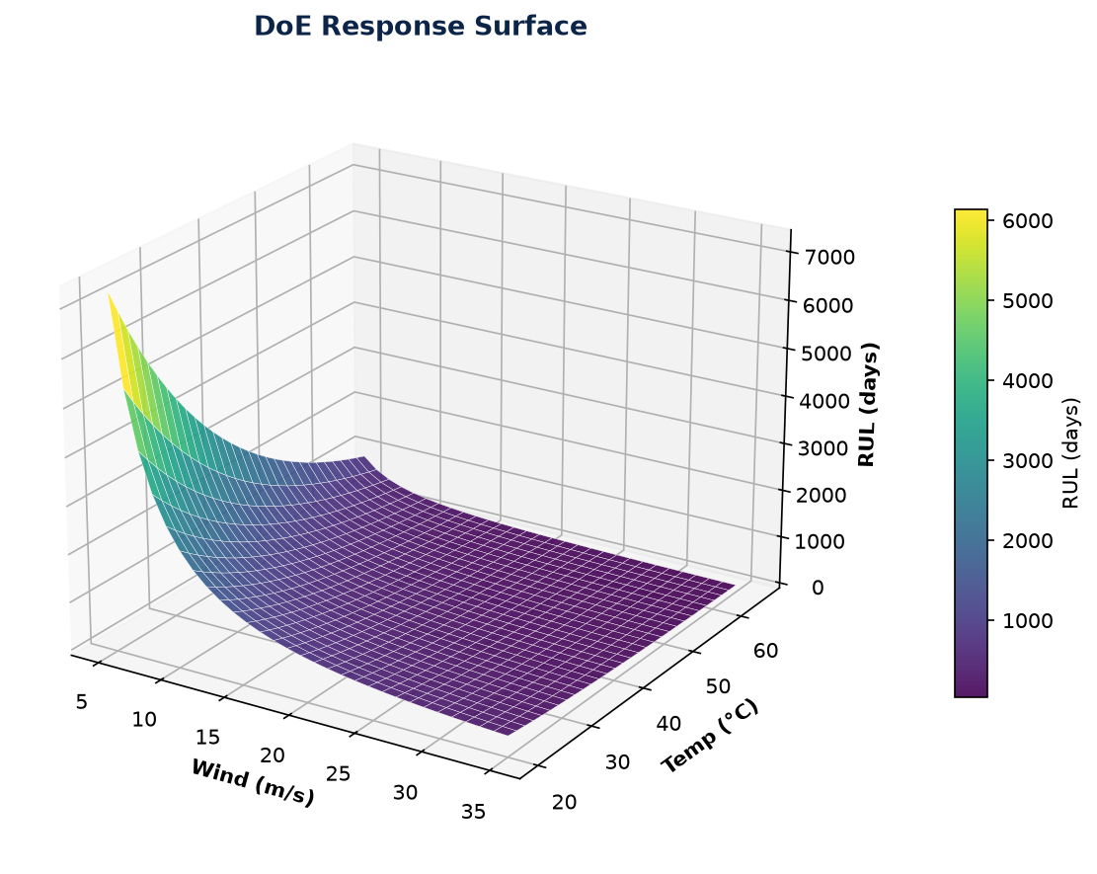
9. Response Surface (DoE POST)
3D surface — equivalent to HEEDS POST visualization

Slide 11
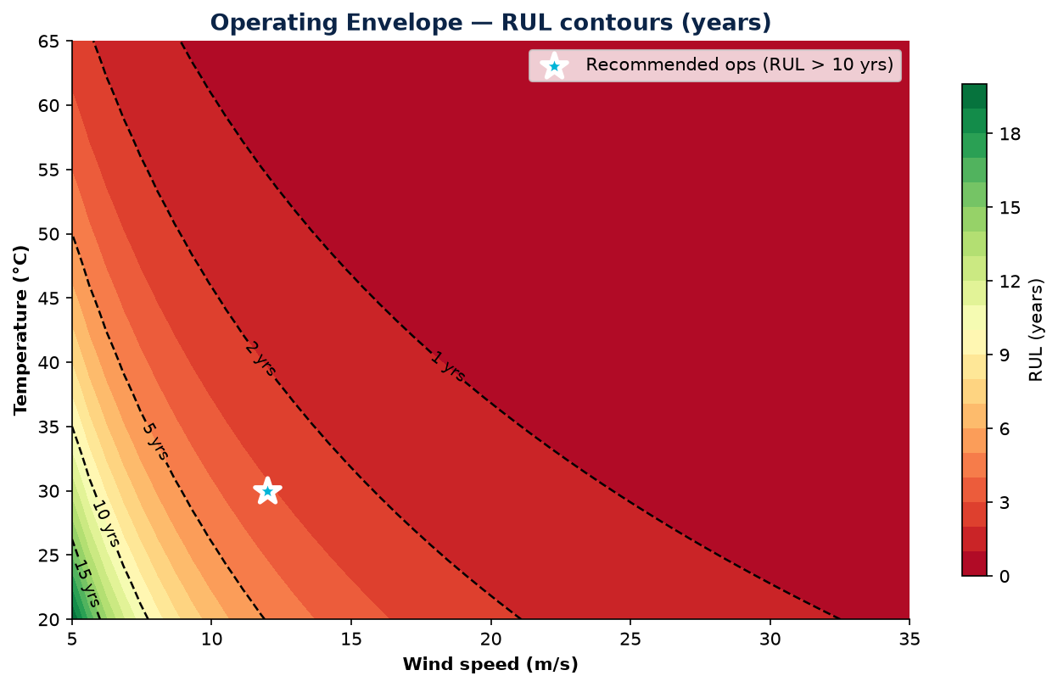
10. Operating Envelope Recommendation
Safe ops: wind ≤ 12 m/s, temp ≤ 30°C → RUL > 10 years

Slide 12
11. Verification vs Validation (This Project)
Verification — 'Have I done the maths right?'
• Sanity checks at anchor points; unit consistency; monotonic trends
Validation — 'Have I done the right maths?'
• Compare predicted RUL ranking with field failure reports
• Future: correlate with Simcenter FEA fatigue at hotspots
Calibration: tune exponent 1.6 and Arrhenius slope using failure data
TRL 4–5: component validated in lab/relevant environment; not fleet-deployed

Slide 13
12. HEEDS Mapping & Live Demo
HEEDS Example 4 (Coil Spring) → Antenna RUL:
• Input tags: wind_ms, temp_C (like coil_diam, wire_diam)
• Output tags: rul_days, rul_years (like deflection, stress)
• Study type: DOE — NOT optimization
Live demo: python project/run_project.py
→ prints verification, DoE table, Pareto ratio, exports figures
Jupyter notebook: DigitalTwin_Antenna_RUL.ipynb (full reproducibility)

Slide 14
13. Value Proposition & Creativity
• Extends real €220K drone inspection into predictive maintenance twin
• Creative contribution: telecom-specific RUL physics + DoE envelope
• Pugh matrix winner vs climber-only / geometry-only approaches
• FMEA: wind fatigue failure mode → digital twin monitoring layer
• Business impact: fewer outages, safer crews, data-driven maintenance windows

Slide 15
14. References
1. AIAA (2020). Digital Twin: Definition & Value
2. Grieves & Vickers (2017). Digital Twin: Mitigating Unpredictable Behavior
3. Tao et al. (2019). Digital Twin in Industry. IEEE TII
4. Montgomery (2017). Design and Analysis of Experiments. Wiley
5. Jardine et al. (2006). Machinery diagnostics review. MSSP
6. Liu et al. (2021). UAV photogrammetry for telecom towers
7. Kapteyn et al. (2021). Predictive digital twins. Nature Comp Sci
8. ISO/IEC 30173:2023 — Digital twin terminology
9. Siemens (2024). HEEDS Multi-Disciplinary Design Exploration

Slide 16
15. Thank You — Q&A Backup
Memorise for oral:
• DT definition with 'throughout its lifecycle'
• V vs V vs calibration — one example each from antenna
• Model coupling: structural + thermal + wind + RUL interdependent
• Extrapolation risk beyond 35 m/s or 65°C
• PCA 6 steps · P-diagram centre: maintain structural integrity
Thank you — questions welcome.

