Slide 1
Big data with Hadoop and Spark
PROJECT
Building a movies recommendation system using collaborative filtering and Alternate least square(ALS)
By
Meghana Vasavada
Date: 09-07-2017

Slide 2
CONTENTS
Recommender System
Collaborative Filtering
Alternating Least Squares (ALS)Algorithm
MovieLens Dataset
Movies Recommendation Pipeline
ALS model and movies Prediction using SPARK in Databricks
Conclusion
References

Slide 3
Recommender System
What is a Recommender System?
Subclass of information filtering system that seeks to predict the "rating" or "preference" that a user would give to an item E.g. music, books and movies
Examples:
In eCommerce recommend items
In eLearning recommend content
In search and navigation recommend links
Use items as generic term for what is recommended
How does it Help?
Help people (customers, users) make decisions
Recommendation is based on preferences
Of an individual
Of a group or community

Slide 4
Recommender System
TYPES OF RECOMMENDER SYSTEM
Content-Based (CB) – use personal preferences to match and filter items
E.g. what sort of books do I like?
Collaborative Filtering (CF) – match ‘like-minded’ people
E.g. if two people have similar ‘taste’ they can recommend items to each other
Social Software – the recommendation process is supported but not automated
E.g. Weblogs provide a medium for recommendation
Social Data Mining – Mine log data of social activity to learn group preferences
E.g. web usage mining

Slide 5
Collaborative filtering
Collaborative filtering: An efficient algorithm to match people with similar interests
In Collaborative filtering we make predictions (filtering) about the interests of a user by collecting preferences or taste information from many users(collaborating).
The underlying assumption is that if a user A has the same opinion as a user B on an issue, A is more likely to have B's opinion on a different issue x than to have the opinion on x of a user chosen randomly.
Commonly used for recommender systems.
These techniques aim to fill in the missing entries of a user-item association matrix.

Slide 6
Collaborative filtering
How does Collaborative filtering work?
Users rate items – user interests recorded. Ratings may be:
Explicit:- buying or rating an item
Implicit:- browsing time, no. of mouse clicks
Nearest neighbour matching used to find people with similar interests
Items that neighbours rate highly but that you have not rated are recommended to you
User can then rate recommended items

Slide 7
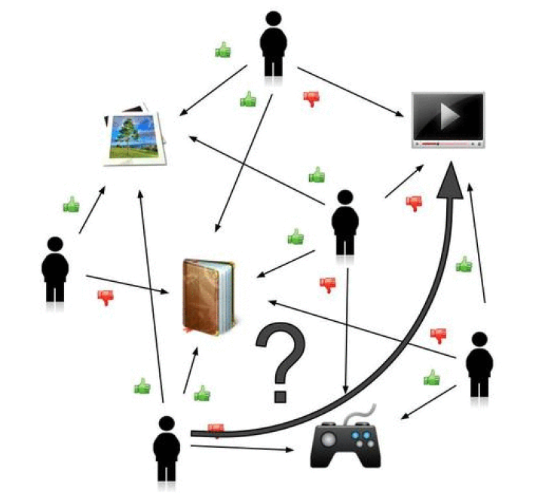
The image below shows an example of collaborative filtering. At first, people rate different items (like videos, images, games). Then, the system makes predictions about a user's rating for an item not rated yet. The new predictions are built upon the existing ratings of other users with similar ratings with the active user. In the image, the system predicts that the user will not like the video

Slide 8
Collaborative filtering
Spark MLlib library for Machine Learning provides a Collaborative Filtering implementation by using Alternating Least Squares (ALS). The implementation in MLlib has the following parameters:
numBlocks is the number of blocks used to parallelize computation (set to 1to autoconfigure).
rank is the number of latent factors in the model.
iterations is the number of iterations to run.
lambda specifies the regularization parameter in ALS.
implicitPrefs specifies whether to use the explicit feedback ALS variant or one adapted for implicit feedback data. (optional)
alpha is a parameter applicable to the implicit feedback variant of ALS that governs the baseline confidence in preference observations.

Slide 9
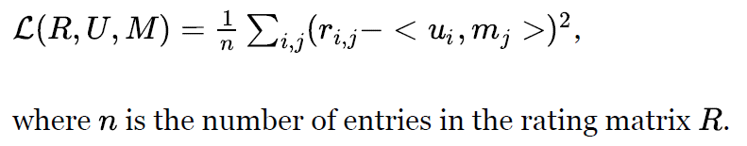
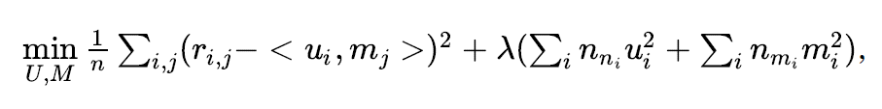
Alternating Least Squares(ALS)
Matrix R can be factorized into two nonnegative matrices, a user-preference matrix U and a preference-rating matrix M
The loss function used in ALS is so called rooted mean square error (RMSE) defined as
In addition, ALS applies L norm regularization on the parameter spaces and U and M.
Combine the loss function, the objective of ALS can be formulated as
where lambda is the regularization parameter that controls the balance of the loss term and the regularization term, nui is the number of movies rated by user i, and nmi is the number of users that rate movies .

Slide 10
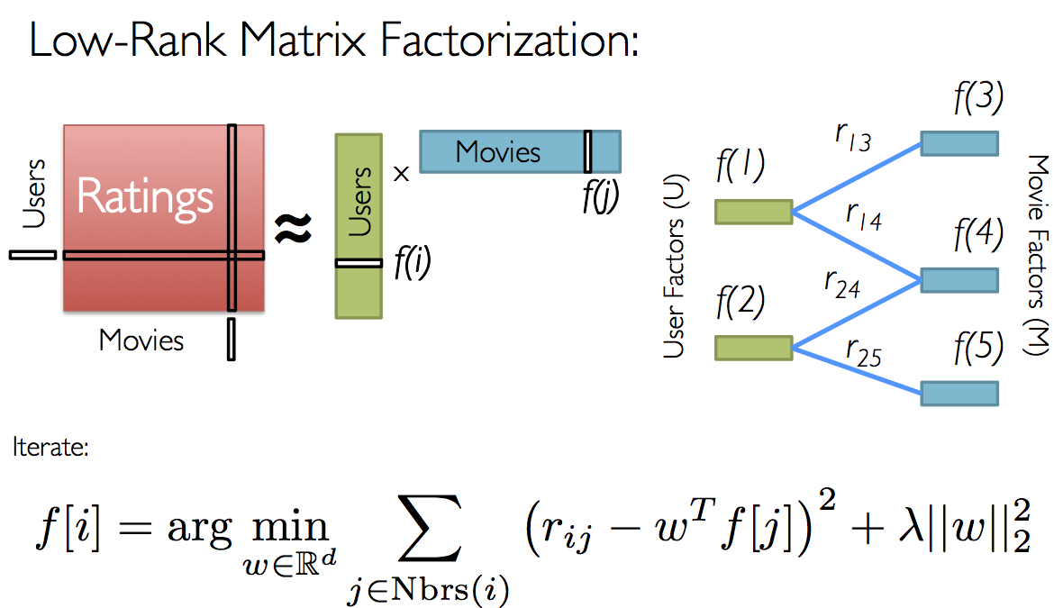
Alternating Least Squares(ALS)

Slide 11
MovieLens Dataset
UserId: MovieLens users were selected at random for inclusion. Their ids have been anonymized. User ids are consistent between ratings.csv and tags.csv (i.e., the same id refers to the same user across the two files)
MovieId: Only movies with at least one rating or tag are included in the dataset. Movie ids are consistent between ratings.csv, tags.csv, movies.csv, and links.csv
Ratings: All ratings are contained in the file ratings.csv. Ratings are made on a 5-star scale
Tags: All tags are contained in the file tags.csv. Each line of this file after the header row represents one tag applied to one movie by one user
Title: Title of the movies from movies.csv
Genres: Genres are a pipe-separated list, e.g Action, Animation

Slide 12
Movies Recommendation-Pipeline
Create a Dataframe from Movies.csv and Ratings.csv
Create a Training and Test Dataset (80:20)
Train the Training model with ALS training parameters
Transform the model to predict the test dataset and compute the Root Mean Square Error (RMSE)
Transform the model to predict the test dataset
Evaluate the model by Cross Validation approach by fine tuning the parameters- New model
Transform the validated model to predict the test dataset

Slide 13
Movies Recommendation-Pipeline
Create the new dataset of 10 new User ratings with UserId as 0
Add the new dataset to the training dataset
Train the new training dataset with ALS training parameters from best model
Repeat the steps for testing the prediction and RMSE
Transform against the unrated movies
Get the top 20 recommended movies having atleast > 500 reviews
Save the model and export the csv file

Slide 14
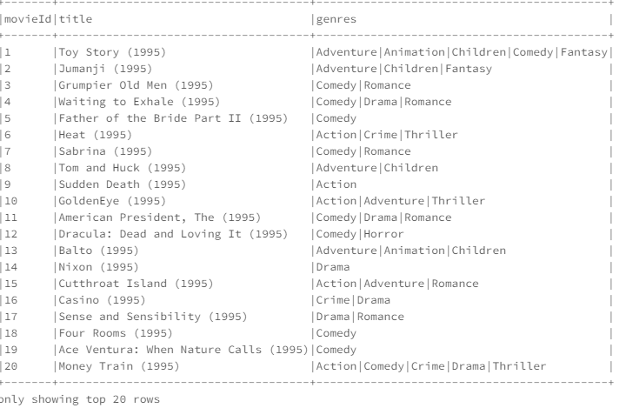
ALS model and movies Prediction using SPARK in Databricks
Creating a Dataframe from movies.csv
moviesDF = spark.sql("select * from movies")
moviesDF.show(truncate = False)

Slide 15
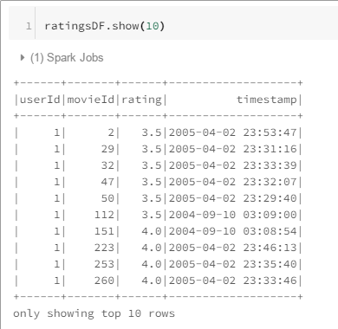
ALS model and movies Prediction using SPARK in Databricks
Creating a Dataframe from ratings.csv
ratingsDF = spark.sql("select * from ratings")
ratingsDF.show()

Slide 16
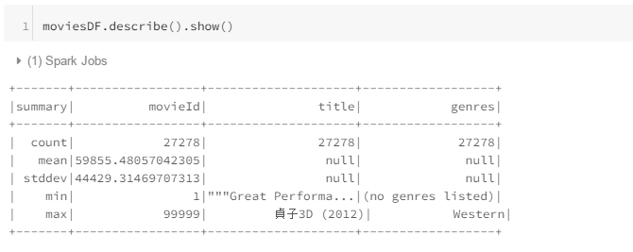
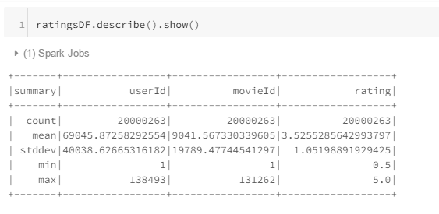
ALS model and movies Prediction using SPARK in Databricks
EDA: Compute statistics to get a better understanding of the data

Slide 17
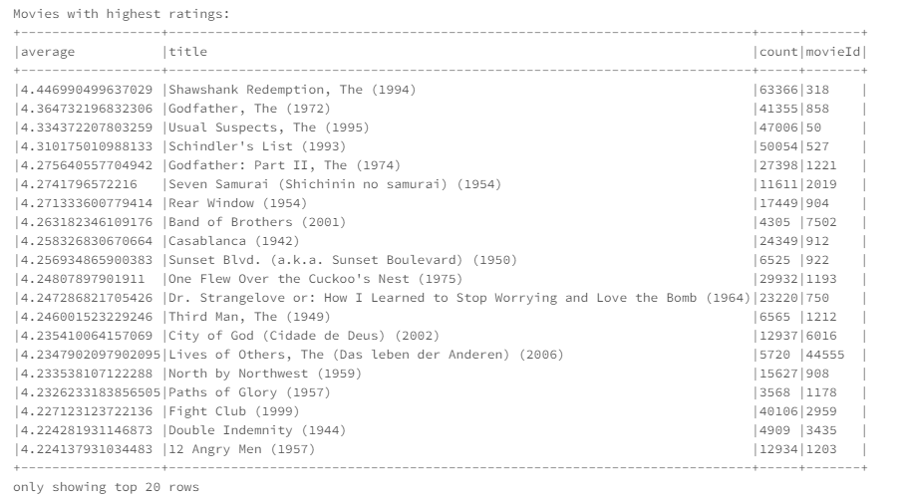
ALS model and movies Prediction using SPARK in Databricks
Analysis to display movies with Highest ratings with more than 500 reviews before training

Slide 18
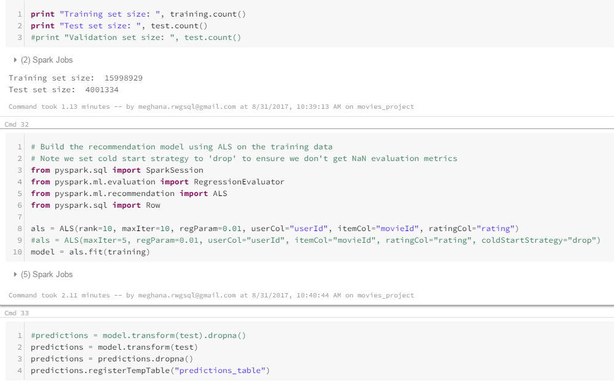
ALS model and movies Prediction using SPARK in Databricks
Collaborative Filtering:
- Splitting Data into Train and test datasets
- Generate a Recommendation model using ALS on the training data and transforming it with Test dataset to generate predictions
(training, test) = ratingsDF.randomSplit([0.8, 0.2])

Slide 19
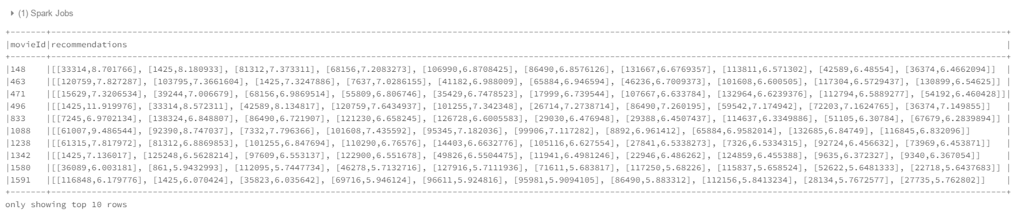
ALS model and movies Prediction using SPARK in Databricks
Collaborative Filtering:
The script below generates top 10 user recommendations for each movie. Here 10 movies
movieRecs = model.recommendForAllItems(10)
movieRecs.show(10,truncate = False)

Slide 20
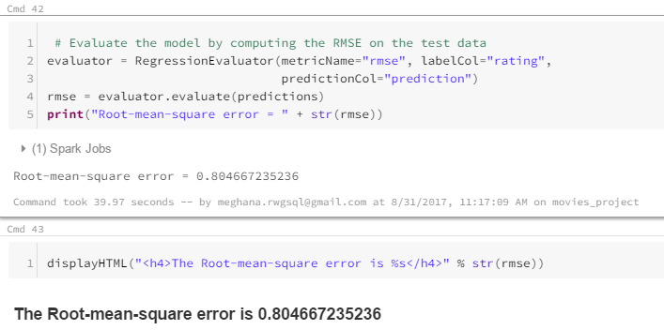
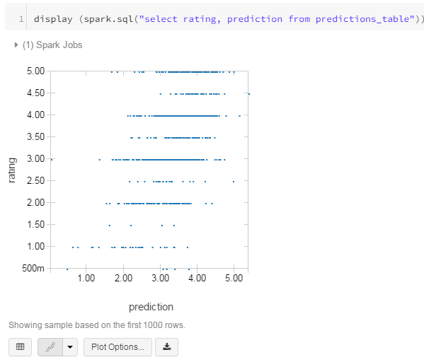
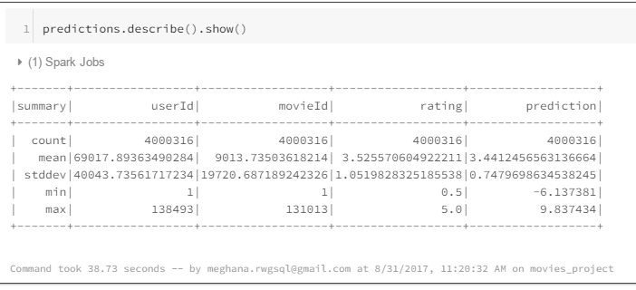
ALS model and movies Prediction using SPARK in Databricks
Collaborative Filtering: Computing Root Mean Square error (RMSE) from the first model
Plot: Ratings vs Predictions

Slide 21
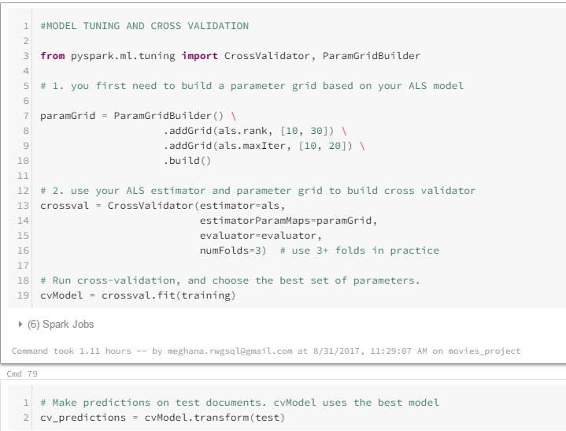
ALS model and movies Prediction using SPARK in Databricks
Collaborative Filtering: Validating the model by fine tuning the parameters

Slide 22

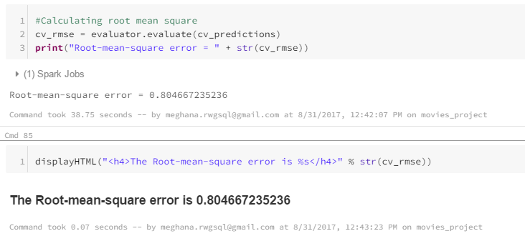
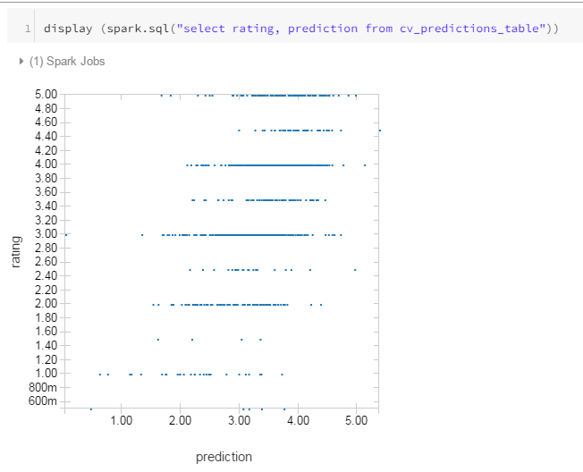
ALS model and movies Prediction using SPARK in Databricks
Collaborative Filtering: Computing RMSE and generating plot of data from Validated model model
Plotting Ratings vs Predictions

Slide 23
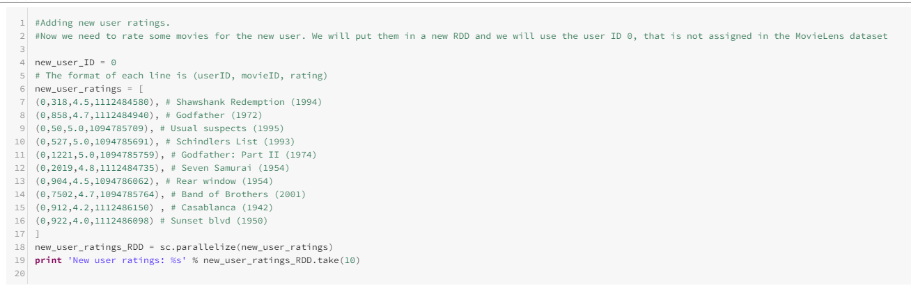
ALS model and movies Prediction using SPARK in Databricks
Collaborative Filtering: Predicting new user ratings
We need to rate some movies for the new user. We will put them in a new RDD and we will use the user ID 0, that is not assigned in the MovieLens dataset.

Slide 24
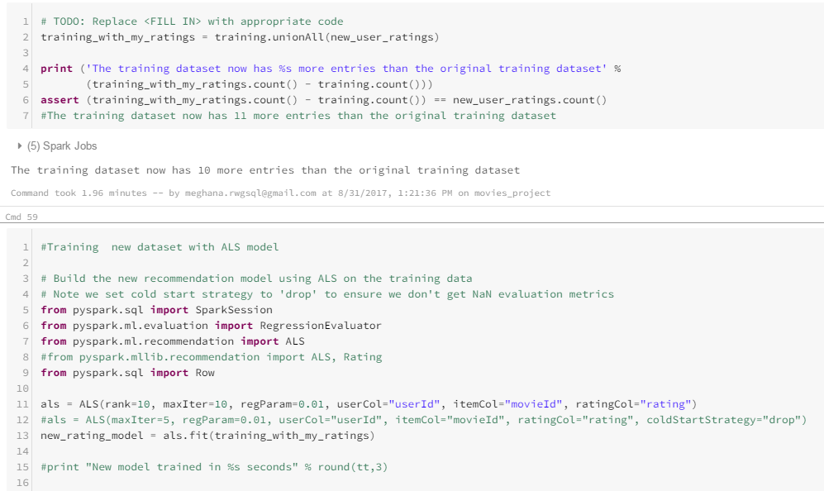
ALS model and movies Prediction using SPARK in Databricks
Collaborative Filtering: Predicting new user ratings
New Training data = new user ratings + training dataset
Building a new model with ALS on new Training dataset

Slide 25
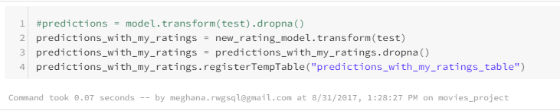
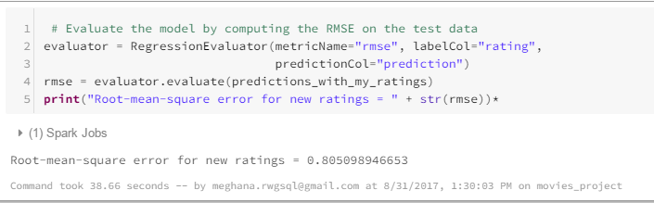
ALS model and movies Prediction using SPARK in Databricks
Collaborative Filtering: Testing the new model with test dataset
Computing RMSE

Slide 26
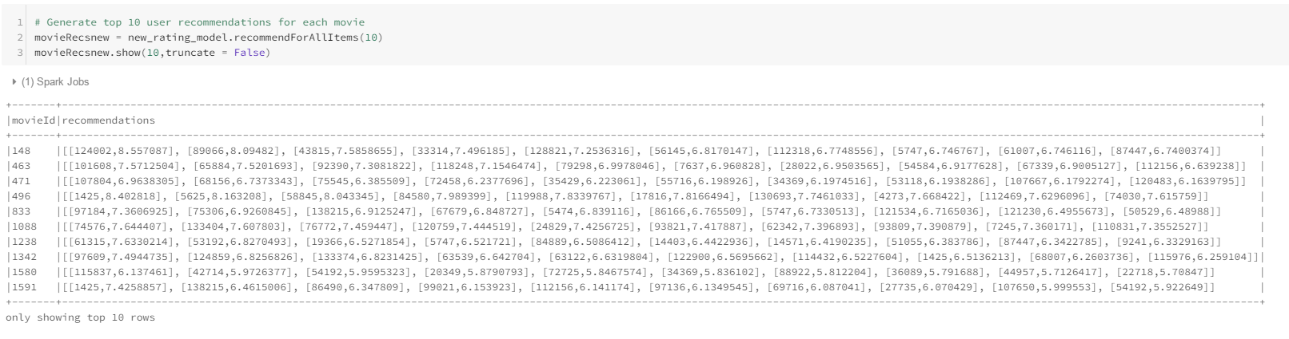
ALS model and movies Prediction using SPARK in Databricks
Predicting new user ratings: Top 10 user recommendations for each movie from the new model

Slide 27
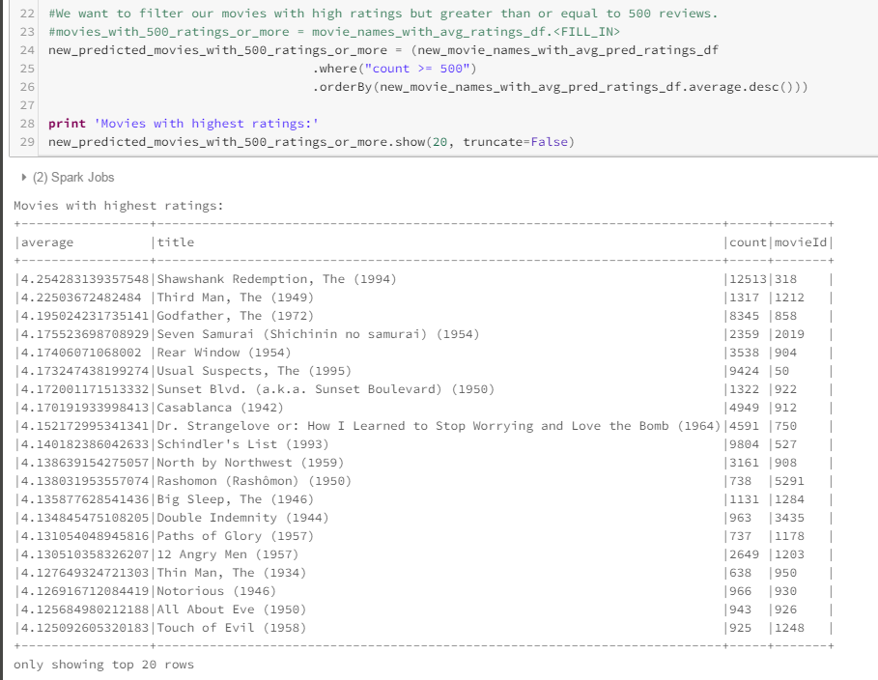
ALS model and movies Prediction using SPARK in Databricks
Filter out movies with high ratings > 500 reviews from the predicted dataset

Slide 28
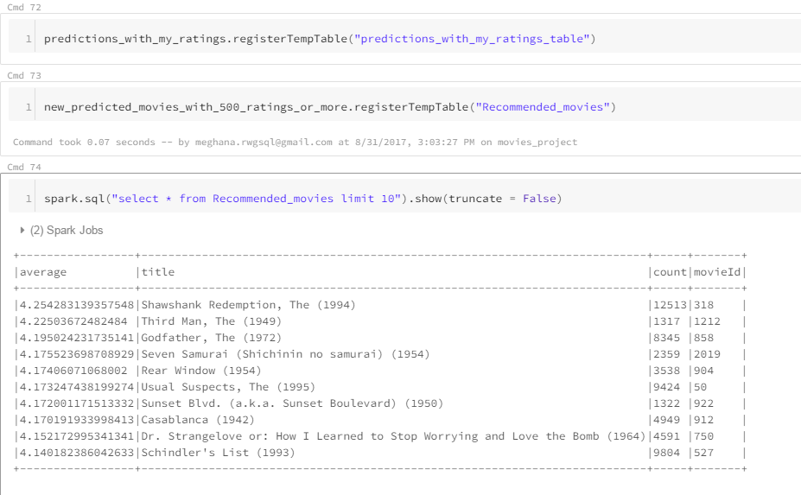
ALS model and movies Prediction using SPARK in Databricks
Filter out movies with high ratings > 500 reviews from the predicted dataset

Slide 29
ALS model and movies Prediction using SPARK in Databricks
average | title | count | movieId
4.254283139 | Shawshank Redemption, The (1994) | 12513 | 318
4.225036725 | Third Man, The (1949) | 1317 | 1212
4.195024232 | Godfather, The (1972) | 8345 | 858
4.175523699 | Seven Samurai (Shichinin no samurai) (1954) | 2359 | 2019
4.174060711 | Rear Window (1954) | 3538 | 904
4.173247438 | Usual Suspects, The (1995) | 9424 | 50
4.172001172 | Sunset Blvd. (a.k.a. Sunset Boulevard) (1950) | 1322 | 922
4.170191934 | Casablanca (1942) | 4949 | 912
4.152172995 | Dr. Strangelove or: How I Learned to Stop Worrying and Love the Bomb (1964) | 4591 | 750
4.140182386 | Schindler's List (1993) | 9804 | 527

Slide 30
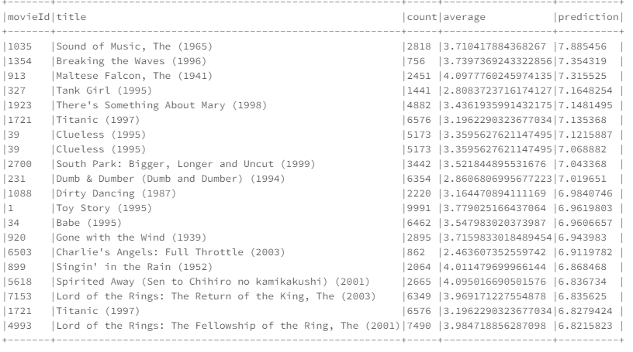
ALS model and movies Prediction using SPARK in Databricks
Getting the movies from Recommended_movies table and Predictions Dataframe
Rec_movies_gt_500_reviews = spark.sql("select Recommended_movies.movieId, Recommended_movies.title, Recommended_movies.count, Recommended_movies.average,predictions_with_my_ratings_table.prediction \
FROM Recommended_movies \
JOIN predictions_with_my_ratings_table ON predictions_with_my_ratings_table.movieId=Recommended_movies.movieId \
ORDER BY predictions_with_my_ratings_table.prediction DESC\
LIMIT 20")
Rec_movies_gt_500_reviews.show(truncate = False)

Slide 31
ALS model and movies Prediction using SPARK in Databricks
Recommended movies with > 500 reviews and ratings: From Recommended_movies table and Predictions Dataframe
movieId | title | count | average | prediction
1035 | Sound of Music, The (1965) | 2818 | 3.710417884 | 7.885456
1354 | Breaking the Waves (1996) | 756 | 3.739736924 | 7.354319
913 | Maltese Falcon, The (1941) | 2451 | 4.097776025 | 7.315525
327 | Tank Girl (1995) | 1441 | 2.808372372 | 7.1648254
1923 | There's Something About Mary (1998) | 4882 | 3.436193599 | 7.1481495
1721 | Titanic (1997) | 6576 | 3.196229032 | 7.135368
39 | Clueless (1995) | 5173 | 3.359562762 | 7.1215887
39 | Clueless (1995) | 5173 | 3.359562762 | 7.068882
2700 | South Park: Bigger, Longer and Uncut (1999) | 3442 | 3.521844896 | 7.043368
231 | Dumb &amp; Dumber (Dumb and Dumber) (1994) | 6354 | 2.8606807 | 7.019651
1088 | Dirty Dancing (1987) | 2220 | 3.164470894 | 6.9840746
1 | Toy Story (1995) | 9991 | 3.779025166 | 6.9619803
34 | Babe (1995) | 6462 | 3.54798302 | 6.9606657
920 | Gone with the Wind (1939) | 2895 | 3.715983302 | 6.943983
6503 | Charlie's Angels: Full Throttle (2003) | 862 | 2.463607353 | 6.9119782
899 | Singin' in the Rain (1952) | 2064 | 4.0114797 | 6.868468
5618 | Spirited Away (Sen to Chihiro no kamikakushi) (2001) | 2665 | 4.095016691 | 6.836734
7153 | Lord of the Rings: The Return of the King, The (2003) | 6349 | 3.969171228 | 6.835625
1721 | Titanic (1997) | 6576 | 3.196229032 | 6.8279424
4993 | Lord of the Rings: The Fellowship of the Ring, The (2001) | 7490 | 3.984718856 | 6.8215823

Slide 32
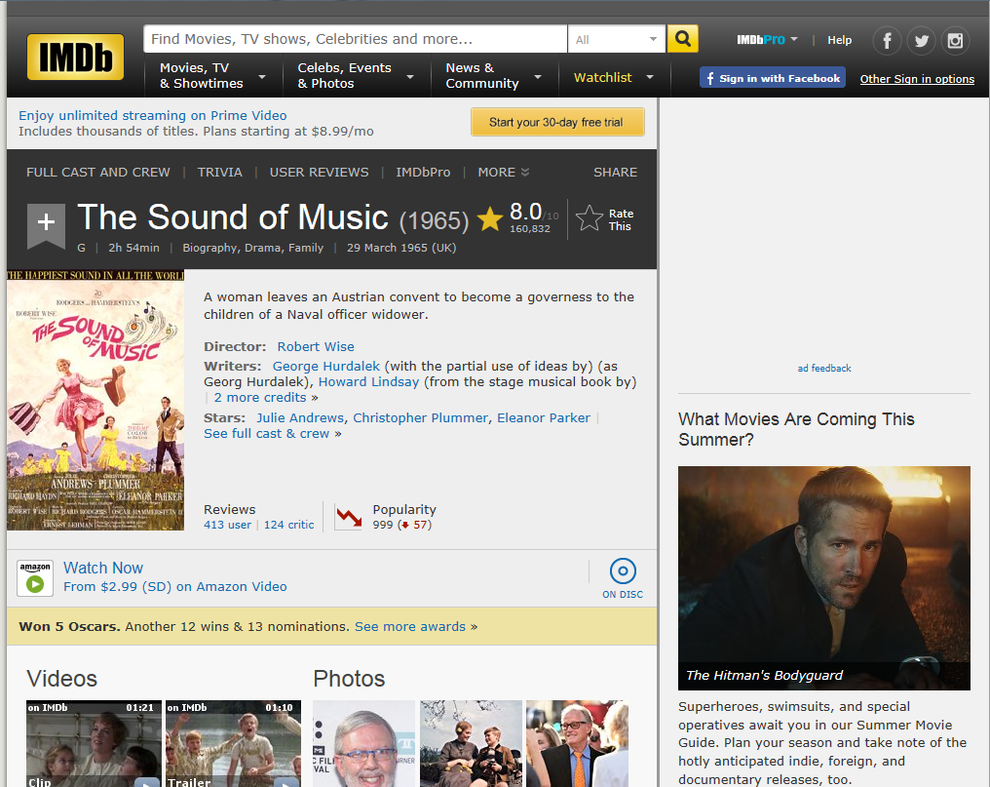
Movies Recommendation
Sound of Music, The (1965)

Slide 33
Conclusion
Spark's MLlib library provides scalable data analytics through a rich set of methods.
Its Alternating Least Squares implementation for Collaborative Filtering is one that fits perfectly in a recommendation engine.
Due to its very nature, collaborative filtering is a costly procedure since requires updating its model when new user preferences arrive.
Therefore, having a distributed computation engine such as Spark to perform model computation is a must in any real world.

Slide 34
References
https://github.com/apache/spark/blob/master/examples/src/main/python/ml/als_example.py
http://spark.apache.org/docs/preview/mllib-collaborative-filtering.html#collaborative-filtering

Slide 35
THANK YOU

