Slide 1
Anomaly detection

Slide 2
What Is Anomaly Detection?
Anomaly detection is finding patterns that do not adhere to what is considered as normal or expected behavior
Generally, an anomaly is an outcome or value that deviates from what is expected, but the exact criteria for what determines an anomaly can vary from situation to situation.
Categories of Anomalies
• Data point-based anomalies
• Context-based anomalies
• Pattern-based anomalies

Slide 3
Data Point-Based Anomalies
If a single instance in a given dataset is different from others with respect to its attributes
A single instance of data is anomalous if it's too far off from the rest. Business use case: Detecting credit card fraud based on "amount spent."
Contextual Based anomalies:
The abnormality is context specific
For example, you might expect a sudden surge in purchases near certain holidays, but these purchases could seem out of place otherwise
Collective anomalies:
A set of data instances collectively helps in detecting anomalies. Business use case: Someone is trying to copy data form a remote machine to a local host unexpectedly, an anomaly that would be flagged as a potential cyber attack.

Slide 4
Anomaly detection is similar to — but not entirely the same as — noise removal and novelty detection.
Outlier Detection:
An outlier may be defined as a piece of data or observation that deviates drastically from the given norm or average of the data set.
Here is a simple scenario in outlier detection, a measurement process consistently produces readouts between 1 and 100(Age), but in some rare cases we get measurements of greater than 200
Novelty detection
Is concerned with identifying an unobserved pattern in new observations not included in training data
Noise removal
In noise removal, there is constant background noise in the data set that must be filtered out
This can also be a case where an image has been altered in some form, such as by having perturbations, loss of detail, fog, etc. The model learns an accurate representation of the original image and outputs a reconstruction without any of the anomalous elements in the image

Slide 5
The Three Styles of Anomaly Detection
Supervised anomaly detection
Semi-supervised anomaly detection
Unsupervised anomaly detection

Slide 6
Supervised anomaly detection is a technique in which the training data has labels for both anomalies and for normal data points. Basically, you tell the model during the training process if a data point is an anomaly or not.
Ex: Random forest, Logistic Regression, Xgboost etc.
Semi-supervised anomaly detection involves partially labeling the training data set. In the context of anomaly detection, this can be a case where only the normal data is labeled. Ideally, the model will learn what normal data points look like, so that the model can flag anomalous data points as anomalies since they differ from normal data points.
Ex: One-Class Support Vector Machine
Unsupervised anomaly detection, as the name implies, involves training the model on unlabeled data. After the training process, the model is expected to know what data points are normal and what points are anomalous within the data set.
Ex: Isolation forest

Slide 7
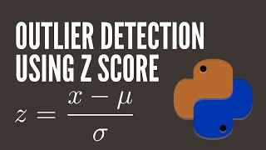
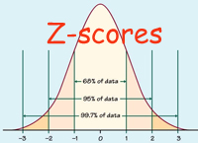
Anomaly Detection Techniques
Simple Statistical Methods :
The simplest approach to identifying irregularities in data is to flag the data points that deviate from common statistical properties of a distribution, including mean, median, mode, and quantiles. Let's say the definition of an anomalous data point is one that deviates by a certain standard deviation from the mean.
In case of time series data, we use rolling window to compute the average across the data points. Technically, this is called a rolling average or a moving average, and it's intended to smooth short-term fluctuations and highlight long-term ones.

Slide 8
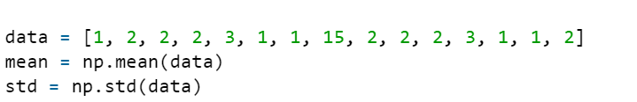
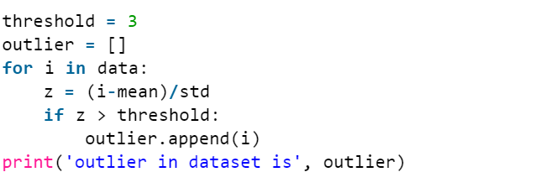

Example :
https://www.geeksforgeeks.org/z-score-for-outlier-detection-python/

Slide 9
Machine Learning-Based Approaches
Density-Based Anomaly Detection
Density-based anomaly detection is based on the k-nearest neighbors' algorithm.
Assumption: Normal data points occur around a dense neighborhood and abnormalities are far away.
The nearest set of data points are evaluated using a score, which could be Euclidian distance or a similar measure dependent on the type of the data (categorical or numerical). They could be broadly classified into two algorithms:
K-nearest neighbor: k-NN is a simple, non-parametric lazy learning technique used to classify data based on similarities in distance metrics such as Eucledian, Manhattan, Minkowski, or Hamming distance.
2 local outlier factor (LOF). This concept is based on a distance metric called reachability distance.
It measures the local deviation of density of a given sample with respect to its neighbors. It is local in the sense that anomaly score depends on how isolated the object is with respect to the surrounding neighborhood.
https://scikit-learn.org/stable/modules/generated/sklearn.neighbors.LocalOutlierFactor.html

Slide 10
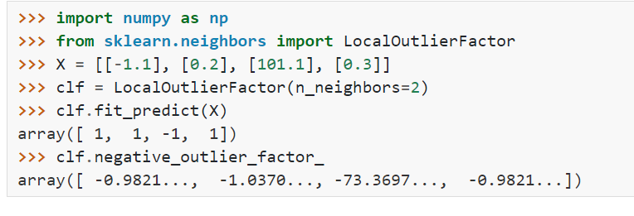
Local outlier factor
fit_predict(X[, y]) | Fits the model to the training set X and returns the labels.
fit(X[, y]) | Fit the local outlier factor detector from the training dataset.
negative_outlier_factor_ | The opposite LOF of the training samples. The higher, the more normal. Inliers tend to have a LOF score close to 1 (negative_outlier_factor_ close to -1), while outliers tend to have a larger LOF score.

Slide 11
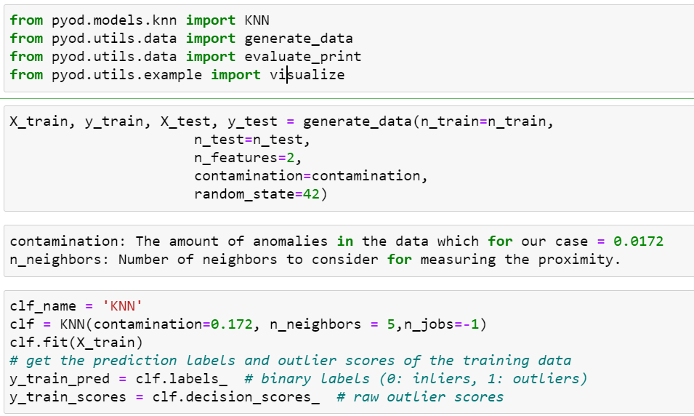
PyOD is a comprehensive Python toolkit to identify outlying objects in multivariate data with both unsupervised and supervised approaches
KNN
https://github.com/yzhao062/pyod

Slide 12
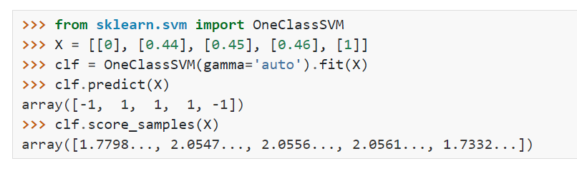
One-Class Support Vector Machine
The One-Class SVM is a modified support vector machine model that is well-suited for novelty detection (an example of semi-supervised anomaly detection). The idea is that the model trains on normal data and is used to detect anomalies when new data is presented to it.
fit(X[, y, sample_weight]) | Detect the soft boundary of the set of samples X.
fit_predict(X[, y]) | Perform fit on X and returns labels for X.
predict(X) | Perform classification on samples in X.
score_samples(X) | Raw scoring function of the samples.

Slide 13
Clustering-Based Anomaly Detection
Clustering is one of the most popular concepts in the domain of unsupervised learning.
Assumption: Data points that are similar tend to belong to similar groups or clusters, as determined by their distance from local centroids.
K-means is a widely used clustering algorithm. It creates 'k' similar clusters of data points. Data instances that fall outside of these groups could potentially be marked as anomalies.

Slide 14
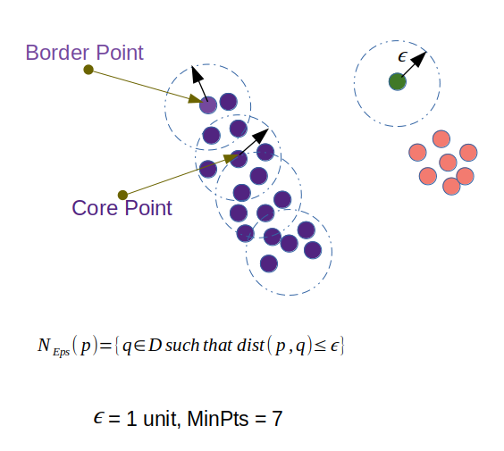
DBSCAN (Density-Based Spatial Clustering of Applications with Noise)
This is a clustering algorithm (an alternative to K-Means) that clusters points together and identifies any points not belonging to a cluster as outliers. It’s like K-means, except the number of clusters does not need to be specified in advance.
Terminology
Epsilon : The maximum distance between two samples for one to be considered as in the neighborhood of the other
minPoints is the minimum number of data points required a point to be considered as a core point. This includes the point itself.

Slide 15
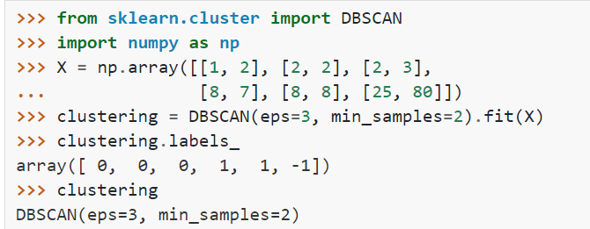
DBSCAN creates a circle of epsilon radius around every data point and classifies them into Core point,
,Border point, and Noise
Core point : A data point is a Core point if the circle around it contains at least ‘minPoints’ number of points
Border Point : A data point is Border point is it doesn’t contain minPoints of data points around it but its reachable to Core point
Noise : A data point is noise if its neither a core point nor a boarder point

Slide 16
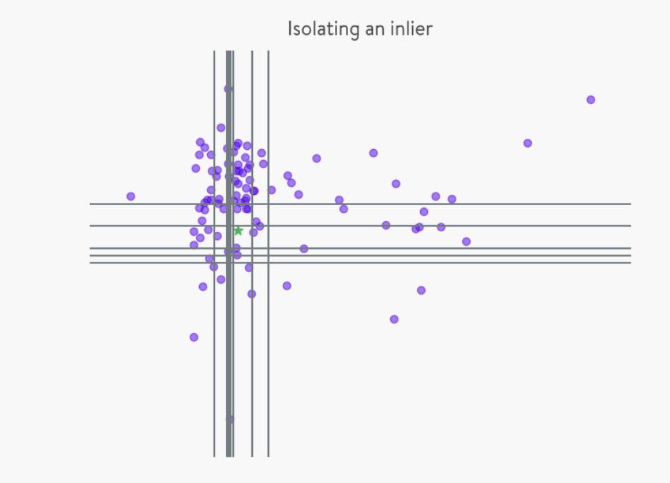
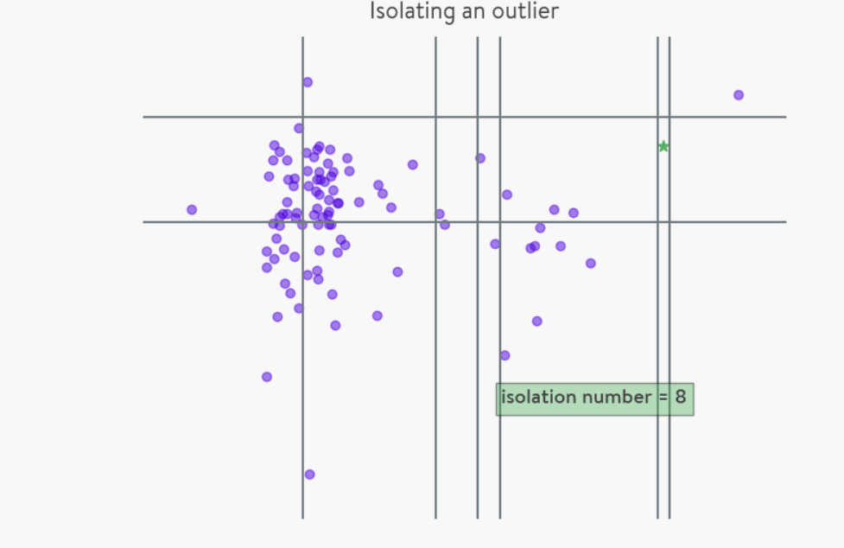
Isolation forest Anomaly Detection
The algorithm isolates each point in the data and splits them into outliers or inliers. This split depends on how long it takes to separate the points.
If we try to segregate a point which is obviously a non-outlier, it’ll have many points in its round, so that it will be really difficult to isolate. On the other hand, if the point is an outlier, it’ll be alone and we’ll find it very easily
An advantage of this algorithm is that it works with a huge data set and several dimensions

Slide 17
Procedure:
How do we separate each point? The simple procedure is as follows for each point of the data set:
Select the point to isolate.
For each feature, set the range to isolate between the minimum and the maximum.
Choose a feature randomly.
Pick a value that’s in the range, again randomly:
If the chosen value keeps the point above, switch the minimum of the range of the feature to the value.
If the chosen value keeps the point below, switch the maximum of the range of the feature to the value.
Repeat steps 3 & 4 until the point is isolated. That is, until the point is the only one which is inside the range for all features.
Count how many times you’ve had to repeat steps 3 & 4. We call this quantity the isolation number.
The algorithm claims that a point is an outlier if it doesn’t have to repeat the steps 3 & 4 several times.
Note that the above pseudocode is a simplification of the real process to understand it better. Actually, as it uses random numbers, this procedure is applied several times and the final isolation number is a combination of all isolation numbers.

Slide 18
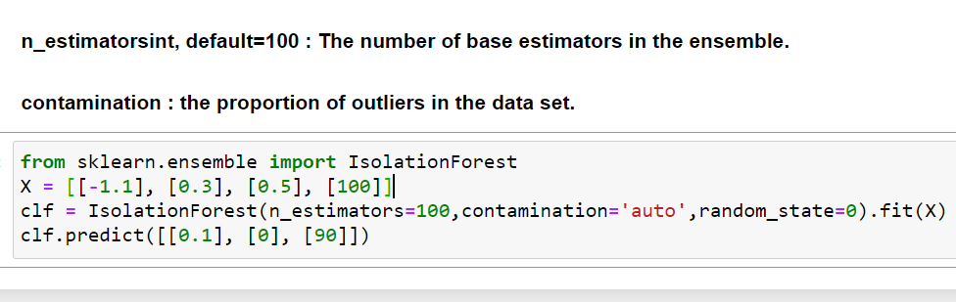
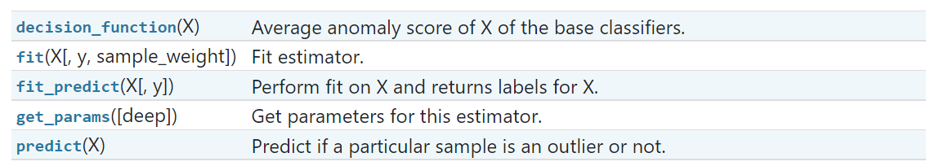
https://quantdare.com/isolation-forest-algorithm/

