Slide 1
Excel Assessment-1

Slide 2
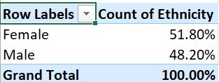
Question-1

Slide 3
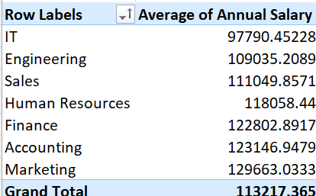
Question-3
There seems to be difference between different departments, but significant means should say about human
resources

Slide 4
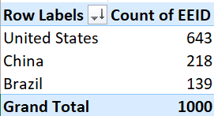
Question-4
United States has the highest

Slide 5
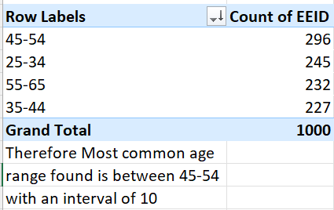
Question-5

Slide 6

Question-6

Slide 7
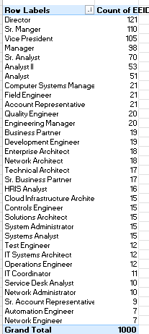
Question-7
Director Job title occurs the most

Slide 8
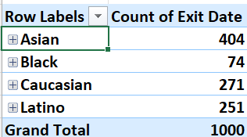
Question-8

Slide 9
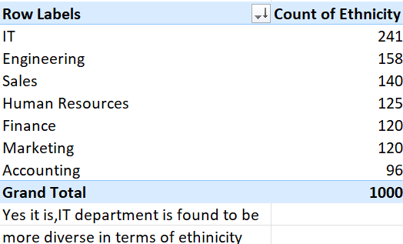
Question-9

Slide 10
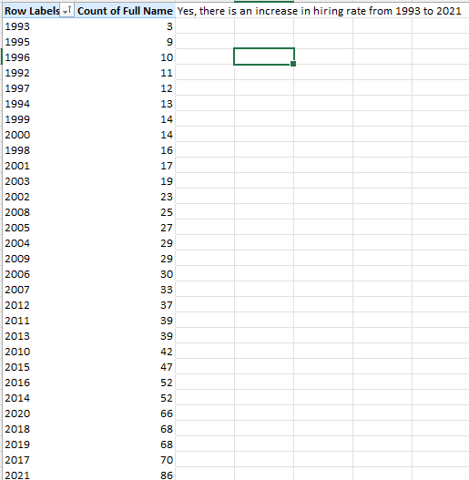
Question-10
Yes, there is increase from
1993 to 2021

