Slide 1
Session-2 Pods an Volunes

Slide 2
What is a Pod?
The smallest unit in Openshift
It contains one or more tightly coupled containers inside it
Each pod has an internal network (localhost)
A pod can run on any Node (Machine on the OCP Cluster)
Pods can scale horizontally (Using Deploymentconfigs or Replication Controllers)
You can create pods from the GUI or from the OCP cli
Most pods should be Stateless
Most pod configurations should be stored on the cluster level.

Slide 3
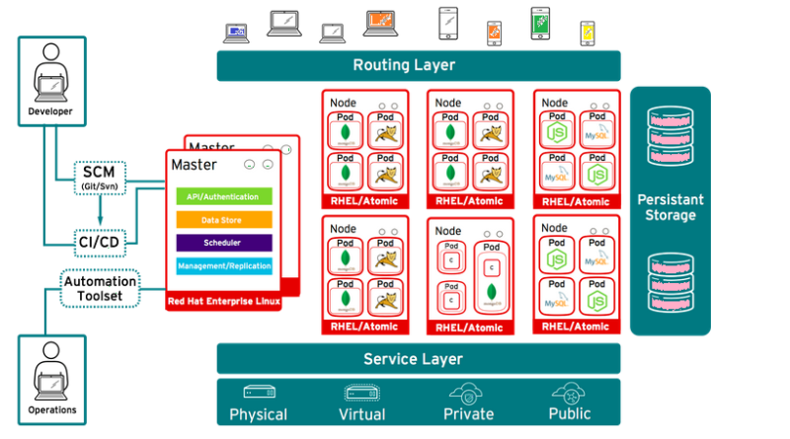
Pods Introduction

Slide 4
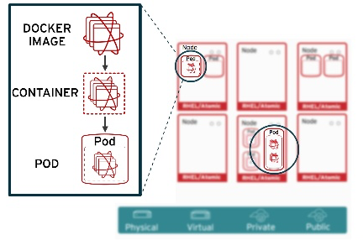
Pods Intruduction

Slide 5
Using the CLI
All openshift objects can be created from the CLI
Common verbs in the cli are:
create generates new resources from files or standard input devices
describe retrieves details about a resource or resource group
get fetches cluster data from various sources
delete erases resources as required
apply pushes changes based on your configuration files
edit edit live configuration files

Slide 6
Using oc-run to create pods
Description
Create and run a particular image, possibly replicated
Creates a deployment config to manage the created container(s). You can choose to run in the foreground for an interactive container execution. You may pass 'run/v1' to --generator to create a replication controller instead of a deployment config.
--restart="Always"
The restart policy for this Pod. Legal values [Always, OnFailure, Never]. If set to 'Always' a deployment is created, if set to 'OnFailure' a job is created, if set to 'Never', a regular pod is created. For the latter two --replicas must be 1. Default 'Always', for CronJobs Never.

Slide 7
Using yaml files to create pods
Description
Create a resource by filename or stdin
JSON and YAML formats are accepted.
Example
# Create a pod using the data in pod.yaml.
kubectl create -f pod.yaml
# Create a pod based on the YAML passed into stdin.
cat pod.json | oc create -f -

Slide 8
Create a httpd pod
$ kubectl run mattias-httpd1 --image=httpd:latest -o=yaml --dry-run=client --restart=Never
apiVersion: v1
kind: Pod
metadata:
creationTimestamp: null
labels:
run: mattias-httpd
name: mattias-httpd
spec:
containers:
- image: httpd:latest
name: mattias-httpd
resources: {}
dnsPolicy: ClusterFirst
restartPolicy: Never
status: {}

Slide 9
Create httpd pod using yaml
$ kubectl run mattias-httpd2 --image=httpd:latest -o=yaml --dry-run=client --restart=Never | oc create –f -
Create env-variable inside pod
kubectl run mattias-httpd3 --image=httpd:latest --restart=Never --env=var1=val1
List test a env variable inside httpd pod after creation
kubectl exec -it mattias-httpd3 -- sh -c 'echo $var1'

Slide 10
Create configmaps
Description
Create a configmap based on a file, directory, or specified literal value.
A single configmap may package one or more key/value pairs.
When creating a configmap based on a file, the key will default to the basename of the file, and the value will default to the file content. If the basename is an invalid key, you may specify an alternate key.
When creating a configmap based on a directory, each file whose basename is a valid key in the directory will be packaged into the configmap. Any directory entries except regular files are ignored (e.g. subdirectories, symlinks, devices, pipes, etc).

Slide 11
persistentVolume vs Configmap
Files under 1 MiB is usually fine to store in a configmaps
Larger files should be stored in a persistenVolume or database.
Secret values should be stored in secrets

Slide 12
Configmap from env-files

Slide 13
10 min Excercise Configmaps
Create 2 env files with multiple key=value inside
From the 2 env files create a configmap similar to the previous example

Slide 14
Configmaps from-literals

Slide 15
10 minutes Excercise Configmaps from literals
Create a configmap with multiple literal values
Use command line or yaml file

Slide 16
Using env and envFrom in Pod

Slide 17
10 minutes excecise env in pod
Use the envFrom field to point to your configuration file inside a pod
Attach a terminal to your pod and type the command: env
Verify enviromen variables are created

Slide 18
Mounting configmap files as volumes in a pod

Slide 19
Excercise mount a configmap as Volume
Mount a configmap as a Volume in some directory in a pod
Do a ls in the directory to verify file content.

Slide 20
Secrets are similar but base64 encoded
You can convert it manually when creating from yaml file
echo -n 'Hello world' | base64
Same command as configmaps when created and very similar when mounting in pod.

Slide 21
15 minuter challenge Pods and Configuration
A pod can contain multipe containers, which is reffered to as a sidecar pattern.
Create a pod with 2 httpd containers running inside it.
Then in the first containers reference a configmap with some enviroment variables inside it. You can use plain values or env values from a file.
oc rsh into the first container and verify the env-variables are set.
oc rsh int the second container and verify that env variables are missing

Slide 22
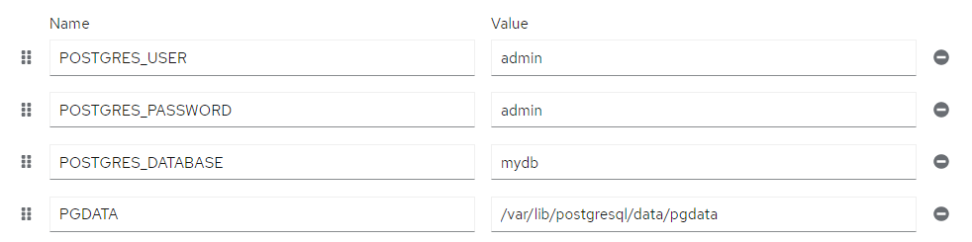
Challenge setup postgres in kubernetes.
Image is: ocp-docker-virtual.repo-tos.intern.folksam.se/postgres:latest
Following env values should be stored in a secret and injected to the Deployment of postgres,
Open a terminal inside a pod a verifry postgres is running.

Slide 23
Pods are stateless but…
Some containers require files to be stored on disk
Sometimes we need to cache data in some directory
Once a pod has restarted, all data is lost
Small files can be mounted in configmaps
Larger files should be stored in PersistentVolumes
To claim data from a persistentVolume we need to define a persistenVolumeClaim

Slide 24
Simple cache volume
The cache volume will store everything inside /cache in the test-container
emptyDir can be used to create a temporary storage

Slide 25
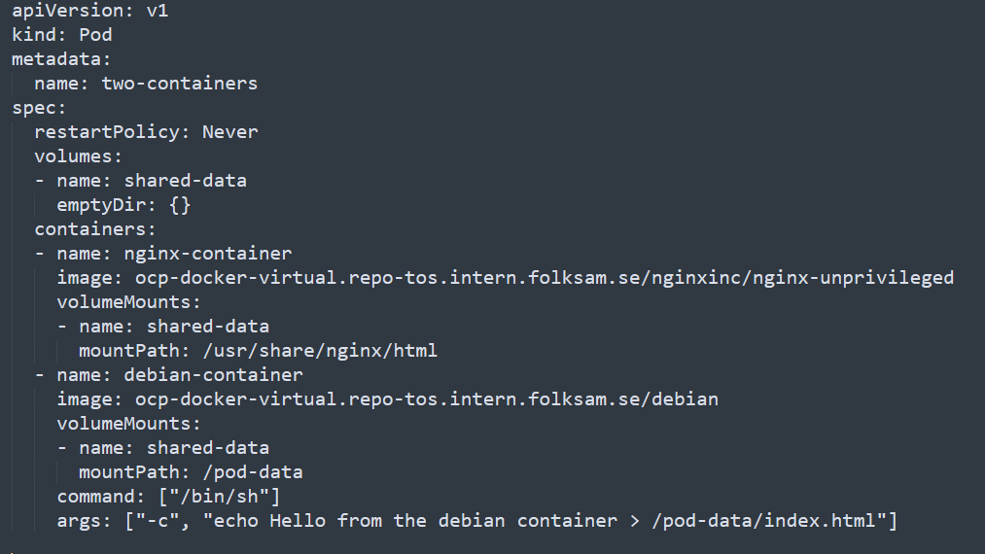
Example nginx + debian sidecar with cache volume

Slide 26
Excercise 15 minutes cache volume
Create a pod with nginx-unprivileged image from dockerhub, then add a sidecar with the debian image and the command and args from the previous example.
Add the emptyDir{} volume and mount it according to the example.
Explain whats happening to another student.
How many containers are running in each pod, and why?

Slide 27
PersistentVolume
Set an optional classname if defined in cluster.
Set a requested storage amount
Set accessMode

Slide 28
PersistentVolumeClaim
If any peristenVolume has a matching classname it can be used.
Needs to match persistentVolume accessType
Amount of storage, needs to be less then available on persistentVolume

Slide 29
Creating a volume inside a pod from a persistentVolumeClaim
Needs to match the name of an existing claim.
Volume name and Mount name needs to match.

Slide 30
Using claimRef and volumeName is recomended

Slide 31
Reclaiming Policys
When a user is done with their volume, they can delete the PVC objects from the API that allows reclamation of the resource. The reclaim policy for a PersistentVolume tells the cluster what to do with the volume after it has been released of its claim. Currently, volumes can either be Retained, Recycled, or Deleted.
In the persistentVolume spec set the field:
persistentVolumeReclaimPolicy: Delete
This will make sure that once you delete the persistenVolumeClaim it will also delete the volume.

Slide 32
Excercise PersitentVolumeClaims
Create a deployment with the following image:
Image: ocp-docker-virtual.repo-tos.intern.folksam.se/nginxinc/nginx-unprivileged
Make a local copy of /usr/share/nginx/html/index.html using oc cp command. (Mounting the persistentVolume will override all files)
Mount a persistentVolume Claim at /usr/share/nginx/html
Modify the local index.html file with some new content.
Use oc cp command to copy the index.html inside the /usr/share/nginx/html directory of the pod, restart all pods and make sure that the file still exists. It will be loaded from the persitentVolume and override existing index.html from the image.
The index.html file is quite small, so try to replace the file using a configmap volume instead, se example on next page. We need to use subPath when mounting single files. Make sure that your configmap only contains the index.html.

Slide 33
Using subPath to mount single files

