Slide 1
Intro
Mattias Svensson Nordell @Consid

Slide 2
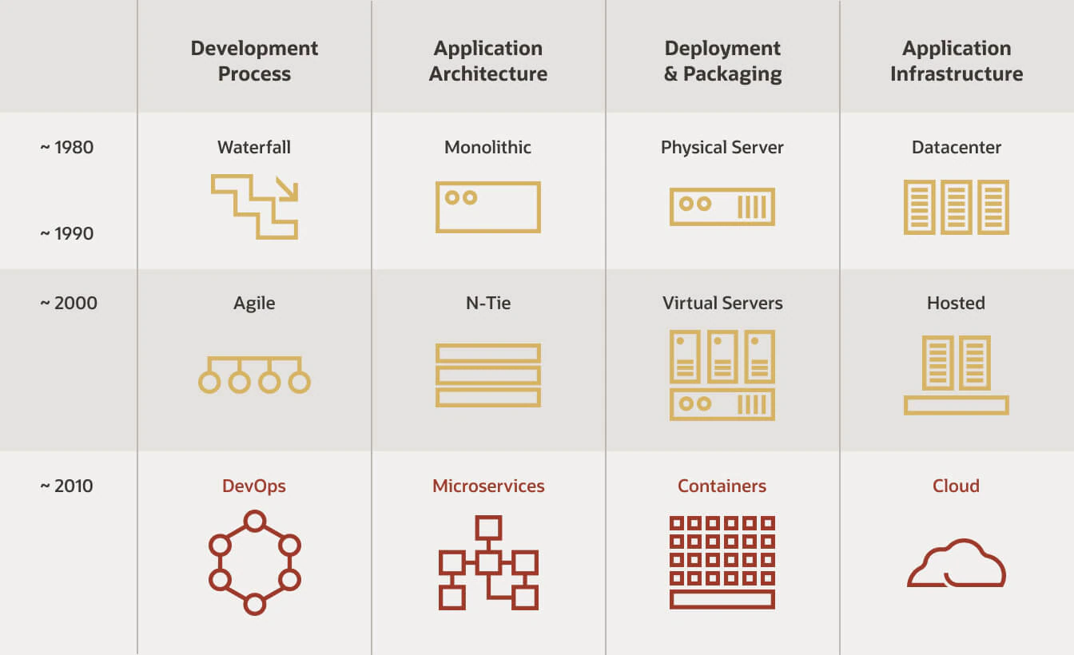
Modern software development

Slide 3

Physical Servers
A physical server refers to a hardware server with the motherboard, CPU, memory and IO-controllers. It's considered a bare-metal server because its hardware is used directly by an OS instead of a virtualization platform.
A physical server is used to run a single instance of an OS. It runs Windows, Linux or another OS and, very often, it's used to run single or multiple applications.
Apps on same machine becomes tightly coupled
Common problems are
One app needs to run another type of OS.
One app needs a specific java version to be installed
One app uses storage on the physical harddrive
It is very hard to manage physical machines for multiple apps. New hardware for each app is expensive and slow to install.

Slide 4
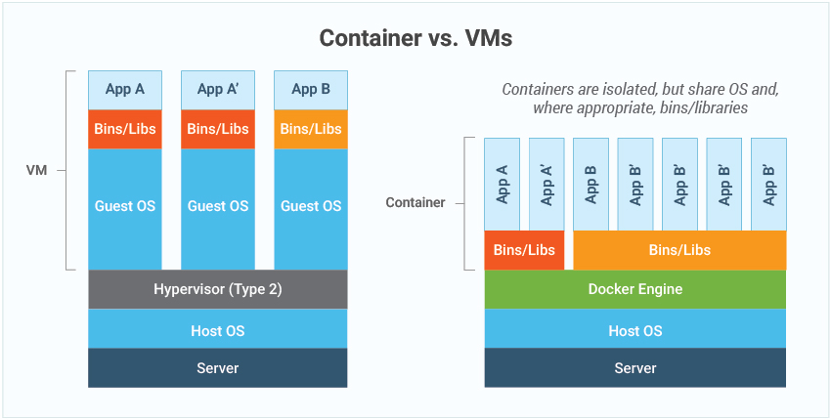

Slide 5
Cloud Native Development
Using a set of principles and technologies to speed up development in the cloud.
01
Example of Cloud Native Methodologies
02
Devops
Microservices
Containers
Agile
CI/CD
Example of Cloud Native Technologies
03
Openshift/Kubernetes
Docker/Container engine
Jenkins or other CICD tools

Slide 6
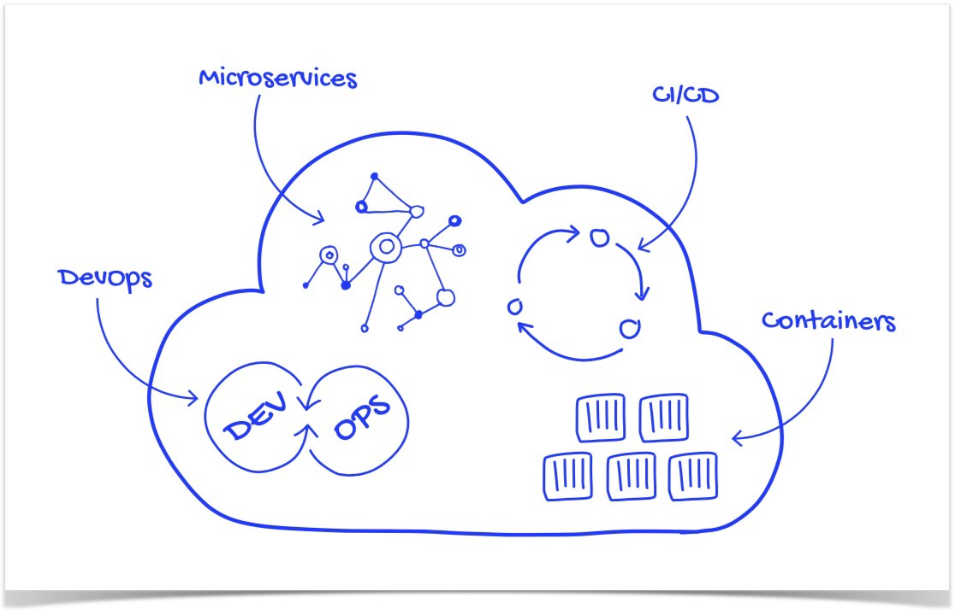
Cloud Native

Slide 7
Docker Development

Slide 8
Docker Desktop
I recommend starting with docker desktop:
https://www.docker.com/products/docker-desktop
Installing docker for desktop will enable docker on your machine
Might need to turn on virtualization on bios (login to bios on computer boot and look for virtualization menus on the cpu settings)
Might need to enable hyper-v and linux subsustems if running on windows. (You can google how to do it)

Slide 9
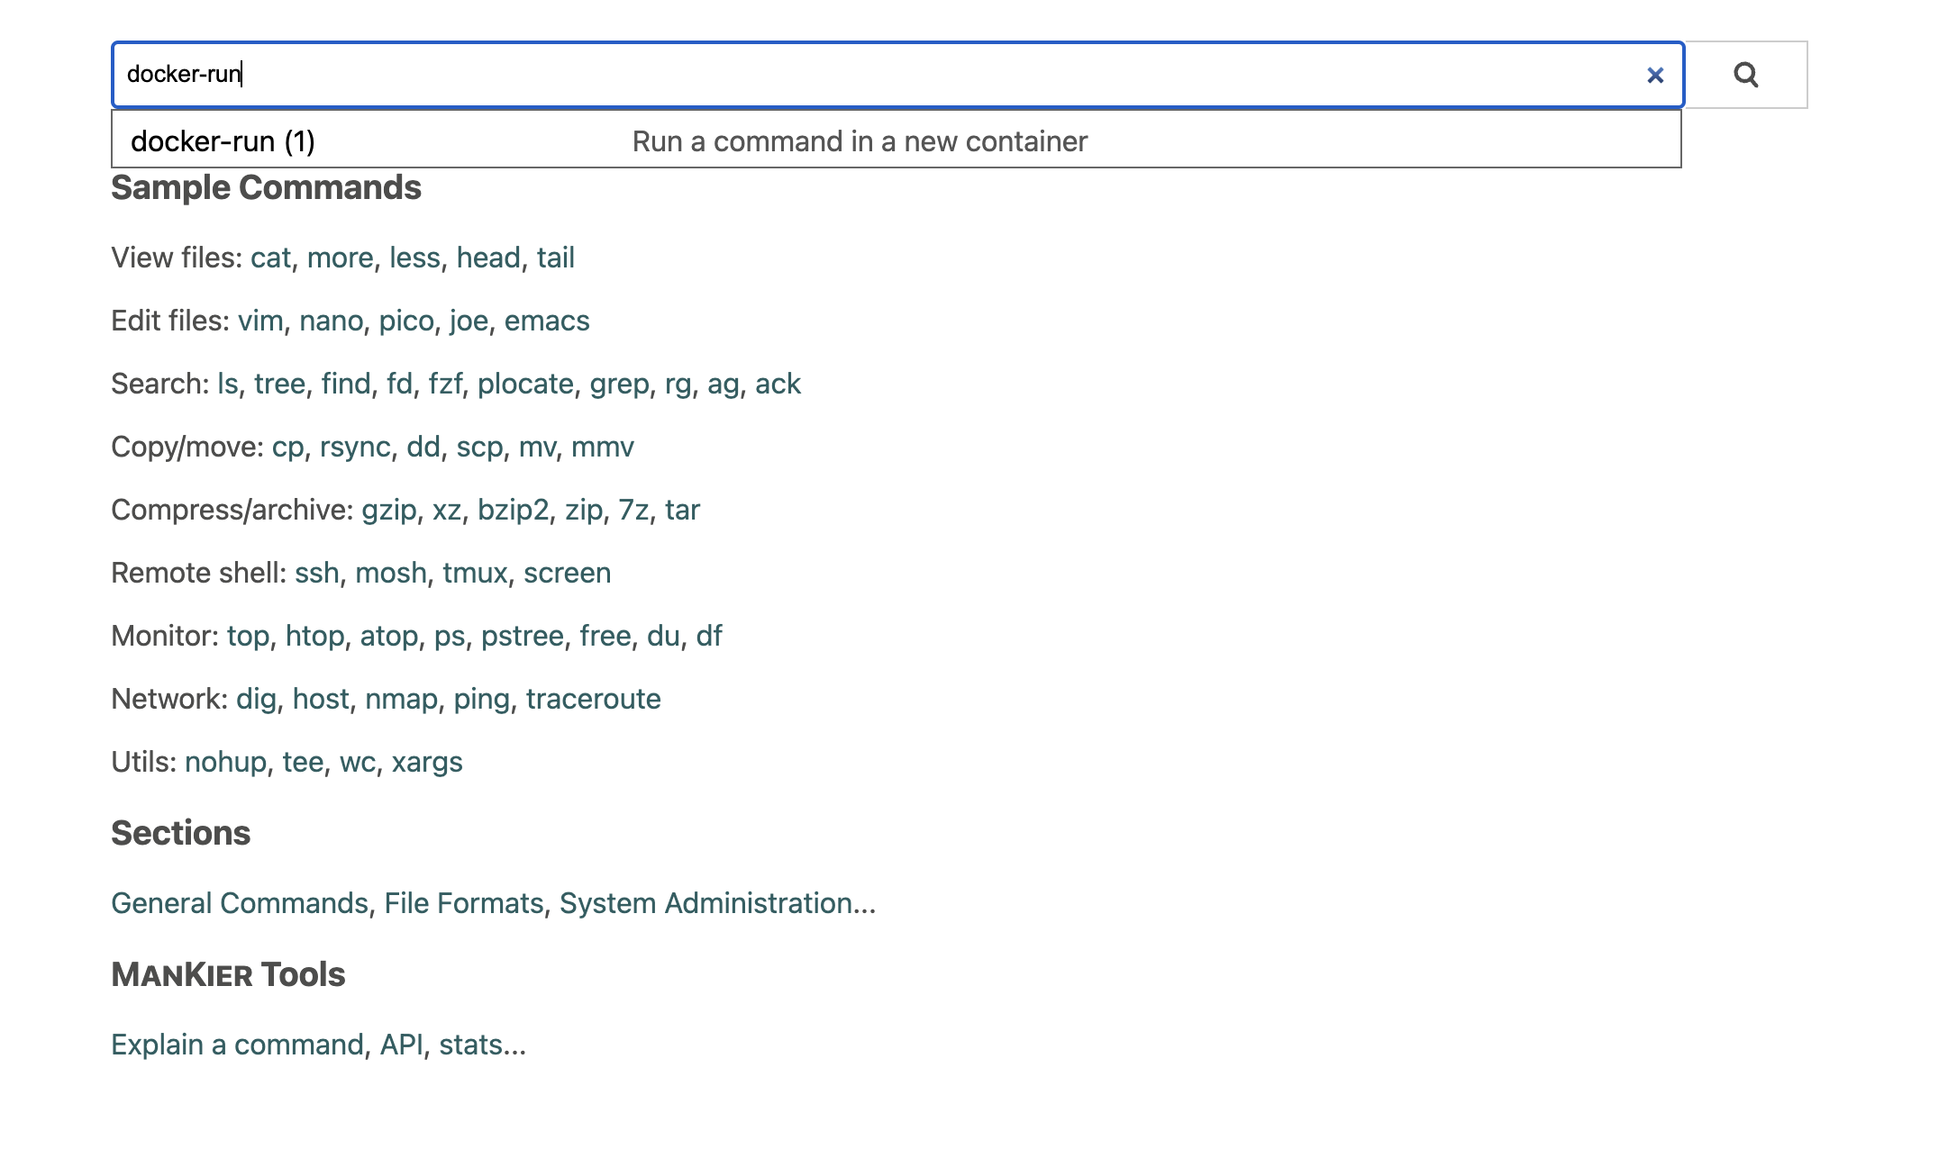
Mankier documentation
Using www.mankier.com
You can search for almost any command in linux and get examples
Documentation is translated from man pages to readable html5
You can even use it for docker, Kubernetes and many other tools

Slide 10
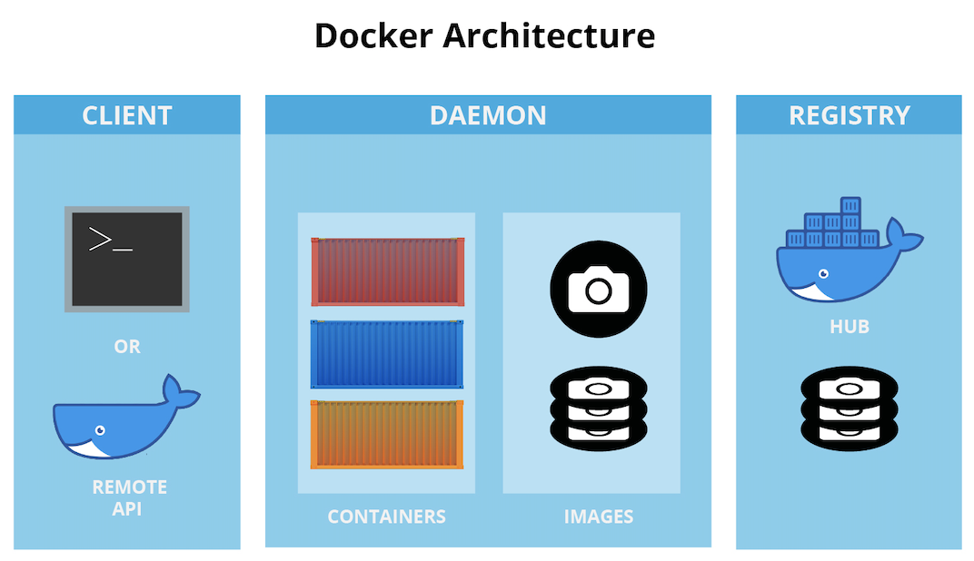
Public registry
Private Registry

Slide 11
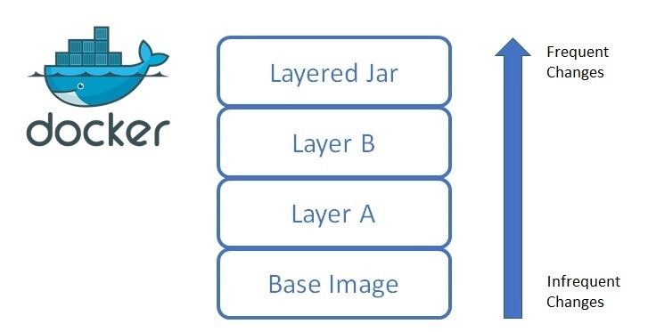
Docker Layers

Slide 12
Mankier documentation
Using www.mankier.com
You can search for almost any command in linux and get examples
Documentation is translated from man pages to readable html5
You can even use it for docker, openshift and many other tools

Slide 13
Pulling docker images from dockerhub
There are multiple available public registries, default for Docker is dockerhub
An images is a snapshot of a filesystem at a given moment in time (Operating System)
When doing a docker pull, the image will end up in your local registry
We will later look at the registry hosted in Openshift
docker pull httpd:latest
You can list all images in the private (local) registry
You can see image id, tag and repository
docker images

Slide 14
Running our first container
Running the busybox container will give no result….
We can name the container so that we can easier find it
A container needs to have a process connected, or it will shutdown
docker run --name b1 httpd
Let’s connect a terminal and se what happens
Attaching a terminal (or any other process) will keep the container running
Exiting the terminal will terminate the container
docker exec -it --name b2 httpd

Slide 15
Running a Container in detached mode
Most of the time we want to run in detached mode
When in detached mode, the container keeps running in the background.
Detached mode will make it easier to manage multiple containers.
docker exec -it -d --name b3 httpd

Slide 16
Listing containers
You can list all running containers
Stopped containers will not show up
docker ps
You can list all running + non running containers
Both stopped and running containers will how up.
docker ps -a

Slide 17
Stopping and starting containers
Stopping a container
docker stop b1
running a container
docker start b2

Slide 18
Deleting containers and images
You can delete a non running container
Running containers need to be stopped before deleted
docker rm b1
You can also delete a running container
Force deleting will not terminate containers gracefully
docker rm b1 --force
You can delete images
Images will be deleted from local registry only
docker rmi busybox:latest

Slide 19
Pruning docker containers
You can delete all stopped containers with prune
docker container prune

Slide 20
Command and Entrypoint
Entrypoint: Will run automatically once the container is started, can insert arguments when starting container through commands (CMD). Entrypoint for a busybox image is ”/bin/sh”
CMD: commands can be overridden by passing new arguments.
For a busybox container you can pass an argument to the /bin/sh command
Busybox doesnt have any proccess running inside it, so it will quit automatically when started. Lets run a sleep proccess to make it stay alive.
docker run -it --name=b7 -d busybox:latest sleep 3600

Slide 21
Some more container examples
Run command in a new container from a tagged image:
docker run image:tag command
Run command in a new container in background and display its ID:
docker run -d image command
Run command in a one-off container in interactive mode and pseudo-TTY:
docker run --rm -it image command
Run command in a new container with passed environment variables:
docker run -e 'variable=value' -e variable image command
Run command in a new container with bind mounted volumes:
docker run -v /path/to/host_path:/path/to/container_path image command
Run command in a new container with published ports:
docker run -p host_port:container_port image command
Run command in a new container overwriting the entrypoint of the image:
docker run --entrypoint command image

Slide 22
How is an image created?
Dockerfiles are used to create images
You need to build and tag your images and store them somwhere
Private registry
External registry
Local registry
Common workflow:
docker build -t mygimage:tag .
docker tag myimages:tag repository/myimage:tag
docker push repository/myimage:tag

Slide 23
Dockerfile Instructions:
A Dockerfile is recipe for creating images
A container is a running instance of an images
Each recipe contains a base with a snapshot of a specific os configuration.
We can modify the base by adding/removing and modifying files inside it.
Lets have a look at some basic commands:
https://dev.to/soutoigor/dockerfile-main-commands-and-instructions-2l2h

Slide 24
Using mankier
Lets see if we can use our knowledge in docker to spin up a container in openshift through command line.
Search mankier for oc-run and see the example to create Deployment.
Did our knowlede in docker help us understand kubernetes?

Slide 25
Docker Labs Online
Visit:
https://training.play-with-docker.com/beginner-linux/
Get a free dockerhub account (only used for this lab)
Complete the first developer lab, and then progress att your own phase.

Slide 26
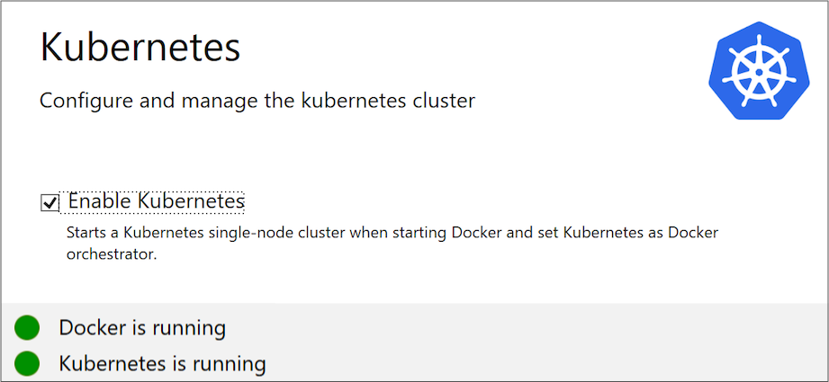
Docker desktop contains a small Kubernetes environment

Slide 27
CLI documentation
https://kubernetes.io/docs/reference/generated/kubectl/kubectl-commands
https://www.mankier.com/1/oc-run

Slide 28
Kubernetes objects
All objects in openshift are describe using yaml or json
Yaml files describes the state/and configuration of our application
Lets have a look at a simple app structure in openshift.

Slide 29
Pods Background
We want to group containers that are tightly coupled
Keeping track of the application configuration and state, since we have a declared yaml file.
Pod configurations are compatible with other internal openshift objects, such as persistent volumes and configmaps.

Slide 30
Pods
Image reference goes here, make sure to use folksam
artifactory and not like this!
Use a reference like this:
ocp-docker-virtual.repo-tos.intern.folksam.se/nginx:1.14.2

Slide 31
15 minute Excercise Pods
Use your knowledge of docker and mankier to find out how to spin up a pod with the httpd image in openshift.
https://www.mankier.com/1/kubectl-run
User the --dry-run=client flag to verify object before creation.
Use the flag --restart=Never, to create pod.
Use your docker knowledge to find out how to exec into the container and run some command.
Now find out how to label your pod with enviroment=dev
What does it mean?

Slide 32
Background Deployments
A deployment will make sure thata desired application state is maintained.
Lets sat we always want to have 3 replicas of a pod, a deployment will try to restart pods if they fail.
We can also specify which strategy to use for our deployment (more on this later)

Slide 33
Deployments
Labels need to match in the pod.
A pod definition inside the deployment object is defined

Slide 34
15 minutes excercise Deployments
Use the kubernetes documentation in combination with the yaml for the httpd pod, to wrap a httpd pod inside a deployment with 3 replicas.
Find out the correct oc command to set a new image version of httpd to 2.4 in the deployment
What will happen to the pods?
Now go to one of your pods and delete them manually
The deployment will try to spin them up again.

Slide 35

Services Background
Pods are nonpermanent resources. If you use a Deployment to run your app, it can create and destroy Pods dynamically.
Each Pod gets its own IP address, however in a Deployment, the set of Pods running in one moment in time could be different from the set of Pods running that application a moment later.
how do the frontends find out and keep track of which IP address to connect to, so that the frontend can use the backend part of the workload?

Slide 36
Services
You need to add a label to your pod, so you can select it.
Other pods can call service with this port.
The port of the pod goes here

Slide 37
15 minute excercise Services
Create a service for the httpd pod using the mankier documentation
You can lookup oc-expose
Create a another httpd pod and curl the other httpd service using service name and port.
The service will expose the pod internally in the namespace for other pods.

Slide 38
Background Routes/Ingress
To be able to access applications from outside the cluster we need to specify a network rule.
When we create a route we get an externally available ipaddress.
We should define a DNS to simplify development.

Slide 39
Routes/Ingress
Our domain is always: apps.aro-dev.intern.folksam.se
This points to an existing service that we want to expose externally with a new dns.

Slide 40
15 minute excercise Routes
Use the previous slide and openshift/kubernetes docs to expose your httpd pod externally outside the cluster.

Slide 41
Challenge
Make a digital drawing of all the kubernetes objects and the relationsship between them.
Read the kubernetes documentation for each object, and summarize the specific goal for each object.

Slide 42
Challenge
create an application in kubernetes with all objects.
You need to set correct values for your app, copying the slide will not work:
You can copy objects from the kubernetes documentation or use the slide as a reference
Create yaml files on your local machine and then use oc apply -f object.yaml to apply the objects in openshift.

Slide 43
Hands on Practice
Learn the basic of the kubectl CLI:
https://kubernetes.io/docs/reference/generated/kubectl/kubectl-commands
Then practice at:

