Slide 1
Helm Charts, Custom Resources and Deployment Strategies
Mattias Bourghardt Nordell @Consid

Slide 2
Handling multiple Kubernetes Resources
We have many types of objects to keep track of
Configmaps, Secrets, Deployments, Services, Volumes etc.
There is a lot of commands to manage objects
Create/Apply, Delete, Patch etc.
Using the project as template becomes messy
Do we really need to Copy/Paste from other repos and then replace values?

Slide 3
Solution With Helm
We can create a helm package containing all our yaml files and then apply the package to Kubernetes.
We can use a standardized way to replace values in our objects
Helm Charts can be store in git, and the packaged charts can be stored in helm repositories.

Slide 4
Example of Helm Chart
Example and guide:
https://helm.sh/docs/intro/quickstart/
https://github.com/bitnami/charts/tree/main/bitnami/mariadb

Slide 5
Running your first chart
helm repo add my-repo https://charts.bitnami.com/bitnami
helm install my-release \
--set auth.rootPassword=secretpassword,auth.database=app_database \
my-repo/mariadb

Slide 6
Custom Resources in Kubernetes
There is a feature in Kubernetes api to handle custom objects
We need to define how the new object should behave
Parameters and Values etc.
Objects doesn’t have any way of syncing with other Kubernetes objects, so wee need to write controllers that will handle events.
Controllers are not part of the Exam, you only need to know that they exist
Many controllers are written in go or Python.

Slide 7
Example of Custom Resource
https://kubernetes.io/docs/tasks/extend-kubernetes/custom-resources/custom-resource-definitions/

Slide 8
JsonPath Expressions
Sometimes you want to find certain field or elements of a json/yaml object. You can use jsonPath fo evaluate faster
You can evaluate Jsonpaths with kubectl.
https://kubernetes.io/docs/reference/kubectl/jsonpath/

Slide 9
Deployment Strategies
Changing the Deploymentconfig will trigger a rolling update
New Pods will start an contiously replace old pods.
We can have multiple versions of the same app for some short time
There will be zero downtime
Sometimes we cant allow multiple versions at the same time, then we we have to set the strategy to recreate in the deploymentconfig.
We can use the fieds in the deploymentconfig to set the strategy
.spec.strategy.type==Recreate
.spec.strategy.type==Rolling

Slide 10
Common Developer Problems
Ability to test a new version of the app, but the app is live and will fail for others testing the app.
Ability to test new openshift configurations live before commiting them.
Handle database changes when deploying a new version.
Rolling out features incrementally

Slide 11
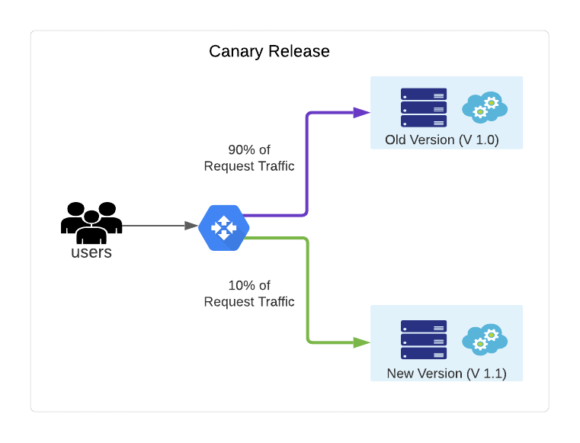
Canary Deployment

Slide 12
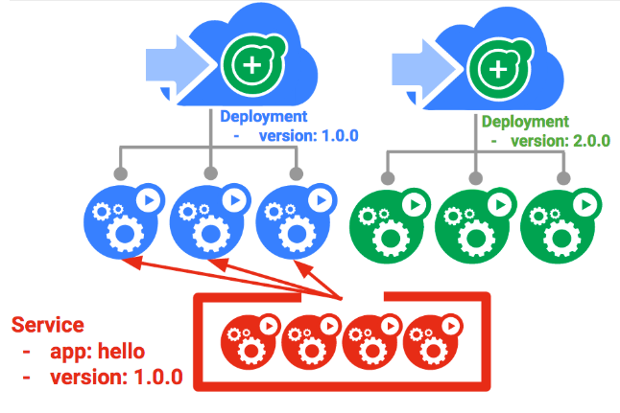
Blue green Deployment

Slide 13
How to implement strategies in Kubernetes?
Blue/Green
Patch selector in service to change traffic between blue and green pods
Make sure that all your objects are labeled Blue/Green
Canary Deployment
use 2 Deploymens with same labels and the scale the pods independently
You can use the kubectl scale command.

Slide 14
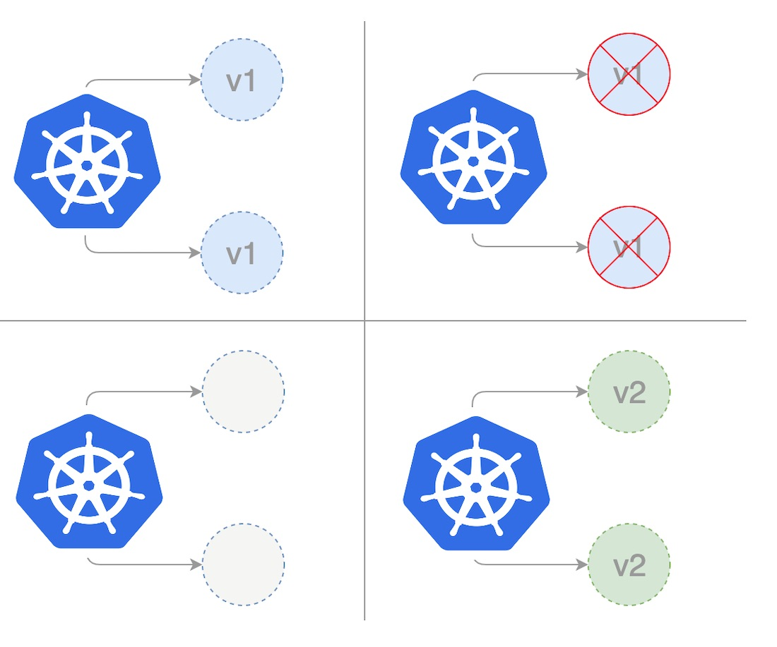
Recreate Strategy

Slide 15
Recreate Strategy
Strategies such A/B and Blue/Green works well with rolling updates
If your app has database changes that doesnt allow the app to run in parallell , then we use recreate.
In your Deployment config:
Set the field .spec.strategy.type==Recreate

Slide 16
Some notes about pod statuses
The status of the pod can be different from the status of the container.
The pod can be marked as running while the actual app is still starting
Traffic of the app can start before initial checking of our app.

Slide 17
liveness and readiness probes

Slide 18
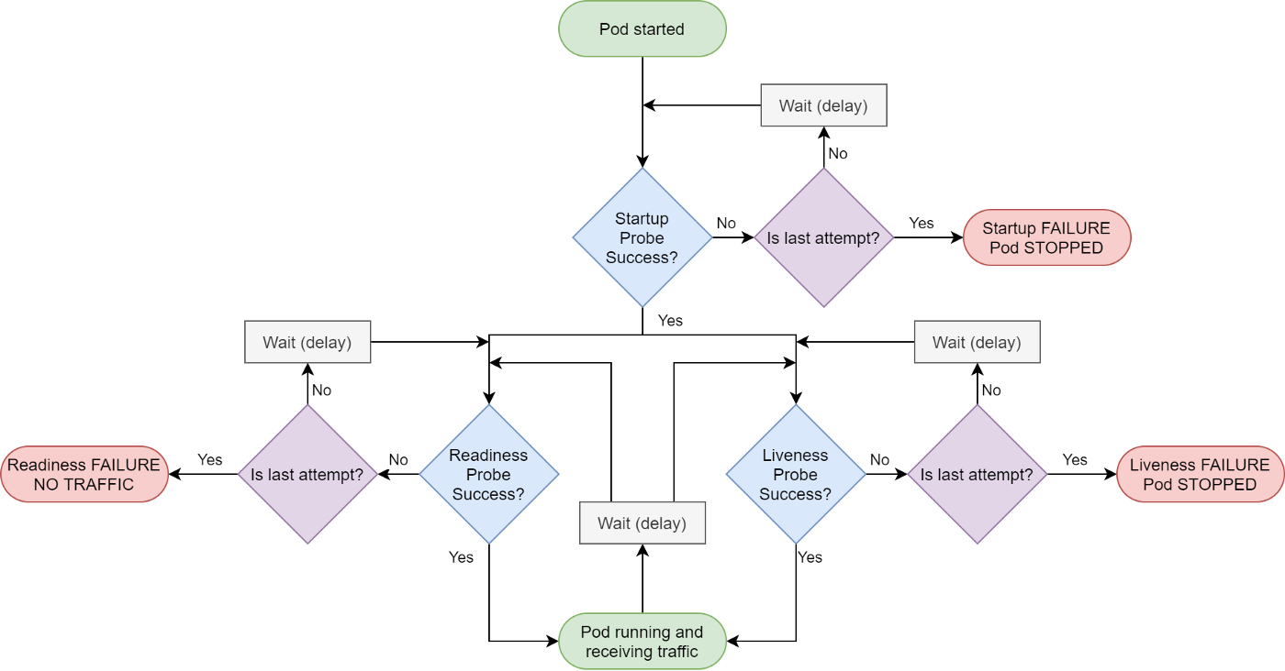
Overview Probes

