Slide 1
ME452 Vehicle dynamics project
Satya Prasad Maddipatla and Wushuang Bai
2021-05-02

Slide 2

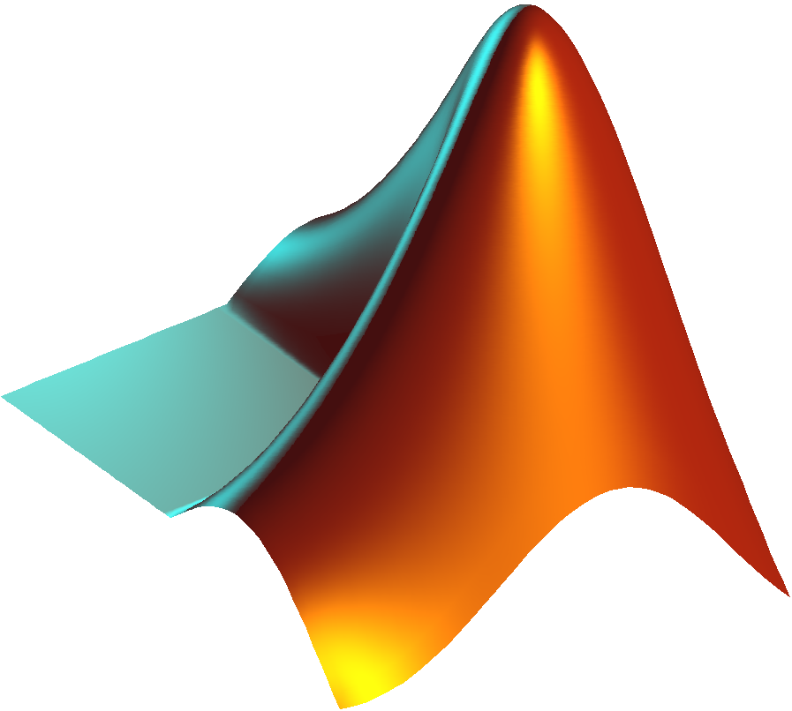
MATLAB Simulink is strong in simulation. However, in many engineering implementations a system is required to be implemented outside MATLAB environment considering factors such as cost and computational efficiency. The objective of this document is to setup a simple example converting a Simulink model into an equivalent MATLAB code version.

Slide 3
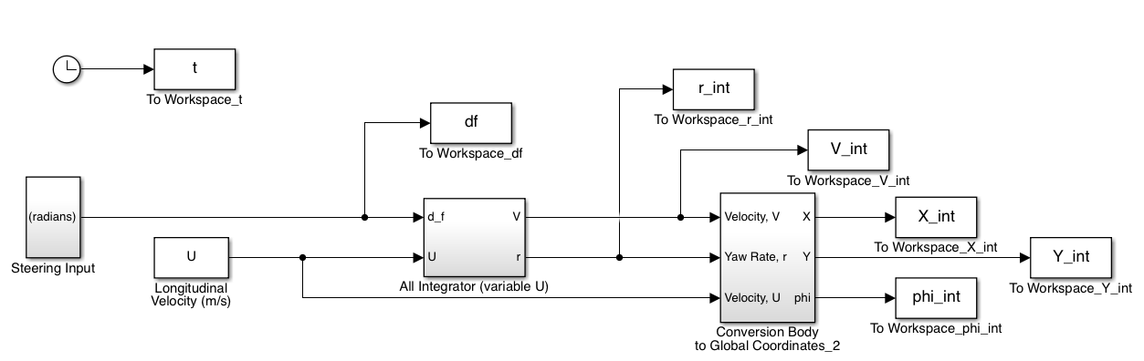
This example uses a vehicle bicycle model which takes steering angle and longitudinal velocity as inputs to generate vehicle position and yaw in global coordinates.
https://github.com/msvsprasad/ME452_BicycleModelProject.git

Slide 4
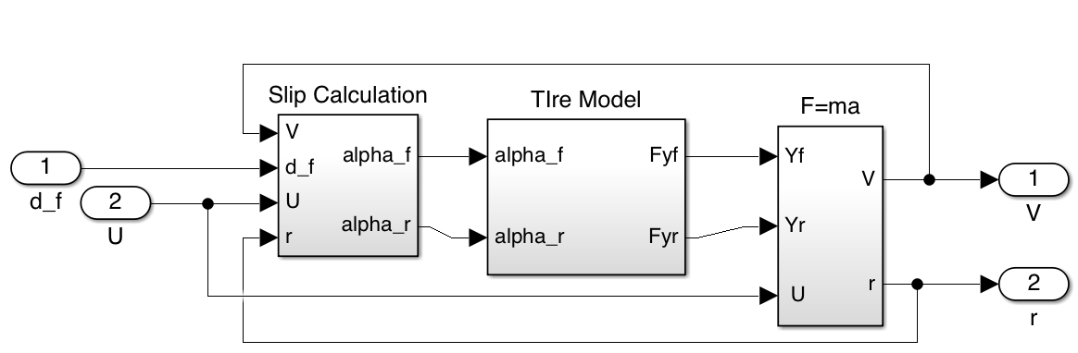
The all-integrator block takes steering angle and longitudinal velocity as input to generate lateral velocity and yaw rate. This includes 3 subsystems to model tire slip, tire lateral force and equation of motion.
Subsystems in all integrator block
Bicycle model

Slide 5
fcn_slipAngles estimates slip angles.
function alpha = fcn_slipAngles(U, V, r, delta_f, vehicle)
%% fcn_slipAngles
% This function computes slip-angles for front and rear wheels. It
% assumes a bicycle model.
%% Calculate Slip-Angles
alpha_f = (V+vehicle.a*r)/U - delta_f;
alpha_r = (V-vehicle.b*r)/U;
alpha = [alpha_f; alpha_r];
end

Slide 6
fcn_lateralForces estimates lateral forces.
function Fy = fcn_lateralForces(alpha, vehicle)
%% fcn_lateralForces
% This function computes lateral-forces at front and rear wheels. It
% assumes a linear model.
%
%% Calculate Lateral Tire Forces
Fyf = vehicle.Caf*alpha(1);
Fyr = vehicle.Car*alpha(2);
Fy = [Fyf; Fyr];
end

Slide 7
fcn_lateralDynamics implements Newton’s II law of motion.
function dydt = fcn_lateralDynamics(~, y, U, Fy, vehicle)
%% fcn_lateralDynamics
% This function calculates lateral acceleration and yaw acceleration.
%
%% Calculate Lateral acceleration and Yaw acceleration
r = y(2);
dVdt = (1/vehicle.m)*(Fy(1)+Fy(2))-r*U;
drdt = (1/vehicle.Iz)*(vehicle.a*Fy(1)-vehicle.b*Fy(2));
dydt = [dVdt; drdt];
end

Slide 8
The Conversion Body to Global Coordinates block takes longitudinal velocity, lateral velocity and yaw rate to generate X,Y position and yaw angle in global coordinate system.

Slide 9
fcn_body2globalCoordinates converts from body to global Coordinates.
function dydt = fcn_body2globalCoordinates(~, y, U, V, r)
%% fcn_body2globalCoordinates
% This function calculates velocites in global coordinates.
%
%% Calculate velocities in Global coordinates
Phi = y(3);
dXdt = U*cos(Phi)-V*sin(Phi);
dYdt = U*sin(Phi)+V*cos(Phi);
dPhidt = r;
dydt = [dXdt; dYdt; dPhidt];
end

Slide 10
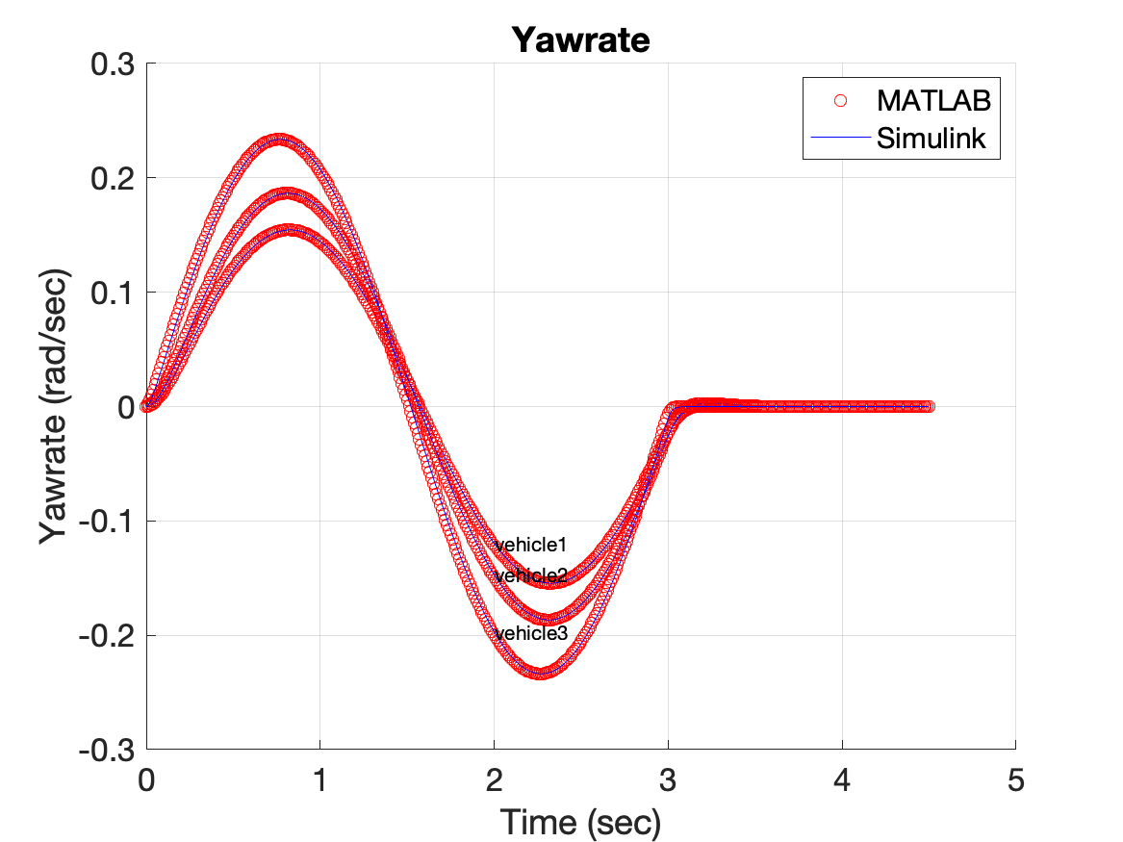
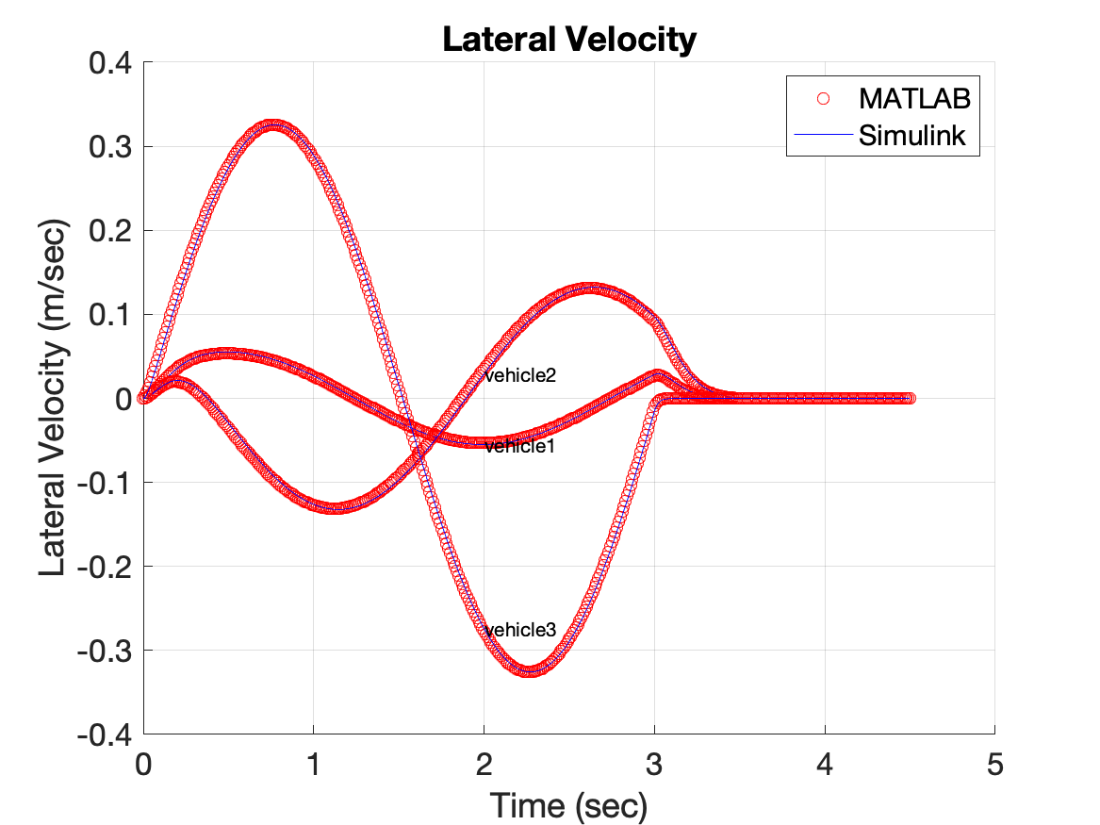
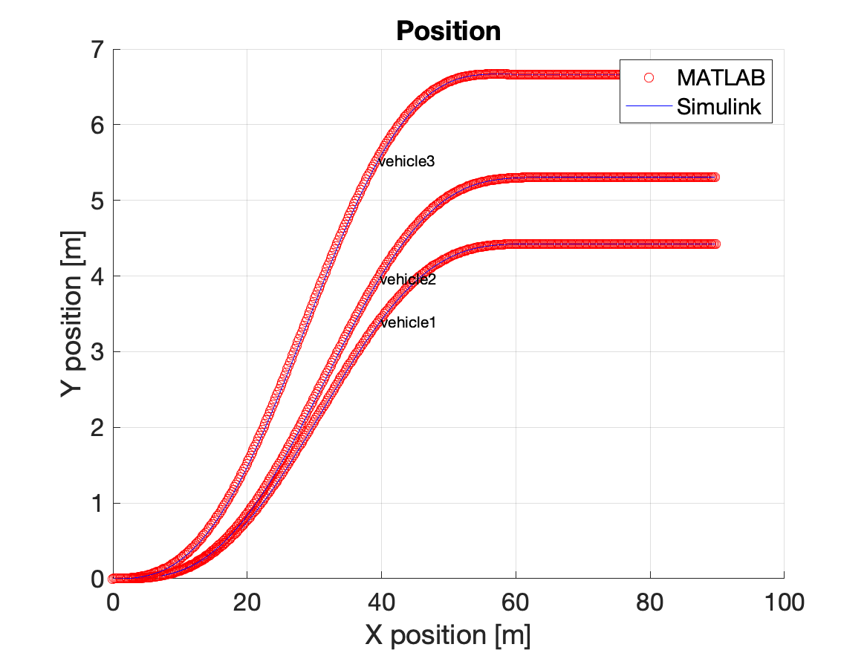
Finally, the results from MATLAB code are compared with the results from Simulink to ensure to be the same. This has been tested using three different vehicle parameters.
https://github.com/msvsprasad/ME452_BicycleModelProject.git

