Slide 1
VS Code Extension
for NTT DATA COBOL
Mark Sweeney

Slide 2
VS Code Extension -- Why?
Visual Studio 2022 and COBOL 6.3+ are 64-bit only
Microsoft has not released a 64-bit SDK for extensions
Visual Studio is very ‘opinionated’.
requires project file
requires files to be local
DB apps require remote compilation
Migration teams prefer to use shell scripts, make, maven or other command line tools.

Slide 3
Visual Studio Code
Consistently voted the most popular IDE according to Stack Overflow surveys
Runs on Windows, Linux, Mac
Open source
Free
Huge amount of 3rd party extensions
Absolutely the worse choice for a name!!!

Slide 4
Requirements
VS Code -- https://code.visualstudio.com/download
VS Code extension for NTT DATA COBOL – customer support site
Visual Studio + Subscription $$$
NTT DATA IDE Extension
Java Development Kit (JDK)
NTT DATA COBOL
TPE compilers
License(s)

Slide 5
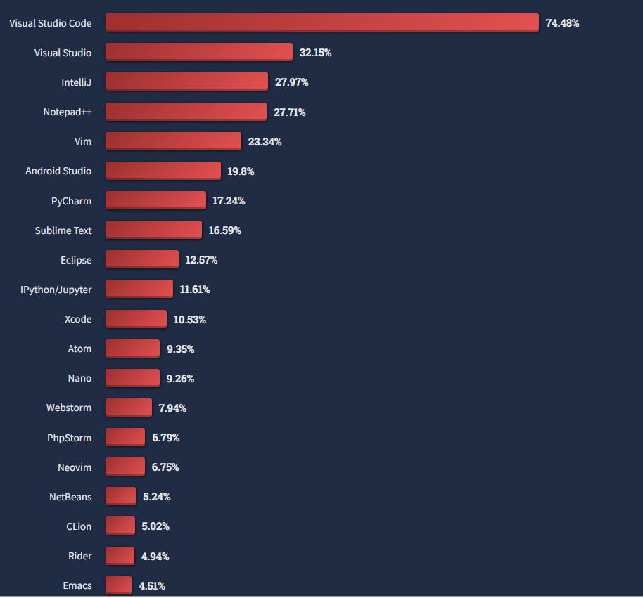
Stack Overflow survey
https://survey.stackoverflow.co/2022/

