Slide 1
GROW TRACK
The Production Side of Food Security
Who grows the world's staples, how fragile that supply is, and who is falling behind — from FAOSTAT production data alone.
Notes:
Opening: We pointed the GROW track at supply-chain risk, so our production analysis speaks to the same questions a TRADE team asks — using only FAOSTAT production data.

Slide 2
THE FINDING
A few crops are one bad harvest from a global shortfall
69%
58%
36%
of the world's buffalo milk is India alone
of world oil palm lost if Indonesia's harvest fails
of world soya sits with one country, Brazil
Notes:
Lead with the punchline. We measured production concentration for every major crop. A handful are so concentrated in one country that a single drought, export ban, or conflict there would remove a large share of world supply. Concentration numbers come straight from FAOSTAT 2024 production shares.

Slide 3
PART 1
What the world grows,
and where
The broad scan: commodities, countries, value, and how production behaves over time.

Slide 4
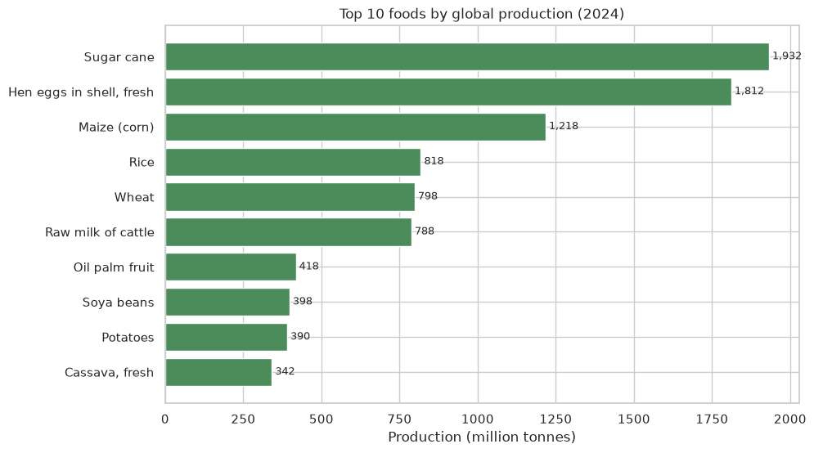
WHAT IS GROWN MOST
A handful of crops feed the world
Sugar cane, maize, rice and wheat dominate global tonnage — the staples worth focusing on.
Notes:
Tonnage isn't importance — sugar cane and milk are heavy/wet. That's why we layer concentration and value on top.

Slide 5
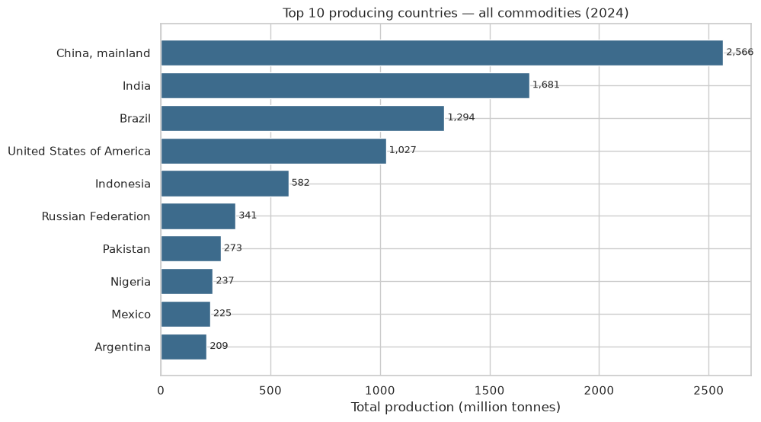
WHERE IT IS GROWN
Five countries carry global output
China, India, Brazil, the US and Indonesia produce the bulk of the world's food by weight.
Notes:
This concentration of producers is the backdrop to every supply-risk question that follows.

Slide 6
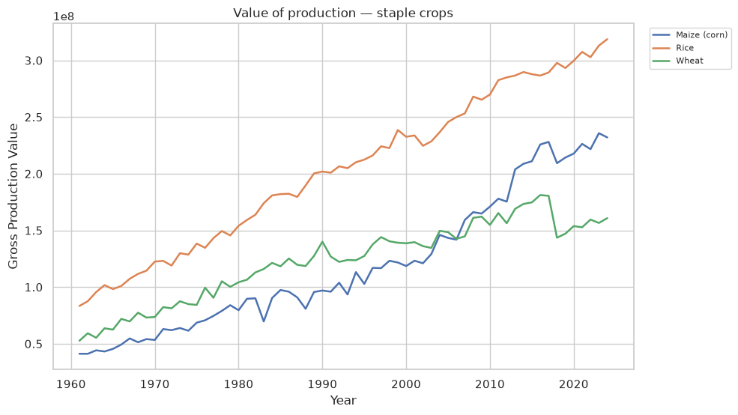
THE ECONOMIC LENS
Value doesn't always track volume
Pairing production value with tonnage shows where crops shift toward higher-value output.
Notes:
Most teams stop at volume. Value divergence is a subtler, more differentiated signal.

Slide 7
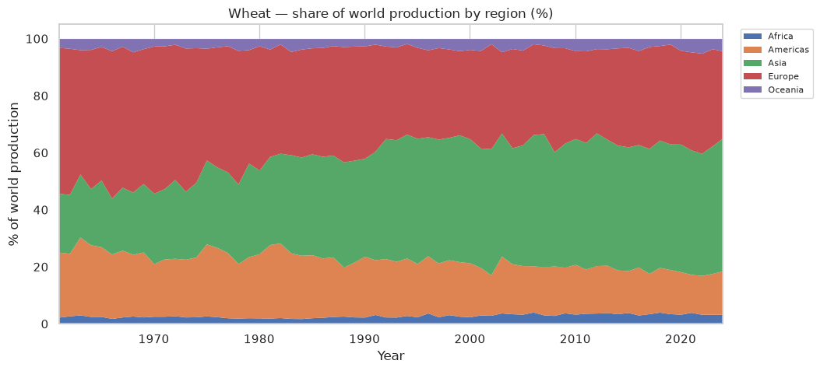
REGIONAL TRENDS FROM THE AGGREGATES TABLE
Production is shifting between regions
FAOSTAT's continent aggregates show each region's share of world output moving over time.
Notes:
Uses FAOSTAT's pre-computed continental aggregates — no summing countries. Answers the brief's core question: how is production shifting across regions over time.

Slide 8
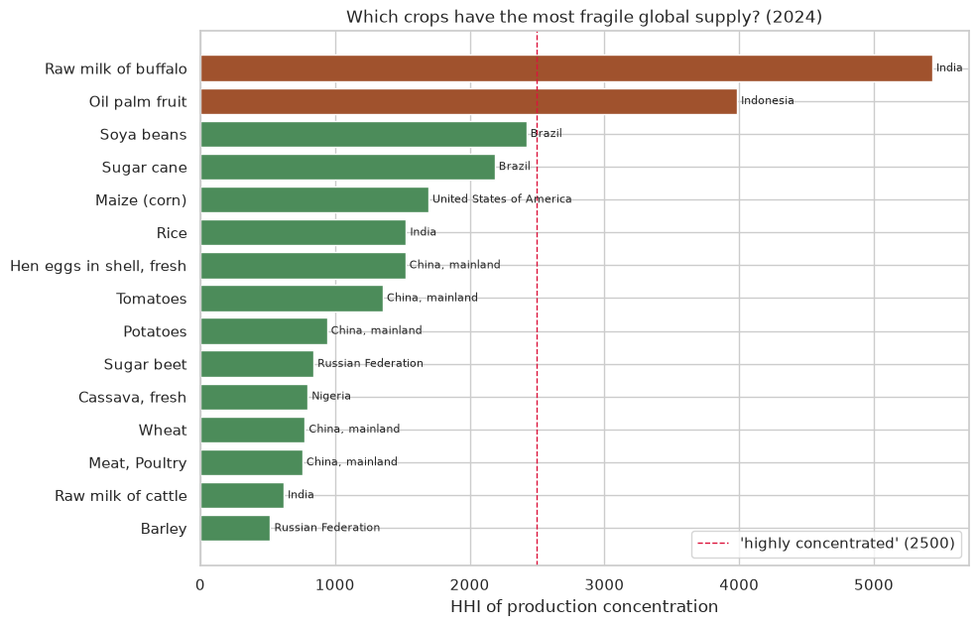
FRAGILE SUPPLY
Some crops are one country deep
By the HHI concentration index, buffalo milk, oil palm and soya are single-point-of-failure crops.
Notes:
HHI is the antitrust concentration measure. >2500 = highly concentrated. India = 69% of buffalo milk; Indonesia = 58% of oil palm.

Slide 9
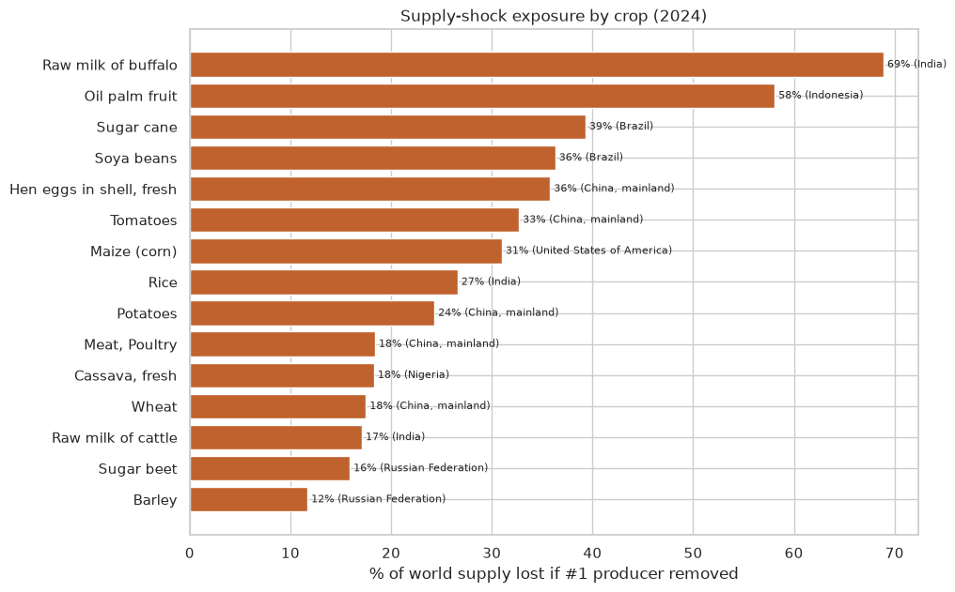
SHOCK EXPOSURE
Lose one producer, lose the supply
Removing the top producer erases 58% of world oil palm, 36% of soya — overnight.
Notes:
The production-side version of a supply shock. If a crop barely grows elsewhere, the shock is baked into geography.

Slide 10
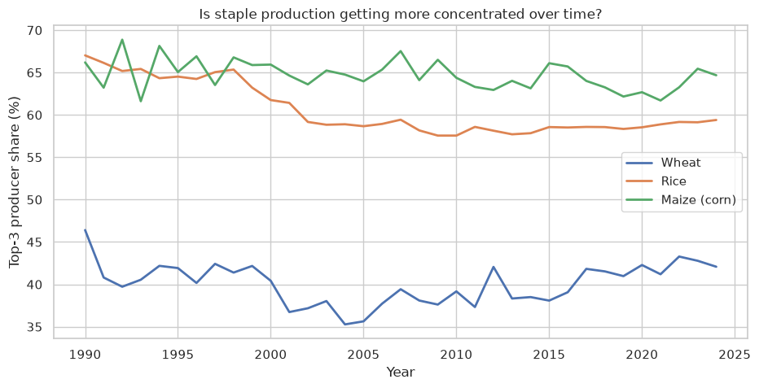
IS RISK RISING?
Staple concentration over time
Tracking the top-3 producer share shows whether global supply is growing more fragile.
Notes:
A rising line would mean systemic risk increasing — a trend-based hypothesis for the modeling phase.

Slide 11
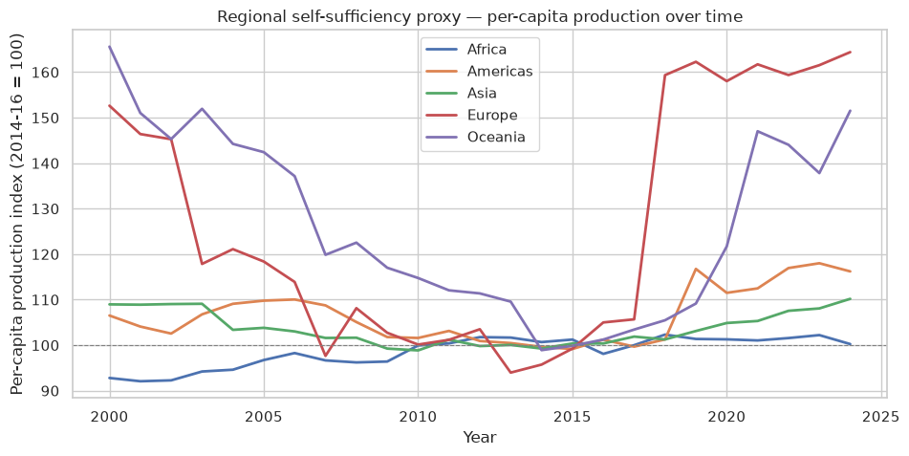
WHO FALLS BEHIND
Africa's output is standing still
Per-capita production rose everywhere but Africa — a signal of rising import need.
Notes:
Index is relative to each region's 2014-16 base, so read Africa's flatness, not the absolute level. Proxy for import reliance without trade data.

Slide 12
PART 2
The staples up close:
wheat, rice, maize
Zooming from the global scan into the three crops that anchor world food supply.

Slide 13
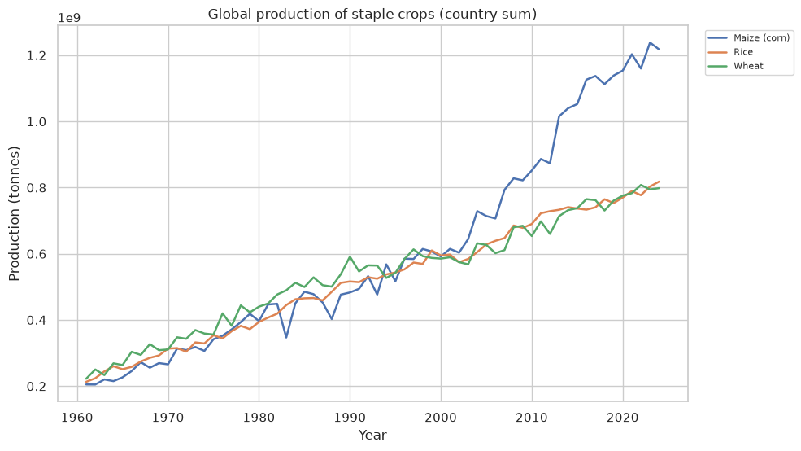
SIX DECADES OF GROWTH
Wheat, rice and maize since 1961
All three roughly quadrupled — but maize pulled ahead, overtaking both after 2000.
Notes:
Global production of the three staples, country sum. Maize's post-2000 surge is driven by feed and industrial demand, not just food.

Slide 14
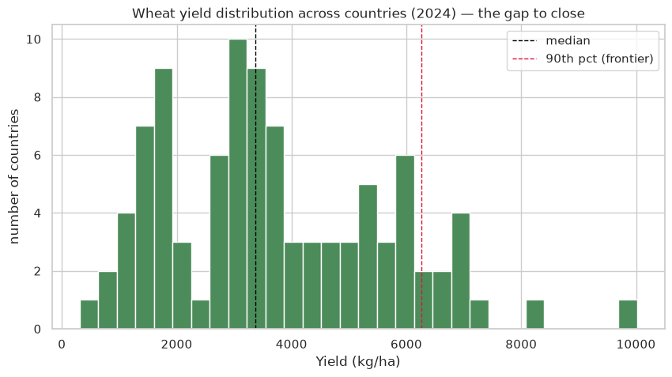
THE OPPORTUNITY
A tenfold wheat yield gap
Top countries reach ~10 t/ha; laggards under 1 — closing the gap lifts output with no new land.
Notes:
Food-security-positive framing: more food without deforestation. New Zealand ~10,000 kg/ha vs Burundi/Libya under 1,000.

Slide 15
WHEAT
Where wheat is grown, over time
Wheat's regional share has shifted markedly — a spread-out crop with no single dominant grower.
Notes:
Wheat's top producer is only ~18% of world output — the least concentrated staple, which matters for the trade bridge next.

Slide 16
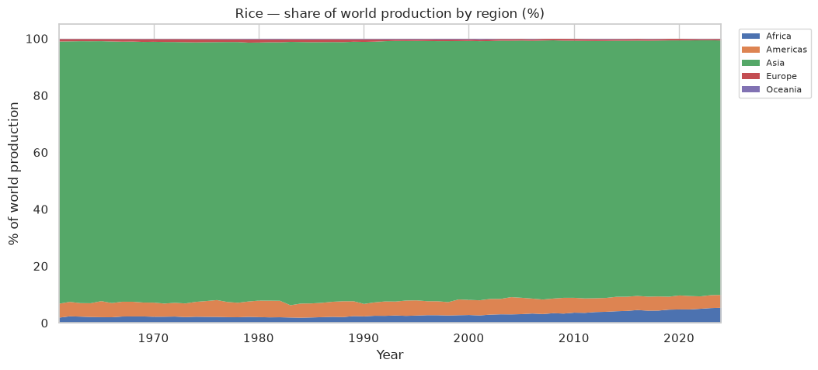
RICE
Where rice is grown, over time
Rice is overwhelmingly Asian — the continent has held ~90% of world production for decades.
Notes:
Asia's dominance in rice is structural and stable — relevant to why Asian importers behave differently from wheat importers.

Slide 17
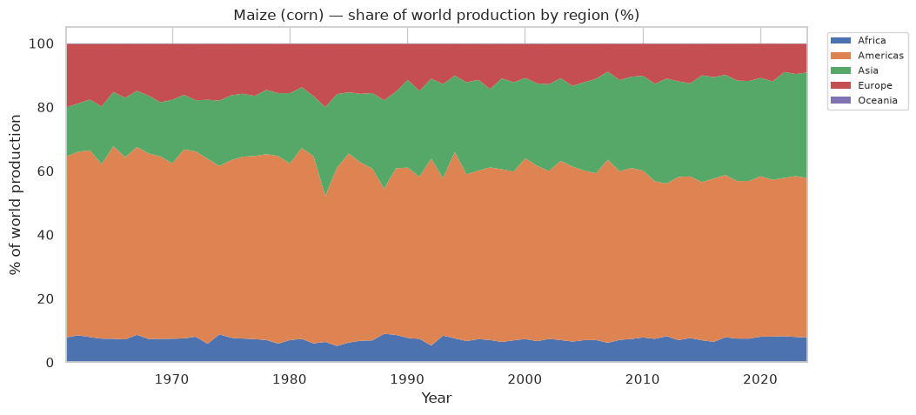
MAIZE
Where maize is grown, over time
The Americas lead maize, but Asia's share has climbed steadily as feed demand grows.
Notes:
Maize's regional shift tracks the global rise in animal-feed and industrial use.

Slide 18
PART 3 — THE BRIDGE TO TRADE
Same crops, same countries,
two lenses
The production side of the TRADE deck's wheat and rice findings.

Slide 19
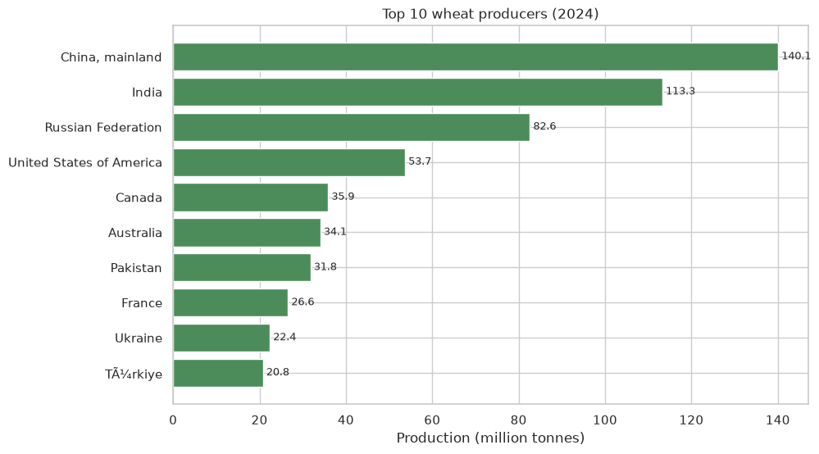
WHEAT — THE SUPPLY BASE
Who grows the wheat others import
The top wheat producers are the supply base behind every importer's dependency.
Notes:
Wheat is grown widely (China #1 at only ~18%) but exported by few — which is why importers still face concentrated suppliers.

Slide 20
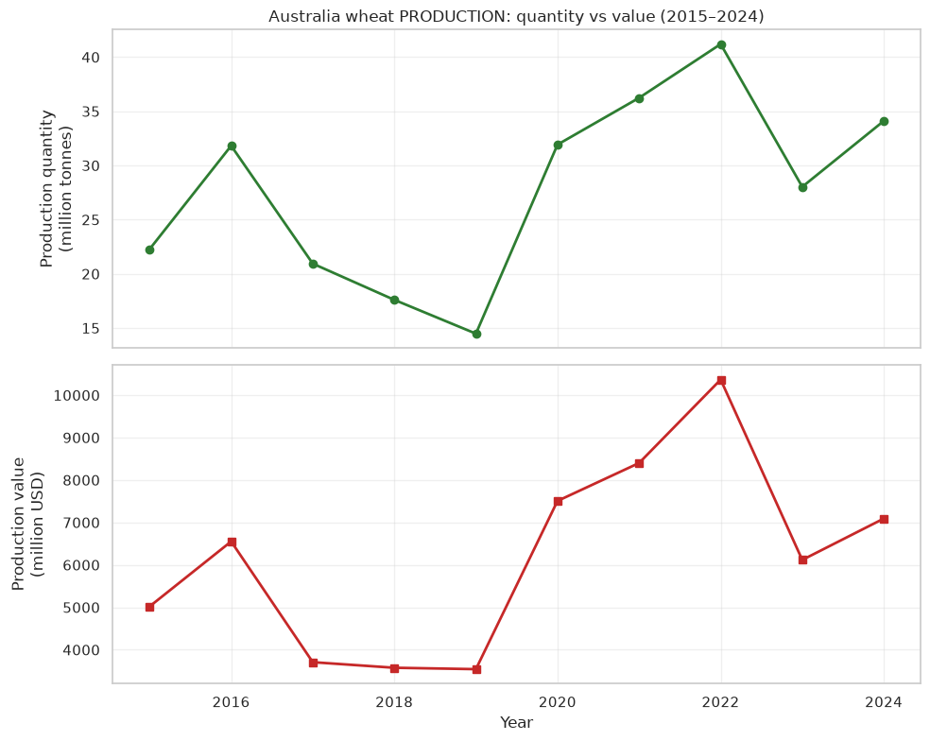
WHEAT — A KEY EXPORTER
Australia's wheat: volatile output
A top wheat exporter, but its production swings with drought — a source of import risk downstream.
Notes:
Australia is one of the few big wheat exporters. Its year-to-year volatility is exactly the kind of supply wobble that propagates to dependent importers.

Slide 21
WHEAT — THE IMPORTER
Indonesia grows no wheat
It's the world's #4 rice producer — but absent from wheat entirely. That gap is why it must import.
53 Mt
~0 Mt
rice produced — 4th in the world
wheat produced — not on the map
Notes:
The TRADE deck showed Indonesia's wheat imports rising in cost. Here's the flip side: it produces essentially no wheat, even though it's the world's #4 rice grower. Grows plenty of rice, none of its wheat — that's the root of the import dependence.

Slide 22
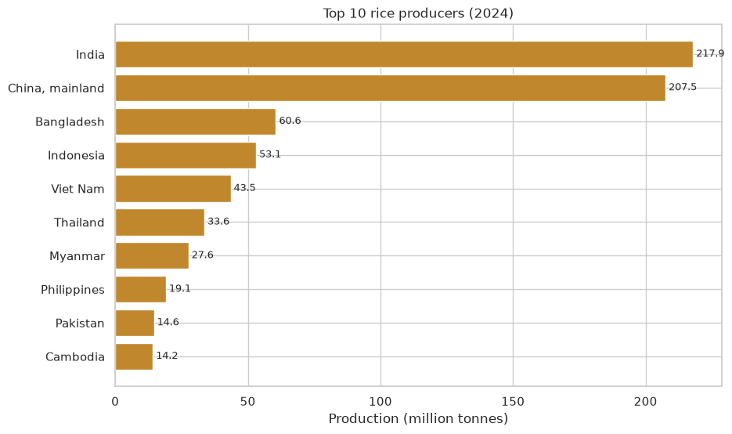
RICE — THE SUPPLY BASE
Who grows the world's rice
Rice production concentrates in Asia — India and China alone are nearly half of world output.
Notes:
The Asian concentration of rice production shapes which countries can export and which must import.

Slide 23
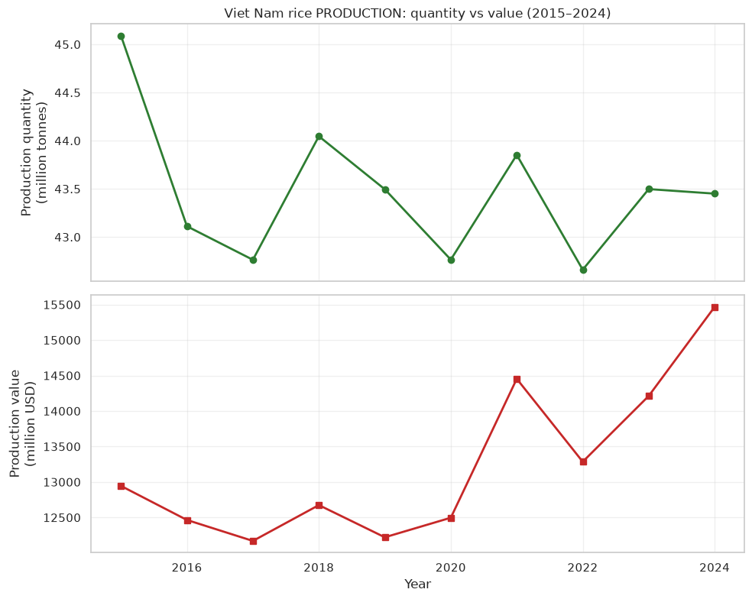
RICE — A KEY EXPORTER
Vietnam's rice: steady surplus
A major rice exporter with steadily rising output — the dependable supply behind many Asian importers.
Notes:
Vietnam's stable, growing rice output is the export backbone that flexible importers like China and the Philippines can lean on.

Slide 24
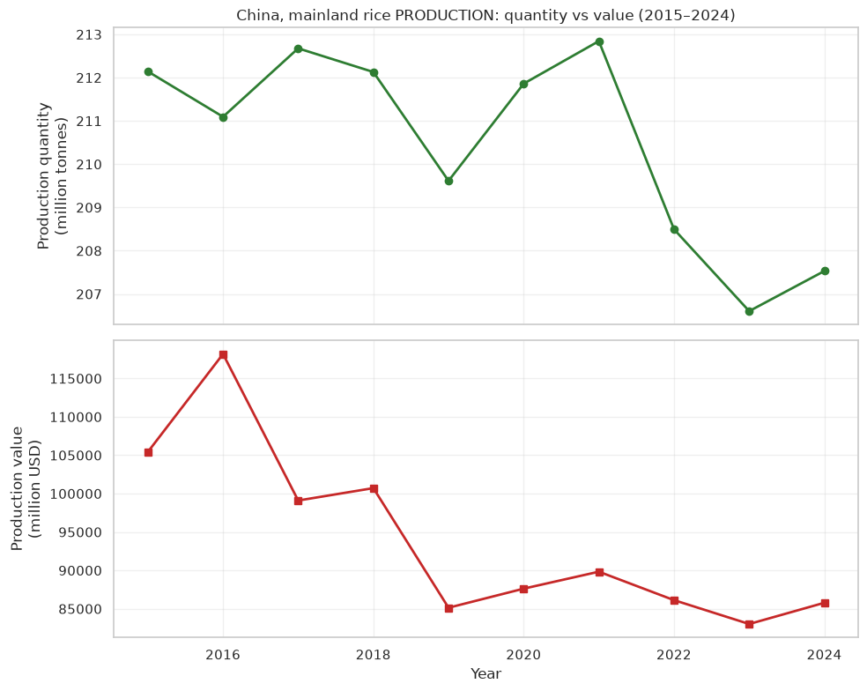
RICE — THE FLEXIBLE IMPORTER
China grows its own rice
200+ Mt of domestic rice is why China can treat rice imports as optional, not critical.
Notes:
The production backbone behind the TRADE deck's 'China + rice = flexible, discretionary imports' finding.

