Slide 1
TRADE

Slide 2
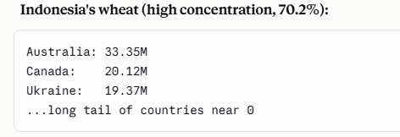
POTENTIAL AREA/S TO CONSIDER within TRADE Dataset
Proof of concept ( Picked staples like top Wheat and Rice importers)
Build a vulnerability score ( only for wheat and Rice importers)-Huge datasets, so adding more would be difficult ( need production data in addition to trade data)
Vulnerability Score = Import Dependency % × Supplier Concentration %
  Import Dependency % = Imports / (Domestic Production + Imports − Exports)
  Supplier Concentration % = (Volume from top 3 suppliers) / (Total import volume)
Apply the score across existing top-10 wheat importers + top-10 rice importers
Unsupervised ML: Cluster (K-means) top wheat importers (and separately, top rice importers) using Import Dependency %, Supplier Concentration %, and Price Volatility as the three features

Slide 3
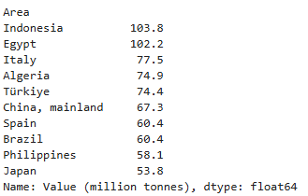
WHEAT TOP IMPORTERS

Slide 4
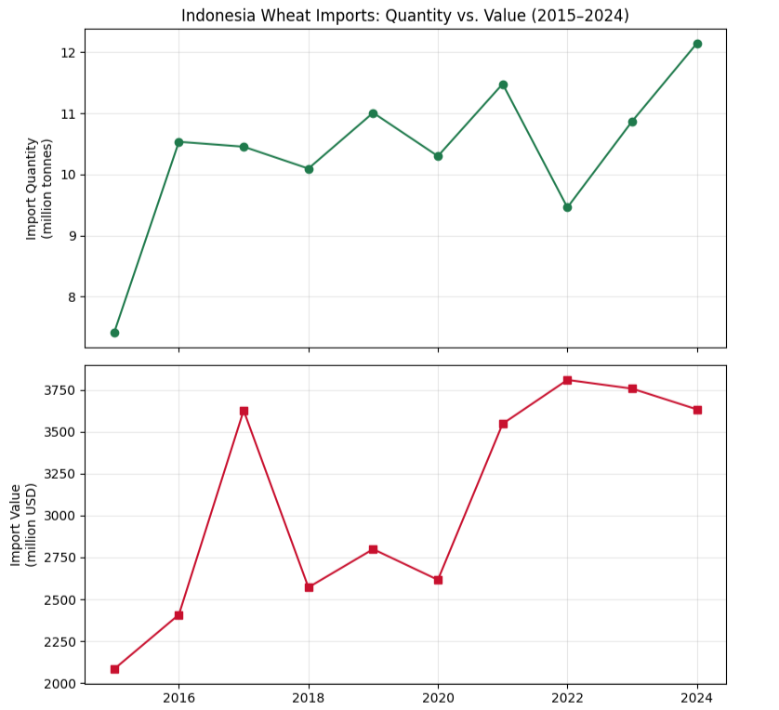
INDONESIA
Identified the dominant traded form for each staple crop (raw grain for wheat, milled product for rice) through volume analysis across all item variants, to avoid double-counting the same crop at different processing stages

Slide 5
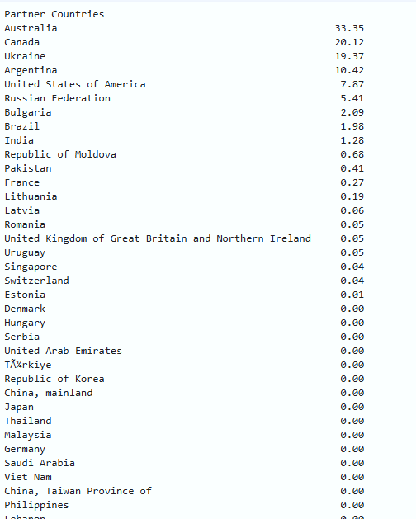
INDONESIA WHEAT SUPPLIERS

Slide 6
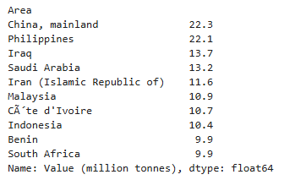
RICE, MILLED TOP IMPORTERS

Slide 7
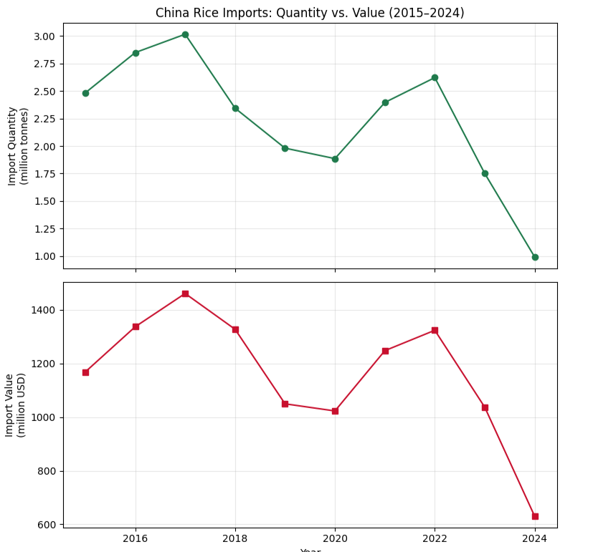
CHINA
Identified the dominant traded form for each staple crop (raw grain for wheat, milled product for rice) through volume analysis across all item variants, to avoid double-counting the same crop at different processing stages

Slide 8
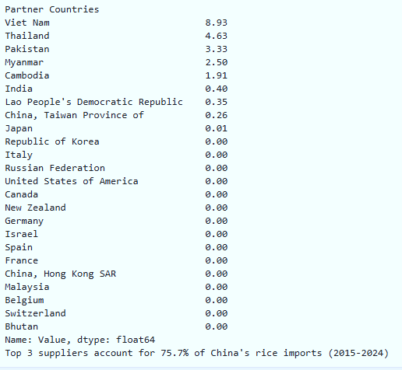
CHINA RICE SUPPLIERS

Slide 9
Indonesia + Wheat: import quantity and value moving in opposite directions during a shock (2022) → genuine structural vulnerability, no domestic alternative
China + Rice: import quantity and value moving together smoothly over time → flexible, discretionary import behavior backed by strong domestic production capacity
"Independent industry reporting (UkrAgroConsult) confirms our FAOSTAT-derived supplier concentration findings and reveals Indonesia has begun actively diversifying, having signed a 2025 MoU to import a minimum 1.0M tonnes of US wheat by 2030 , direct evidence that the vulnerability our analysis identifies is already being addressed by industry actors, validating both our methodology and the real-world relevance of supplier concentration as a risk metric."
https://ukragroconsult.com/en/news/indonesia-to-increase-wheat-consumption-and-imports/

Slide 10
