Slide 1
W03 PREPARE: STUDENT SKILLS
WELCOME TO PC103
WEEK3
APPLICATION ACTIVITY: WELLNESS PLAN

Slide 2
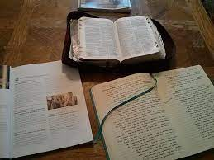

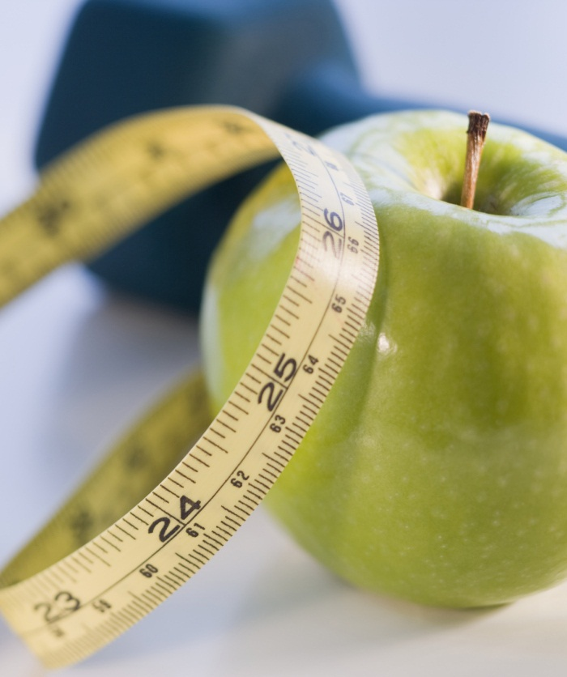

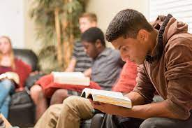
HEALTH AND WELLNESS FOR ACADEMIC SUCCESS
Notes:
NOTE: To replace a picture, just select and delete it. Then use the Insert Picture icon to replace it with one of your own!

Slide 3
HEALTH AND WELLNESS FOR ACADEMIC SUCCESS
Spiritual Thought
Devotional
BYU Application Process
Introductory Certificate Course
Student Skills Lesson
Application Activity: SMART Goals
Student Skills Application: Wellness Plan

Slide 4
SPIRITUAL THOUGHT
“And I was led by the Spirit, not knowing beforehand
the things which I should do.”
- 1 Nephi 4:6 -

Slide 5
DEVOTIONAL
How can Heavenly Father make a way for you to succeed in your educational path?
Why is it important to know that when you die, you won't take money or a home, or a car, but you will take your education?

Slide 6
BYU Application Process
What is your progress regarding your BYU or Ensign College application?
Does anyone have any issues regarding the application process?

Slide 7
Introductory Certificate Course
One person: Please discuss your experience with your Introductory Certificate course?
One person: Please share a significant challenge you are facing in your course? (The class can assist with giving solutions for the challenge)
One person: What is going well with your Introductory Certificate course?

Slide 8
Student Skills Lesson
“I remember the story of a bird that started to trade his feathers for worms. It was easy to get food that way, and the bird thought he had plenty of feathers. As he continued to trade his feathers, the bird enjoyed not having to get up early to hunt for worms anymore. He could sit in his nest all day and never have to move a muscle. Eventually, however, the bird got too used to this and realized he could no longer fly because he had lost his vital feathers.”
(Elder Adrian Ochoa, “Be Strong, Be Healthy, Be Smart,” New Era, October 2013)

Slide 9
Student Skills Lesson
What principle stands out to you in this story?
How does this story relate to experiences you have had in your own life?
Writing prompt: What connections can you make from this story to our physical, spiritual, social and mental health? (Give students 60sec to write their answer)
Discussion questions: (two people)
What did you write about? Why?
How are these areas of physical, mental and spiritual health connected?
How does your health affect your academic success?

Slide 10
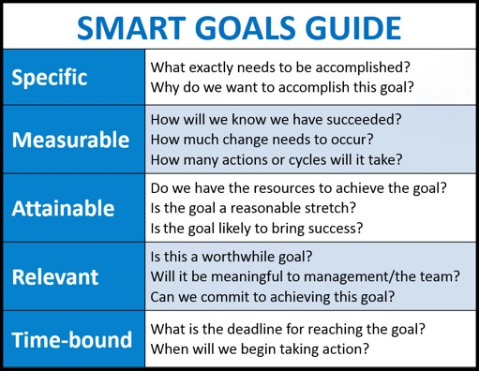
Application Activity: SMART Goals
The application activity this week is to set goals in each wellness area (we must choose two): physical, spiritual, social and mental.

Slide 11
Application Activity: SMART Goals
Goal setting allows you to identify what is most important in your life and take small steps of action to get there.
Why is goal setting important?
What is the difference between good ideas and goals?

Slide 12
Student Skills Application: Wellness Plan
PHYSICAL | SPIRITUAL | SOCIAL | MENTAL
Class Discussion:
What can we learn in the process of completing our wellness plan?
Why is it important to remember our priorities when goal setting?
How can our pacing guides from last week help with progress on the SMART goals in the Wellness Plan?
What questions would you like to ask your classmates to help you improve your specific goals?

Slide 13
“Learning is becoming more like God…”
- Russell T. Osguthorpe -

