Slide 1
Gaussian Elimination
Major: All Engineering Majors
Author(s): Autar Kaw
http://numericalmethods.eng.usf.edu
Transforming Numerical Methods Education for STEM Undergraduates

Slide 2
Naïve Gauss Elimination http://numericalmethods.eng.usf.edu

Slide 3
Naïve Gaussian Elimination
A method to solve simultaneous linear equations of the form [A][X]=[C]
Two steps
1. Forward Elimination
2. Back Substitution

Slide 4

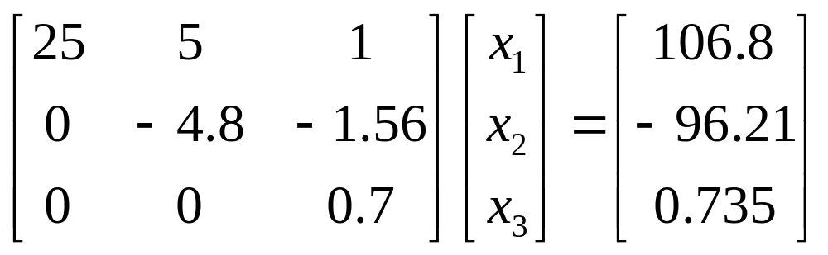
Forward Elimination
The goal of forward elimination is to transform the coefficient matrix into an upper triangular matrix

Slide 5
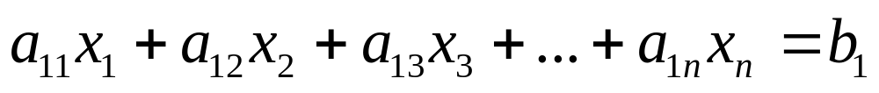

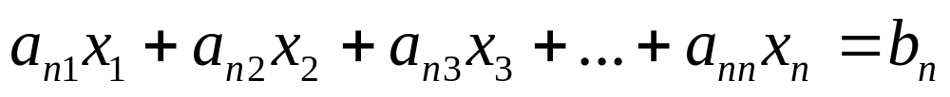
Forward Elimination
A set of n equations and n unknowns
. .
. .
. .
(n-1) steps of forward elimination

Slide 6

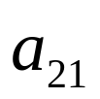
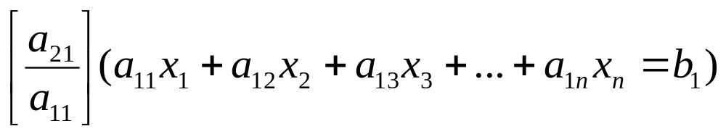
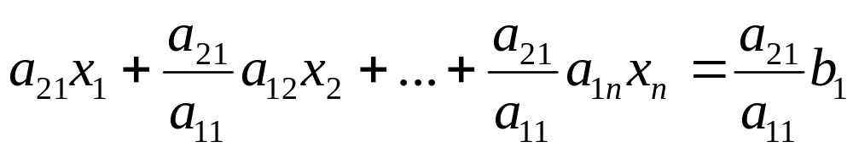
Forward Elimination
Step 1
For Equation 2, divide Equation 1 by and multiply by .

Slide 7
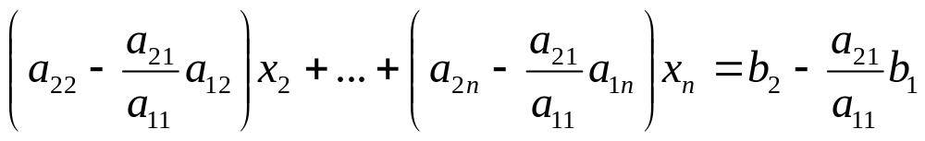
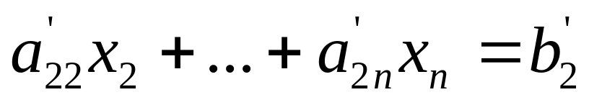
Forward Elimination
Subtract the result from Equation 2.
−
_________________________________________________
or

Slide 8
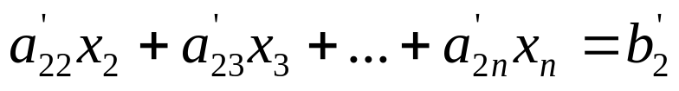
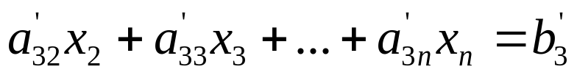
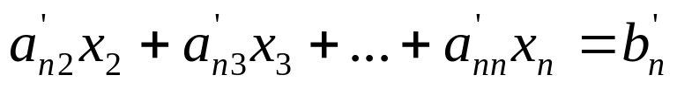
Forward Elimination
Repeat this procedure for the remaining equations to reduce the set of equations as
. . .
. . .
. . .
End of Step 1

Slide 9
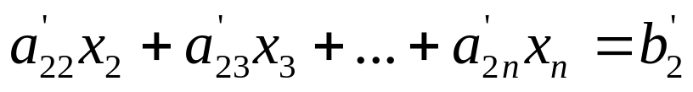
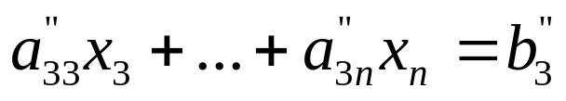
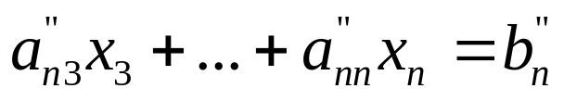
Forward Elimination
Step 2
Repeat the same procedure for the 3rd term of Equation 3.
. .
. .
. .
End of Step 2

Slide 10
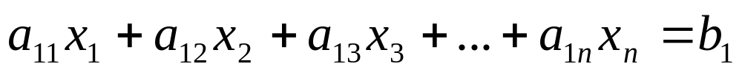

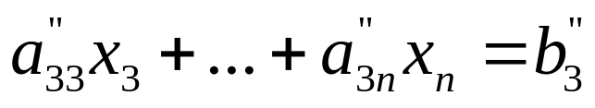
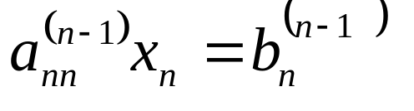
Forward Elimination
At the end of (n-1) Forward Elimination steps, the system of equations will look like
. .
. .
. .
End of Step (n-1)

Slide 11
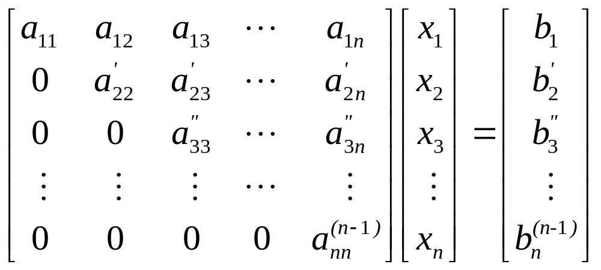
Matrix Form at End of Forward Elimination

Slide 12
Back Substitution
Solve each equation starting from the last equation
Example of a system of 3 equations

Slide 13
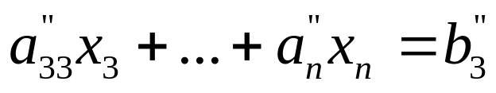
Back Substitution Starting Eqns
. .
. .
. .

Slide 14
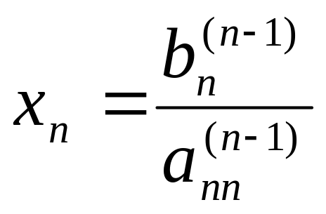
Back Substitution
Start with the last equation because it has only one unknown

Slide 15

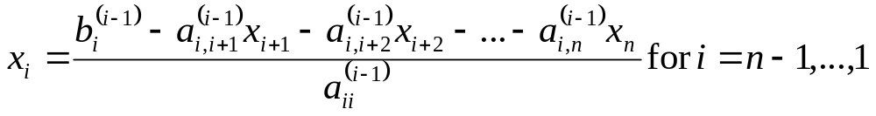
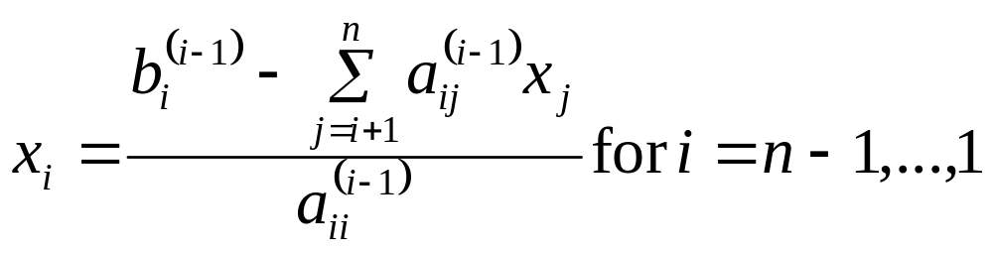
Back Substitution

Slide 16
THE END
http://numericalmethods.eng.usf.edu

Slide 17
Additional Resources
For all resources on this topic such as digital audiovisual lectures, primers, textbook chapters, multiple-choice tests, worksheets in MATLAB, MATHEMATICA, MathCad and MAPLE, blogs, related physical problems, please visit
http://numericalmethods.eng.usf.edu/topics/gaussian_elimination.html

Slide 18
Naïve Gauss Elimination
Example http://numericalmethods.eng.usf.edu

Slide 19

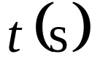
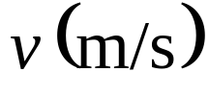
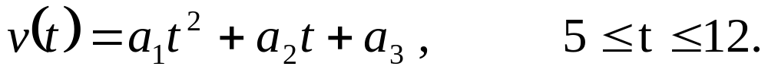
Example 1
The upward velocity of a rocket is given at three different times
Table 1 Velocity vs. time data.
Time, | Velocity,
5 | 106.8
8 | 177.2
12 | 279.2
The velocity data is approximated by a polynomial as:
Find the velocity at t=6 seconds .

Slide 20
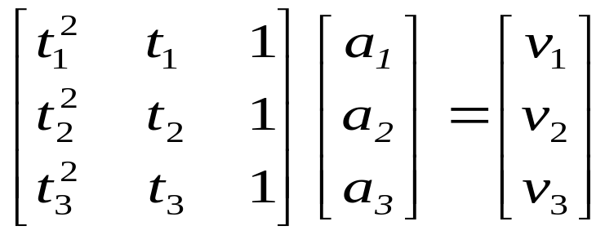

Example 1 Cont.
Assume
Results in a matrix template of the form:
Using data from Table 1, the matrix becomes:

Slide 21
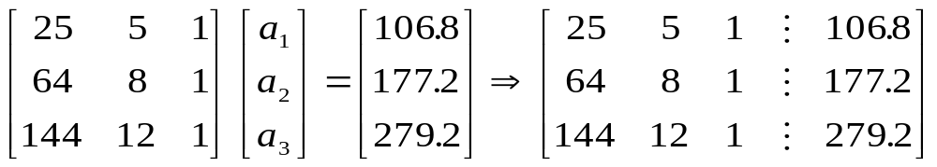
Example 1 Cont.
Forward Elimination
Back Substitution

Slide 22
Forward Elimination

Slide 23
Number of Steps of Forward Elimination
Number of steps of forward elimination is
(n−1)=(3−1)=2

Slide 24
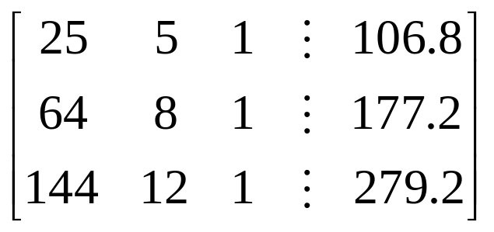
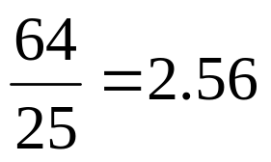
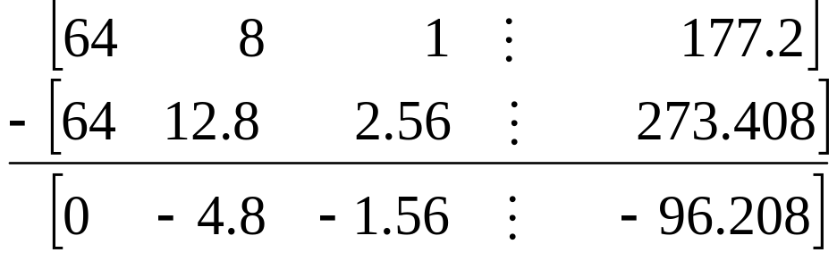
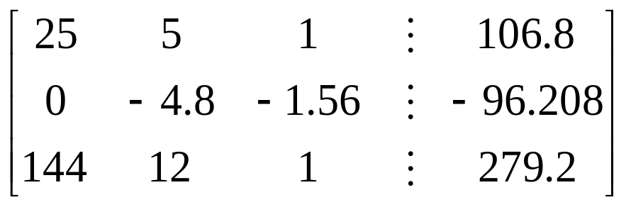
Forward Elimination: Step 1
Divide Equation 1 by 25 and
multiply it by 64, .
.
Subtract the result from Equation 2
Substitute new equation for Equation 2

Slide 25

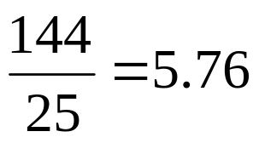
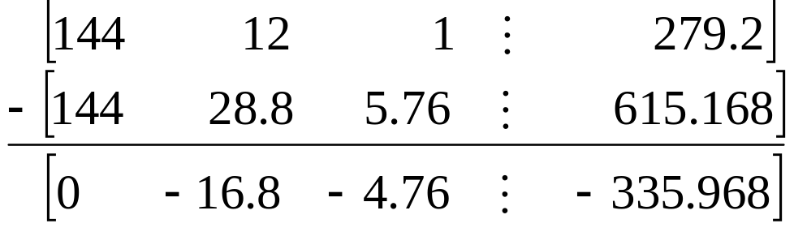
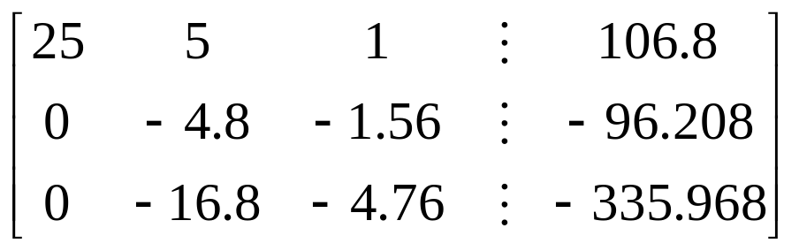
Forward Elimination: Step 1 (cont.)
Divide Equation 1 by 25 and
multiply it by 144, .
.
Subtract the result from Equation 3
Substitute new equation for Equation 3

Slide 26

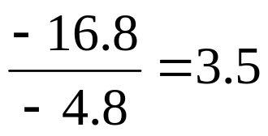
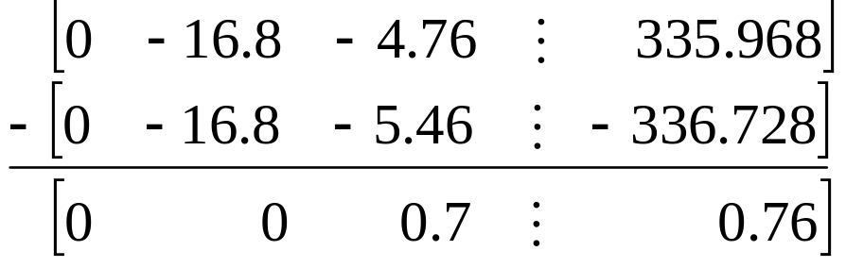
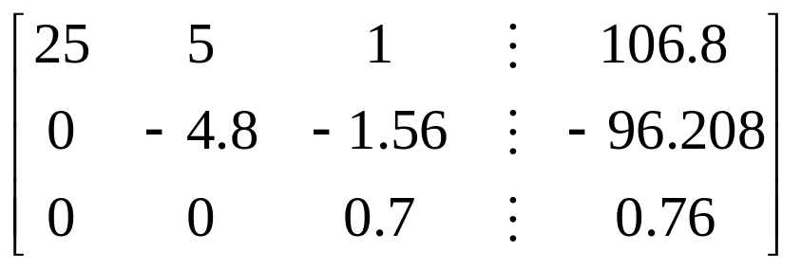
Forward Elimination: Step 2
Divide Equation 2 by −4.8
and multiply it by −16.8,
.
Subtract the result from Equation 3
Substitute new equation for Equation 3

Slide 27
Back Substitution

Slide 28
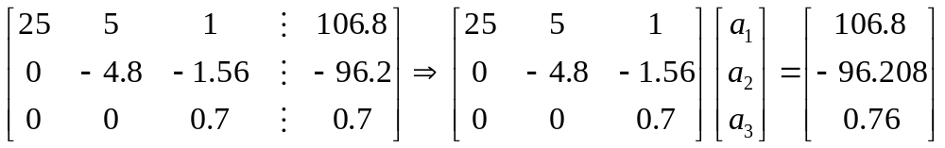
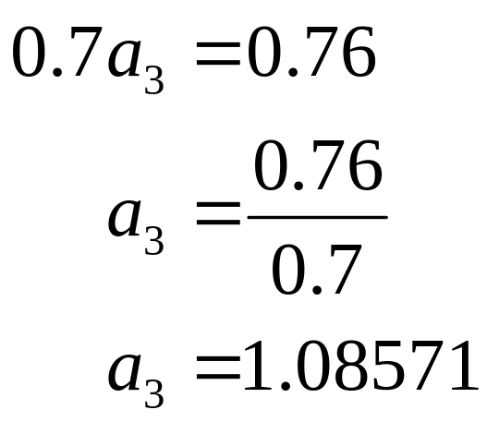
Back Substitution
Solving for a₃

Slide 29
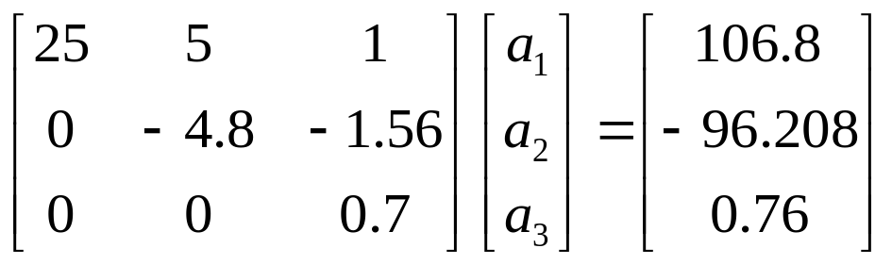
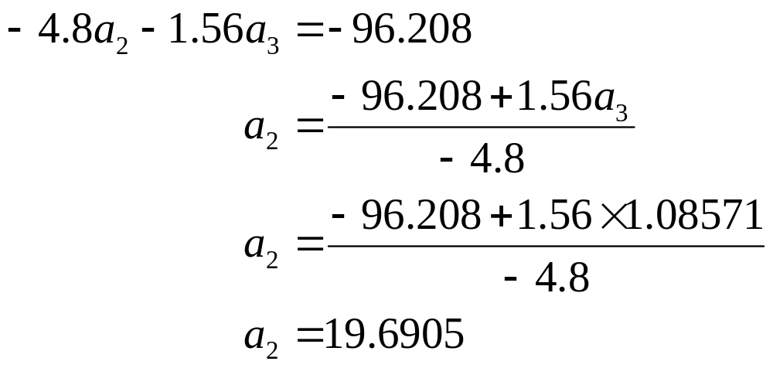
Back Substitution (cont.)
Solving for a₂

Slide 30
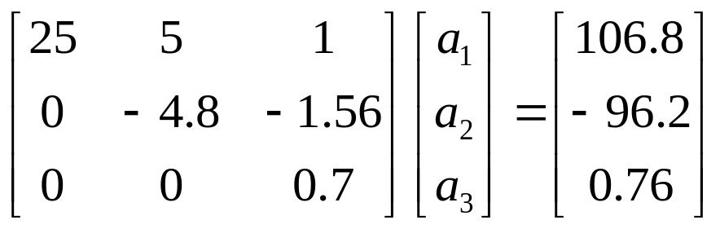
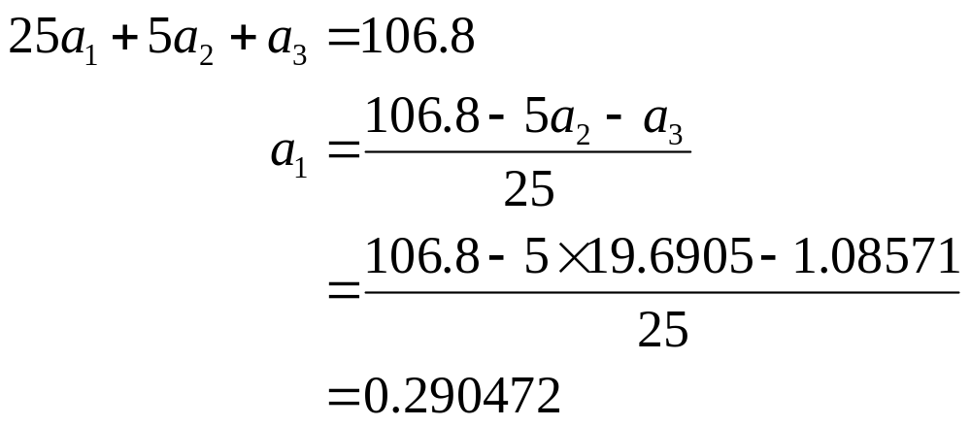
Back Substitution (cont.)
Solving for a₁

Slide 31

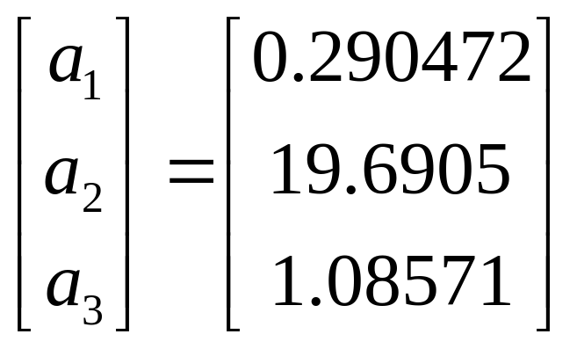
Naïve Gaussian Elimination Solution

Slide 32
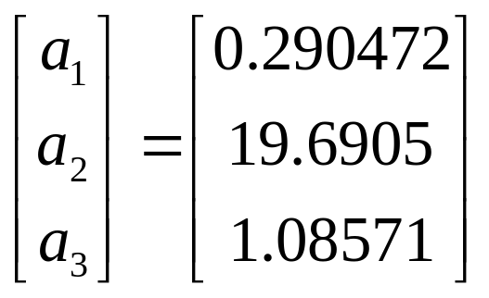
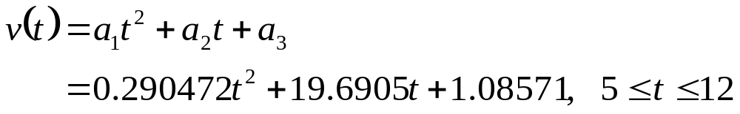
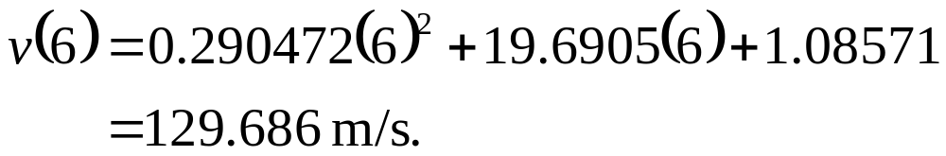
Example 1 Cont.
Solution
The solution vector is
The polynomial that passes through the three data points is then:

Slide 33
THE END
http://numericalmethods.eng.usf.edu

Slide 34
Naïve Gauss Elimination
Pitfalls http://numericalmethods.eng.usf.edu

Slide 35
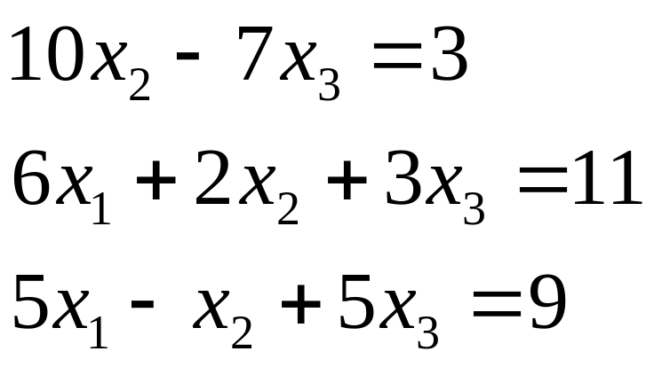
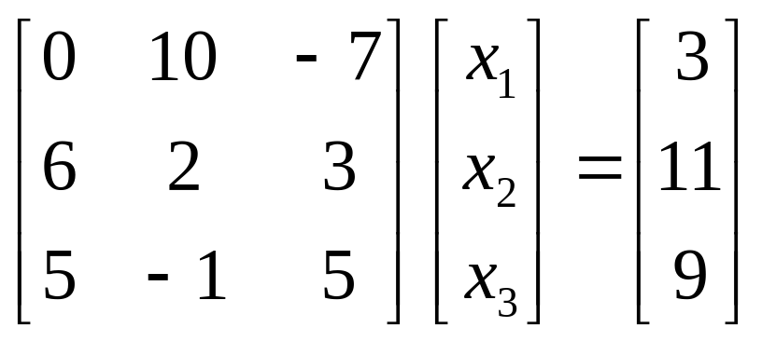
Pitfall#1. Division by zero

Slide 36
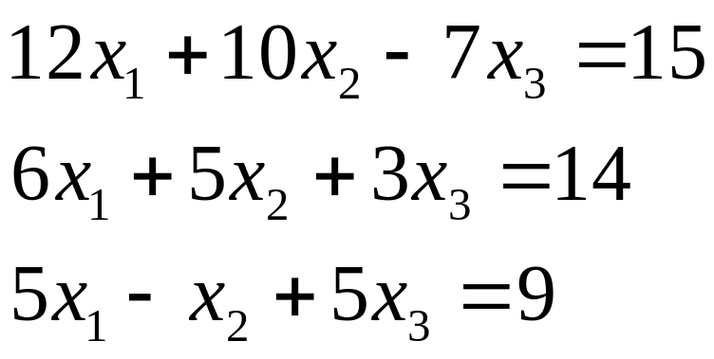

Is division by zero an issue here?

Slide 37



Is division by zero an issue here? YES
Division by zero is a possibility at any step of forward elimination

Slide 38


Pitfall#2. Large Round-off Errors
Exact Solution

Slide 39

Pitfall#2. Large Round-off Errors
Solve it on a computer using 6 significant digits with chopping

Slide 40

Pitfall#2. Large Round-off Errors
Solve it on a computer using 5 significant digits with chopping
Is there a way to reduce the round off error?

Slide 41
Avoiding Pitfalls
Increase the number of significant digits
Decreases round-off error
Does not avoid division by zero

Slide 42
Avoiding Pitfalls
Gaussian Elimination with Partial Pivoting
Avoids division by zero
Reduces round off error

Slide 43
THE END
http://numericalmethods.eng.usf.edu

Slide 44
Gauss Elimination with Partial Pivoting http://numericalmethods.eng.usf.edu

Slide 45
Pitfalls of Naïve Gauss Elimination
Possible division by zero
Large round-off errors

Slide 46
Avoiding Pitfalls
Increase the number of significant digits
Decreases round-off error
Does not avoid division by zero

Slide 47
Avoiding Pitfalls
Gaussian Elimination with Partial Pivoting
Avoids division by zero
Reduces round off error

Slide 48



What is Different About Partial Pivoting?
At the beginning of the k^{th} step of forward elimination, find the maximum of
If the maximum of the values is
in the p ^{th} row,
then switch rows p and k.

Slide 49

Matrix Form at Beginning of 2nd Step of Forward Elimination

Slide 50

Example (2nd step of FE)
Which two rows would you switch?

Slide 51

Example (2nd step of FE)
Switched Rows

Slide 52
Gaussian Elimination with Partial Pivoting
A method to solve simultaneous linear equations of the form [A][X]=[C]
Two steps
1. Forward Elimination
2. Back Substitution

Slide 53
Forward Elimination
Same as naïve Gauss elimination method except that we switch rows before each of the (n-1) steps of forward elimination.

Slide 54
Example: Matrix Form at Beginning of 2nd Step of Forward Elimination

Slide 55
Matrix Form at End of Forward Elimination

Slide 56
Back Substitution Starting Eqns
. .
. .
. .

Slide 57
Back Substitution

Slide 58
THE END
http://numericalmethods.eng.usf.edu

Slide 59
Gauss Elimination with Partial Pivoting
Example http://numericalmethods.eng.usf.edu

Slide 60

Example 2
Solve the following set of equations by Gaussian elimination with partial pivoting

Slide 61


Example 2 Cont.
Forward Elimination
Back Substitution

Slide 62
Forward Elimination

Slide 63
Number of Steps of Forward Elimination
Number of steps of forward elimination is (n−1)=(3−1)=2

Slide 64


Forward Elimination: Step 1
Examine absolute values of first column, first row
and below.
Largest absolute value is 144 and exists in row 3.
Switch row 1 and row 3.

Slide 65




Forward Elimination: Step 1 (cont.)
Divide Equation 1 by 144 and
multiply it by 64, .
.
Subtract the result from Equation 2
Substitute new equation for Equation 2

Slide 66




Forward Elimination: Step 1 (cont.)
Divide Equation 1 by 144 and
multiply it by 25, .
.
Subtract the result from Equation 3
Substitute new equation for Equation 3

Slide 67


Forward Elimination: Step 2
Examine absolute values of second column, second row
and below.
Largest absolute value is 2.917 and exists in row 3.
Switch row 2 and row 3.

Slide 68




Forward Elimination: Step 2 (cont.)
Divide Equation 2 by 2.917 and
multiply it by 2.667,
.
Subtract the result from Equation 3
Substitute new equation for Equation 3

Slide 69
Back Substitution

Slide 70


Back Substitution
Solving for a₃

Slide 71


Back Substitution (cont.)
Solving for a₂

Slide 72

Back Substitution (cont.)
Solving for a₁

Slide 73


Gaussian Elimination with Partial Pivoting Solution

Slide 74
Gauss Elimination with Partial Pivoting
Another Example http://numericalmethods.eng.usf.edu

Slide 75




Partial Pivoting: Example
Consider the system of equations
In matrix form
=
Solve using Gaussian Elimination with Partial Pivoting using five significant digits with chopping

Slide 76



Partial Pivoting: Example
Forward Elimination: Step 1
Examining the values of the first column
|10|, |-3|, and |5| or 10, 3, and 5
The largest absolute value is 10, which means, to follow the rules of Partial Pivoting, we switch row1 with row1.
Performing Forward Elimination

Slide 77

Partial Pivoting: Example
Forward Elimination: Step 2
Examining the values of the first column
|-0.001| and |2.5| or 0.0001 and 2.5
The largest absolute value is 2.5, so row 2 is switched with row 3
Performing the row swap

Slide 78

Partial Pivoting: Example
Forward Elimination: Step 2
Performing the Forward Elimination results in:

Slide 79



Partial Pivoting: Example
Back Substitution
Solving the equations through back substitution

Slide 80


Partial Pivoting: Example
Compare the calculated and exact solution
The fact that they are equal is coincidence, but it does illustrate the advantage of Partial Pivoting

Slide 81
THE END
http://numericalmethods.eng.usf.edu

Slide 82
Determinant of a Square Matrix
Using Naïve Gauss Elimination
Example http://numericalmethods.eng.usf.edu

Slide 83
Theorem of Determinants
If a multiple of one row of [A]_{nxn} is added or subtracted to another row of [A]_{nxn} to result in [B]_{nxn} then det(A)=det(B)

Slide 84

Theorem of Determinants
The determinant of an upper triangular matrix [A]_{nxn} is given by

Slide 85


Forward Elimination of a
Square Matrix
Using forward elimination to transform [A]_{nxn} to an upper triangular matrix, [U]_{nxn}.

Slide 86

Example
Using naïve Gaussian elimination find the determinant of the following square matrix.

Slide 87
Forward Elimination

Slide 88



Forward Elimination: Step 1
Divide Equation 1 by 25 and
multiply it by 64, .
.
Subtract the result from Equation 2
Substitute new equation for Equation 2

Slide 89



Forward Elimination: Step 1 (cont.)
Divide Equation 1 by 25 and
multiply it by 144, .
.
Subtract the result from Equation 3
Substitute new equation for Equation 3

Slide 90



Forward Elimination: Step 2
Divide Equation 2 by −4.8
and multiply it by −16.8,
.
.
Subtract the result from Equation 3
Substitute new equation for Equation 3

Slide 91


Finding the Determinant
After forward elimination
.

Slide 92
Summary
Forward Elimination
Back Substitution
Pitfalls
Improvements
Partial Pivoting
Determinant of a Matrix

Slide 93
Additional Resources
For all resources on this topic such as digital audiovisual lectures, primers, textbook chapters, multiple-choice tests, worksheets in MATLAB, MATHEMATICA, MathCad and MAPLE, blogs, related physical problems, please visit
http://numericalmethods.eng.usf.edu/topics/gaussian_elimination.html

Slide 94
THE END
http://numericalmethods.eng.usf.edu

