Slide 1
Chapter 2, Linear Systems, Mainly LU Decomposition
Notes:
Chapter number refers to “Numerical Recipes” chapters.

Slide 2
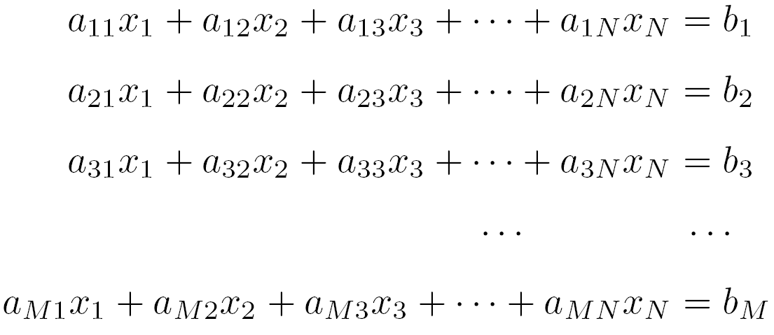
Linear Systems
In matrix form: A x = b
See, e.g., “Matrix Analysis and Applied Linear Algebra”, Carl D. Meyer, SIAM, 2000.

Slide 3
Existence and Solutions
M = N (square matrix) and nonsingular, a unique solution exists
M < N, more variables than equations – need to find the null space of A, A x = 0 (e.g. SVD)
M > N, one can ask for least-square solution, e.g., from (A^{T}A) x = (A^{T} b)
Notes:
M is the number of equations

Slide 4
Some Concepts in Linear Algebra
Vector space and its dimension
Null space of a matrix A: the set of all x such that Ax = 0
Range of A: the set of all Ax
Rank of A: max number of linearly independent rows or columns
Rank of A + Null space Dim of A = number of columns of A

Slide 5
Computation Tasks and Pitfalls
Solve A x = b
Find A⁻¹
Compute det(A)
Round off error makes the system singular, or numerical instability makes the answer wrong.

Slide 6
Gauss Elimination
Basic facts about linear equations
  Interchanging any two rows of A and b does not change the solution x
  Replace a row by a linear combination of itself and any other row does not change x
  Interchange column permutes the solution
Example of Gauss elimination
Pivoting
Notes:
Gauss elimination makes reduced echelon form, which is helpful to find null space or determine if the linear system is consistent.

Slide 7

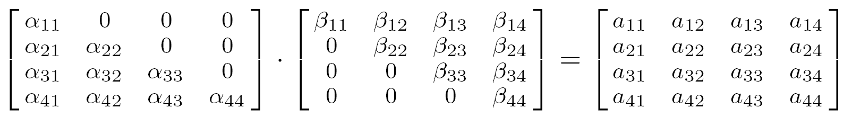
LU Decomposition
LU = A
Thus A x = (LU) x = L (U x) = b
Let y = U x, then solve y in L y = b by forward substitution
Solve x in U x = y by backward substitution

Slide 8
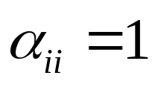
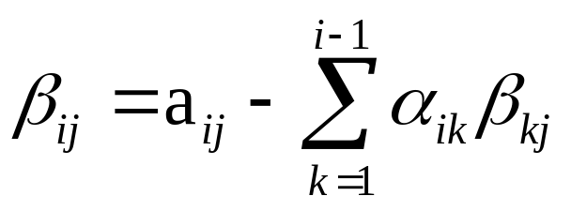
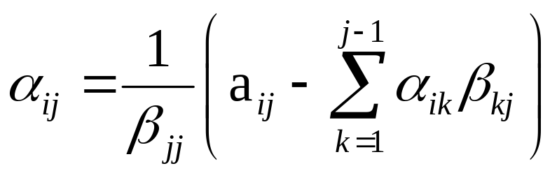
Crout’s Algorithm
Set for all i
For each j = 1, 2, 3, …, N
  (a) for i = 1, 2, …, j
  (b) for i = j +1, j +2, …, N

Slide 9
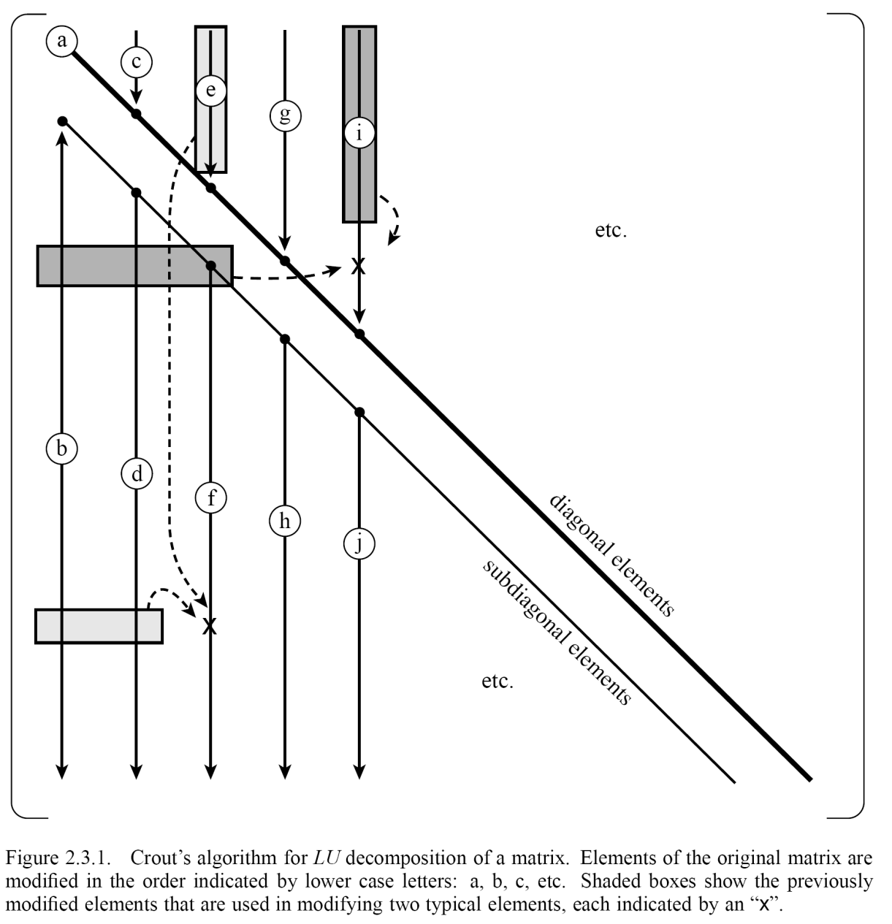
Order of Update in Crout’s Algorithm

Slide 10
Pivoting
Pivoting is essential for stability
Interchange rows to get largest β_{ii}
Implicit pivoting (when comparing for the biggest elements in a column, use the normalized one so that the largest coefficient in an equation is 1)

Slide 11
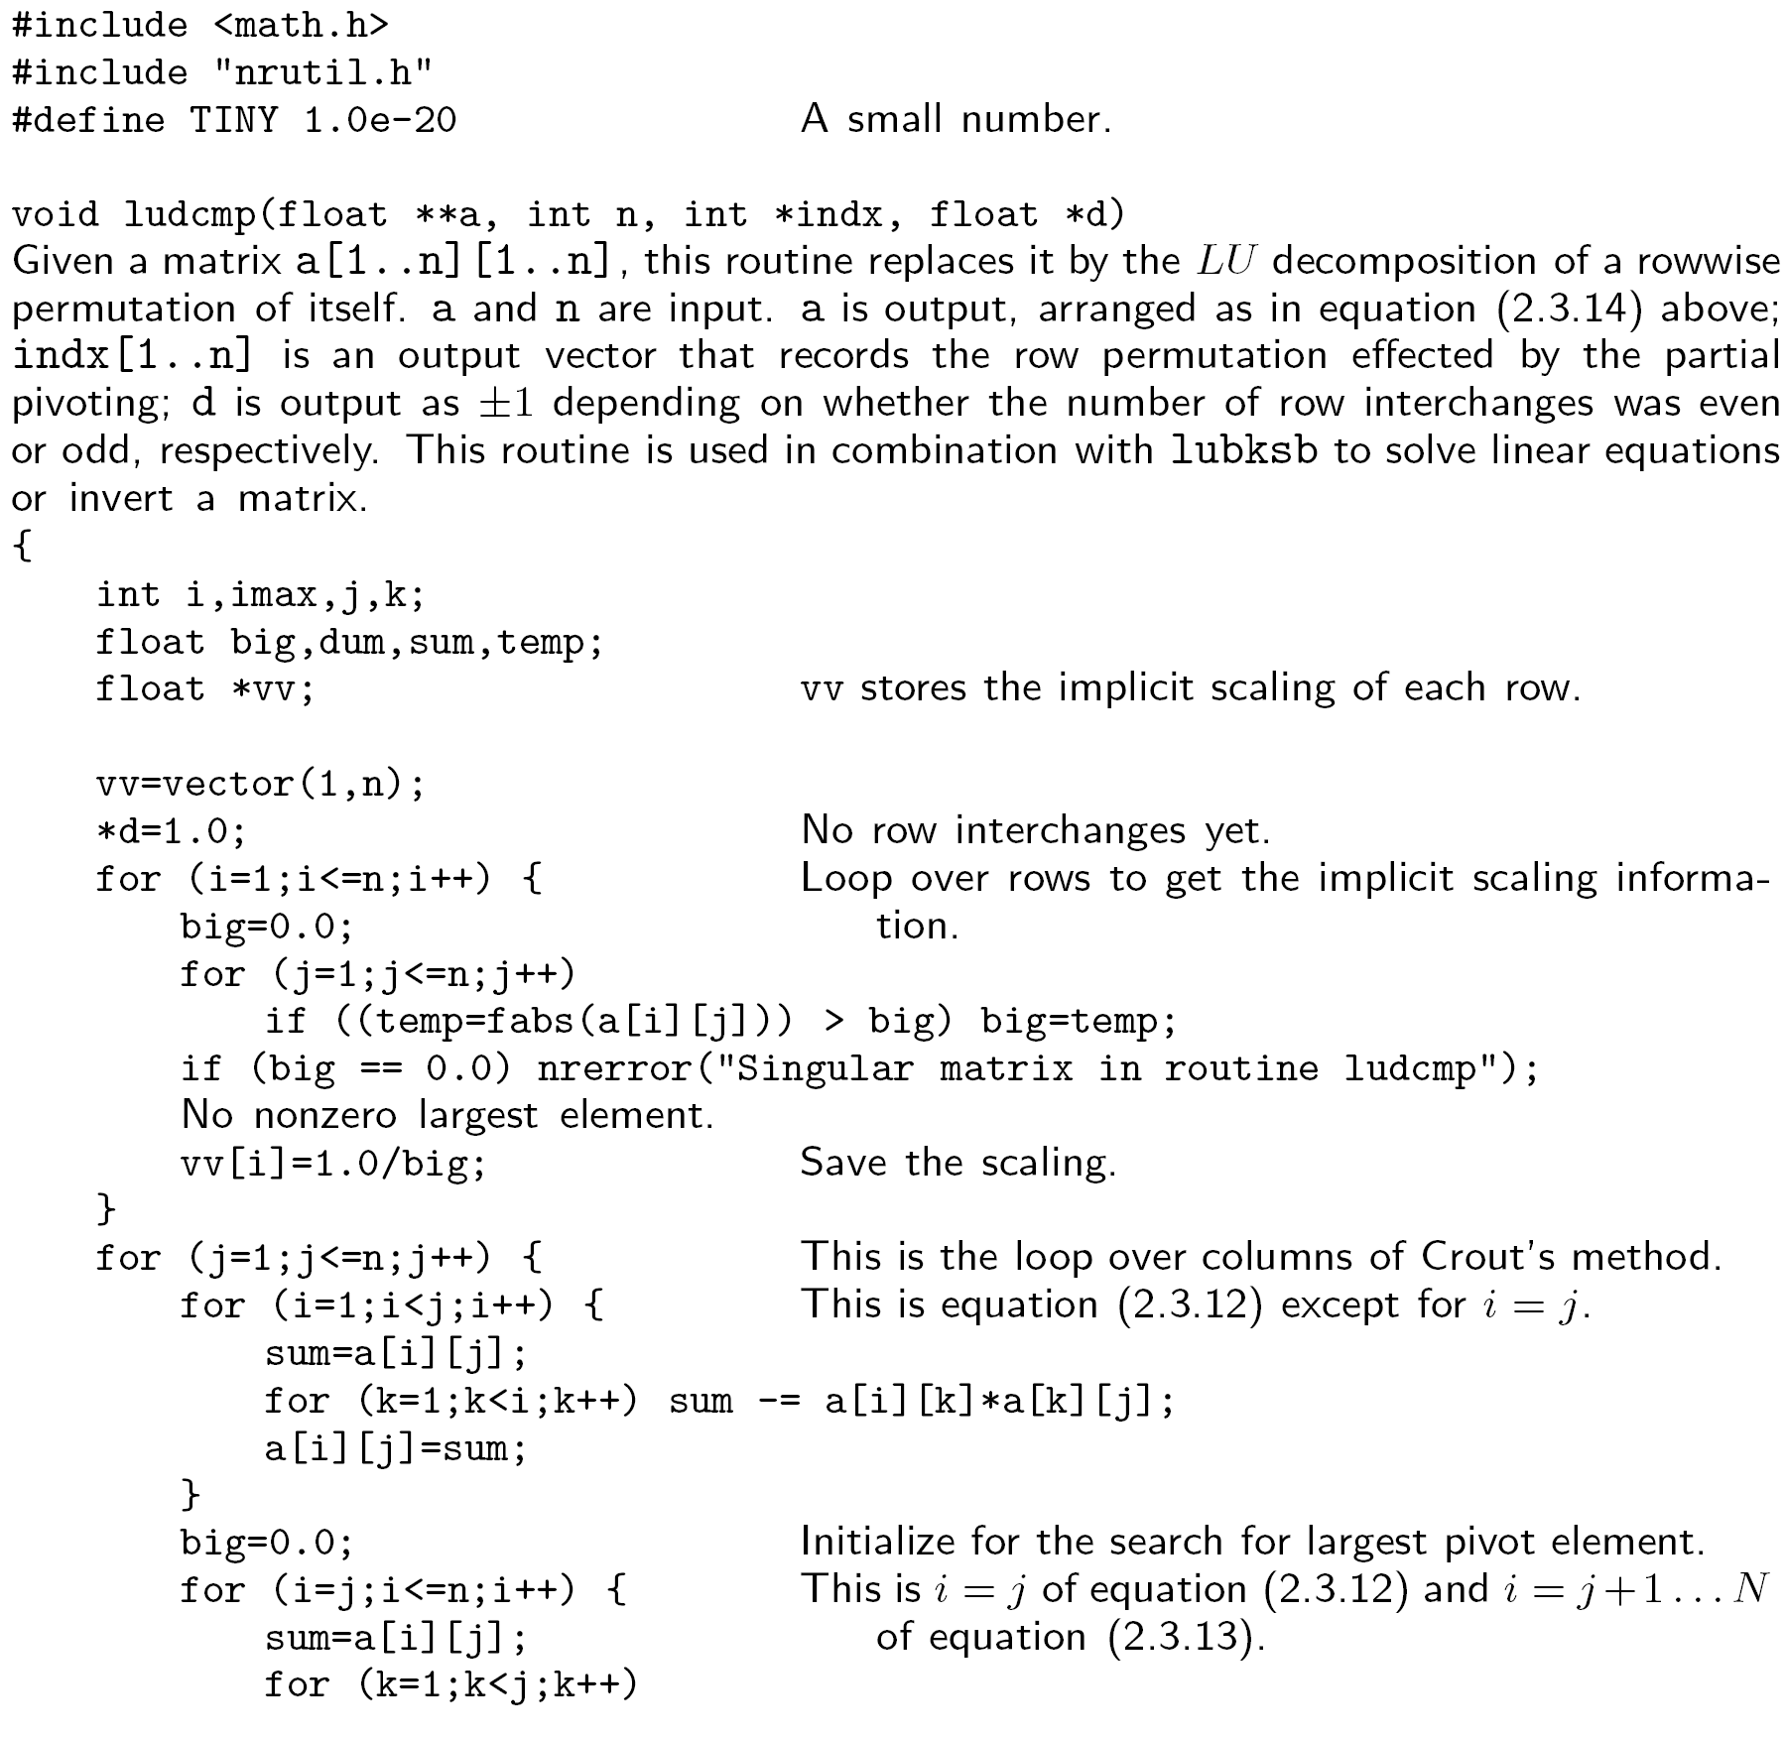

Slide 12
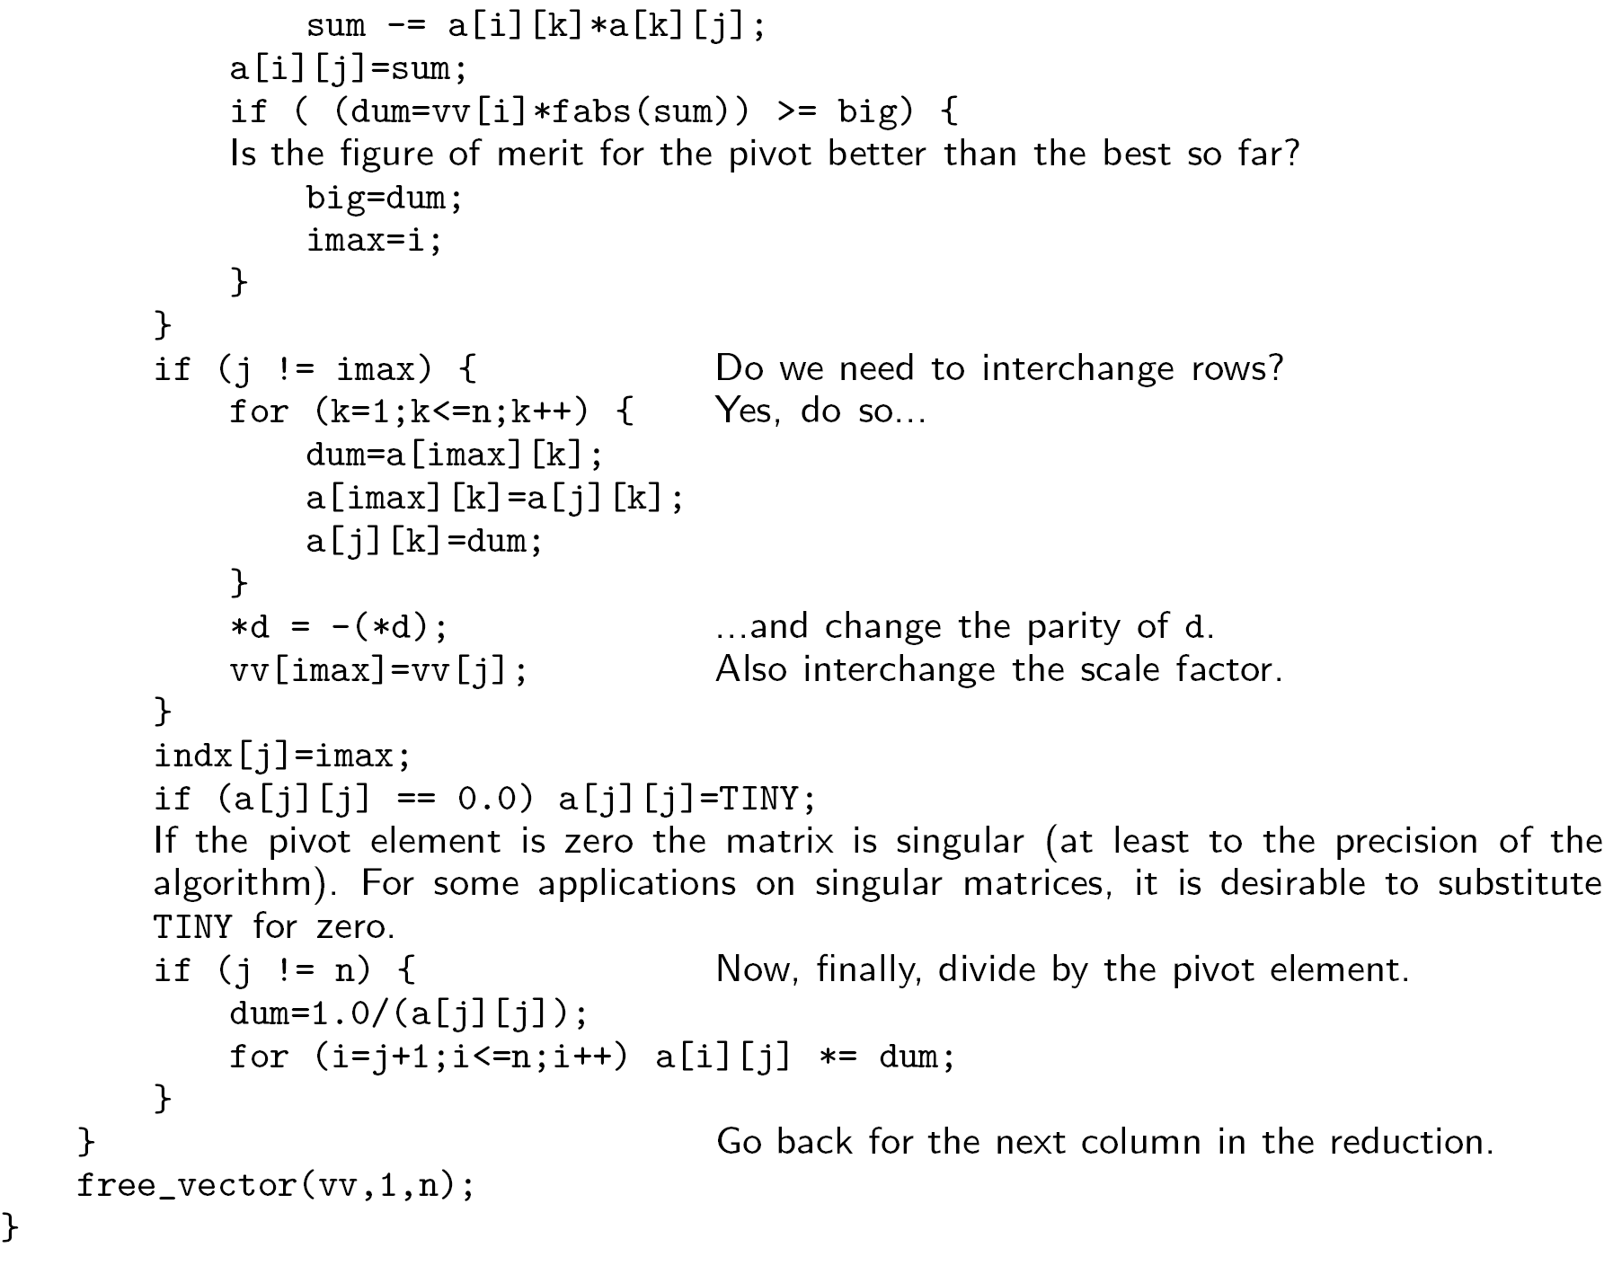

Slide 13
Computational Complexity
How many basic steps does the LU decomposition program take?
Big O( … ) notation & asymptotic performance
O(N³)
Notes:
More precisely, how many additions and multiplications one need to perform?

Slide 14
Compute A⁻¹
Let B = A⁻¹
then AB = I (I is identity matrix)
or A [b₁, b₂, …,b_{N}] = [e₁, e₂, …,e_{N}]
or A b_{j} = e_{j} for j = 1, 2, …, N
where b_{j} is the j-th column of B.
I.e., to compute A⁻¹, we solve a linear system N times, each with unit vector e_{j}.

Slide 15
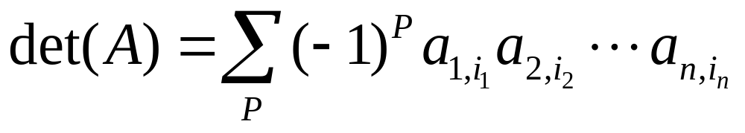
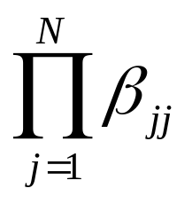
Compute det(A)
Definition of determinant
Properties of determinant
Since det(LU) = det(L)det(U), thus
det(A) = det(U) =
Notes:
Chapter 6 of CD Meyer’s book for linear algebra is very good on determinants.

Slide 16
Use LAPACK
Lapack is a free, high quality linear algebra solver package (downloadable at www.netlib.org/lapack/). Much more sophisticated than NR routines.
Written in Fortran 77, but can be used with Fortran 90 or 95
Calling inside C is possible (but machine/compiler dependent); C interface available.

Slide 17
What Lapack can do?
Solution of linear systems, Ax = b
Least-square problem, min ||Ax-b||²
Singular value decomposition, A = UsV^{T}
Eigenvalue problems, Ax = λx.

Slide 18
An Example for Lapack Fortran Routine
SUBROUTINE DSYEVR(JOBZ, RANGE, UPLO, N, A, LDA, VL, VU, IL, IU, ABSTOL, M, W, Z, LDZ, ISUPPZ, WORK, LWORK, IWORK, LIWORK, INFO)
DSYEVR computes selected eigenvalues and, optionally, eigenvectors of a real symmetric matrix T. Eigenvalues and eigenvectors can be selected by specifying either a range of values or a range of indices for the desired eigenvalues.
JOBZ (input) CHARACTER*1 = 'N': Compute eigenvalues only; = 'V': Compute eigenvalues and eigenvectors.
RANGE (input) CHARACTER*1 = 'A': all eigenvalues will be found. = 'V': all eigenvalues in the half-open interval (VL,VU] will be found. = 'I': the IL-th through IU-th eigenvalues will be found. For RANGE = 'V' or 'I' and IU - IL < N - 1, DSTEBZ and DSTEIN are called
UPLO (input) CHARACTER*1 = 'U': Upper triangle of A is stored; = 'L': Lower triangle of A is stored.
N (input) INTEGER The order of the matrix A. N >= 0.
A (input/output) DOUBLE PRECISION array, dimension (LDA, N) On entry, the symmetric matrix A. If UPLO = 'U', the leading N-by-N upper triangular part of A contains the upper triangular part of the matrix A. If UPLO = 'L', the leading N-by-N lower triangular part of A contains the lower triangular part of the matrix A. On exit, the lower triangle (if UPLO='L') or the upper triangle (if UPLO='U') of A, including the diagonal, is destroyed.

Slide 19
An example for calling Lapack in C
1. Prototype declaration in C:
dsyevr_(char *JOBZ, char *RANGE, char *UPLO, int *N, real *A, int *LDA, real *VL, real *VU, int *IL, int *IU, real *ABSTOL, int *M, real *W, real *Z, int *LDZ, int *ISUPPZ, real *WORK, int *LWORK, int *IWORK, int *LIWORK, int *INFO);
2. Pass everything as pointers
3. Call the routine as
dsyevr_(&JOBZ, &RANGE, &UPLO, &N, A, &LDA, ….)
See the program eigen.c for more detail.
Notes:
We’ll encourage the students do use the C interface, instead of this.

Slide 20
Reading, Reference
Read NR, Chap. 2
M. T. Heath, “Scientific Computing: an introductory survey”.
For a more thorough treatment on numerical linear algebra computation problems, see G H Golub & C F van Loan, “Matrix Computations”
Notes:
See also J. Stoer & R. Bulirsch, “Introduction to Numerical Analysis”, but a very theoretical book.

Slide 21
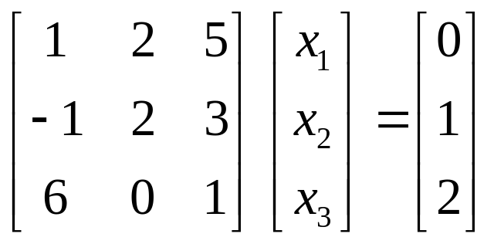
Problems for Lecture 2 (we’ll do the problems during a tutorial)
1. Consider the following linear equation
(a) Solve the system with LU decomposition, following Crout’s algorithm exactly without pivoting.
(b) Find the inverse of the 3x3 matrix, using LU decomposition.
(c) Find the determinant of the 3x3 matrix, using LU decomposition.
2. Can we do LU decomposition for all square, real matrices? What is the condition for the existence of an LU decomposition?

