Slide 1
Translation elongation cycle
2
3
4
E
P
A
E
To easily keep tracking of all classes,
I used a class_identifier(number 0-13) to label each ribosome class
Class-0-9 can be mapped in one complete elongation cycle
Each complete elongation cycle can add a new amino acid to the peptide
To reduce data complexity, some classes can be grouped. They are:
Class 2, 3 and 0
Class 5 and 9. Also, class-13 can be taken same to class-5.
Class 6 and 8
P
A
E
P
E
A
P
A
E
P
A
E
P
A
A, P/E
EF-G^{c}, A, P/E
E
P
A, P
A
E
P
A
A
E
0
P
E
P
A
E
P
6
E
A/P, P/E
A
1
P
E
A
8
P
A
EF-G^{e}, A/P, P/E
E
P
A
EF-Tu-A/T, P
EF-Tu-A/T, P, E
E
P
A
E
P
E
A
P
A
E
P
A
7
E
P
A
E
EF-G^{e}, P, E
P
A
P
P, E
5
9
Translation initiation or termination are not captured,
except for a P/E state
There are also very few other classes,
which is hard to say now but they are very rare
E
P
A
10
11, 12, 13
E
P
A
P/E

Slide 2
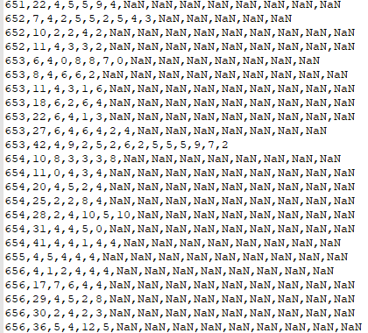
The data format of the _tomoNum_pid_riboclass_sequence file
The first column is tomoNum that indicates which tomogram/cell it is from
The second is a polysome ID, but only works when combining with specific tomoNum
Columns 3 - N indicate ribosome class-number, sequentially.
A row indicates a polyribosome
Note: polyribosome’s length varies.
The NaN does not mean anything.
For example, the first polysome shown here, its sequence is 4-5-5-9-4

