Slide 1
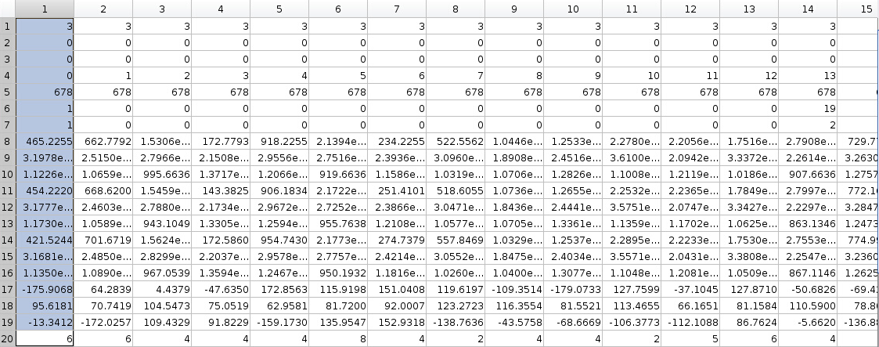
Each column = one ribosome

Slide 2
Row format
% 1 : 1: is the expressome, i.e. ribosome interact with RNAP. 3: not
% 2 :
% 3 :
% 4 : local particle seq. Note this local seq is just a relative seq in each tomo
% 5 : tomoNum, identifier for one tomogram
% 6 : polysome identifier in one tomogram. For ribosome belongs to the same polysome, they will have the same non-zero number.
For single ribosome, the value will be zero.
Note, polysome Id is not unique between tomograms so need to use tomoNum & polysome ID specify a polysome
% 7 : The relative rank of this ribosome in the polysome it belongs to. Sequence is min -> -> max
% 8 : x-coordinate of ribosome mass center in full tomogram(3708x3708x1800). The scale is pixels. One pixel=0.17nm
% 9 : y-coordinate in full tomogram
% 10 : z-coordinate in full tomogram
% 11 : calculated mRNA entry site: x in full tomogram
% 12 : calculated mRNA entry site: y in full tomogram
% 13 : calculated mRNA entry site: z in full tomogram
% 14 : calculated mRNA exit site: x in full tomogram
% 15 : calculated mRNA exit site: y in full tomogram
% 16 : calculated mRNA exit site: z in full tomogram
% 17 : rot in RELION. aound z axis
% 18 : tilt in RELION. aound new Y axis
% 19 : psi in RELION. aound new z axis
% 20 : ribosome class No. label. used to track ribosome classification results.

