Slide 1
UE Informationsvisualisierung (186.143) Visualising World of Warcraft Token Prices
Martin Szalay (01526755)
Johannes Temme (00306409)
Institute of Visual Computing & Human-Centered Technology, TU Wien, Austria

Slide 2
WoW and Token Background
World of Warcraft - MMORPG from Activision Blizzard with a monthly subscription.
Players can buy WoW tokens for real money (20 EUR) and sell to other players for gold.
With tokens you can add game time to WoW subscription or add money to their Battle.net balance.
Notes:
multiplayer online role-playing game made by Blizzard Entertainment in 2004
gold = in-game currency
balance - used to purchase e.g. other games of Blizzard or Activision like Call of Duty
token = 13 EUR battle net balance. So 7 EUR extra money for activision blizzard

Slide 3
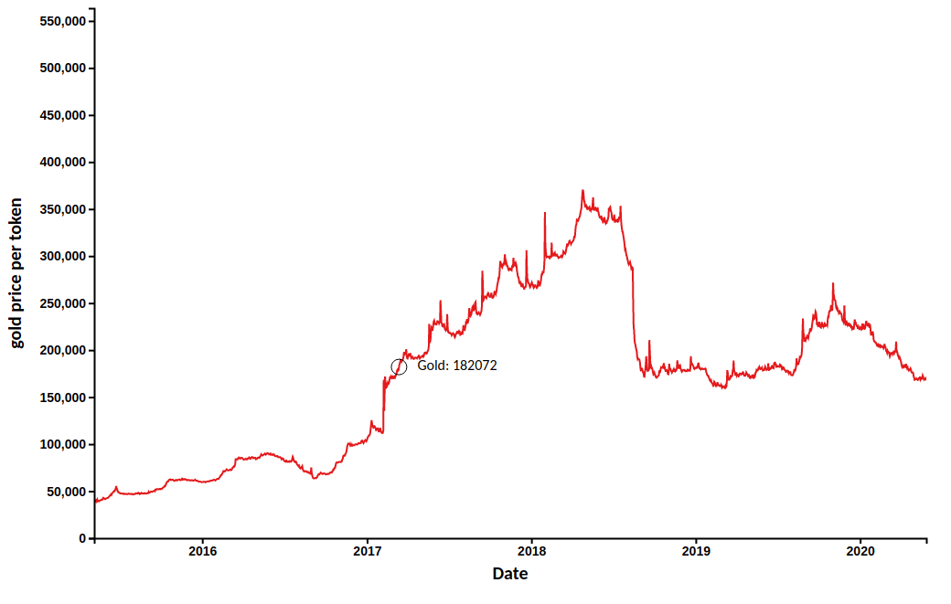
Main Question
The exchange rate of token vs. gold depends on supply and demand (determined separately for 5 different regions)

Slide 4
Main Question
Question: Do game/ patch releases of Blizzard influence the token-gold exchange rate?

Slide 5
Data and Preprocessing
publicly available historic token-gold exchange rates from WoWTokenPrices - Price and History Tracker (tracking rates every ~20 minutes). preprocessing:
fill missing (backward fill per region)
adjust date format
determine daily average prices
manually assembled data on game and patch releases of Blizzards and Activision's games

Slide 6
Visualisation and Interaction Methods
line chart to visualise token-gold rates (vertical axis) versus time (horizontal axis)
separate line charts for each region toggled by dropdown menu to avoid spaghetti charts
brush line chart to further zoom into chart by selecing time interval
visualise game/patch releases by vertical lines
coloured by type of release (game, content-patch, minor-patch, raid-patch)
displays further information on mouse-over (name of the game/ patch, date) and click (youtube video in case of game/ content-patch release)

Slide 7
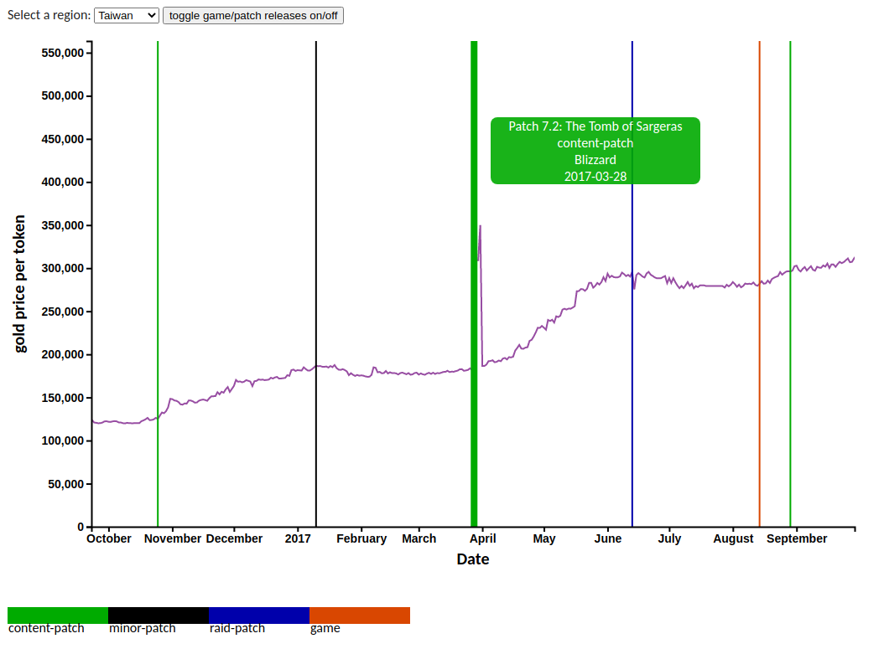
Visualisation and Interaction Methods

Slide 8
Implementation
using d3, js, python
based on
skeleton of Exercise 2
amended implementations available at www.d3-graph-gallery.com (brushing, line charts) and bl.ocks.org (tool-tip on mouse-over)
Deployed on Microsoft Azure: https://infovis-ue3.azurewebsites.net

Slide 9
Answers to Our Main Question
especially game and content-patches seem to explain spikes in the line charts (changes of the gold-token price)
spikes are differently pronounced across regions
not all spikes can be attributed to recent game/ patch releases

