Slide 1
Dolphin social network

Slide 2
Dataset summary
An undirected social network of frequent associations observed among 62 dolphins (Tursiops) in a community living off Doubtful Sound, New Zealand, from 1994-2001.
Edge Type | Social association
Node Type | Dolphin
Avg Edges | 159.00
Avg Nodes | 62.00

Slide 3
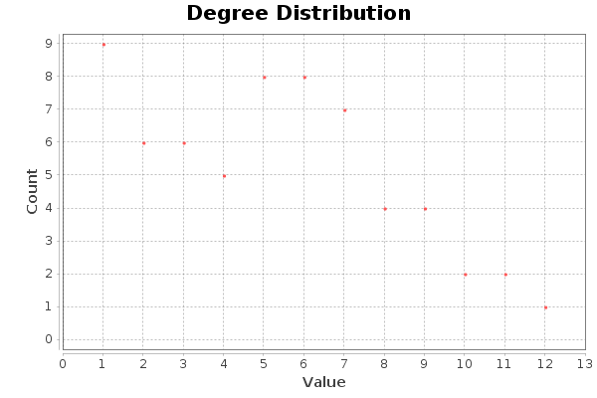
Average Degree: 5.129

Slide 4
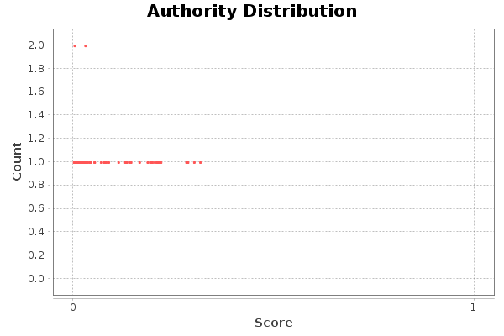

Slide 5
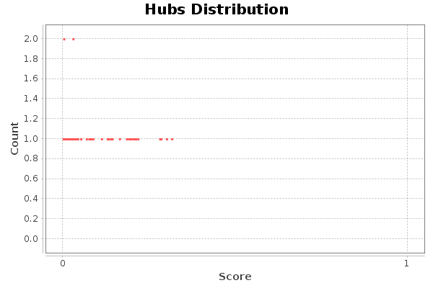

Slide 6
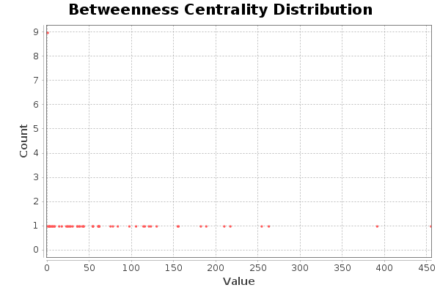

Slide 7
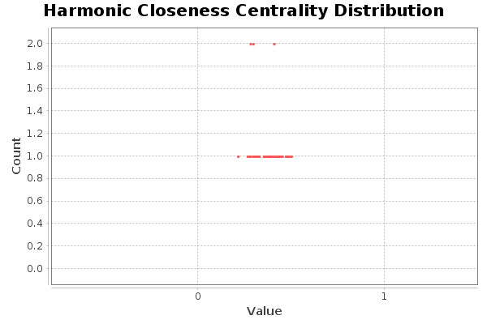

Slide 8
