Slide 1


Speech Translation
Xutai Ma
11/11/2020

Slide 2
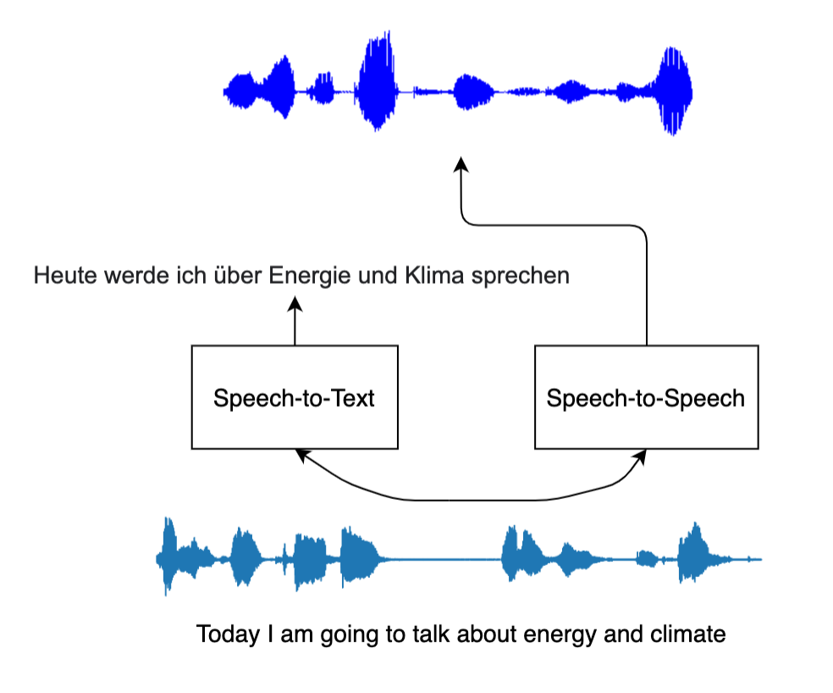
Introduction
What is speech translation?
Translate speech in source language to text / speech in target language

Slide 3
Introduction
Why/Where do we need speech translation?
International conferences (e.g., UN, EU)
Live video translation (e.g., YouTube, streaming)
Personal translator (e.g., international travels)
Google translate (Conversation)

Slide 4
How to do speech translation?

Slide 5
Cascade Speech Translation
A pipeline of systems
Transcribe source speech into source text
Translated source text with a text MT model
If the output is speech, synthesize speech from target text

Slide 6
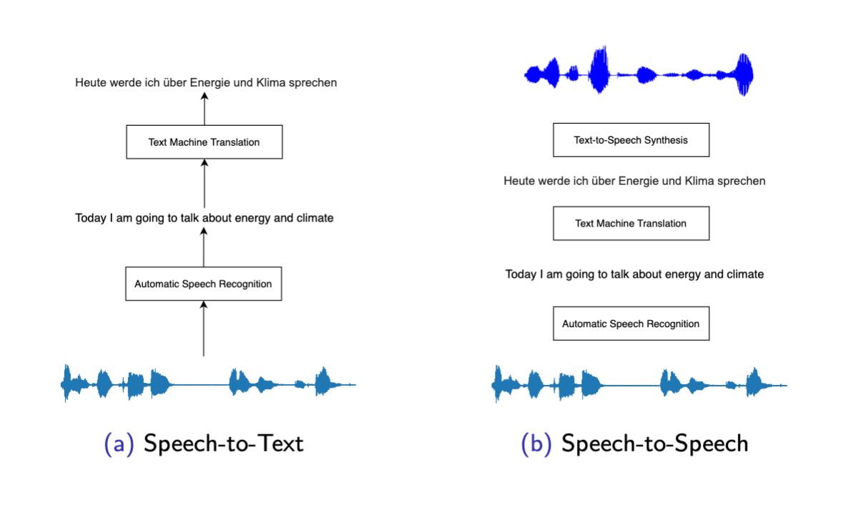
Cascade Speech Translation
Waibel et al., 1991; Woszczyna et al., 1993; Vidal, 1997; Wang and Waibel, 1998; Takezawa et al., 1998; Ney, 1999; Bangalore and Riccardi, 2001; Fu-Hua Liu et al., 2003; Schultz et al., 2004;
Matusov et al., 2005; Bertoldi and Federico, 2005; Zhang et al., 2005; Pérez et al., 2007; Sperber et al., 2017, 2019; Zhang et al., 2019; Beck et al., 2019; Black et al., 2002; Sumita et al., 2007

Slide 7
Background: Speech Processing and Recognition
Speech Processing
How to represent speech → feature extraction
Automatic Speech Recognition (ASR)
Transcribe speech to text in one language
Seq2seq task, but input and output have the same order

Slide 8
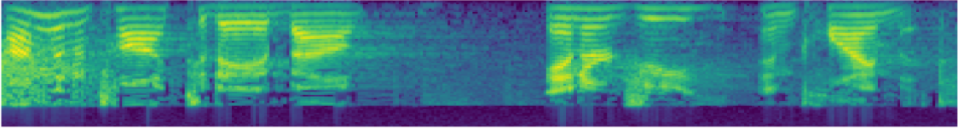
Feature Extractions
Short-Term Spectrum
(Mel-frequency cepstral coefficients) MFCC
Convert speech samples to sequence of vectors

Slide 9
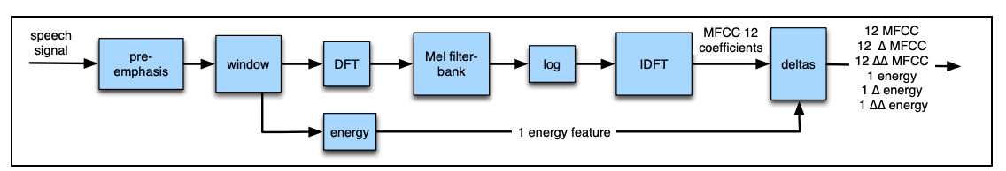
Feature Extractions

Slide 10
Automatic Speech Recognition
Revisit noisy channel model
Language Model
$$\hat{Y}= argmax P\left(Y | X\right)=argmax P(X|Y)P\left(Y\right)$$
Acoustic Model

Slide 11
Automatic Speech Recognition
Acoustic Model
Phone recognizer
Gaussian mixture model + hidden Markov model
Neural-based models

Slide 12
Automatic Speech Recognition
Acoustic Model
Neural-based models
Fully connect / recurrent layers
Pooling layers
Convolutional layers

Slide 13
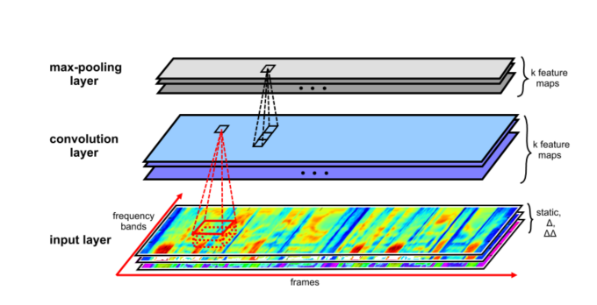
Automatic Speech Recognition
Convolutional layers
Zhang, Ying, et al. "Towards end-to-end speech recognition with deep convolutional neural networks." arXiv preprint arXiv:1701.02720 (2017).

Slide 14
Automatic Speech Recognition
Language Model
Viterbi
Decoder
Today I would like …
Acoustic Model

Slide 15
Automatic Speech Recognition
Seq2Seq model
Decoder with attention mechanism
Recurrent layers
Pooling layers
Convolutional layers
Encoder

Slide 16
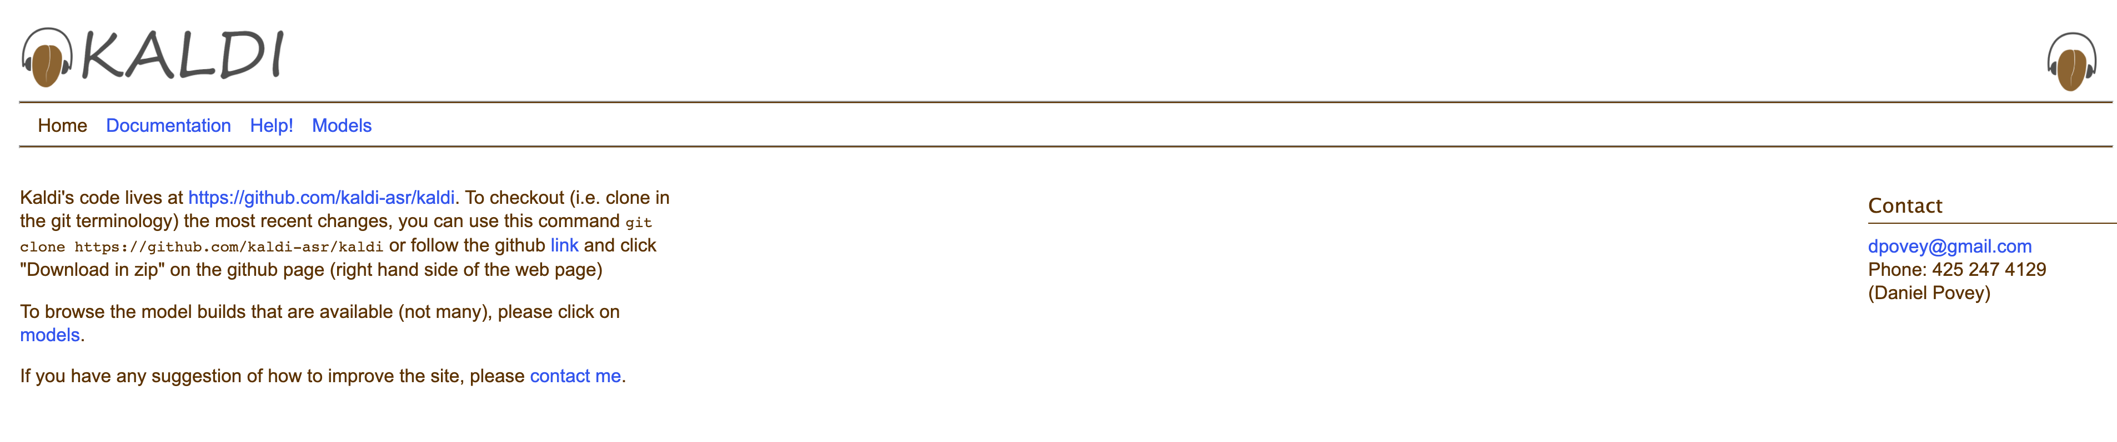
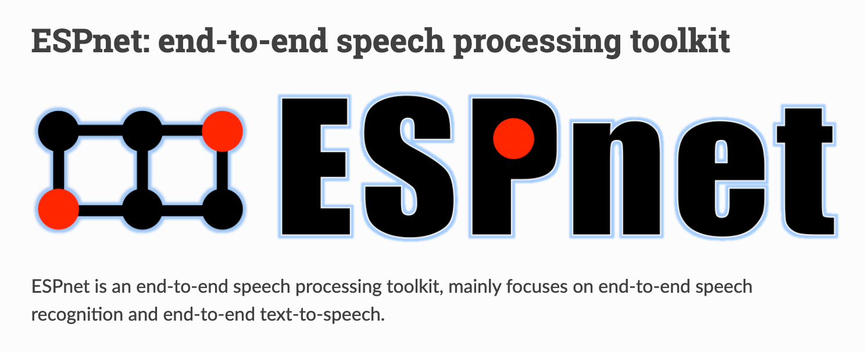
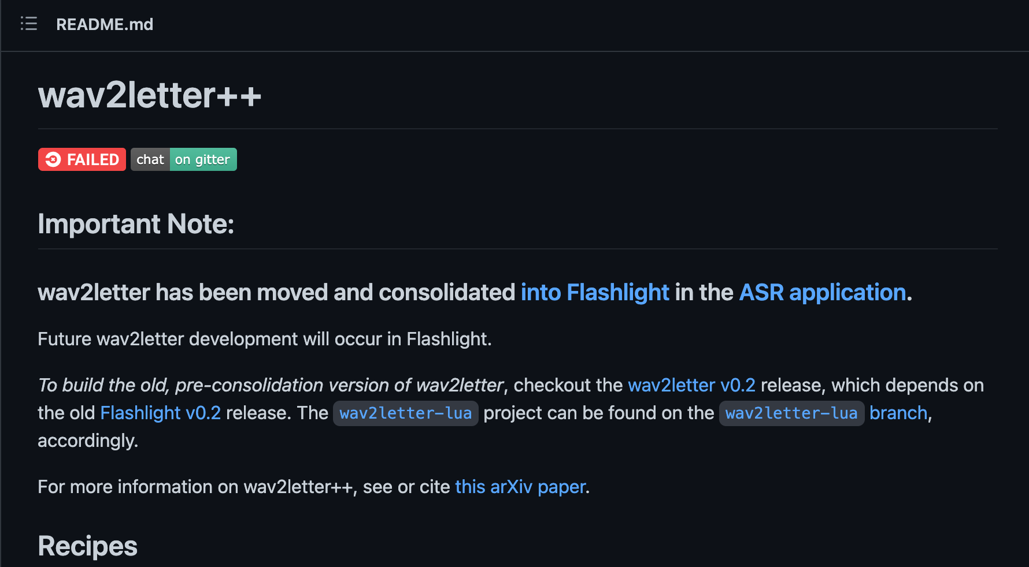
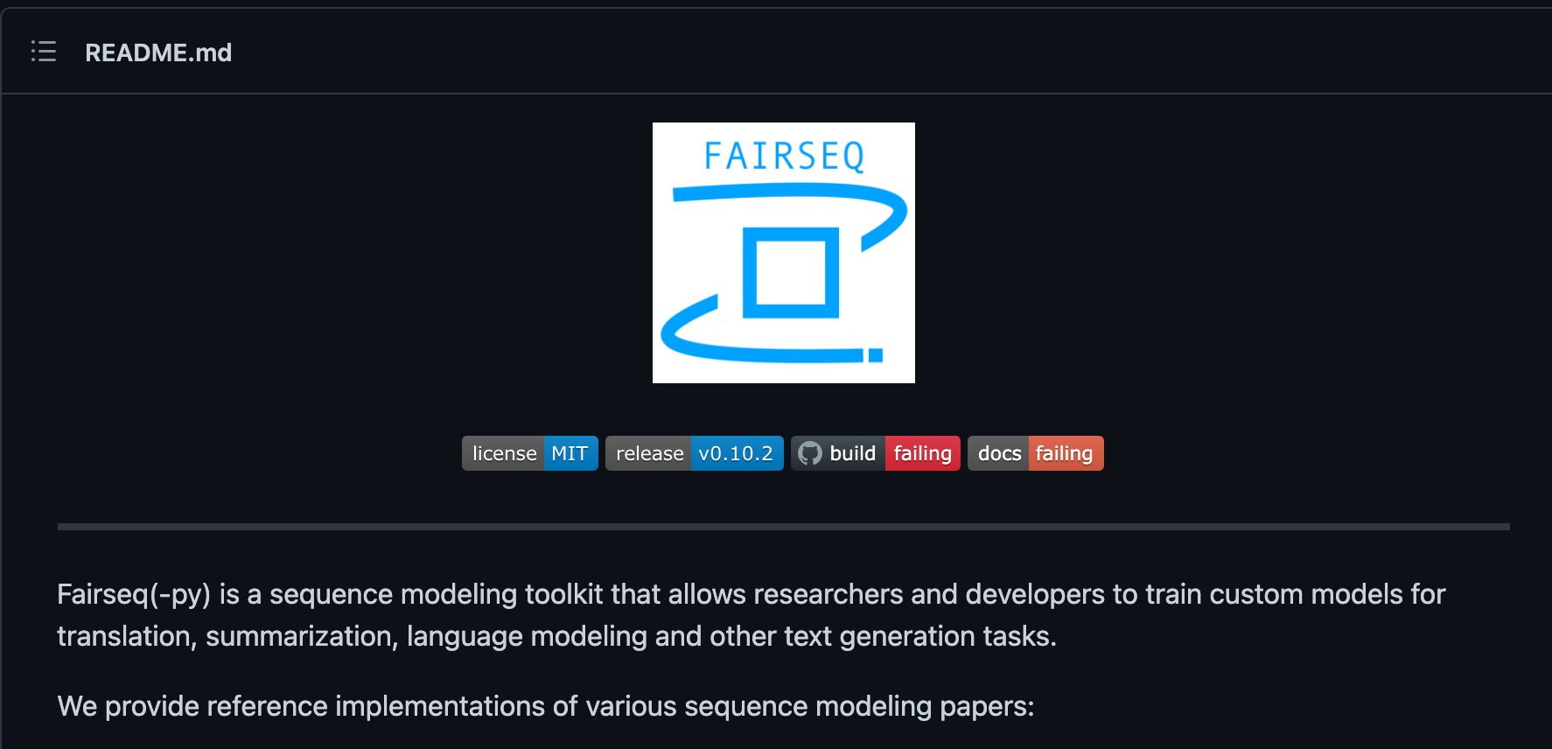
Automatic Speech Recognition

Slide 17
Cascade Speech Translation
Waibel et al., 1991; Woszczyna et al., 1993; Vidal, 1997; Wang and Waibel, 1998; Takezawa et al., 1998; Ney, 1999; Bangalore and Riccardi, 2001; Fu-Hua Liu et al., 2003; Schultz et al., 2004;
Matusov et al., 2005; Bertoldi and Federico, 2005; Zhang et al., 2005; Pérez et al., 2007; Sperber et al., 2017, 2019; Zhang et al., 2019; Beck et al., 2019; Black et al., 2002; Sumita et al., 2007

Slide 18
Cascade Speech Translation
Pros
Easy to build (ASR + MT or ASR + MT + TTS)
More training data
Different data for ASR and MT
Cons
Model size
Inference latency
Compounding errors

Slide 19
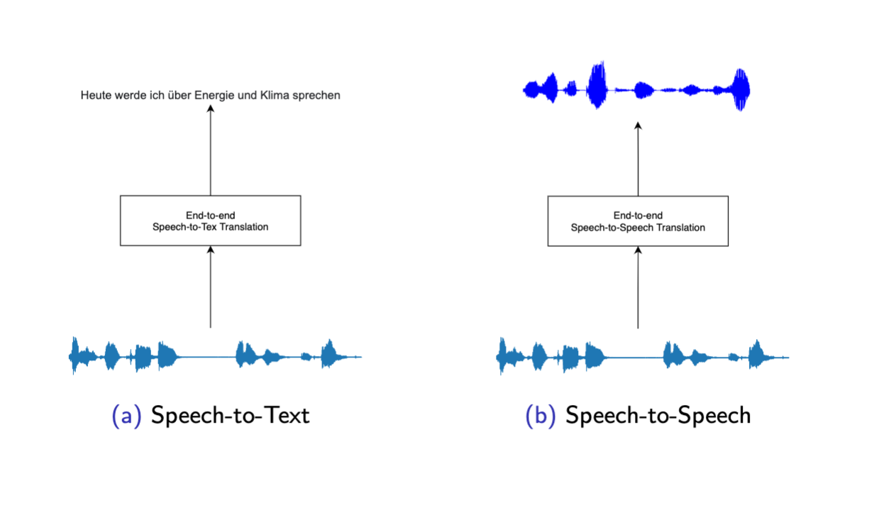
End-to-end Speech Translation
Duong et al. (2016); Berard et al. (2016); Weiss et al. (2017); Bansal et al. (2018); Di Gangi et al. (2019b); Pino et al. (2020); Inaguma et al. (2020)

Slide 20
Automatic Speech Recognition
Decoder with attention mechanism
Recurrent layers
Pooling layers
Convolutional layers
Encoder

Slide 21
End-to-End Speech Translation
Decoder with attention mechanism
Recurrent layers
Pooling layers
Convolutional layers
Encoder

Slide 22
End-to-End Speech Translation
Pros
Small model size
Lower inference latency
No Compounding errors
Cons
Data!

Slide 23
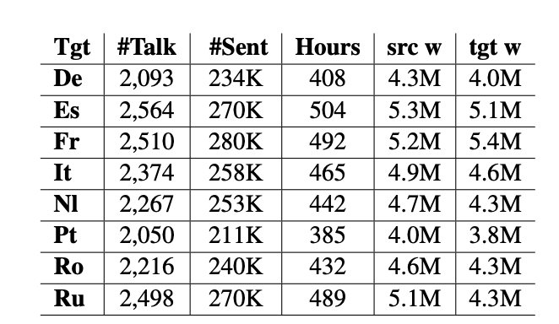
Data Scarcity
Data is more difficult to collect and annotate
Parallel speech to text / speech
 | #sent
WMT 16 EN-DE | ~4M
WMT 14 EN-FR | ~14M
Speech Translation Dataset
Machine Translation Dataset
Di Gangi, Mattia A., et al. "Must-c: a multilingual speech translation corpus." 2019 Conference of the North American Chapter of the Association for Computational Linguistics: Human Language Technologies. Association for Computational Linguistics, 2019.

Slide 24
Data Scarcity
Data augmentation
Multi-task
Share components with other models (ASR / MT)
Multi-lingual training
Pretrained components
Self-learning
Train on synthesized data
Pino, Juan, et al. "Self-training for end-to-end speech translation." arXiv preprint arXiv:2006.02490 (2020).
Inaguma, Hirofumi, et al. "Multilingual end-to-end speech translation." 2019 IEEE Automatic Speech Recognition and Understanding Workshop (ASRU). IEEE, 2019.
Kano, Takatomo, Sakriani Sakti, and Satoshi Nakamura. "End-to-end speech translation with transcoding by multi-task learning for distant language pairs." IEEE/ACM Transactions on Audio, Speech, and Language Processing 28 (2020): 1342-1355.

Slide 25
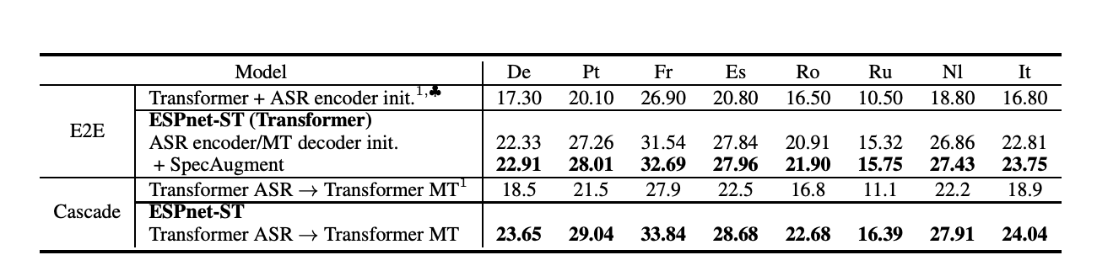
End-to-End Speech Translation
Inaguma, Hirofumi, et al. "ESPnet-ST: All-in-one speech translation toolkit." arXiv preprint arXiv:2004.10234 (2020).

Slide 26
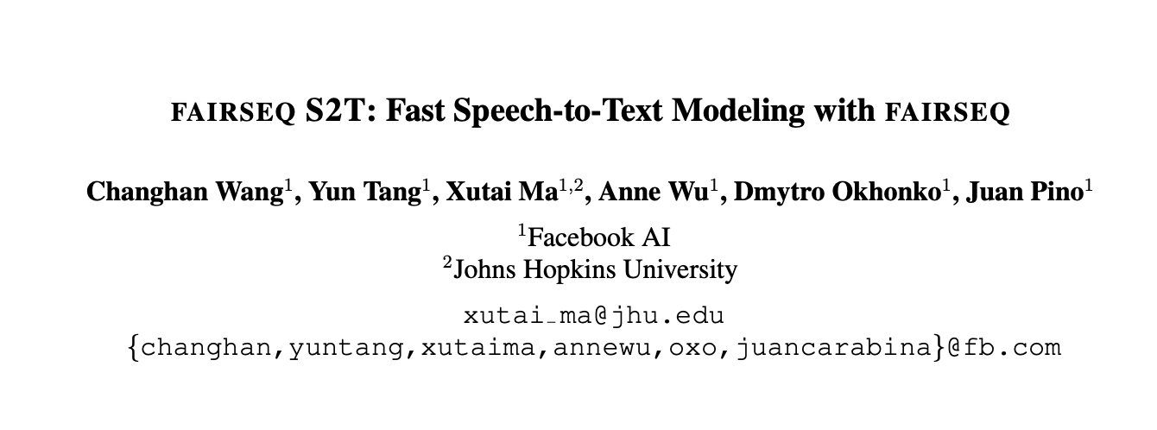
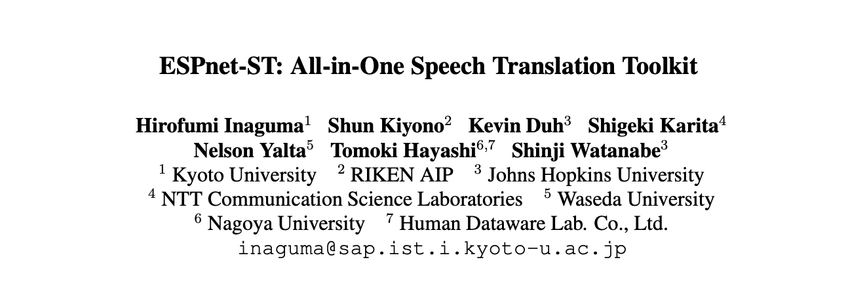
End-to-End Speech Translation
Open source toolkits

Slide 27
Simultaneous Speech Translation
Start the translation before read all the input speech
I am going to talk today about energy and climate.
Heute spreche ich zu Ihnen über Energie und Klima.

Slide 28
Simultaneous Speech Translation
Input
I am going to talk today
about energy and climate.
Read
Simultaneous Policy
Write
Output
Heute spreche ich
zu Ihnen über Energie und Klima.

Slide 29
Simultaneous Translation Policies
Reinforcement learning (Gu et al. 2017; Luo et al. 2017; Lawson et al. 2018)
Less stable learning process.
Fixed policy (Cho and Esipova 2016; Ma et al. 2019a)
Weaker performance, for instance Wait-K (Ma et al. 2019a).
Monotonic attention (Raffel et al., 2017; Arivazha-gan et al., 2019; Ma et al., 2020)
The State of the art for the task.

Slide 30
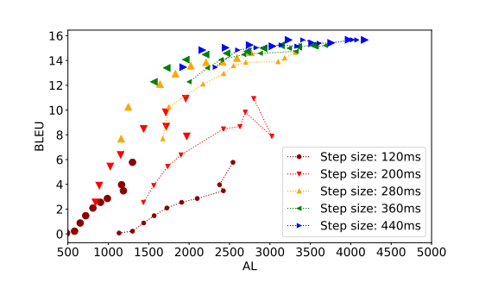
Quality-Latency Trade-off
The lagging behind an oracle/perfect system

Slide 31
Speech-to-Speech Translation
Source speech → target speech
Cascade
ST + Text-to-speech (TTS) system
End-to-end (direct)
Directly generate target spectrogram
Preserve prosody, emphasis, emotion
Suffers more from data scarcity

Slide 32
Direct Speech-to-Speech Translation
Feature
Extractor
Source Speech signals
Source Speech Features
S2ST Model
Vocoder
Target Speech signals
Source Speech Spectrogram

Slide 33
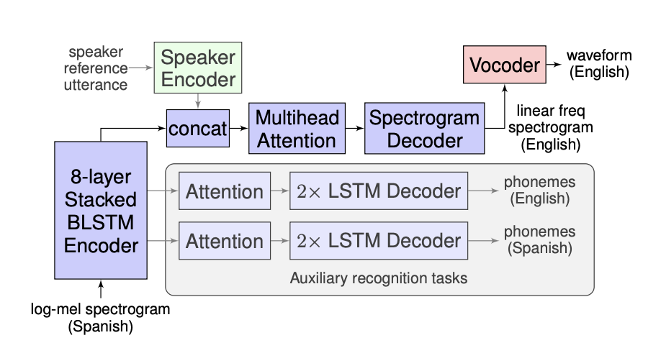
Direct S2ST with Sequence-to-Sequence Model
Speech encoder from ASR & ST
Spectrogram decoder from TTS
Multi-task learning
Examples
Y. Jia et al., "Direct Speech-to-Speech Translation with a Sequence-to-Sequence Model." Proc. Interspeech 2019

Slide 34
Conclusion
Speech translation is a new and challenging task
End-to-end approach shows strength when overcome the data scarcity issue.
More challenges: low latency, speech-to-speech, etc.

