Slide 1
German

Slide 2
Background and history
Early German
Dates back to as early as the 6th century
Started with old high German, as it split from Old Saxon
Modern German
Started out as a purely written language
Became standardized in both written and spoken forms in 1901
Written spelling was reformed in 1996
Most widely spoken first language in the EU

Slide 3
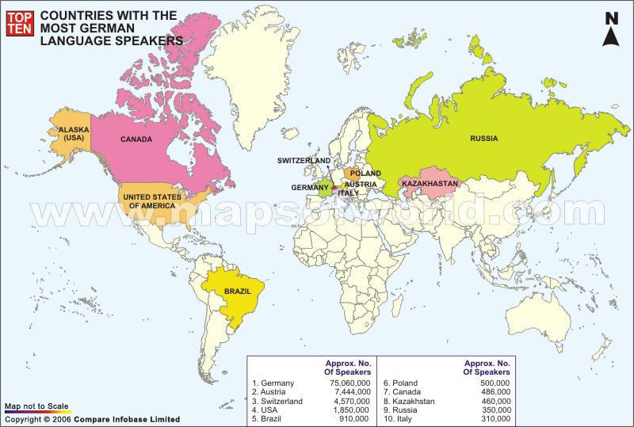
German Geography

Slide 4
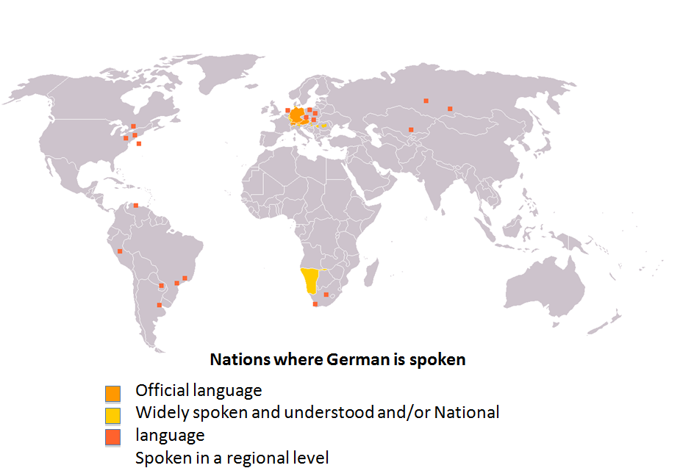

Slide 5
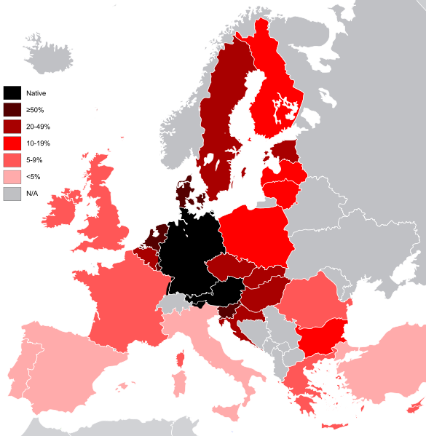

Slide 6
German Dialects
Complex variation between dialects
All German dialects belong to the dialect continuum of High German and Low Saxon
Low German
Less common, not often spoken
Maintained by some newspapers in northern Germany
High German
Various different branches
Yiddish is the only one that doesn’t use Latin script

Slide 7
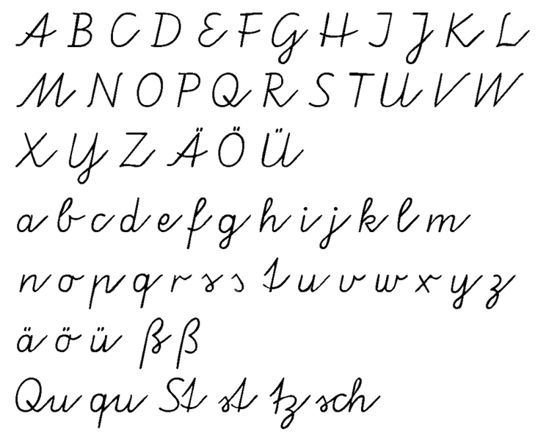
Orthography
26 standard Latin letters
German has three vowels with Umlaut
ä, ö and ü,
(ae, oe and ue)
Eszett or scharfes
s (sharp s), ß

Slide 8
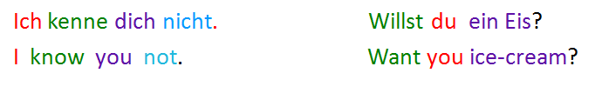
Grammatical elements
Declension of nouns and adjectives
nominative(Nominativ/Werfall)
genitive (Genitiv/Wesfall)
dative (Dativ/Wemfall)
accusative (Akkusativ/Wenfall)
Gender
Masculine
Feminine
Neuter
Numerical representations
Singular and plural
Verb tenses
Present and present perfect
Simple past and past perfect
Future and future perfect
Lack of auxiliary verb in negation and question

Slide 9
Compound words
Long concatenation of words
The last word that determines the word type
The last noun of the compound word determines its gender
Types:
Noun + noun (der Mülleimer/ the garbage pail) Adjective + noun (die Großeltern/ grandparents) Noun + adjective (luftleer/ airless) Verb stem + noun (die Waschmaschine/ washing machine) Preposition + noun (der Vorort/ suburb) Preposition + verb (runterspringen/ to jump down) Adjective + adjective (hellblau/ light blue)

Slide 10
Word order
Normal affirmative sentences
The inflected verb always has position 2
Polar questions, exclamations, and wishes
The inflected verb always has position1
Subordinate clauses
The verb occurs at the very end (not always in speech)
Main verb or auxiliary verb
Always appear second in the sentence
With auxiliary, main goes to end of sentence
Preceded by the topic
The element in focus is at the end

Slide 11
Linguistic data/resources
COSMAS Corpus
Over a billion words, online-searchable German and Austrian corpora
NEGRA Corpus
Saarland University Syntactically Annotated Corpus of German Newspaper Texts
QTAG Part of speech tagger for German
2nd largest number of Wikipedia pages (1355000 pages)
Europarl German-English parallel corpus

Slide 12
German and MT
Difficulties:
Different syntactic structure at the clause level
Rich German morphology
Specific problems with compound words
Progress:
Lots of work on German due to its popularity/relation to English
As early as 1972 from UT
Many MT systems now exist for German including Google translate

Slide 13
Sources:
Statistical Machine Translation of German Compound Words, Maja Popovi´c, Daniel Stein, Hermann Ney
Durrell, Martin; Hammer, A.E. (2002), Hammer's German Grammar and Usage (Fourth ed.)
Towards better Machine Translation Quality for the German–English Language Pairs, Philipp Koehn Abhishek Arun Hieu Hoan
Development of German-English machine translation system: http://www.dtic.mil/dtic/tr/fulltext/u2/743319.pdf
http://en.wikipedia.org/wiki/German_language
http://en.wikipedia.org/wiki/German_grammar
European Parliament Proceedings Parallel Corpus 1996-2011, http://www.statmt.org/europarl/
Statistical natural language processing and corpus-based computational linguistics: An annotated list of resources, http://nlp.stanford.edu/links/statnlp.html

