Slide 1
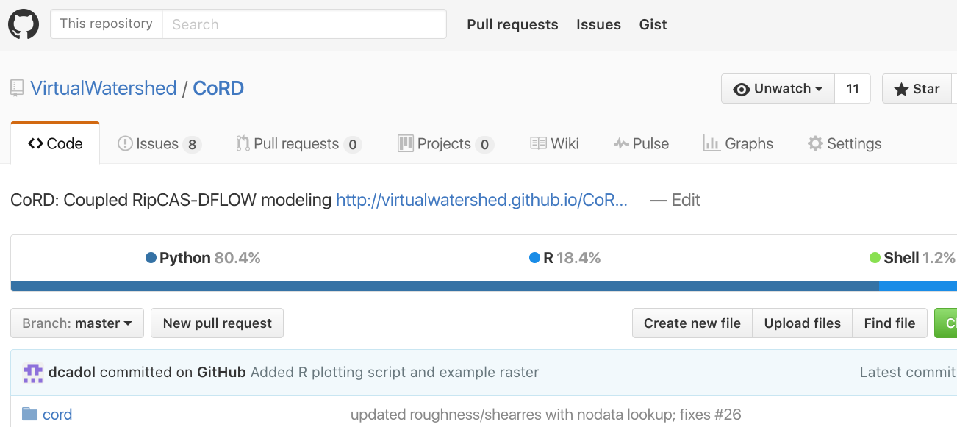
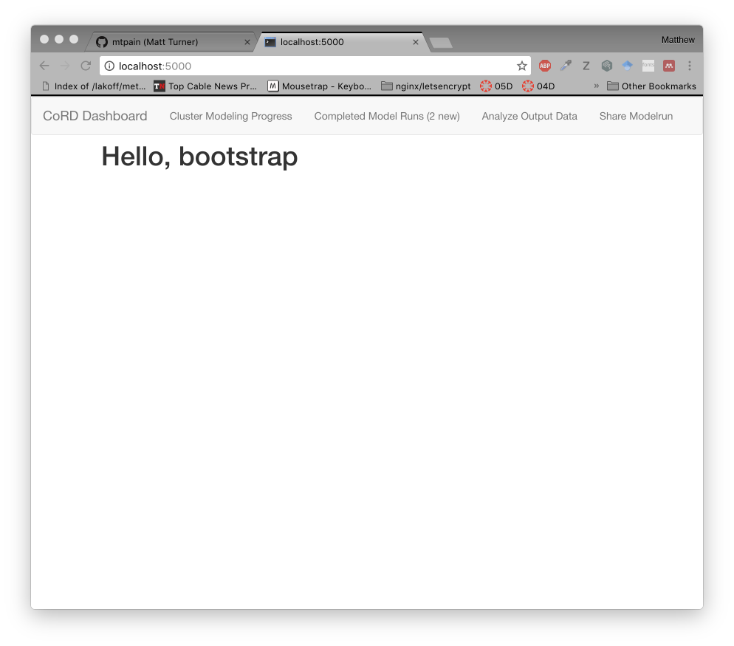
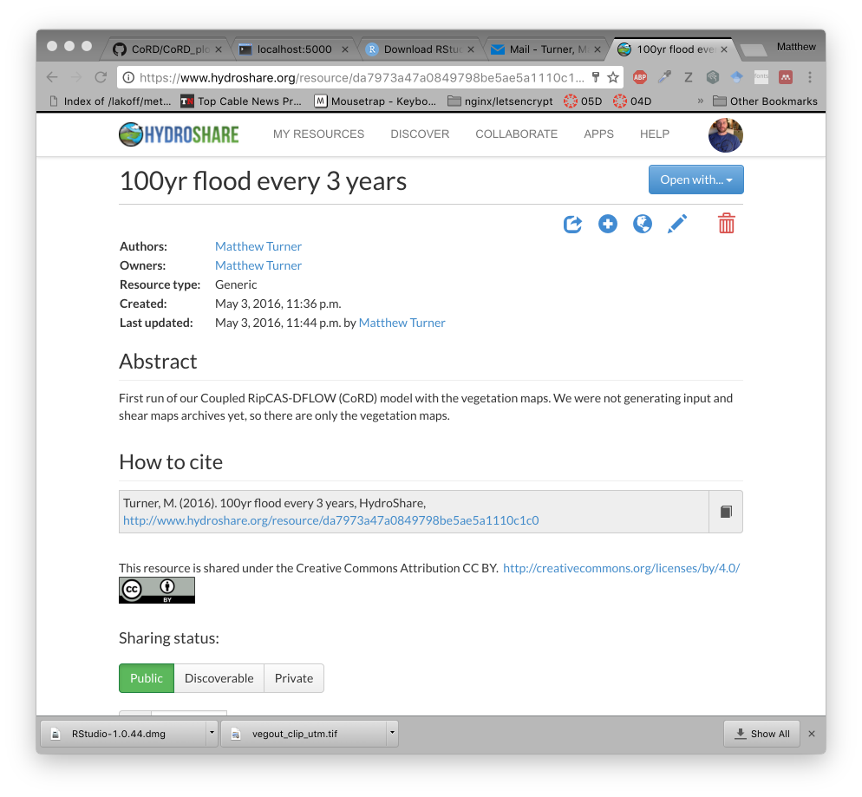

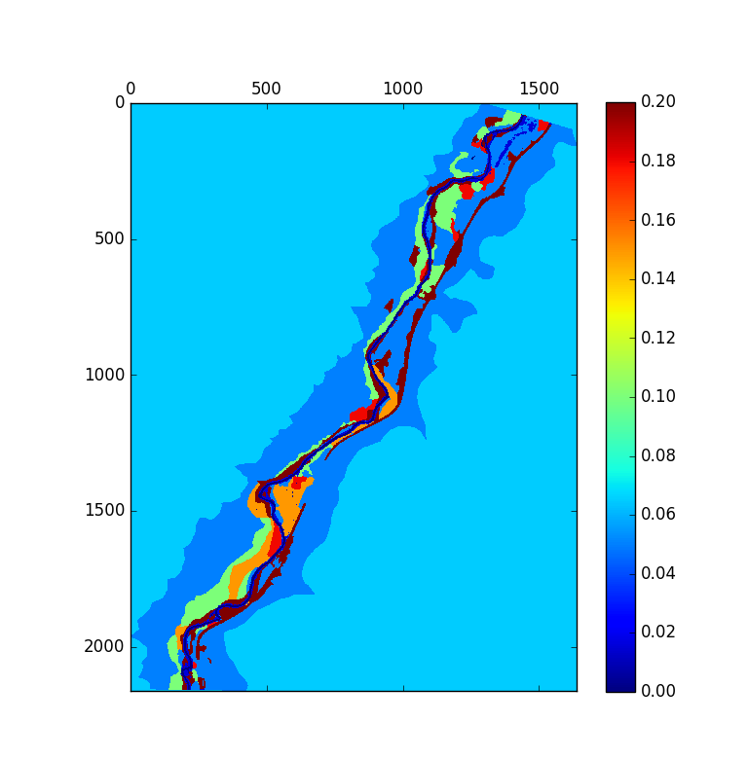
100% open source
from day one
Automatic Data
Management and
Sharing
“SSH-Free”
Job Queue Management
Built-in analytical & vis tools
https://camo.githubusercontent.com/9b5fe78b8fab010b0c7c3a3646152ef64347eb09/687474703a2f2f692e696d6775722e636f6d2f576b59614179742e706e67

