Slide 1
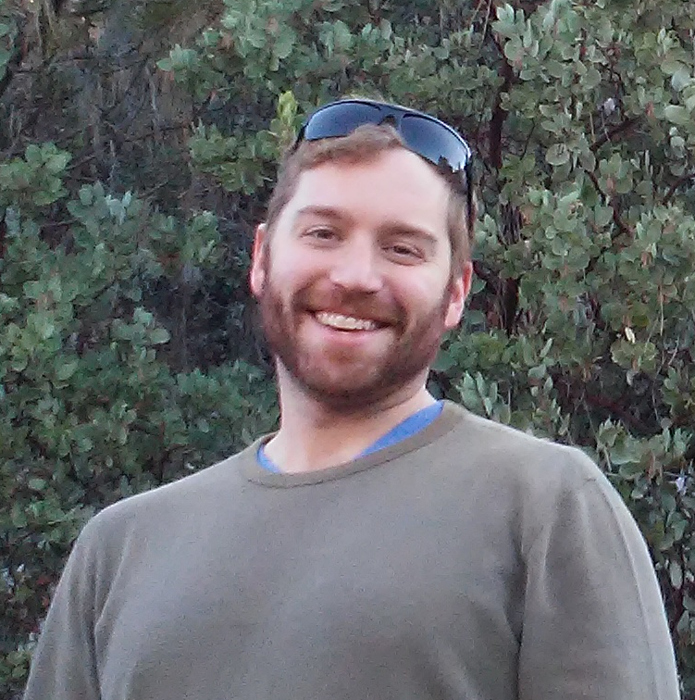
University of New Mexico
NM Tech/
Mississippi
DFLOW
&
CPU
Cluster
Weekly teleconference. Update on progress toward
milestones.
CI
Vegetation &
Flood Data.
RipCAS & analysis
Development
University of Idaho/
UC Merced

