Slide 1
Water (Boise River?) Sustainability in the Treasure Valley
EPSCoR Interdisciplinary Modeling Course 2015
Jennifer Van Osdel, Christopher Velasco,
Kazi Tamaddun,
Elijah Mlawsky,
Chao Chen,
Matthew Turner

Slide 2
Main Objectives
1. Develop a prototypical low-dimensional model that can be used to engage stakeholders throughout the Treasure Valley in participatory modeling exercises.
2. The model should be able to be refined, re-run, and revised during the course of a single day stakeholder group meeting.

Slide 3
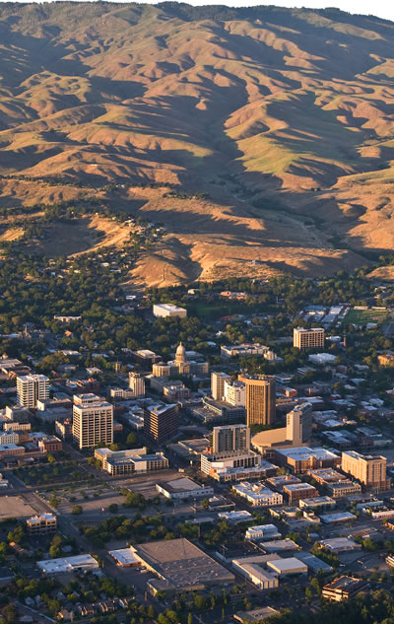
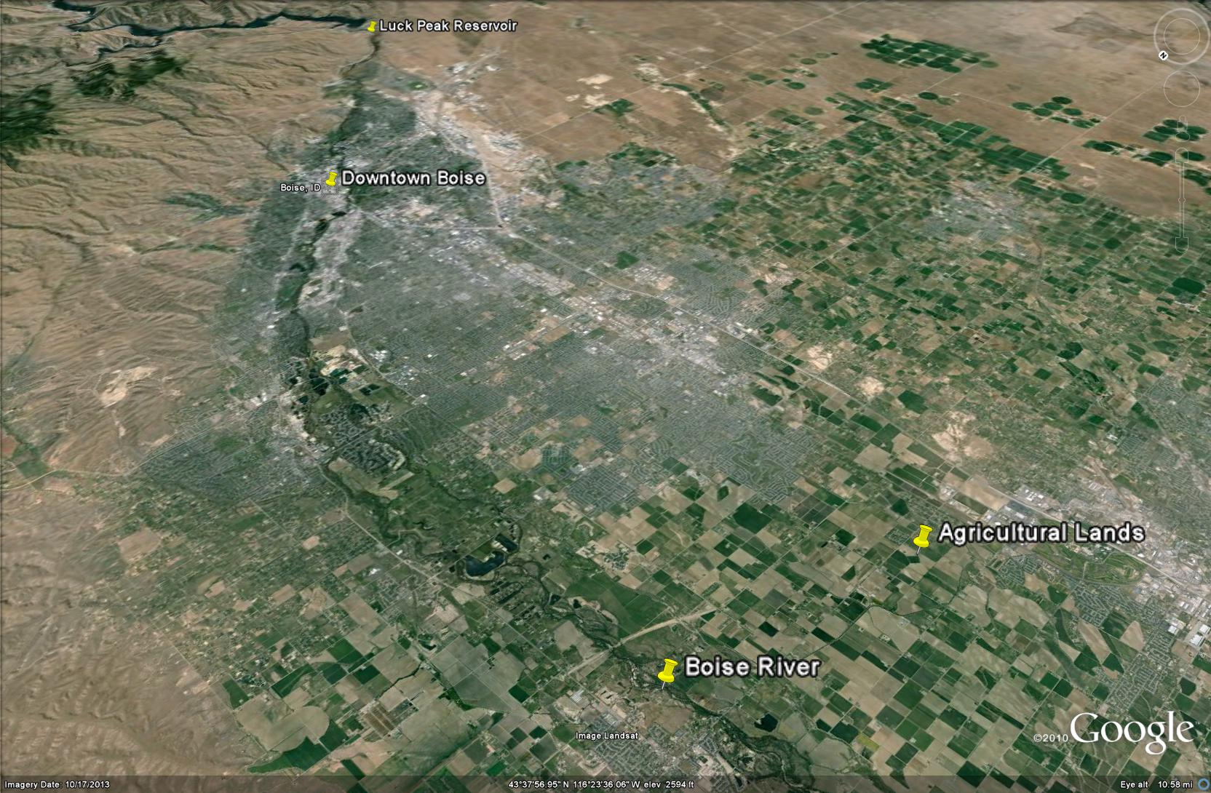
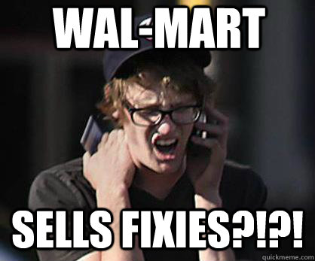
Treasure Valley
Where we are!
Balance of water use is changing: ag lands being taken over by “hipster fixie riding software developers” and/or subdivisions and strip malls

Slide 4
Benjamin Turner: Ask why fast
Engage stakeholders:
John Wilson: “War story” where no one argued with a model because all were involved
Simple model all can understand:
Econ 101: supply and demand
Dam discharge and New York Canal opening determine supply
Constantly evolving urban/agricultural mix determines demand

Slide 5
Low-dimensional model
Two-scale:
Water supply
Water use
Water supply:
Timing, magnitude of dam and canal discharge
Water use:
Demand as a function of urban:agricultural land use
Timing of ag irrigation
By modularizing the model, later users may modify either the supply or demand part of the model to suit their needs.

Slide 6
Model Details
Lucky Peak Dam Discharge
“Local Knowledge” of dam operators does not match rule curve: infer behavior statistically and in relationship to climate change
NY Canal
Relate discharge of NY Canal to inflow and discharge of dam plus climate factors that influence ag use in the valley
Supply/Demand
Estimate historical then project ag/urb land use ratio to predict future demand.

Slide 7
Stakeholder Engagement
Web app to educate the public including allowing them to “turn knobs” that represent the few dimensions of our simple model
Can bring to public meetings as well as be a persistent location for public to engage
Can gather statistics on what scenarios users choose and at least get a sense of the scenarios on people’s minds

Slide 8
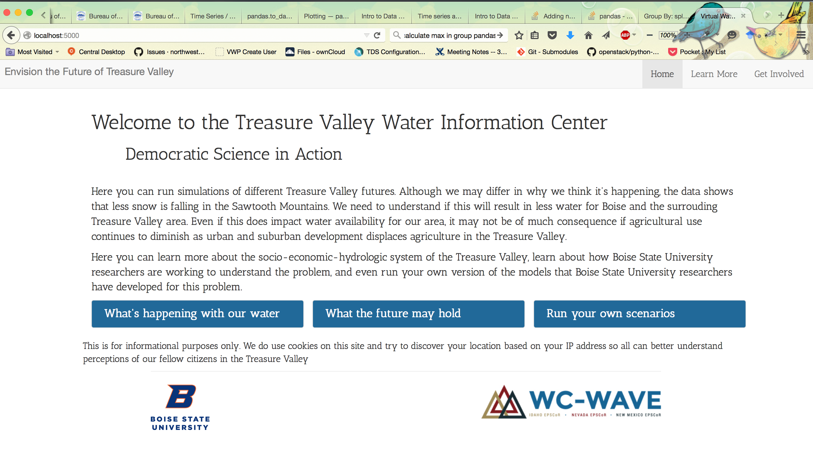
Stakeholder Engagement
Web app to educate the public including allowing them to “turn knobs” that represent the few dimensions of our simple model

Slide 9
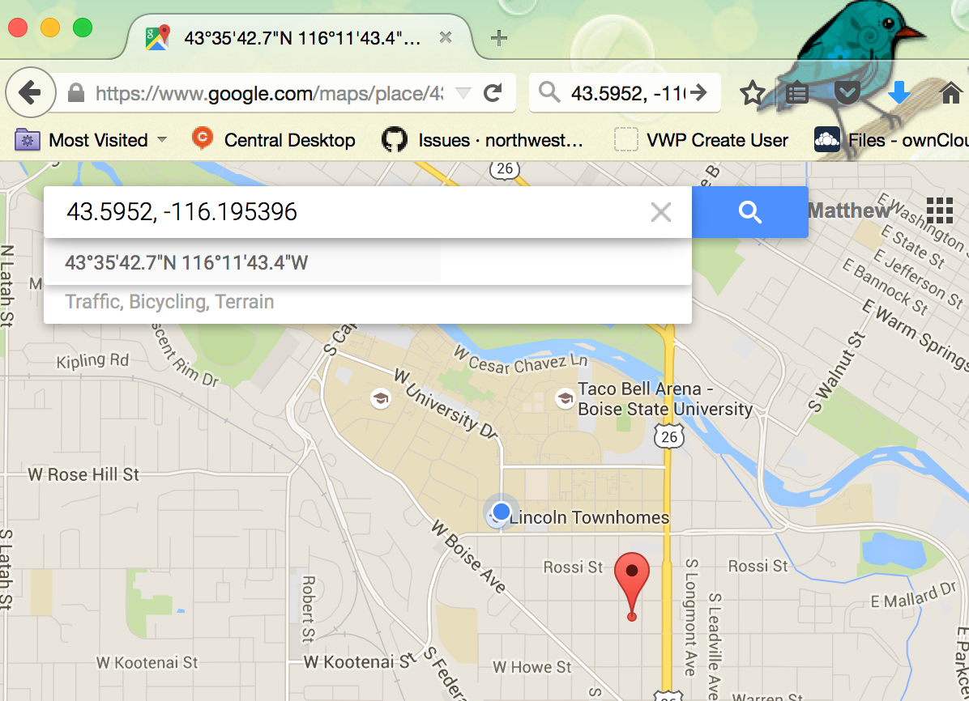
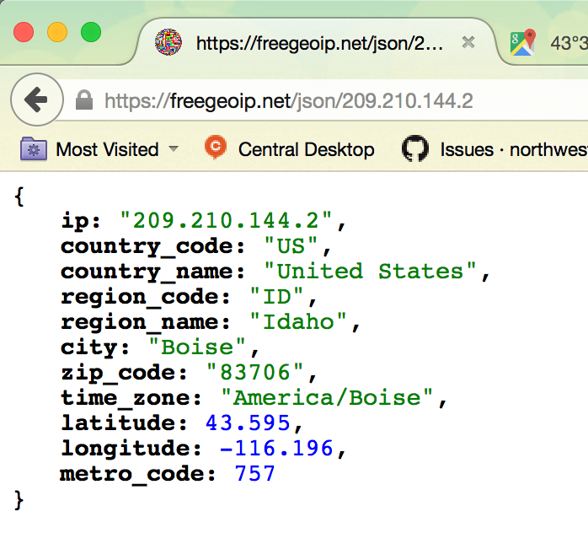
Stakeholder Engagement
Can get estimates of location of users based on IP address to further resolve social “scale”

