Slide 1
How I use git
a tirade by matt turner
NKN staff meeting

Slide 2
Why Git?
The industry standard developed for Linux kernel version control (Linus Torvalds on developing Git)
GitHub-enabled collaboration: easy, graphical, web interface for merging files from any number of contributors, and several other indispensible collaboration tools
Selectively add and commit changes locally
“Branching” is not SVN branching: branches are quickly and easily created, merged, or destroyed locally
The case for Git in 2015: http://www.netinstructions.com/the-case-for-git

Slide 3
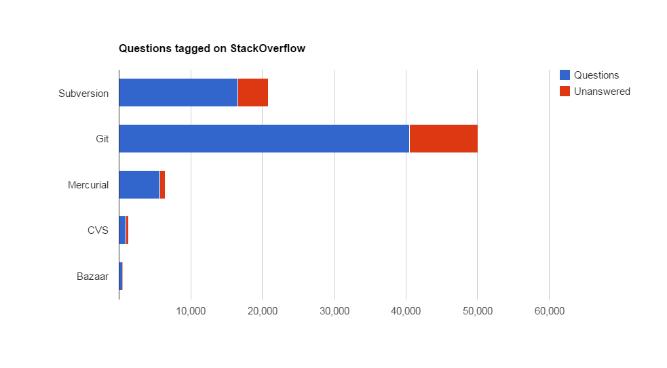
Why Git?
The case for Git in 2015: http://www.netinstructions.com/the-case-for-git

Slide 4
What is version control?
A way to separate code states with the goal of:
Backtracking to a previously stable version
Understand and document the history of a project
Group codebase changes into chunks
Referred to as VCS for version control system

Slide 5
What is distributed version control?
Improvement on version control where local changes are kept local until the user decides to share or merge changes
Automatic code backup: if the subversion server fails, code is lost. Here every person has, at some point in history, a common codebase
Git and Mercurial are both DVCS’s, distributed version control system.
Because version control isn’t coordinated with a central server until requested; versioning happens locally then “remote” server is updated

Slide 6
diff git mercurial
Git does not require you to commit all changes at once when you take a snapshot
In a few blog posts I saw mercurial deemed “easier to learn” a few times, mainly because of this it seems
Git allows you to rewrite history, again seen by some as evil, but seen by others (me included) as useful
I regularly make tens of commits for each new feature I produce. Often only a few of these are actually useful for anyone other than me, so ideally I would rewrite history to make it more digestible for others. I don’t take the time mostly, but this is bad practice.
Other stuff, but I really don’t know since I don’t use hg

Slide 7
Summary
Git is the open source and industry standard
(lots of excellent documentation available)
GitHub is the open source standard
(no exaggeration to say it’s fundamental to the open source movement)
Git and GitHub help me get shit done, stay organized, and seamlessly integrate the work of others

Slide 8
How I use git: an outline
write some new code and a README
git init
git add code_1.py code_2.py README.md
git commit –m “initial commit message here”

Slide 9
How I use git: an outline
2. Make changes to code locally and pull to web server
git add changed_file1.html changed_file2.css
git commit –m “fixed styling and layout of ...”
git push origin master
ssh mt@dev2.nkn.uidaho.edu
cd project_dir && git pull origin master

Slide 10
How I use git: an outline
3. Collaboration
create github issue and assign it to coworker
they work on their own version of the code and implement fix or improvement
they open a “pull request”: a request that I download their changes and make sure it does what we want and doesn’t do anything we don’t want
git checkout master && git merge their_changes

Slide 11
How I use git: an outline
4. Automatically update dependencies from other repos
we want to use a specific version of another repo in our own project
git submodule add {other_project_url} other_project_name
3. When we want to get updates, git submodule update

Slide 12
Tutorial
After this tutorial you will be able to:
Get the current history and state of a project’s code
Edit that code, create your own commits (snapshots in time), and open a pull request to have your edits included in the project
Double check these with the github hello world demo. Could do hello world as a command-free intro then move on to shell interface

Slide 13
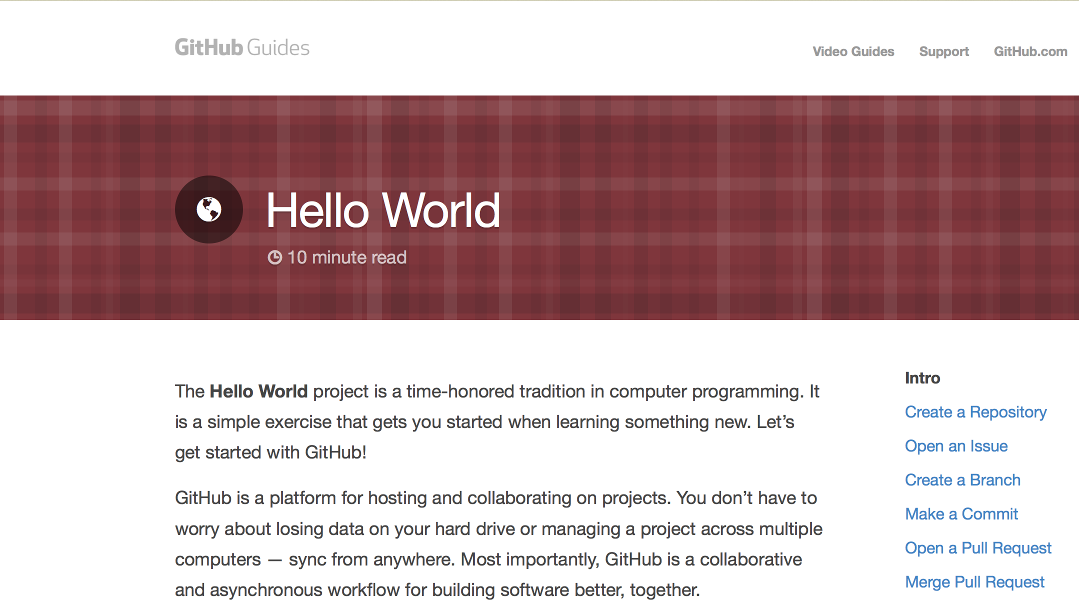
GitHub Guides: Hello World
https://guides.github.com/activities/hello-world/

