Slide 1

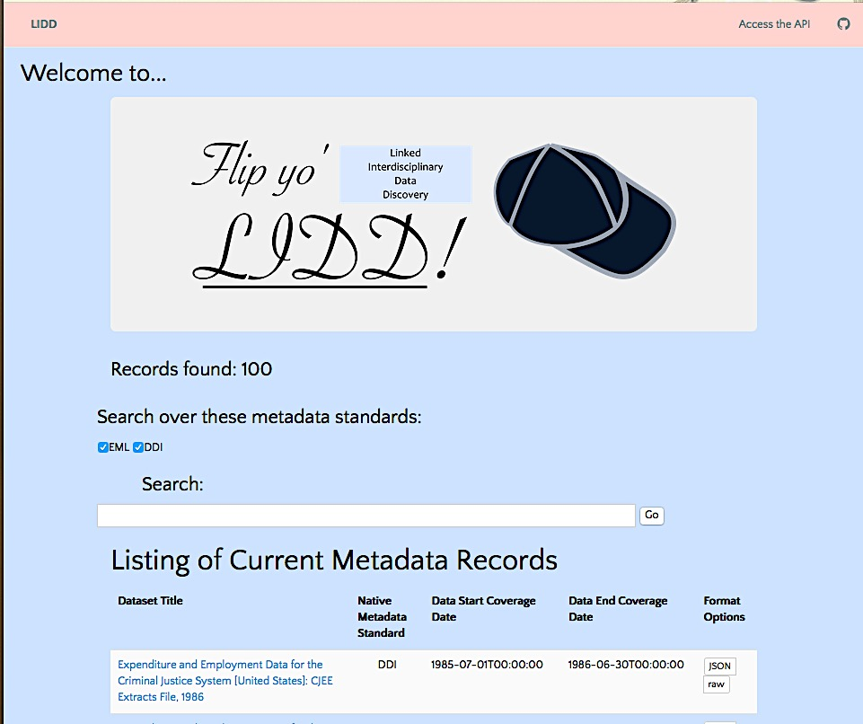

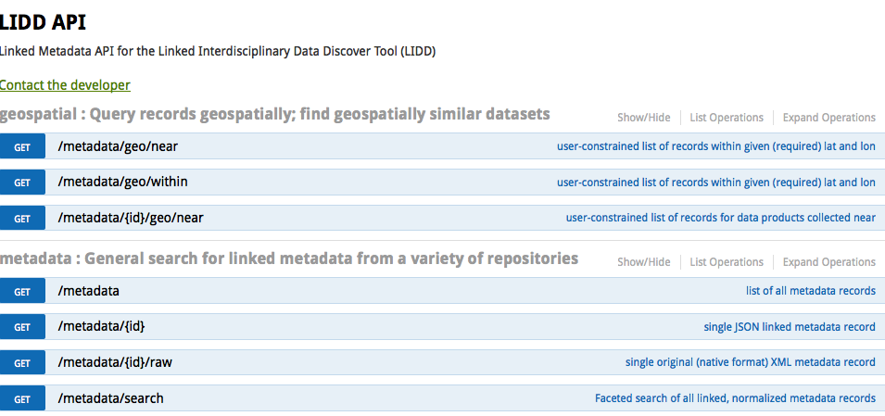

Linked Interdisciplinary Data Discovery Matthew Turner Northwest Knowledge Network, University of Idaho, USA
User-centric Web App
A user comes to our app to discover relevant datasets across disciplines and save them for future use.
Users not necessarily savvy to metadata jargon. Only the front-end developer must know some things about linked data and JSON-LD specificially.
Use ORCiD for log-in to personalize user experience by, e.g., making suggestions based on publishing history.
https://mt.northwestknowledge.net/lidd
Linked Metadata HTTP API
/api/metadata[/{id}[/raw]]
/api/metadata/search
/api/metadata/(near, within)
future: multiple formats, SPARQL, text analysis
/api/metadata/{id}/{[raw, ttl, rdf, ...]}
/api/sparql /api/metadata/{id}/similarTo/{id2}
Public
API
https://mt.northwestknowledge.net/lidd/api
Linked Normalized Metadata Model
References:
JSON for Linking Data, https://json-ld.org
Ecological Markup Data Specification, https://knb.ecoinformatics.org/#external//emlparser/docs/eml-2.1.1
Dave Viegls, d1_local_cache, https://github.com/vdave/d1_local_cache
ICPSR Bulk Metadata Cache, http://www.icpsr.umich.edu/icpsrweb/content/membership/or/metadata/xml/index.html
Normalized Metadata (JSON-LD, HCLS?)
DataONE Parser
D1 EML
D1 D.Core
ICPSR Parser
ICPSR DDI
D1 FGDC
Other Repositories...
formats
other
repos’
Acknowledgements:

