Slide 1
Improving NMT
by Olha Kaminska and Viacheslav Komisarenko

Slide 2
MT error Analysis: summary
Most of the errors in our results were caused by fact, that machine used synonyms, which have a little different meaning and it changes sense of the sentences:
1. Our ability to help create asset-based services can result in faster time to value. Our ability to help create valuable services can result in faster values.
2. Increase the efficiency and effectiveness of your IT infrastructure. Increase the performance and effectiveness of your IT infrastructure.
3. Business continuity is vital to business success. Business stability is vital business success.
4. The EU provides more than half of all development aid. The EU gives more than half of all development aid.
5. A new phenomenon loomed in the shadows: the internet. New phenomena spelled in the shadows: Internet.

Slide 3
How to fix
We suppose, that using of ensembles method can improve our result.
The main idea – several results can give us different synonyms of unobvious word, so, we can choose the most common variant, which probably has closest meaning.
We are planning run several models with different values of hyperparameters and combine their results.

Slide 4
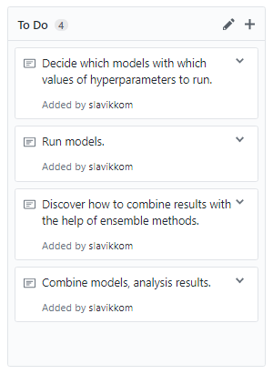
Schedule
- next week, until 6.11
- week after next, until 13.11
- during next 2 weeks, parallel task, until 13.11
- after all previous tasks, until 20.11
20.11 – Intermediate report
Couple of weeks to fix model and create final version

Slide 5
Thanks for your attention!

