Slide 1
Removing Noise from Audio with Recurrent Neural Networks: A Look at RNNoise
Presentation by Matthew Taylor

Slide 2
Motivation
Noise suppression dates back to the 1970s
Other traditional noise suppression algorithms already exist, with mediocre results
Audacity
BRIL
Can we use AI to make the process faster and more accurate?
Yes!
With recurrent neural networks (RNNs) and classic signal processing techniques

Slide 3
Advantages of RNNs
RNNs can dynamically adapt to various types of noise
RNNs model temporal sequences
Hardware requirements are extremely low and processing time is extremely short
60x faster than real-time on an x86 CPU
7x faster than real-time on a Raspberry Pi
Can even be implemented in JavaScript and executed in your browser

Slide 4
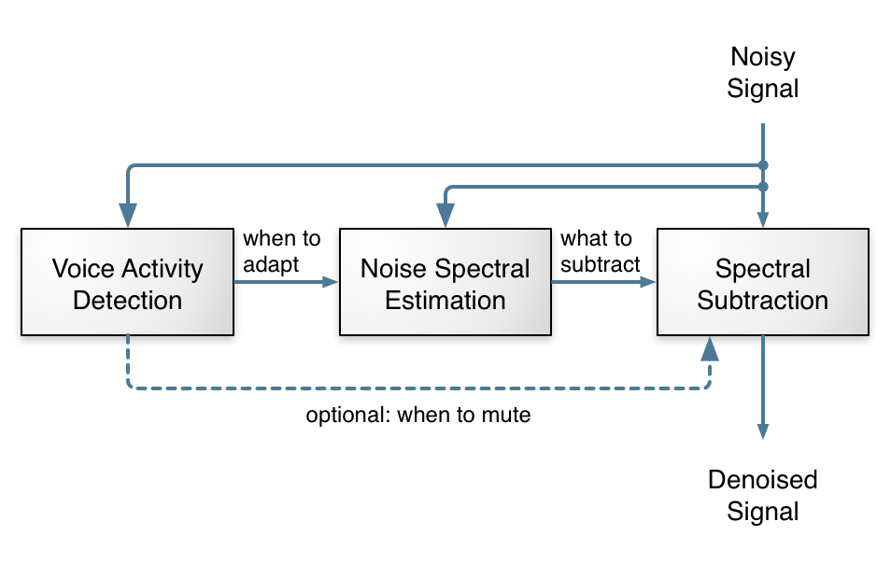
How It Works
RNN determines what part of audio should be removed

Slide 5
Implementation
The RNN was created and trained in Python using Keras
After training, the model was translated into C
Cython
Noise removal performed in C

Slide 6
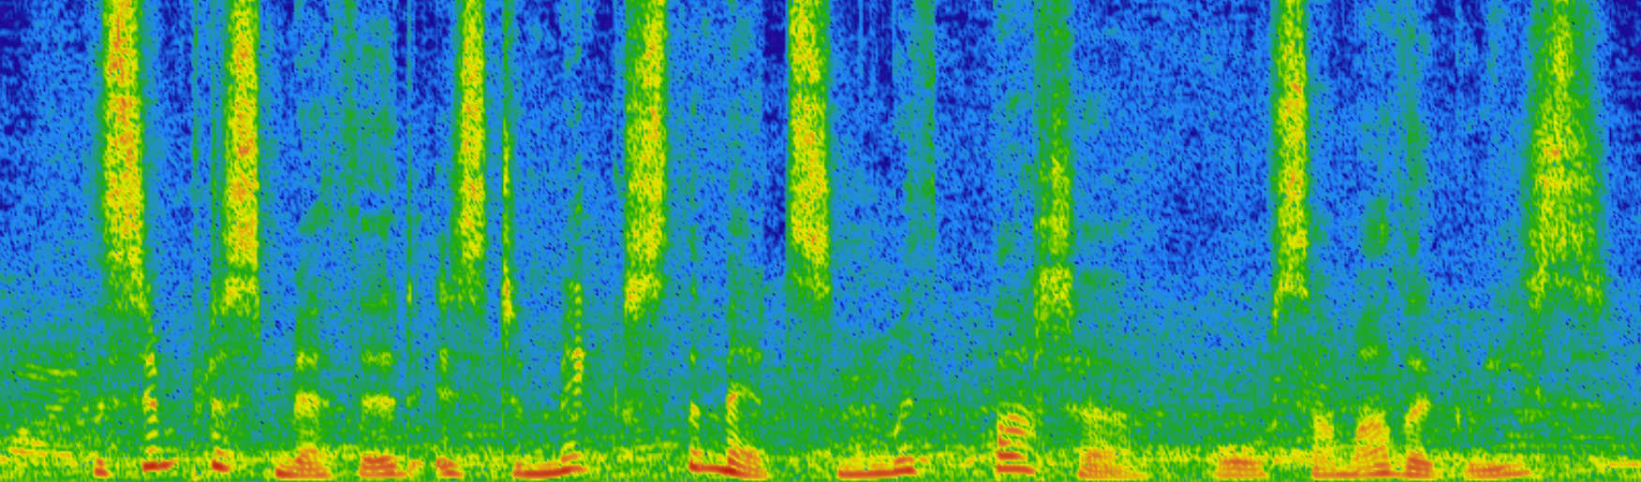
Results (before)
Green specks represent noise, dark blue represents silence

Slide 7
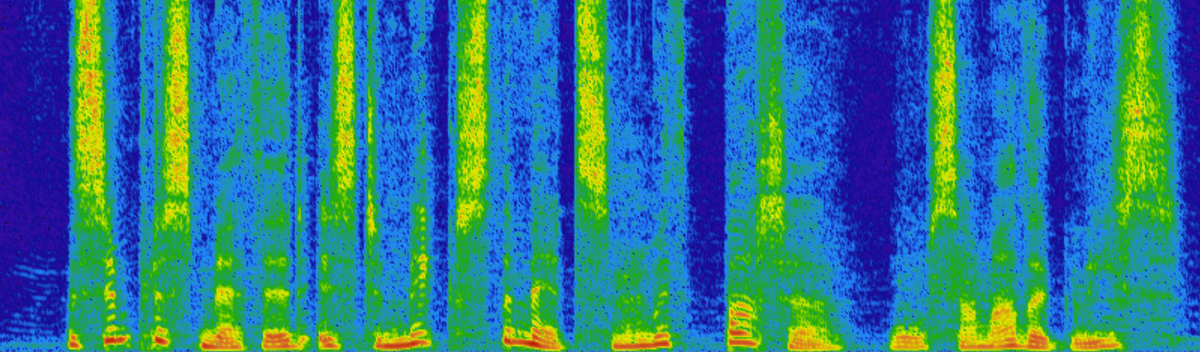
Results (after)
Green specks represent noise, dark blue represents silence

Slide 8
Resources
https://people.xiph.org/~jm/demo/rnnoise/
https://hacks.mozilla.org/2017/09/rnnoise-deep-learning-noise-suppression/
https://en.wikipedia.org/wiki/Recurrent_neural_network

