Slide 1
Removing Noise from Audio with Recurrent Neural Networks: A Look at RNNoise
Presentation by Matthew Taylor

Slide 2
Motivation
Noise suppression dates back to the 1970s
Other traditional noise suppression algorithms already exist, with decent results
Audacity
BRIL
Can we use AI to make the process faster and more accurate?
Yes!
With recurrent neural networks (RNNs)

Slide 3
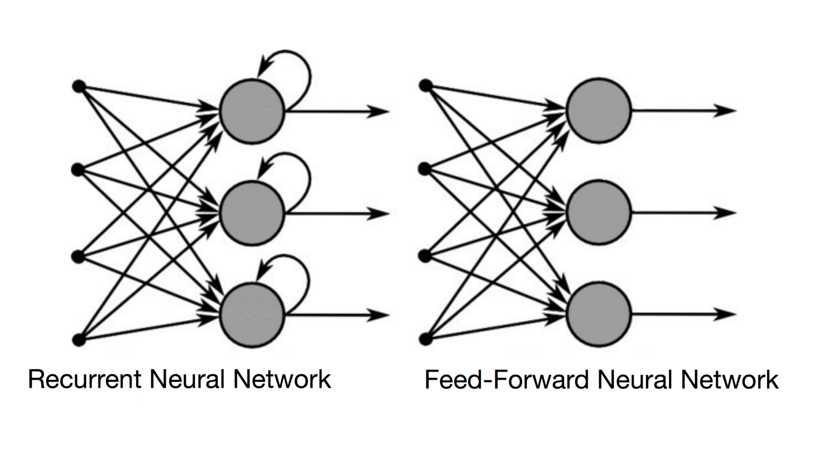
Recurrent Neural Networks (RNNs)
Traditional feedforward neural networks output a linear combination of current inputs
Recurrent neural networks simply introduce an internal state at each node
Recurrent neural networks output combinations of current and past inputs
Very short-term memory

Slide 4
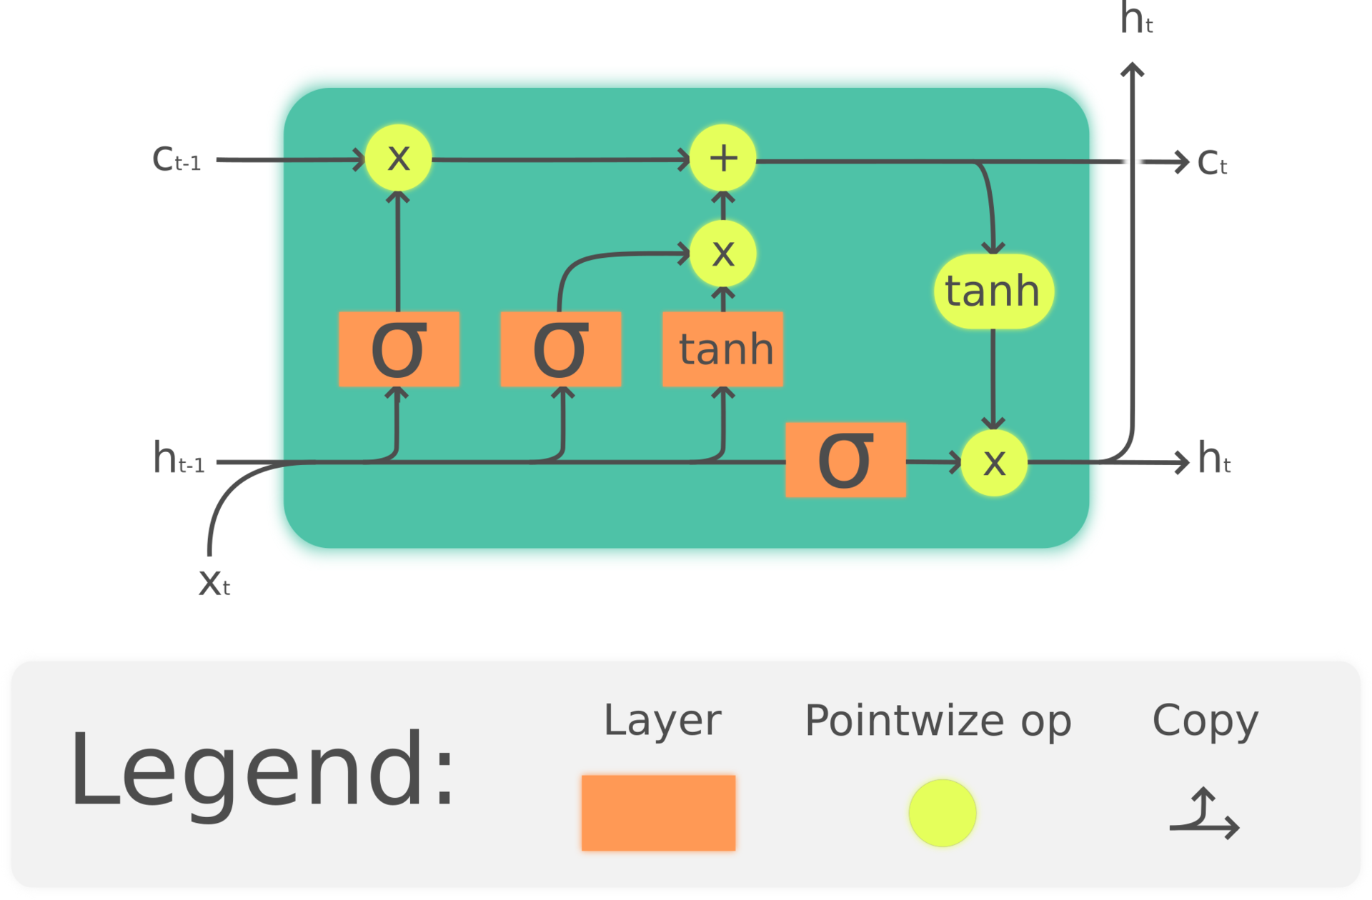
Long Short-Term Memory (LSTM)
A different RNN node architecture that allows for longer memory
Essential for long, dynamic input sequences
RNNs with LSTM are often called LSTM networks or LSTMs

Slide 5
RNN Perks
RNNs can dynamically adapt to various types of noise
RNNs are well-suited for processing temporal data
Long short-term memory (LSTM) allows for processing of long sequences
Hardware requirements are extremely low and processing time is extremely short
60x faster than real-time on an x86 CPU
7x faster than real-time on a Raspberry Pi
Can even be implemented in JavaScript and executed in your browser

Slide 6
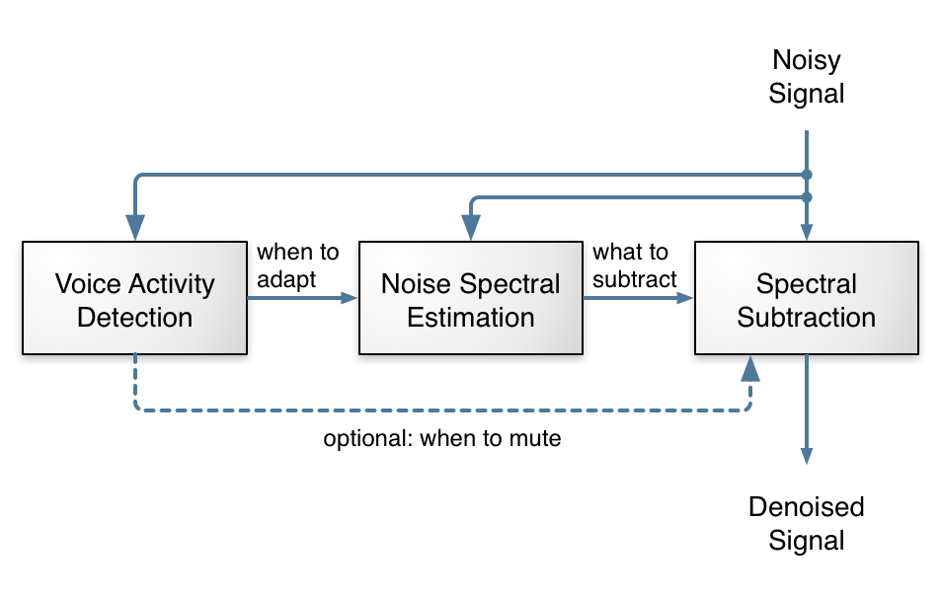
How RNNoise Works
RNN determines what part of audio should be removed

Slide 7
Implementation
The RNN was created and trained in Python using Keras
After training, the model was translated into C
Cython
Noise removal performed in C

Slide 8
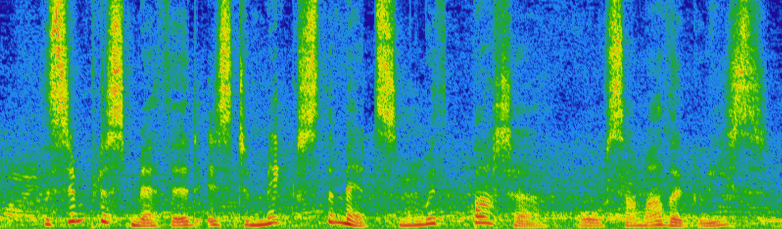
Results (before)
Green specks represent noise, dark blue represents silence

Slide 9
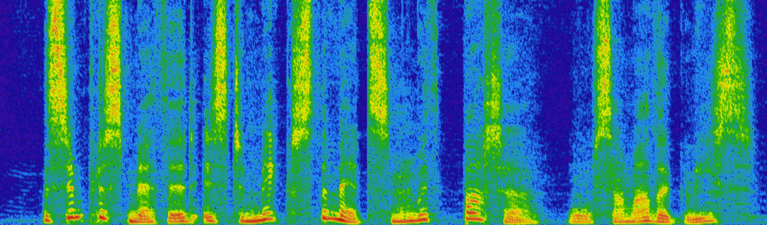
Results (after)
Green specks represent noise, dark blue represents silence

Slide 10
Resources
https://people.xiph.org/~jm/demo/rnnoise/
https://hacks.mozilla.org/2017/09/rnnoise-deep-learning-noise-suppression/
https://en.wikipedia.org/wiki/Recurrent_neural_network
https://towardsdatascience.com/recurrent-neural-networks-and-lstm-4b601dd822a5
https://en.wikipedia.org/wiki/Long_short-term_memory

