Slide 1
ACM Citation Data Analysis
Michelle Turovsky – December 2019

Slide 2
Overview
Slide | Slide #
Analysis Goal | 3
I. Build ACM Citation Network | 4-5
II. Visualize In-Degree Distribution | 6-7
III. Weighted Pagerank Algorithm | 8-9
IV. Average Clustering Coefficient | 10-11

Slide 3
Analysis Goals
ACM has a large repository of millions of publications, each of which may reference other publications.
Which paper gets referenced most often, and do the papers that reference it also get referenced frequently?
By understanding which papers get referenced by other important papers most frequently, we can start to understand the likelihood that a reader would stumble upon a random paper.

Slide 4
I. Build ACM Citation Network
Semi-structured data must be parsed for paper index and paper references
FlatMapValues by Paper Title
Remove special characters
Put data into table format with a column for paper_index1 and paper_index2 where paper_index1 references paper_index2

Slide 5
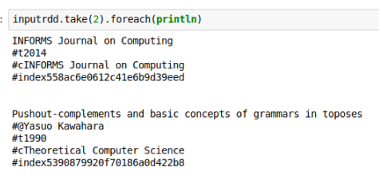
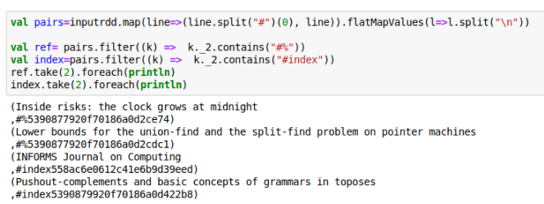
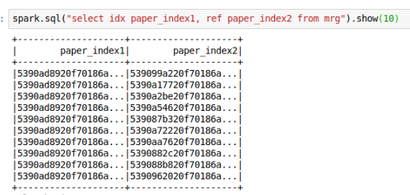
I. Build ACM Citation Network

Slide 6
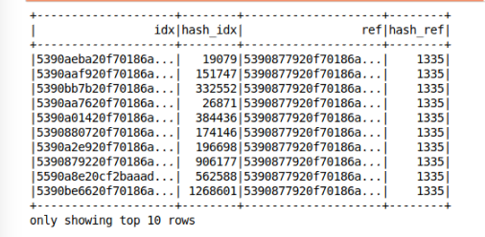
II. Visualize In-Degree Distribution
zipWithIndex creates a numeric index for each unique alphanumeric index in the ACM Citation

Slide 7

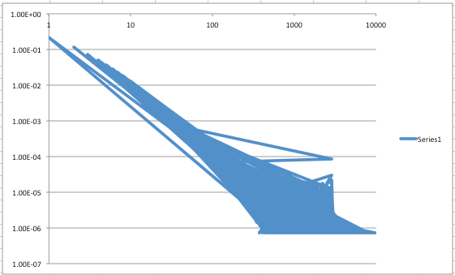
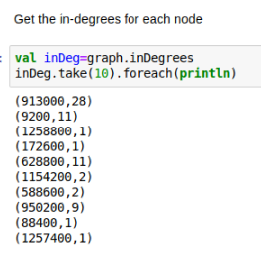
II. Visualize In-Degree Distribution
p(k): in-degree probability distribution of a network
n_{k}: # vertices with in-degree value
n: total # nodes in graph

Slide 8

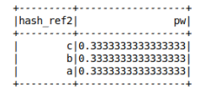
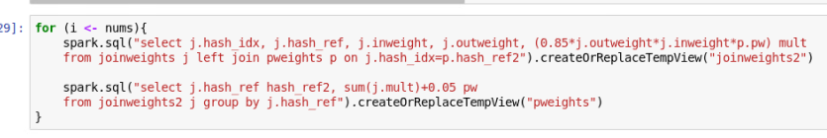
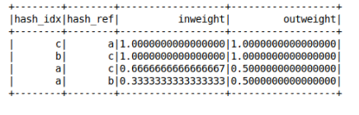
III. Weighted Page Rank Algorithm
1. Initialized as a constant
2. Updated through for-loop
3. Inlinks and Outlinks calculated via Spark SQL

Slide 9
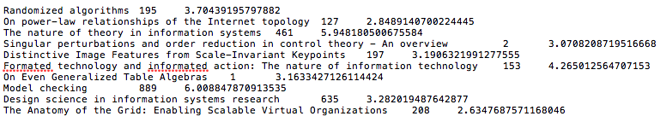
III. Weighted Page Rank Algorithm
Output of top 10 papers via weighted pagerank algorithm
(paper_title number_of_inlinks pagerank)

Slide 10

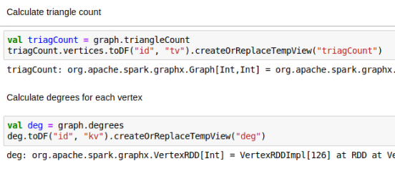
IV. Average Clustering Coefficient
t_{v}: # of triangles per vertex
k_{v}: degrees per vertex

Slide 11
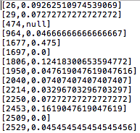
IV. Average Clustering Coefficient
Output of local clustering coefficients :
(vertex , clustering coefficient)
Output of average clustering coefficient:

