Slide 1
Second capstone
Project presentation

Slide 2
Problem statement
Problem statement
Which specific data driven solutions such as change in ticket prices or reduction in current costs of specific facilities should Big Mountain resort implement to offset the increase in operating costs of $1,540,000 this season and capitalise on its facilities?

Slide 3
Context of the problem
Big Mountain resort has recently installed a new chair lift to help increase the distribution of visitors across the mountain.
This has led to an increase in operating costs of $1,540,000.
The company needs to offset this increase in operating cost by finding more data driven business solutions.
Current pricing is based only on charging a premium about the market averages rather than based on how important facilities are.
Data for 330 resorts including big mountain resort to come up with a solution.

Slide 4
Recommendations
Business executive have suggested the following changes:
Permanently closing down up to 10 of the least used runs.
Adding a run, increasing the vertical drop by 150 feet, and installing an additional chair lift.
Add two acres of snow making area along with the second suggested changes.
Increasing the longest run by 0.2 miles and guaranteeing its snow coverage by adding 4 acres of snow making capability.

Slide 5
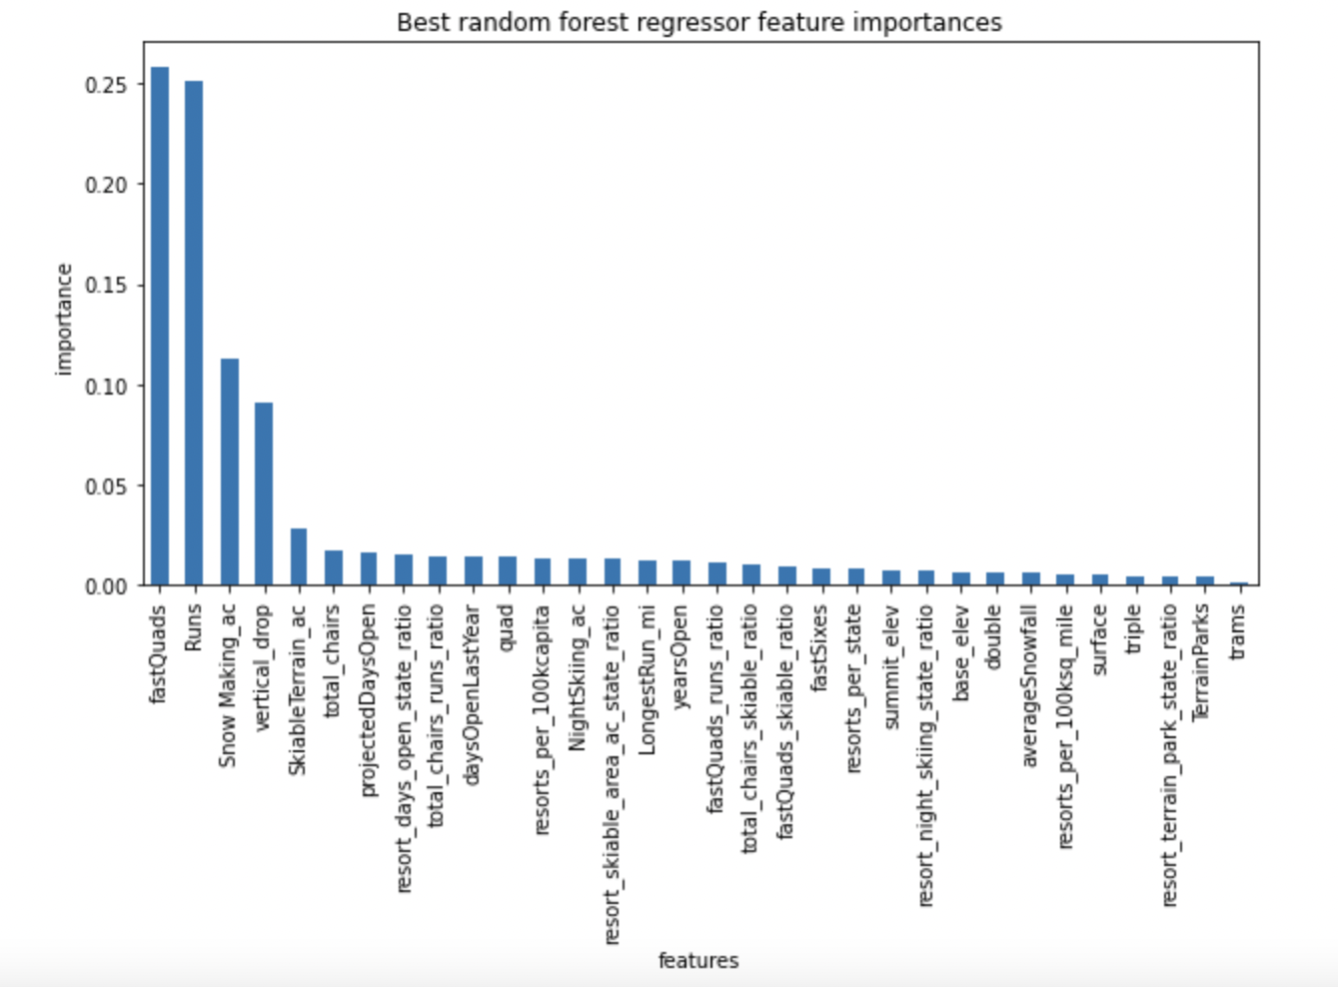
Methodology
To further investigate these suggestions by using a data driven approach we have used a random forest model to predict ticket prices
The importance of each of the features in predicting ticket price is shown in the plot below:
Most important features are fastQuads, Runs, Snow making_ac and vertical_drop.

Slide 6
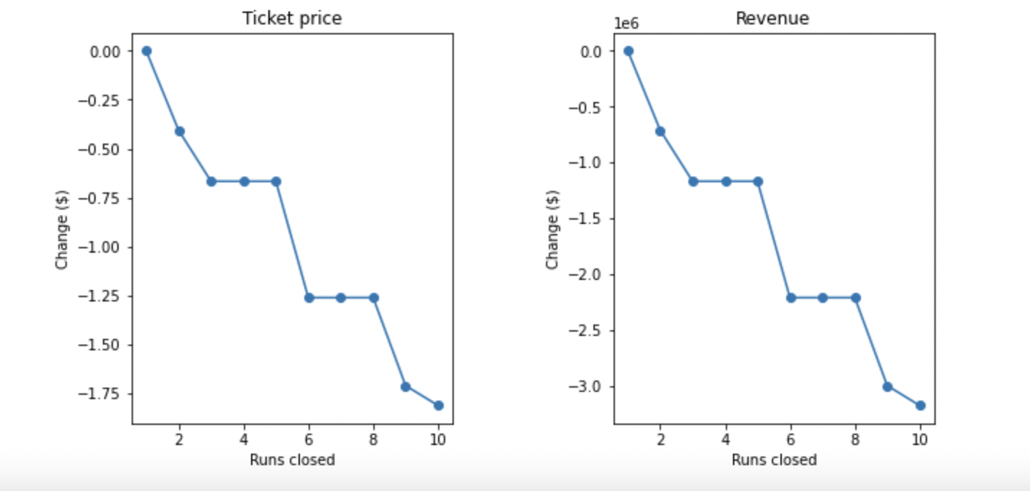
Effect on ticketing prices by closing runs
Predicted decrease in ticketing price and revenue if more than one of the least closed runs is closed.
Dramatic increase in ticket price and revenue if more than five of the least closed runs are closed.

Slide 7
Ticket price predictions based on remaining suggestions
 | Increase in ticketing price | Revenue increase in season
Adding run + chairlift + increase in vertical drop of 150 ft | $8.61 | $15065471
Adding run + chairlift + increase in vertical drop of 150 ft+ increase in snow making areas by 2 acres | $9.90 | $17322717
Increase in longest run by 0.2mile | $0 | $0

Slide 8
Summary and Conclusion
Suggested recommendation is to increase the vertical drop by adding a run to a point 150 feet lower down with an installation of an additional chair lift.
Permanently closing down one of the least used runs maybe a good idea. We need to know operating costs of runs to evaluate it further
The model should be deployed as a web application so that new combinations of parameters could be explored by business analysts.
Adding an additional increase of snow making area of 2 acres only brings a small increase in prices so not a good idea.

