Slide 1
Predicting Parkinson Disease using protein and peptide data

Slide 2
Problem
Given protein and peptide abundance data from a patient, can we predict their Parkinson progression scores at that time point?
Four Parkinson’s scores to be predicted at each time point:
UPDRS1
UPDRS2
UPDRS3
UPDRS4

Slide 3
Strategy to solve
Split the 234 patient data set with 227 proteins and 671 peptides, 80:20 into training and test datasets
Impute missing values and combine clinical data with the protein and peptide data
Identify important features to select to build prediction models
Run the models and identify the one which performs best on the training dataset
The selected model’s performance evaluated on the test dataset

Slide 4
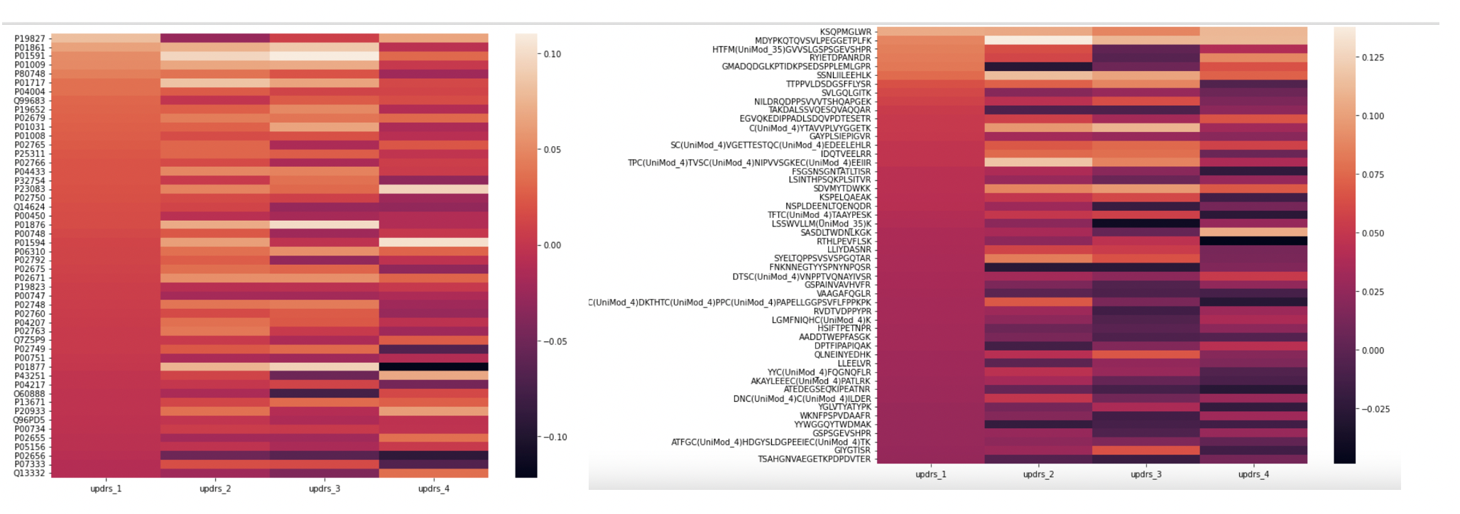
Selecting features for prediction
The protein and peptide values were not correlated with the UPDRS scores.

Slide 5
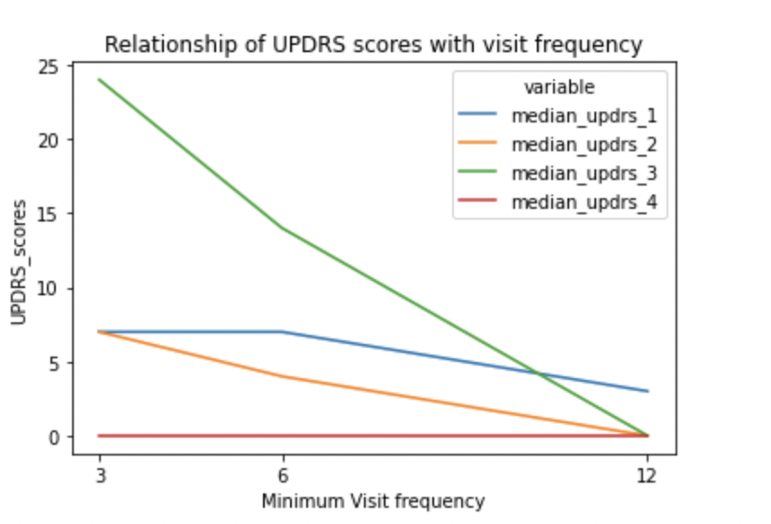
The feature that associate with UPDRS scores 1-3 was the minimum time frequency at which the patient visited.
39% of UPDRS4 scores were missing. We imputed these missing values with the median UPDRS4 value which was zero. Since so many of the values were missing the imputed values could affect the lack of trend seen here.

Slide 6
Boruta selection
We chose the Boruta method to select features for each of the UPDRS scores.
Boruta works by creating shadow features of the actual features and then tests if the features work better than the shadow features.
The next slide shows the selected features for each of the UPDRS scores.

Slide 7
UPDRS1
visit_month_diff_min
P01008
P05155
Q9Y6R7
NLREGTC(UniMod_4)PEAPTDEC(UniMod_4)KPVK
upd23b_clinical_state_on_medication_Unknown
UPDRS2
visit_month_diff_min
P01594
P02766
P43121
ASNLESGVPSR
DSGRDYVSQFEGSALGK
TPLGDTTHTC(UniMod_4)PR
upd23b_clinical_state_on_medication_Unknown
UPDRS3
visit_month_diff_min
P01594
P02766
P43121
ASNLESGVPSR
DSGRDYVSQFEGSALGK
TPLGDTTHTC(UniMod_4)PR
upd23b_clinical_state_on_medication_Off
upd23b_clinical_state_on_medication_On
upd23b_clinical_state_on_medication_Unknown
UPDRS4
QKVEPLRAELQEGAR
upd23b_clinical_state_on_medication_Unknown
*Apart from visit_month_diff_min, another non protein/peptide feature used is up23db_clinical_state_on_medication, which is if a medication was being taken at the time of UPDRS measurement.

Slide 8
Testing continuous predictor models
We tested prediction of the UPDRS scores using LightGBM and support vector machine (SVM) after hyperparameter tuning in training data.
RMSE (Root mean square error) very high for both models in the training dataset and not within 10% of the mean UPDRS scores.
Poor performance of models in predicting UPDRS scores.
 | RMSE (LightGBM) | RMSE(SVM) | Mean UPDRS
UPDRS1 | 4.74 | 5.61 | 6.48
UPDRS2 | 4.57 | 5.74 | 5.74
UPDRS3 | 10.2 | 12.6 | 17.5
UPDRS4 | 2.03 | 2.51 | 0.96

Slide 9
Categorization based approach
Given that we have poor performance predicting UPDRS scores, we simplified the problem by using logistic regression, which is used on categorical variables.
UPDRS scores were categorized into high and low based on median.
Boruta selected features were used for predicting categorization.
Training accuracy was encouraging.
 | Training accuracy
UPDRS1 | 0.69
UPDRS2 | 0.71
UPDRS3 | 0.76
UPDRS4 | 0.80

Slide 10
Test data
The model was found to be good at predicting test accuracy and F1 scores based on categorizing the models.
 | Test_accuracy | F1_score
UPDRS1 | 0.76 | 0.78
UPDRS2 | 0.72 | 0.77
UPDRS3 | 0.74 | 0.73
UPDRS4 | 0.73 | 0.80

Slide 11
Conclusions
Protein and peptide abundance values were not able to accurately predict UPDRS scores even when used with other variables.
The training dataset may have been insufficient to allow the development of a protein/peptide based model.
A simpler logistic regression based classification approach could be used with the protein/peptide abundance data.

