Slide 1
IEEE TRANSACTIONS ON NANOTECHNOLOGY · MANUSCRIPT IN PREPARATION
Device-Guided Calibration of the
Stanford RRAM Compact Model
Generalization, Identifiability, and Deposition Trends in
Sputter-Deposited TaOₓ Devices
Md Tawsif Rahman Chowdhury · Alireza Moazzeni · Gozde Tutuncuoglu
Department of Electrical & Computer Engineering, Wayne State University
Fit quality is not enough — we also report cycle-to-cycle generalization and parameter identifiability with every extraction.

Slide 2
MOTIVATION
A good overlay is necessary — but not sufficient
▸ Compact models are usually calibrated by matching one measured I–V loop. A clean overlay can be reached even when very different parameter sets fit equally well.
▸ The risk: fit knobs get mistaken for material/process information — two fits with identical butterfly curves can disagree on Eₐ, Rₛ, or gap geometry.
▸ We separate two questions rarely reported for RRAM:
Our position
Reliable compact-model extraction must report three things together:
1 Fit quality
2 Cycle-to-cycle generalization
3 Parameter identifiability
…plus conduction-regime validity, so we know where the device physics sits outside the model.
Generalization
Does a fit to one representative cycle predict the other measured cycles of the same device?
Identifiability
Which fitted parameters stay stable when the measured cycle population is resampled?
Device-Guided Calibration of the Stanford RRAM Model · Chowdhury, Moazzeni, Tutuncuoglu · Wayne State University
2

Slide 3
DEVICES & EXPERIMENT
Twelve TaOₓ deposition conditions (DOE)
▸ Sputter-deposited TaOₓ cross-point RRAM, 4 µm feature, asymmetric Ta-oxide bilayer stack.
▸ Two fab-facing knobs: O₂ fraction (20–35%) and RF sputter power (75–250 W).
▸ Face-centered factorial with 4 replicated center points (S9–S12) — lets us test which extracted parameter is stable enough to plot vs. process.
▸ Bipolar DC switching on a Keysight B1500; automated quality screen rejects shorted / open / noise-floor sweeps.
▸ S1 reference device: all 40 cycles pass, mean quality 8.9/10.
Sample | O₂ (%) | Power (W)
S1 | 20 | 75
S2 | 20 | 250
S3 | 35 | 75
S4 | 35 | 250
S5 | 20 | 162.5
S6 | 35 | 162.5
S7 | 27.5 | 75
S8 | 27.5 | 250
S9–S12 | 27.5 | 162.5 (×4 center)
Deposition design of experiments (Table I).
Device-Guided Calibration of the Stanford RRAM Model · Chowdhury, Moazzeni, Tutuncuoglu · Wayne State University
3

Slide 4
METHODOLOGY
A device-first extraction pipeline
1
Medoid cycle
2
Regime classify
3
Physics priors
4
Mechanism loss
pick the representative measured sweep by ranked quality
ohmic / PF / Schottky / FN per segment
regime-tied prior windows for 21 parameters
down-weight Schottky/FN points the model can't represent
5
Bayesian opt.
6
Generalization
7
Identifiability
8
Ablation
HSPICE-in-the-loop, 48+160 evals, then Nelder–Mead
score the medoid fit on every other cycle
200 cycle-bootstrap refits + Fisher cross-check
isolate what priors / regime / BO each contribute
Stanford–PKU Verilog-A model (rram_v_1_0_0): Iₜₕ = I₀·exp(−g/g₀)·sinh(V/V₀), gap evolves thermally. Polarity-split V₀, Eₐ, ν₀, g; shared scale/parasitic terms. 616 HSPICE transients per point estimate.
Device-Guided Calibration of the Stanford RRAM Model · Chowdhury, Moazzeni, Tutuncuoglu · Wayne State University
4

Slide 5
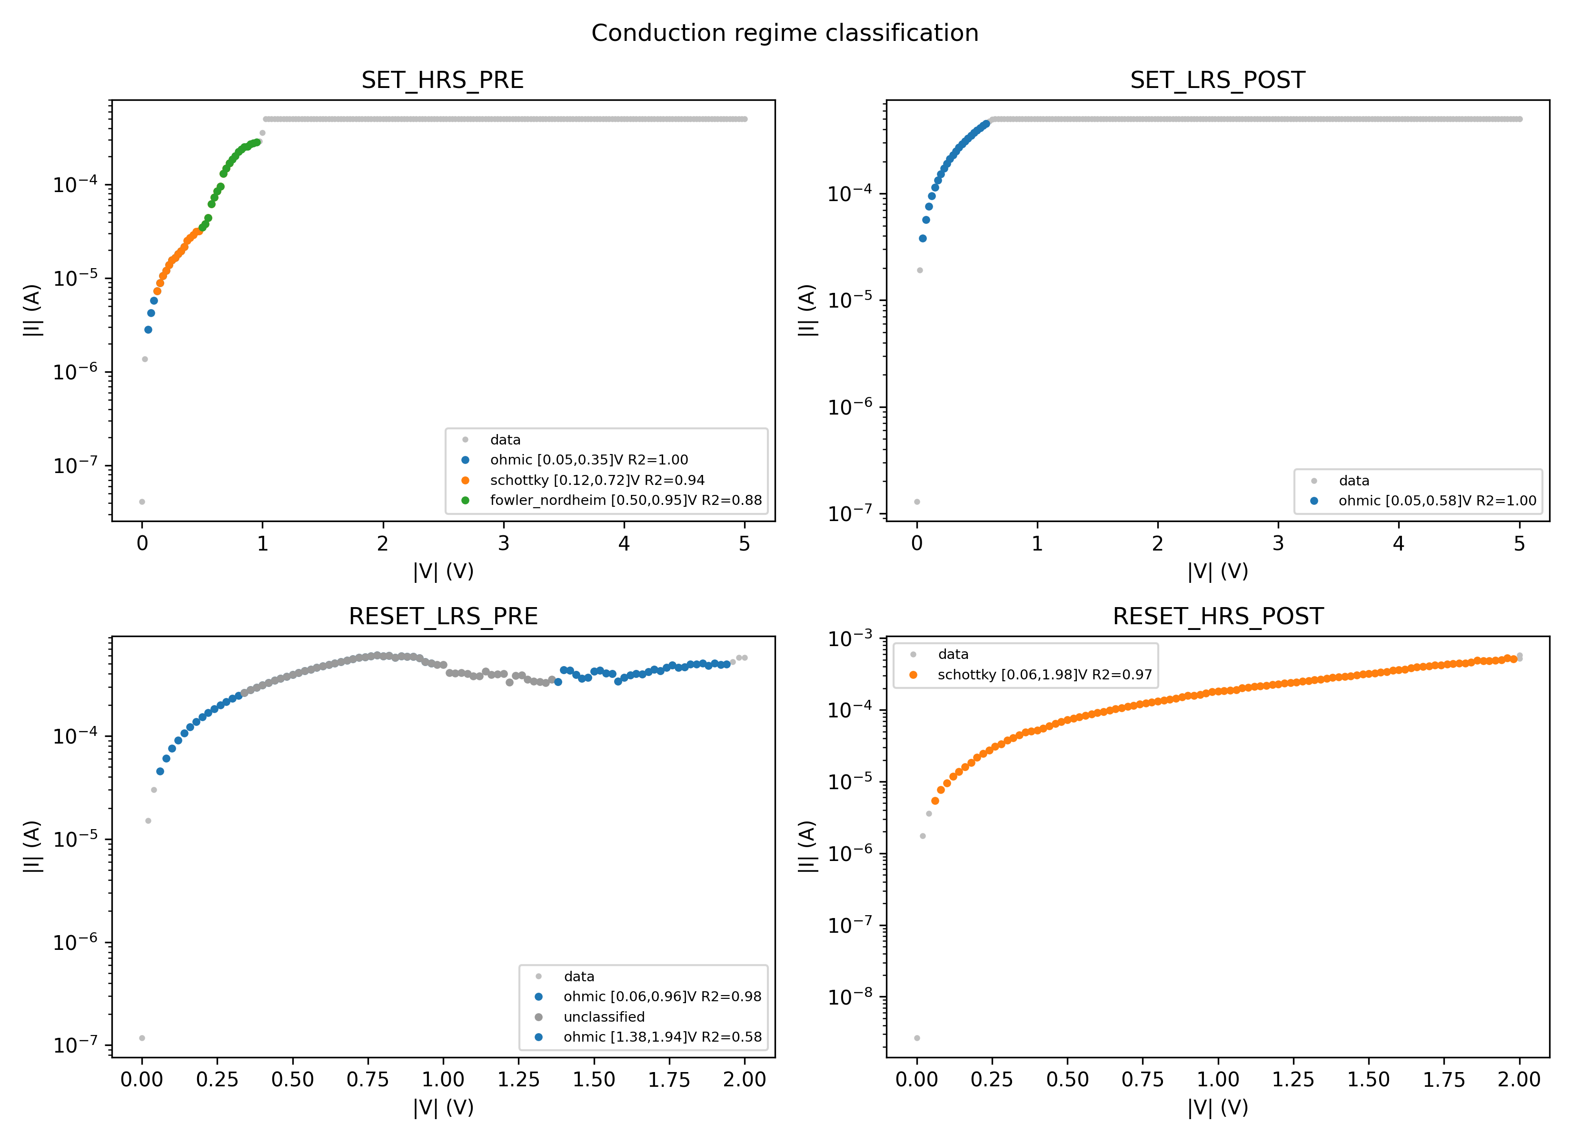
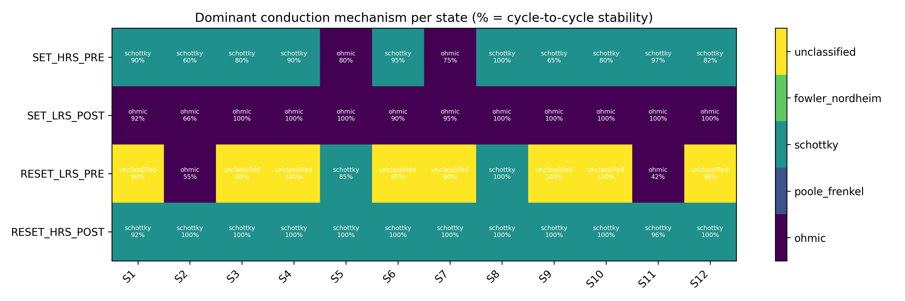
RESULT 1 · DEVICE PHYSICS
Ohmic LRS, Schottky-limited HRS — across the whole DOE
Dominant mechanism & cycle stability, all 12 conditions (Fig. 2).
▸ Post-SET LRS is ohmic-dominant for every condition (66–100% stability).
▸ Post-RESET HRS is Schottky-dominant in 92.5–100% of cycles, εᵣᵈʸⁿ = 4.7–34 (physically admissible).
▸ PF is rare — it is not the dominant mechanism for any state/condition.
▸ Implication: Stanford bulk sinh law has no explicit Schottky branch → expect a RESET residual floor.
S1 regime classification of the four resistance-state segments (Fig. 1).
Device-Guided Calibration of the Stanford RRAM Model · Chowdhury, Moazzeni, Tutuncuoglu · Wayne State University
5

Slide 6
RESULT 2 · POINT ESTIMATE
The fits reproduce the measured butterfly curves
0.530
0.761
▸ Captured: hysteresis order, SET & RESET transitions, compliance region, LRS return branch.
▸ Largest residuals sit at the SET transition and the Schottky-limited HRS approach — exactly where the regime map warned the current law is incomplete.
▸ Durbin–Watson < 2 everywhere: residuals are correlated along the sweep — remaining error is systematic model mismatch, not measurement scatter.
▸ S2 is the worst case (O₂-poor, high power): largest RESET RMSE, lowest SET DW, least stable Schottky assignment.
Mean SET RMSE
Mean RESET RMSE
log₁₀|I| decades
harder: Schottky HRS
Cond. | RMSE SET | RMSE RESET | DW SET | DW RESET
S1 | 0.500 | 0.689 | 0.86 | 0.85
S2 | 0.772 | 1.016 | 0.46 | 0.56
S6 | 0.468 | 0.650 | 0.94 | 0.93
S8 | 0.495 | 1.001 | 1.03 | 0.54
Mean | 0.530 | 0.761 | — | —
Excerpt of Table II (12 conditions total).
Device-Guided Calibration of the Stanford RRAM Model · Chowdhury, Moazzeni, Tutuncuoglu · Wayne State University
6

Slide 7
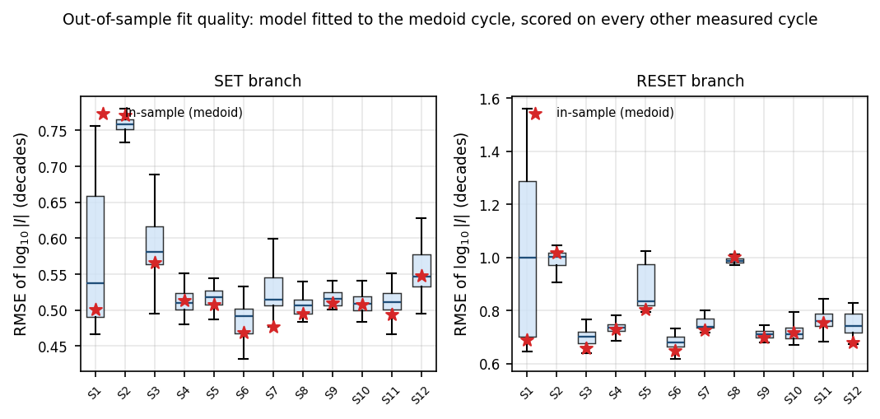
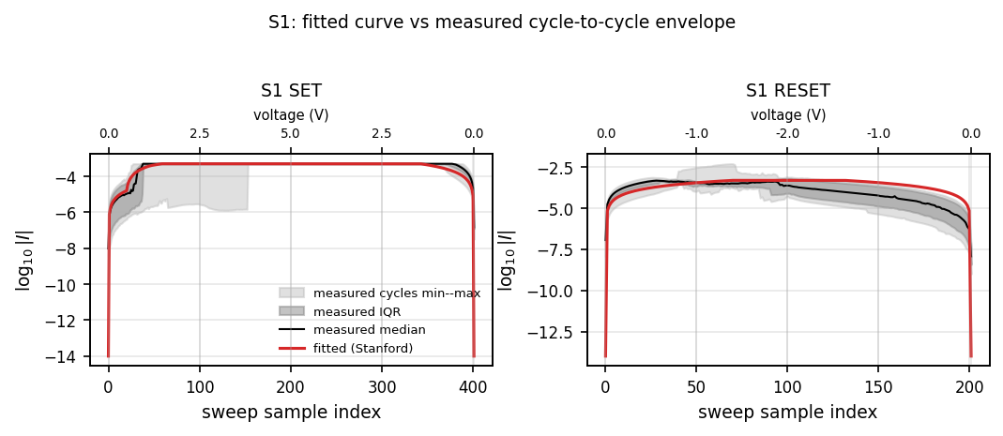
RESULT 3 · GENERALIZATION
A one-cycle fit predicts every other cycle
0.012
0.039
SET gap
RESET gap
held-out − in-sample
decades
▸ Held-out medians 0.542 (SET) / 0.800 (RESET) vs. in-sample 0.530 / 0.761.
▸ Every condition: in-sample RMSE falls inside the held-out interquartile range.
▸ Coverage: fitted SET curve stays inside the measured min–max band at 77% of points (63% for RESET).
▸ Takeaway: the fit describes the device population — not a memorized trace. Lower RESET coverage = missing Schottky branch, not overfitting.
Held-out per-cycle RMSE; stars = in-sample medoid (Fig. 4).
S1 fit vs. measured cycle-to-cycle envelope (Fig. 5).
Device-Guided Calibration of the Stanford RRAM Model · Chowdhury, Moazzeni, Tutuncuoglu · Wayne State University
7

Slide 8
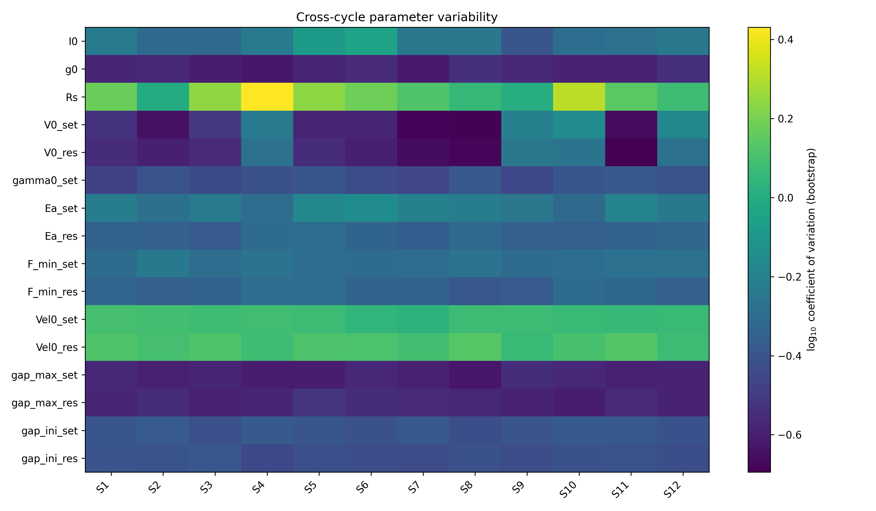
RESULT 4 · IDENTIFIABILITY
What the DC data actually constrain
▸ Repeatable: branch voltage scales V₀, median CV ≈ 0.28 — the butterfly curvature pins them down.
▸ Not repeatable: Rₛ (CV 1.44), velocity prefactors ν₀ (1.19 / 1.28), I₀ and Eₐ also vary widely (CV > 1).
▸ Fisher cross-check agrees on the broad picture, but condition numbers 10¹⁸–10⁶⁶ make it a local sensitivity map only.
▸ Rₛ is the cautionary case: looks locally well-determined at one optimum, yet swings under cycle resampling.
Bottom line
DC butterfly data constrain effective branch scales & switching-field combinations — not a unique split into prefactors, activation energies, and gap geometry.
Cycle-bootstrap CV, 200 refits × 12 conditions — primary evidence (Fig. 6).
Device-Guided Calibration of the Stanford RRAM Model · Chowdhury, Moazzeni, Tutuncuoglu · Wayne State University
8

Slide 9
RESULT 5 · ABLATION
What each ingredient actually buys
Variant | RMSE SET | RMSE RESET
Regime-conditioned + weighting | 0.530 ± 0.081 | 0.761 ± 0.123
Physics priors + BO | 0.546 ± 0.077 | 0.756 ± 0.124
Uninformative priors + BO | 0.537 ± 0.076 | 0.755 ± 0.126
Physics priors, no BO | 0.571 ± 0.115 | 1.528 ± 0.434
▸ Optimization is the must-have: no-BO RESET balloons to 1.53 decades vs. ~0.76 for optimized variants.
▸ Three optimized variants land at nearly identical overlay error.
▸ So priors/regime don't lower the overlay — they stop the fit from abusing unsupported Schottky/FN HRS regions to distort Stanford bulk parameters.
▸ Reinforces the thesis: overlay alone can't establish physical extraction. Generalization + identifiability decide what's trustworthy.
Unweighted validation RMSE so weighting gives no scoring advantage (Table IV).
Device-Guided Calibration of the Stanford RRAM Model · Chowdhury, Moazzeni, Tutuncuoglu · Wayne State University
9

Slide 10
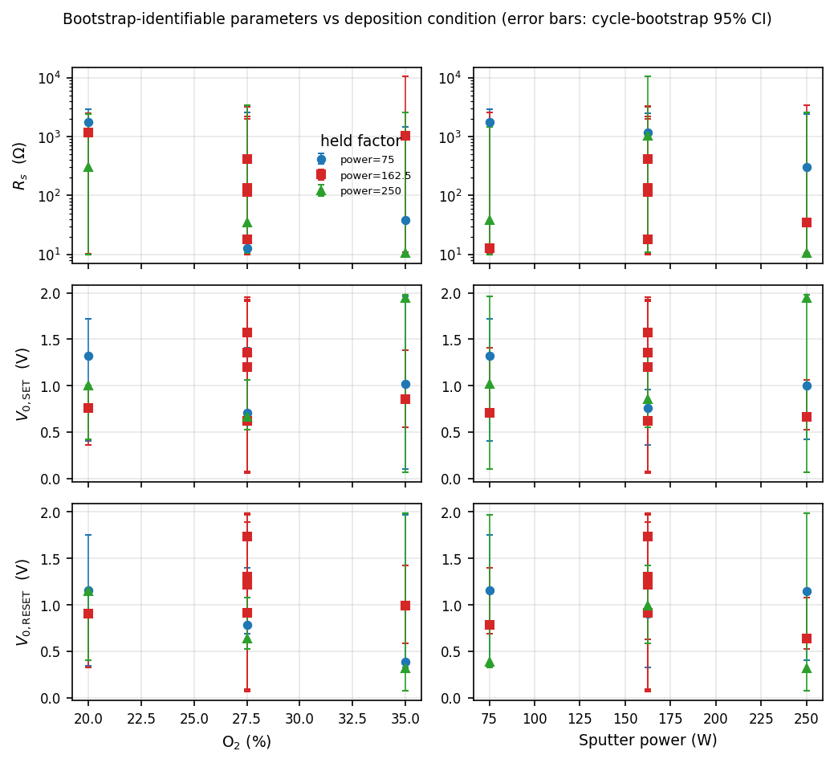
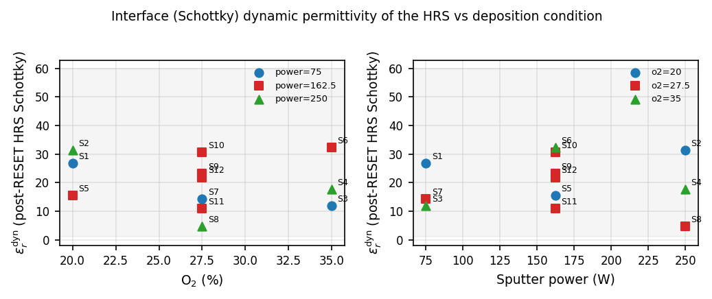
RESULT 6 · PROCESS TRENDS
Only identifiable parameters get a response surface
Post-RESET HRS dynamic permittivity vs. O₂ and power (Fig. 9).
▸ V₀,SET and V₀,RESET have tight bootstrap CIs and move systematically with deposition → usable process trends.
▸ Rₛ spans 1–2 decades in its bootstrap CI — locally Fisher-identifiable, but must NOT be a response-surface output.
▸ HRS εᵣᵈʸⁿ = 4.7–32 for all 12 conditions; ~3× scatter across center points (S9–S12) reveals interface variability — an automated extension of prior manual analysis.
Bootstrap-identifiable parameters vs. deposition (Fig. 8).
Device-Guided Calibration of the Stanford RRAM Model · Chowdhury, Moazzeni, Tutuncuoglu · Wayne State University
10

Slide 11
TAKEAWAYS
Report extraction with three numbers, not one
Fits are accurate — Mean RMSE 0.530 (SET) / 0.761 (RESET) decades across all 12 TaOₓ conditions.
…and they generalize — One-cycle fit predicts held-out cycles within 0.012 / 0.039 decades — the device, not one trace.
Most parameters aren't identifiable — Only branch voltage scales V₀ are repeatable (CV ≈ 0.28); Rₛ, ν₀, Eₐ, gap geometry are not (CV > 1).
Process trends, conservatively — Only V₀ supports a deposition response surface; Rₛ cannot, despite looking locally identifiable.
Model adequacy is the RESET floor — Post-RESET HRS is Schottky-dominant in 92.5–100% of cycles — outside the Stanford bulk sinh law.
Next: add a barrier-limited HRS branch to the compact model — the regime map already supplies the target windows and slopes.

