Slide 1
LLIO Results
LSTM Model

Slide 2
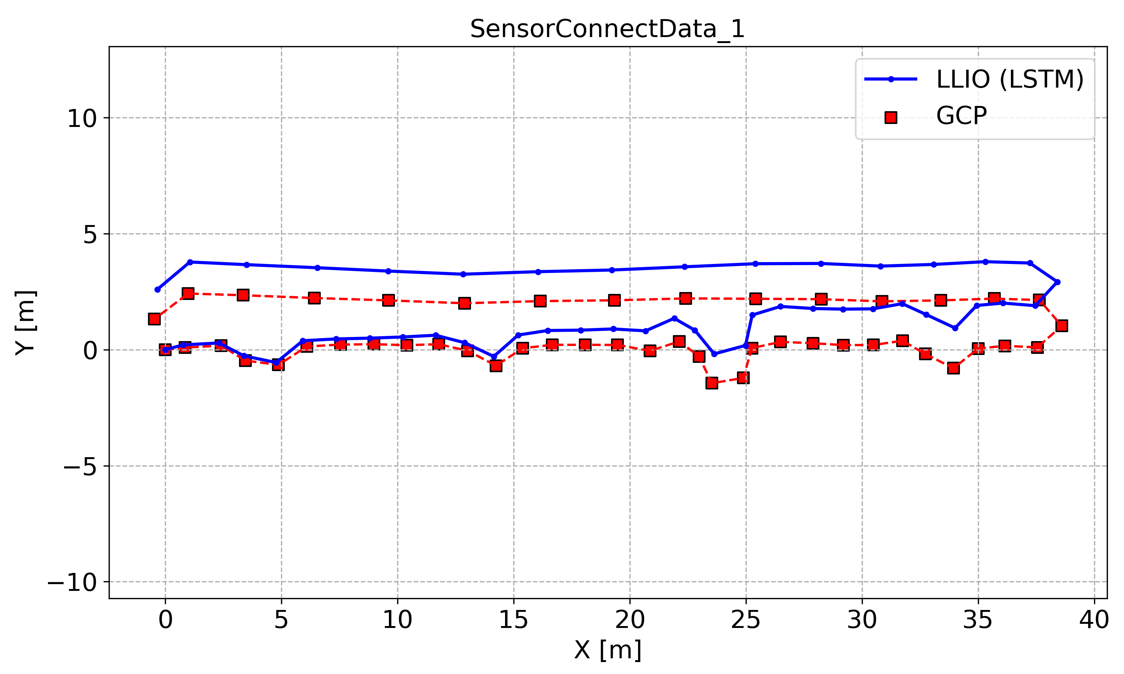
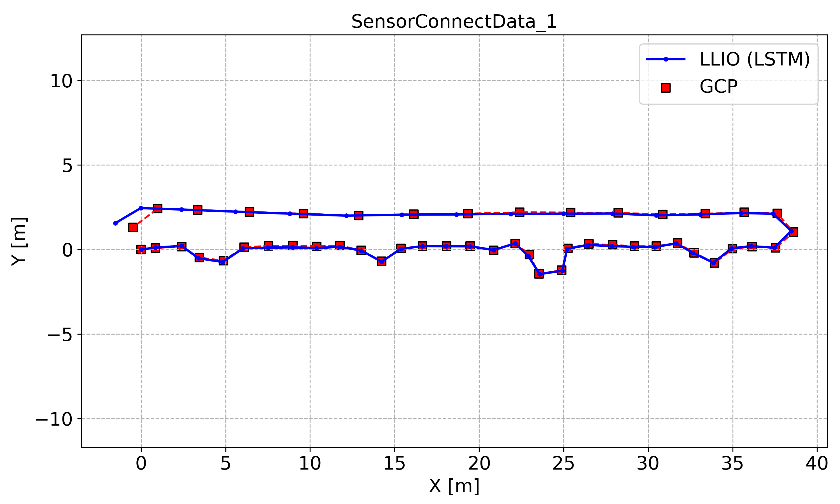
seed 0 results (4, 35, 51 excluded)
seed 0 results (35, 51 excluded)
seed 0 results (51 excluded)
seed 0 results (trained w/ all data)

Slide 3
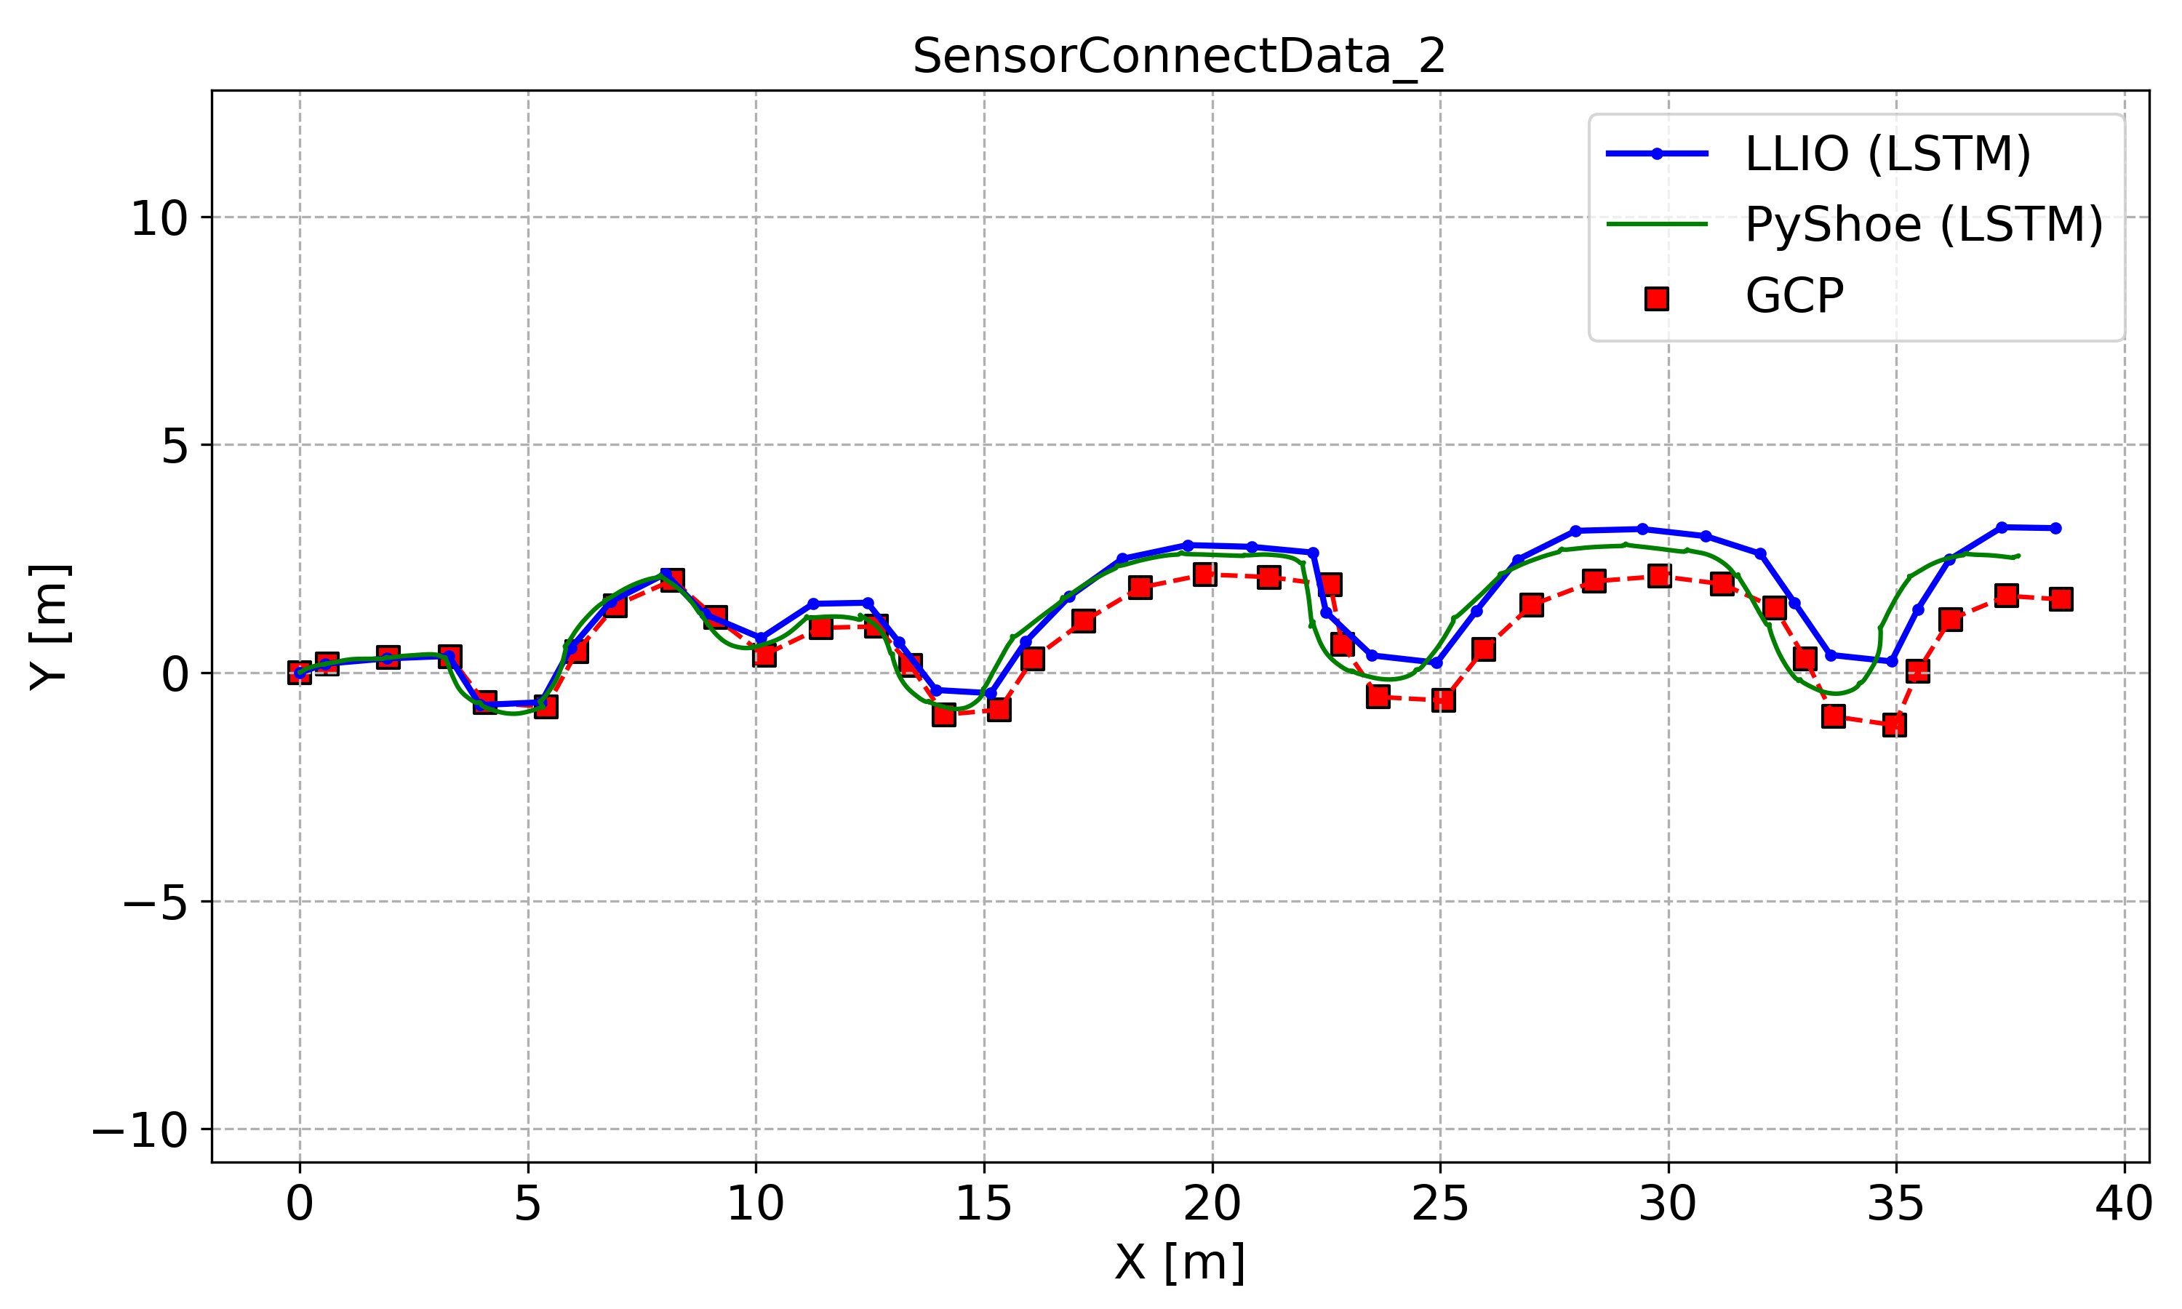
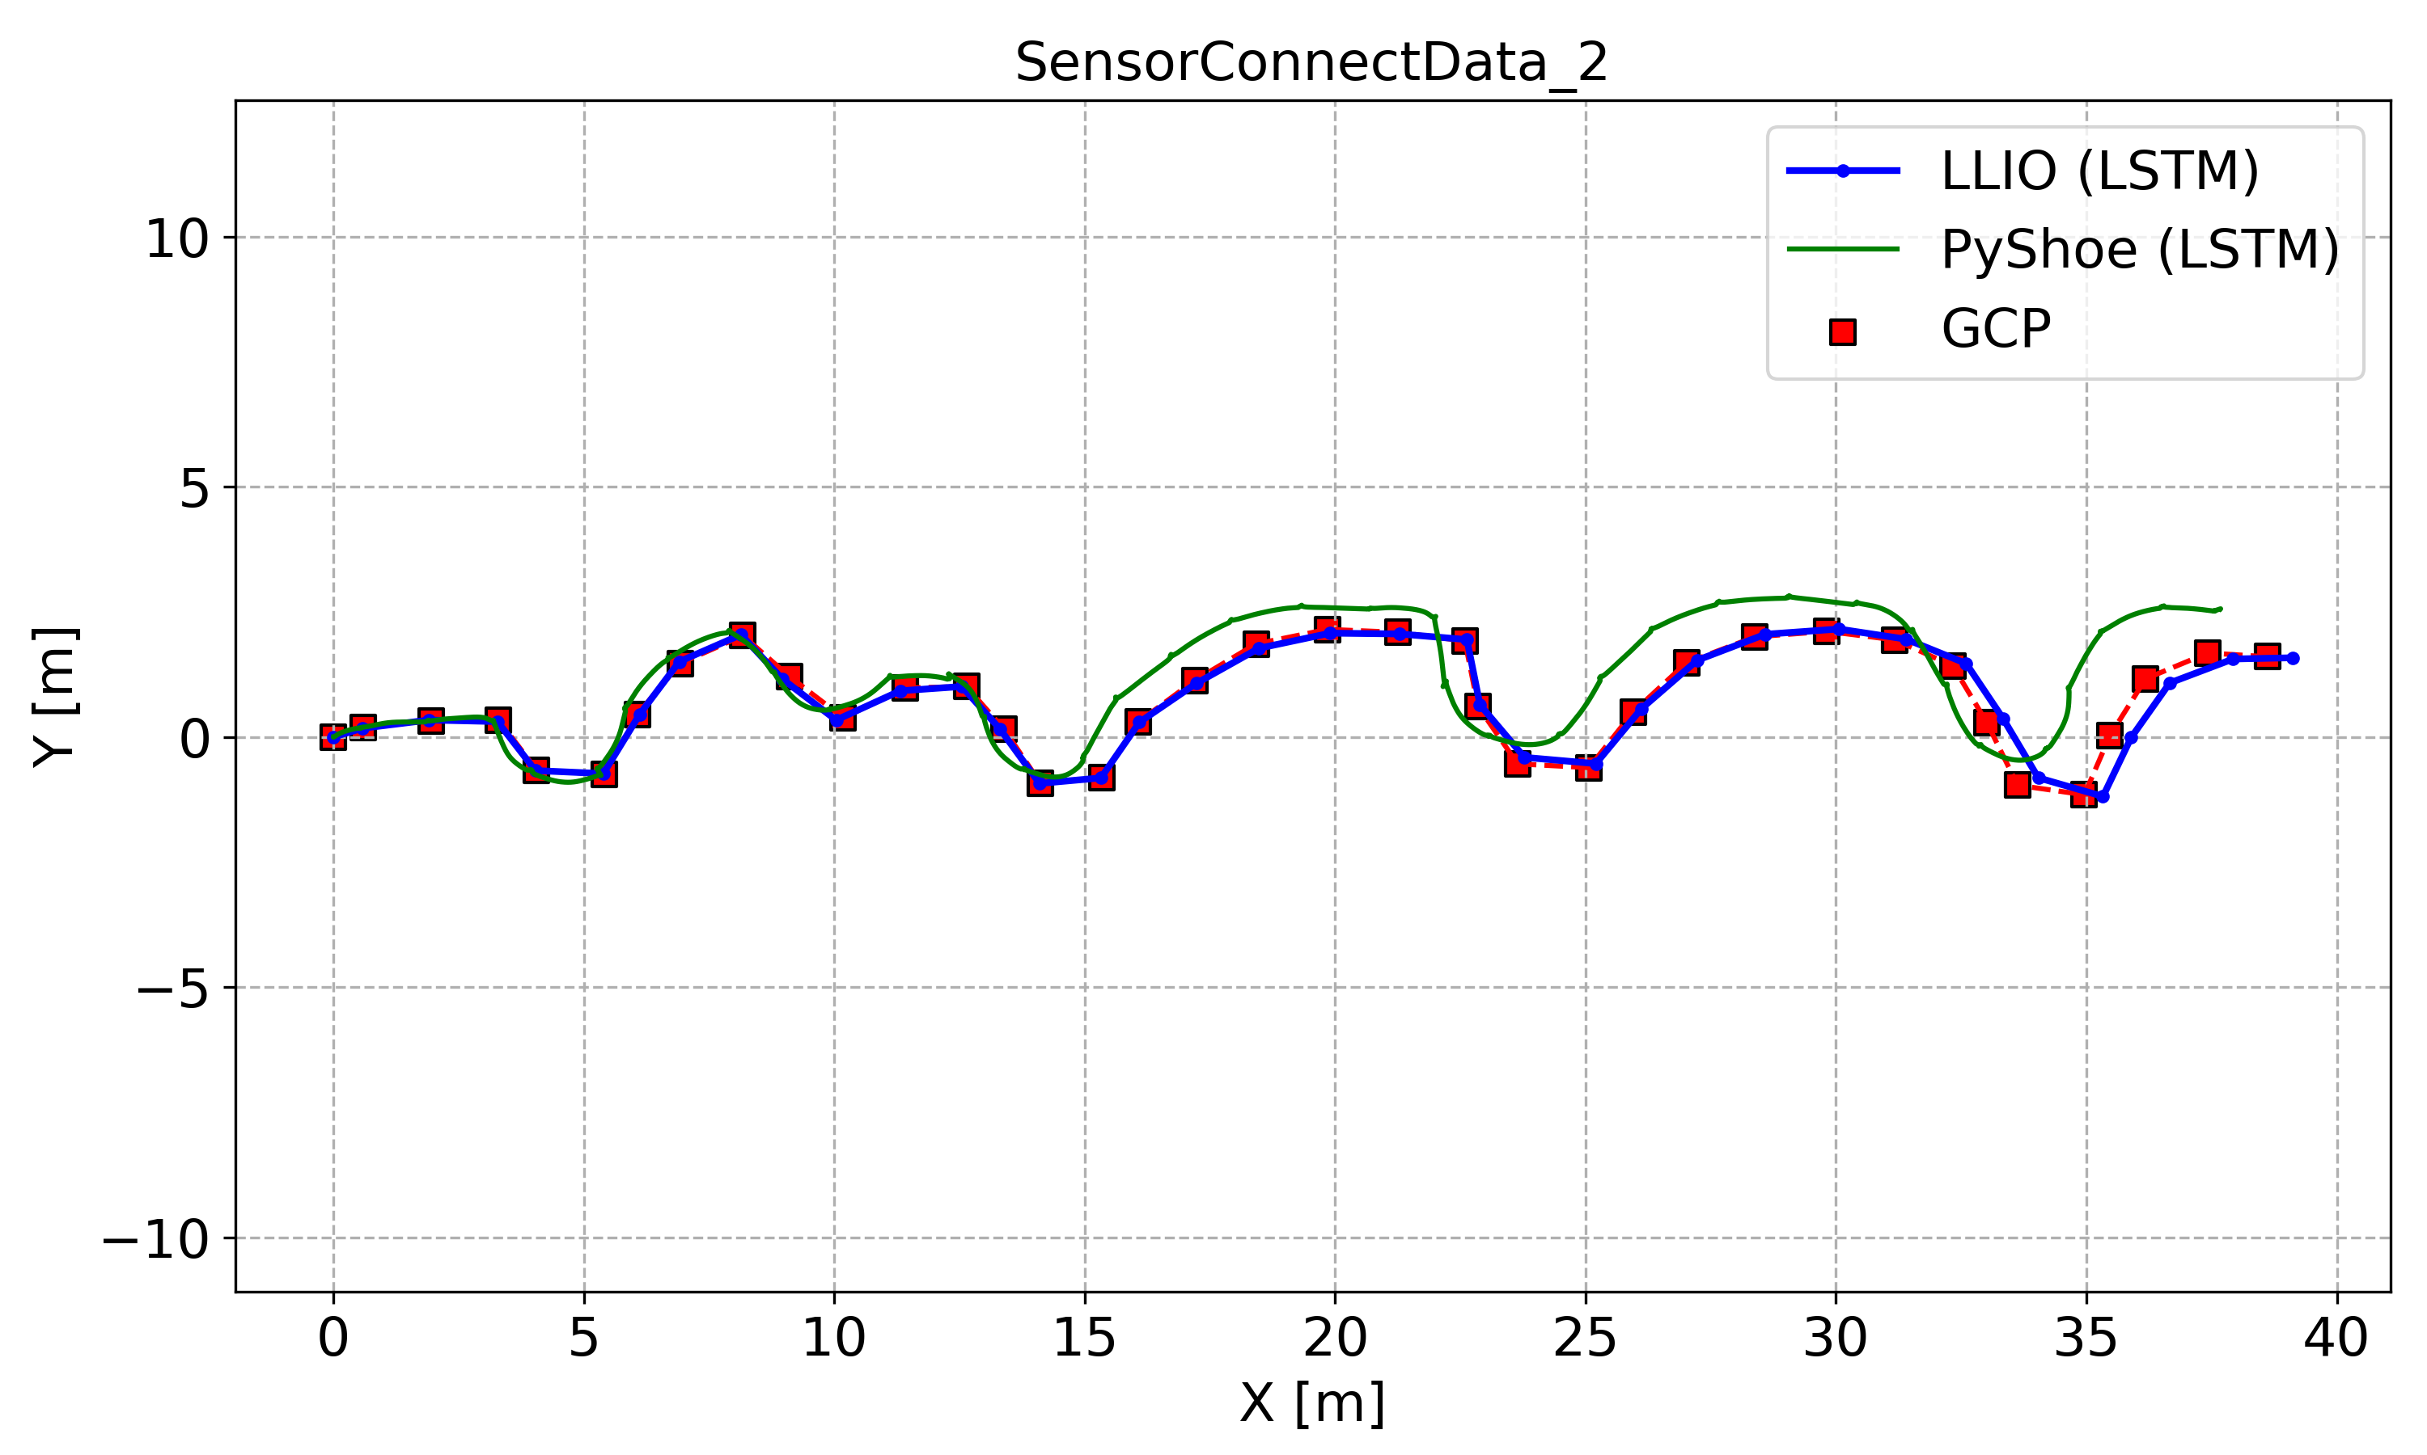
seed 0 results (4, 35, 51 excluded)
seed 0 results (35, 51 excluded)
seed 0 results (51 excluded)
seed 0 results (trained w/ all data)

Slide 4
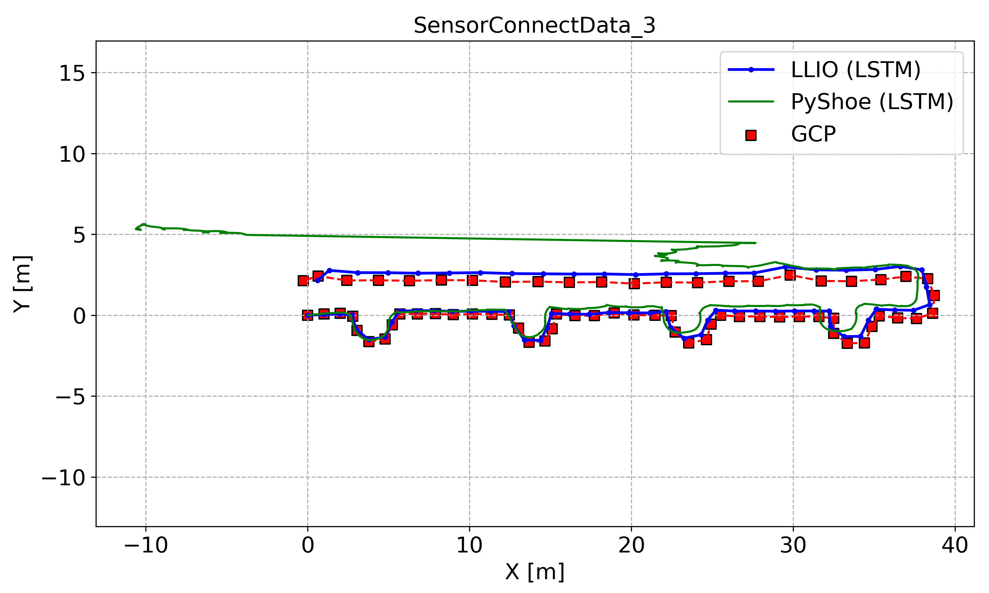

seed 0 results (4, 35, 51 excluded)
seed 0 results (35, 51 excluded)
seed 0 results (51 excluded)
seed 0 results (trained w/ all data)

Slide 5
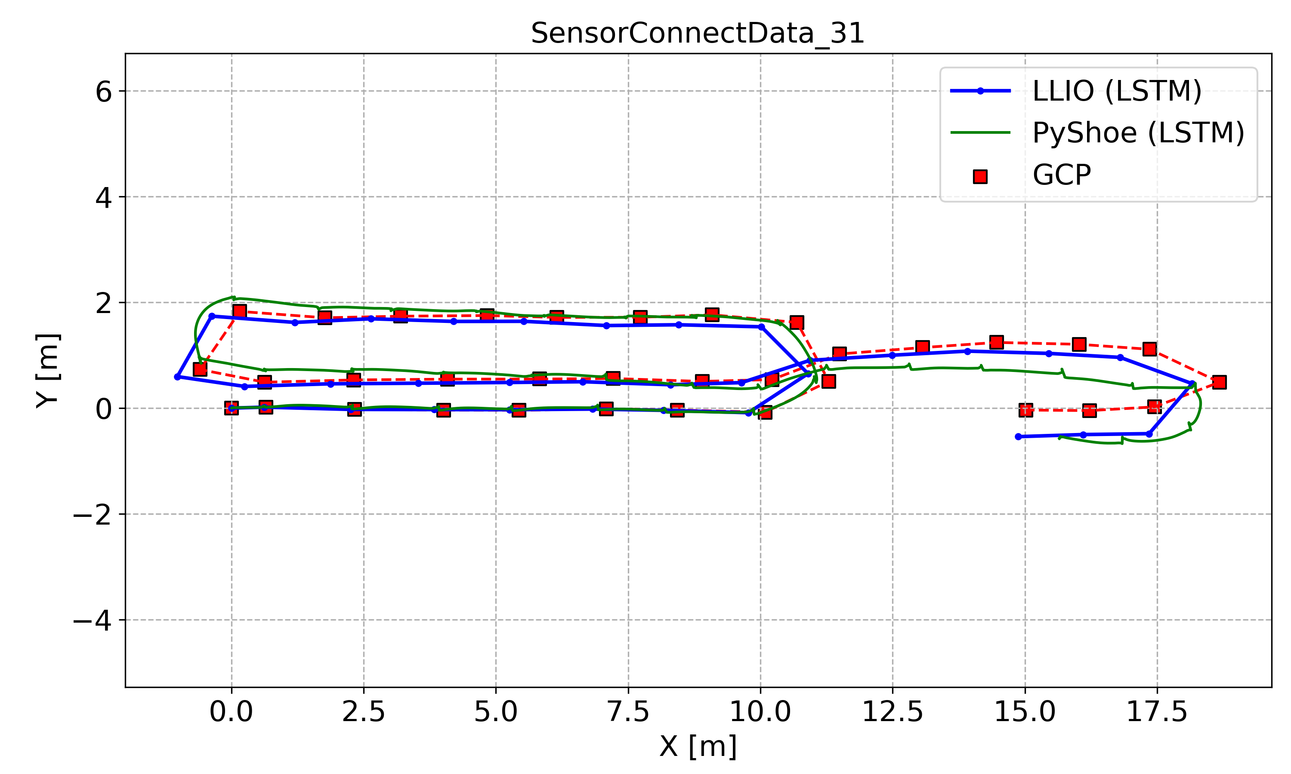
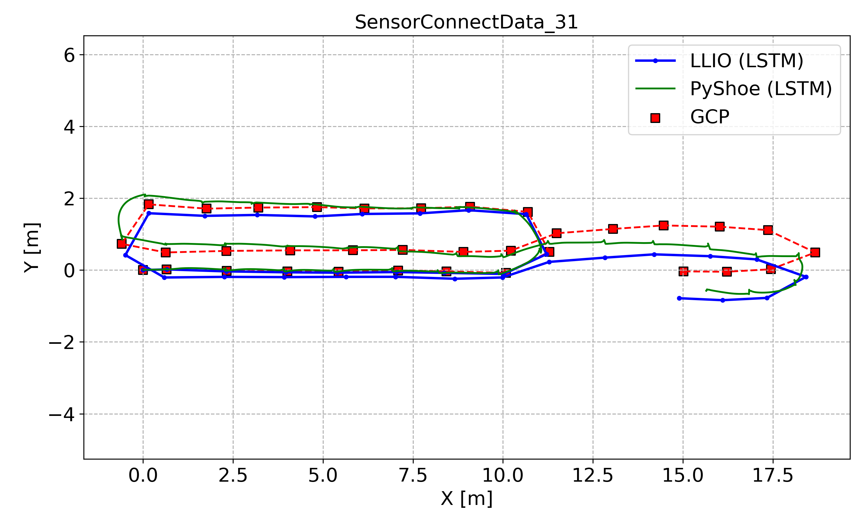
seed 0 results (4, 35, 51 excluded)
seed 0 results (35, 51 excluded)
seed 0 results (51 excluded)
seed 0 results (trained w/ all data)

Slide 6
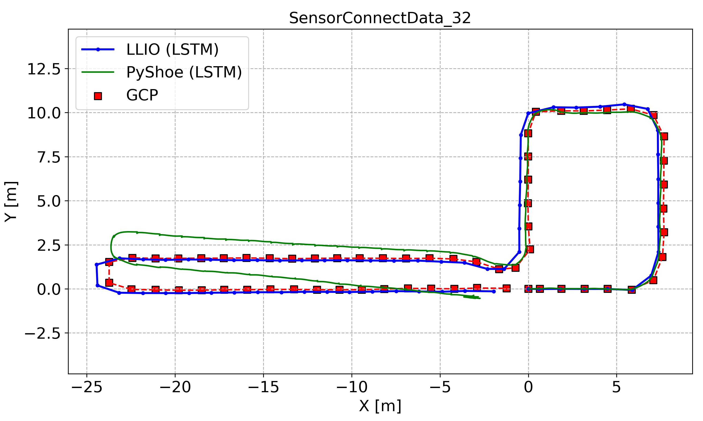
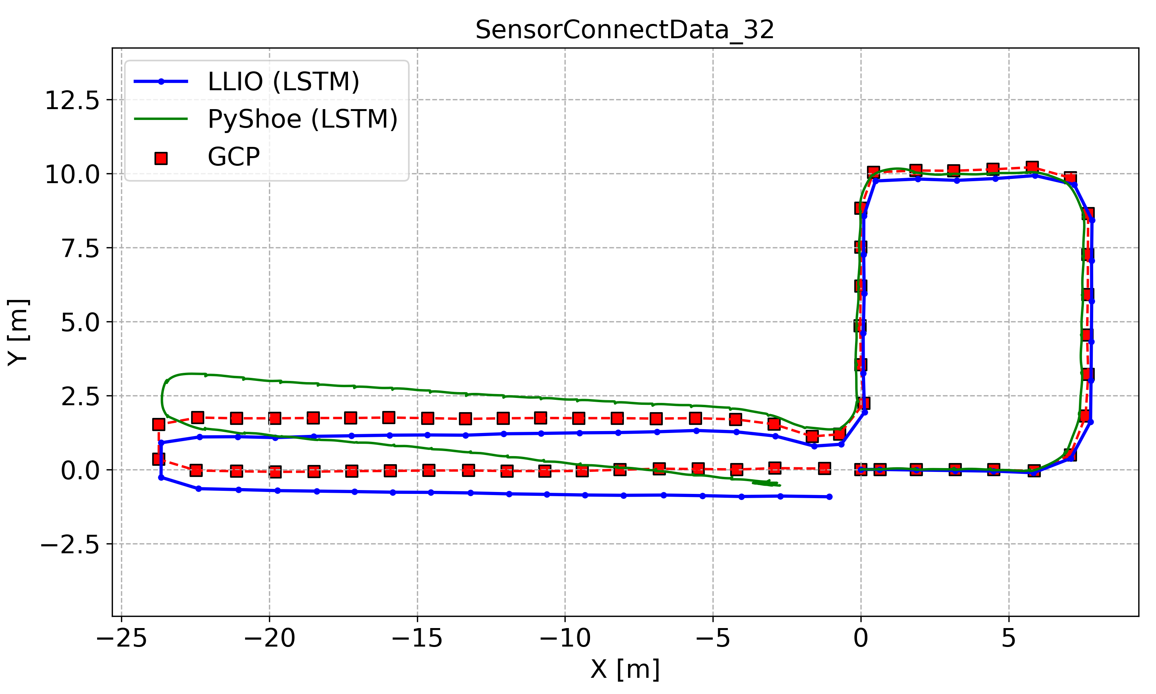
seed 0 results (4, 35, 51 excluded)
seed 0 results (35, 51 excluded)
seed 0 results (51 excluded)
seed 0 results (trained w/ all data)

